Slide 1



Dynamic Websites
Topic 1:
Introduction to the Module
Notes:
NCC Education - Title Master

Slide 2
Content
Web applications and their functions
Static vs dynamic websites
The parts of Web Application
Designing and coding a web-based user interface
CSS3
Bootstrap
An overview of Ajax and JavaScript
Notes:
NCC Education - Slide Master

Slide 3
The Old Internet
Static web pages needed to be refreshed by the server every time the data changed
Almost everything was gone server side
Working with web pages was very slow
Every action would require sending of user data, forming the page, downloading and parsing of that page
Client computers fetch information from central servers to display web pages

Slide 4
The Modern Internet
Web pages are fully functioning applications.
Facebook
Google apps
Processing is done in real time on the client side
Web page contains instructions from the browser
The browser does the work of formatting the data
This makes the web pages more interactive

Slide 5
Static –v- Dynamic Websites
Static website tend to be basic pages with no scripting or interactivity except hyperlinks
Fully static websites are uncommon but a small business with maybe only a one or two pages might still use these
Dynamic websites includes interactive elements such as search boxes and allows html code to be shared between all pages of the site

Slide 6
Web Applications - 1
A web application or web app is client-server software application that runs the user interface in a web browser
The distinction between ‘web’ application and ‘desktop’ applications has become less meaningful as:
Most desktop applications incorporate internet functionality
Most web applications now imitate the look and feel of desktop applications

Slide 7
Web Applications - 2
Google Chrome OS is an example of an operating system which is fully designed to work on the web
Desktop applications still have benefits:
Bandwidth is a bottleneck in highly interactive performance
Privacy and security is easier when you have control over the data
They can be optimised for desktop content

Slide 8
Web Applications - 3
It is now relatively easy to develop dynamic websites
Users expect more user-experience from websites and the site can make a difference between a sale or not
Web applications have advantages to developers and users:
They are easily maintained
They can be easily deployed
They are always available (provided you have an internet connection)

Slide 9
The Parts of a Web Application - 1
Web application and commonly e-commerce websites have three “layers” which is responsible for different part of the system:
Presentation layer – this handles the user frontend
Application layer (logic tier) – this handles the business logic
Data layer – this handles the storage and retrieval of data
This is usually called a N-Tier architecture, where N is the number of tiers.

Slide 10
The Parts of a Web Application - 2
Website generally consists of:
Front-end web server
Middle dynamic content processing and generation level application server
Database management software

Slide 11
The Parts of a Web Application - 3
Different tools are used to handle the complexities of the different tiers
These are separated out to ensure maximum flexibility when building applications
At user level, languages such as Javascript and CSS are commonplace
For application level, server side languages such as PHP and RUBY are used
For data level, MySQL and Oracle are common.

Slide 12
Presentation
At the presentation level, much of what is done is to do with the user experience, for example:
Formatting of the website properly
Handling simple data validation
Animation and interface flourishes – what else?
It is more seamless for the user for this to be handed in the client’s browser
When updated data is required (to update the user interface), that request is sent to the application layer

Slide 13
Application
At the application layer handles all the functionality
Things such as “programming”
Sometimes referred to as the “business logic”
Most often handled on the server via a language such as PHP or RUBY.
Also serves as the mediator between the presentation and the data.
All interaction between these two should be done through the application layer

Slide 14
Data
The data layer is responsible for optimized data access
This can be done in the application layer, but there are benefits to using a dedicated layer
This is most often handled using a database management system such as MySQL
The data layer can handle caching of data, and persistent storage
It can handle load-balancing between servers

Slide 15
Communication Between Layers
Communication between layers is handled via a platform independent protocol
Such as XML
This allows for layers to be swapped in and out
Provided they can honor the format of communication packets
You can change the entire front-end without having to alter any of the other layers
Communication in a formal format is important
The computers that control each layer may be clusters and located in entirely different continents

Slide 16
User Interface 1
In web design the user interface will make or break your website.
Websites need to be intuitive for the users.
They need to be built so users can’t get lost in the site.
Poor use of colour and layout will result in:
Lost sales
Poor feedback
Customers giving up navigation

Slide 17
User Interface 2
Some user interface good practice considerations:
Understand the user needs
What are the required functionality?
How information flow through the system?
Avoid discrimination and accessibility
International standard ISO9241

Slide 18
User Interface Example 1
Have a look at Amazon website and identify some of the aspects that make it a user friendly website.
Identify three positive and three negative aspects.

Slide 19
User Interface Example 2
Have a look at uglytub.com and identify how this website design differs to Amazon.
What do you think are some of the problems with this website?
Identify three positive and negative aspects.

Slide 20
UI Considerations 1
There are some considerations that the website developer needs to take into account when designing a website:
Colour – what colours to use, how many, how are these viewed by users?
Layout – how should the pages be laid out? How do you want users to navigate the site? What are the key items you want users to see? How does this impact on the layout?
Who are your audience? What are their needs? What will bring them to your website? What about design patterns?

Slide 21
UI Considerations 2
It is good practice to keep things consistent and simple on a website, eg have a template design for each page.
The website needs to be easy to understand and navigate. The design should guide users through the site.
Consider font types – Comic Sans tend to be the most popular and work best for users with disabilities.
What text should be highlighted? What about contrasting text in the menu?
Keep forms simple and easy to complete.

Slide 22
Using Colour - 1
Can highlight certain sections or words
Emphasis important sections
More effective than shape
Might not work for users who are colour blind
More than 7 colours becomes less efficient

Slide 23
Using Colour - 2
Don’t just jump into using colours immediately
Get it right in black & white
Concentrate on layout first
Use colour as an additive feature
Can give emphasis to words
Can be used for grouping related items

Slide 24
Using Colour - 3
Yellow and red ends of the spectrum increase eye fatigue
Red produces most eye strain but is most stimulating ... grabs the attention more
Blue produces least eye strain and is perceived as most cheerful
Green is perceived as most restful
Bright/large areas of colour attract attention

Slide 25
Colour Perceptions - 1
Viewers are attracted to bright colours
Bright colours quickly tire viewers’ eyes
Viewers look at bright colours first
Overusing bright colours confuses the viewer
Use minimum number of colours on one screen

Slide 26
Colour Perceptions - 2
Too many colours can make it look gaudy and cheap
Headline/caption with each letter different colour can annoy viewers
Basic colours (black, white, yellow, red, blue, green, grey) work best for text colours.
Cluttered screens can handle fewer colours
Screens with fewer items can handle more colours

Slide 27
Colour Combinations
Use appropriate combinations
Avoid clashing colours (green/blue or red/blue)
Avoid red/green as 10% of male population suffers from colour blindness
Is this easy to read or does it look “blurred”?
Is this easy to read or does it look “blurred”?

Slide 28
Text Layout
Do not centre or right justify all text as this makes it difficult to read
Too large/small text makes viewers uncomfortable
Headings, subheadings and main points should be highlighted (bold, italic or colour)
Use same font size for similar things
Don’t use underline for headings
Avoid all upper case text as lower case is easier to read
Screen text should be left justified with ragged right edge

Slide 29
Web Page Layout
Users scan rather than read everything
Users tend to look for headings that tell them “this is what I want”
Scan technology shows where users tend to look on a webpage – this is where you put key information

Slide 30
CSS3
CSS stands for Cascading Style Sheet and describes how the computer interface deals with the layout, colours and fonts on a website.
CSS separates these elements from the web page.
CSS can improve accessibility of a webpage.
CSS3 is the latest version of the cascading style sheet language and includes new presentation techniques such as shadows, gradients and rounded corners.

Slide 31
Example CSS
Below is an example of css which you can produce in your text editor:
body { background-color: red; } h1 { color: white; text-align: left; } p { font-family: courier; font-size: 16px; }

Slide 32
Semantic HTML elements
Semantic implies meaning and it is concerned with meaning rather than structure eg:
<div> - this tag doesn’t tell us what the content is – this is an example of a non-semantic element
<form> - this tag tells us what the content is and is an example of a semantic element
Without semantic structure some “machines” will not be able to read your website and may be missed by search engines.

Slide 33
Semantic HTML5 Elements
Some examples:
<header>
<nav>
<section>
<article>
<summary>
<time>

Slide 34
HTML5 Elements
A home page may be split into different sections for the introduction, main information and contact information.
<selection> element defines a section in the document.
<selection> element can be used to split the home page into different sections.

Slide 35
Responsive Design
Responsive web design allows the web designer to provide a site for optimal viewing on different devices eg a computer desktop, tablet or mobile phone.
Responsive web design uses CSS and HTML to make the content look good on any device by resizing, hiding, shrinking or enlarging the content.

Slide 36
Web Site Templates
W3.CSS website has created some templates which you can download and edit. These are based on different themes eg band, art, architect for example.
Visit: https://www.w3schools.com/Css/css_rwd_templates.asp
Have a look and see if these can help you.

Slide 37
Bootstrap
Bootstrap is open source software which uses HTML, CSS and JS to build responsive mobile websites.
Bootstrap uses HTML5 doctype.
Bootstrap is mobile first and optimizes code for mobile devices and then scales the website up using CSS media queries.
Bootstrap is free to download and use.

Slide 38
Bootstrap Responsible Meta Tag
Previously we looked at code that allowed us to scale up, Bootstrap is developed for mobile first.
The following responsible viewport meta tag needs to be included:
The width=device-width sets the width of the page to follow the screen width.
Initial-scale=1 sets the zoom level when the page is loaded by the browser.
<meta name=“viewport” content=“width-device-width, initial-scale=1, shrink-to-fit=no”>

Slide 39
Example Bootstrap Page
This is an example of bootstrap page with responsive fixed with container:
<!DOCTYPE html> <html lang="en"> <head> <title>Bootstrap Example</title> <meta charset="utf-8"> <meta name="viewport" content="width=device-width, initial-scale=1"> <link rel="stylesheet" href="https://maxcdn.bootstrapcdn.com/bootstrap/3.3.7/css/bootstrap.min.css"> <script src="https://ajax.googleapis.com/ajax/libs/jquery/3.2.0/jquery.min.js"></script> <script src="https://maxcdn.bootstrapcdn.com/bootstrap/3.3.7/js/bootstrap.min.js"></script> </head> <body> <div class="container"> <h1>My First Bootstrap Page</h1> <p>This is some text.</p> </div> </body> </html>
Reference: https://www.w3schools.com/bootstrap/bootstrap_get_started.asp

Slide 40
Bootstrap Templates
As Bootstrap is free opensource software there are lots of examples of templates that you can download, edit and are completely free to use.
Bootstrap uses responsive grid system.

Slide 41
Ajax- 1
Although XML is part of the Ajax title, it is not strictly required.
However, we will be using in the short term.
AJAX is a grouping of technologies.
It is not programming language in itself.
AJAX makes use of HTML and CSS for presentation.
It uses the Document Object Model to adapt and manipulate data.

Slide 42
Ajax - 2
Ajax makes use of a special kind of object called the XMLHttpRequest object.
This allows Ajax to communicate with the server and request HTML/PHP pages.
Ajax does not allow direct access to the application layer.
It is contained within an HTML page, and so must communicate via that.
This impacts on our dynamic web pages architecture.

Slide 43
Ajax - 3
The Ajax processing loop is as follows:
The browser creates an XMLHttpRequest object and then sends that to the server.
The server processes the object and then sends back the response.
The browser processes the response using JavaScript.
The browser then updates the page content to reflect changes.
The results is a very responsive web page.

Slide 44
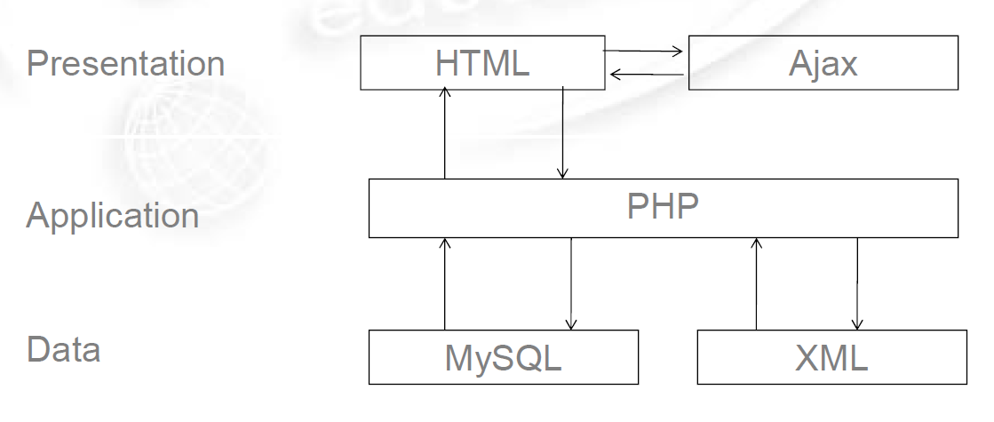
Our Architecture So Far

Slide 45
JavaScript - 1
The various technologies of Ajax are held together by a scripting language called JavaScript.
This has very little to do with Java, the programming language.
JavaScript allows us to locate code in a web page so that it can be executed by the browser.
This offloads some of the bandwidth and processing costs from the server to the client.
We can use this to create more responsive user interfaces.

Slide 46
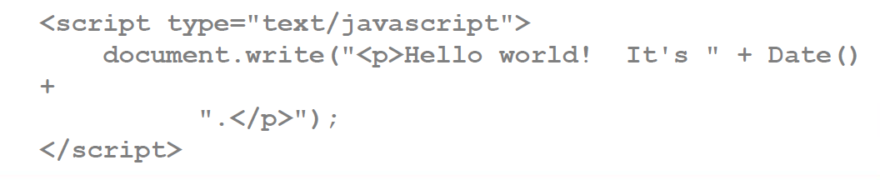
JavaScript - 2
Before we begin to unravel Ajax, we must first learn the syntax of JavaScript.
This is relatively straightforward.
As with our PHP, we can incorporate JavaScript directly into a HTML page.
Using the <script> tag:
JavaScript's can be placed in external files

Slide 47
The Document Object Model - 1
Core to JavaScript is the concept of the Document Object Model (DOM).
The DOM is a way of representing XML documents as a tree,
And by extension, HTML/XHTML documents.
There are several ways of parsing XML documents into workable structures.
The one we used for our PHP RSS parser is called the SAX method; DOM is another.

Slide 48
The Document Object Model - 2
The DOM creates a structure that is easy for developers to navigate.
Hints as to the structure of a document are provided.
Any time that tags are nested, they become nodes in the tree,
Nodes in turn may contain nodes of their own.
We can then explore branches and iterate over nodes as needed.

Slide 49
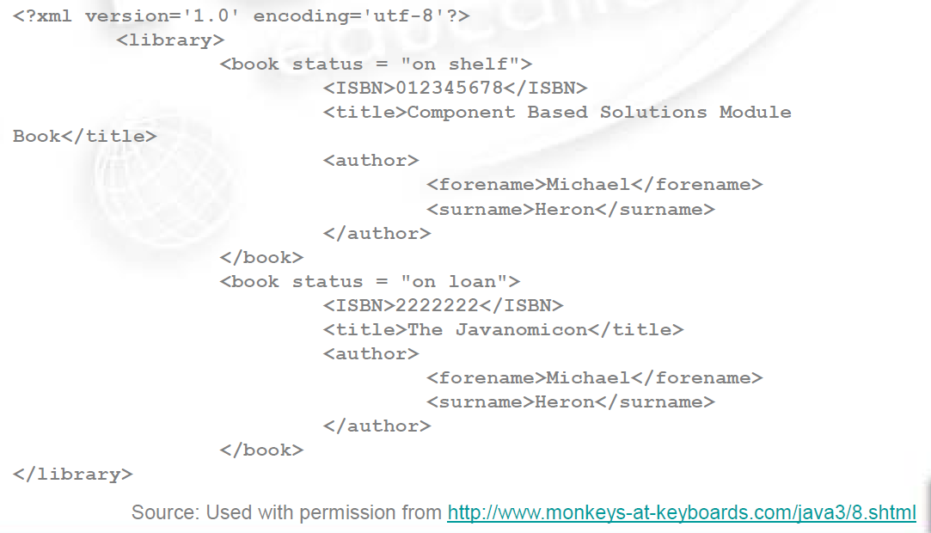
The DOM - 1

Slide 50
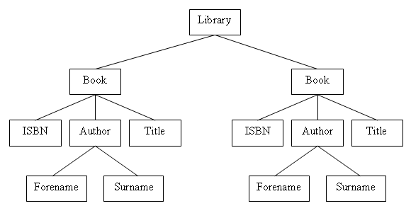
The DOM - 2
Source: Used with permission from http://www.monkeys-at-keyboards.com/java3/8.shtml

Slide 51
JavaScript and the DOM
Every HTML page in JavaScript is represented as a document object.
This is available for us for free, we do not need to do anything to create or access it.
We can make use of a number of useful methods.
getElementByld is the most useful of these to begin with.
It gives us access to the element matching the ID we provide.

Slide 52
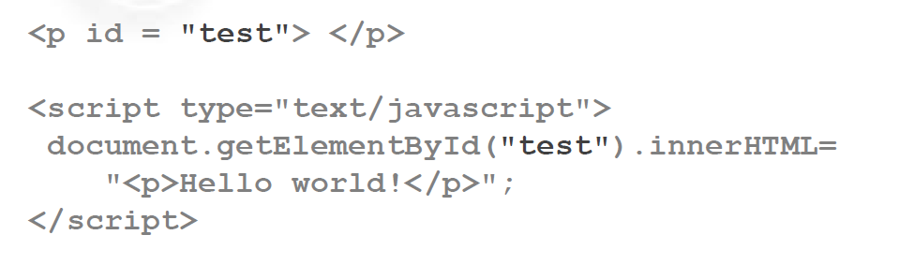
Manipulating HTML
Much of the power of JavaScript comes from allowing us to modify HTML elements once they have been loaded into the browser.

Slide 53
JavaScript
Inner HTML represents the textual content of an element.
This is not part of the DOM specification, but it is almost universally supported by browsers.
We can use this to dynamically adjust our web page content as required as seen on the previous page.
We can also bind JavaScript functions to be invoked when we interact with HTML elements, such as buttons.
This is where much of the real power lies.

Slide 54
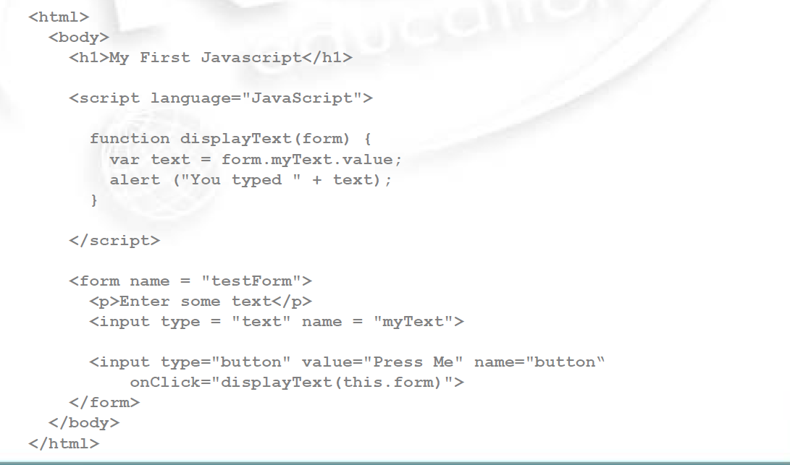
JavaScript Functions - 1

Slide 55
JavaScript Functions - 2
<script>
function myFunction() {
var txt;
var person = prompt("Please enter your name:", “Mickey Mouse");
if (person == null || person == "") {
txt = “Prompt has been cancelled.";
} else {
txt = “Hi " + person + "! How can we help you today?";
}
document.getElementById("demo").innerHTML = txt;
}
</script>

Slide 56
Ajax
Our first steps in Ajax require us to navigate an awkward element of dynamic websites.
Browser compatibility.
Every browser handle the initial parts of setting up an XMLHttpRequest object differently.
And we need to honour each of these methods.
This makes the first part of setting up our Ajax quite verbose.
Mostly, everything that follows is standardised.

Slide 57
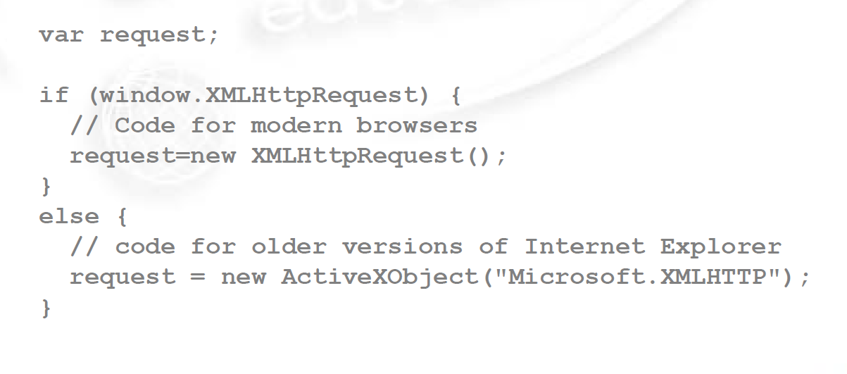
The Request Object

Slide 58
Server Communication
Communication with the server is handled via GET/POST requests.
We do this through the open and send methods of the XMLHttpRequest object we created.
request.open(“GET”, “test.txt”, trust);
request.send();
There are three parameters to open:
The method of the request
The URL of the request
Whether to handle the request asynchronously

Slide 59
Receiving the Response
As with our XML parser, we handle this through the use of a callback.
We do not know when the server is going to give us the response, so we provide a function to be called as and when it happens.
To do this, we create a function and bind it to the onreadystatechange property of our XMLHttpRequestobject.
We do this before we send a request.

Slide 60
The Server Response
The server response is made up of three key parts.
The ready state
This will be a number of 0 to 4.
Only 4 means “it’s compete”
The request status
200 means “ok” here.
This is the standard HTTP status code.
The response text
This is what the server gave us back.
It is also what we will usually need to parse with JavaScript.

Slide 61
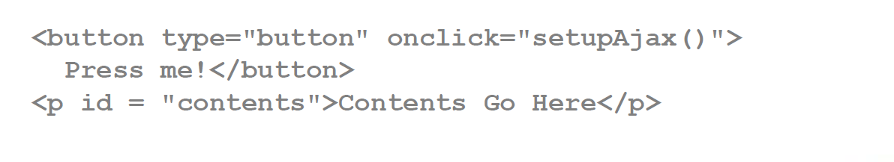
A Simple Ajax Application - 1
For the following, we have a small text file on the server.
When we press the button, we replace the contents of a <p> tag with what is in the text file:

Slide 62
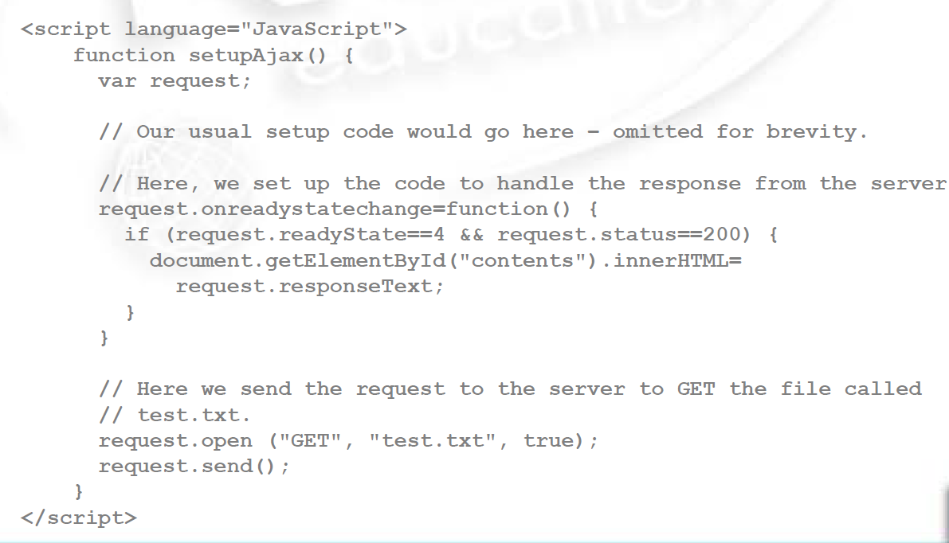
A Simple Ajax Application - 2

Slide 63
Ajax Applications
For our Ajax application, we are binding event handlers to that they occur at particular points in a document’s lifetime.
There are many places where this can be done.
onLoad and onUnload handle when a page is loaded or unloaded.
onFocus, onBlur and onChange permit you handle when there is interaction with a form element.

Slide 64
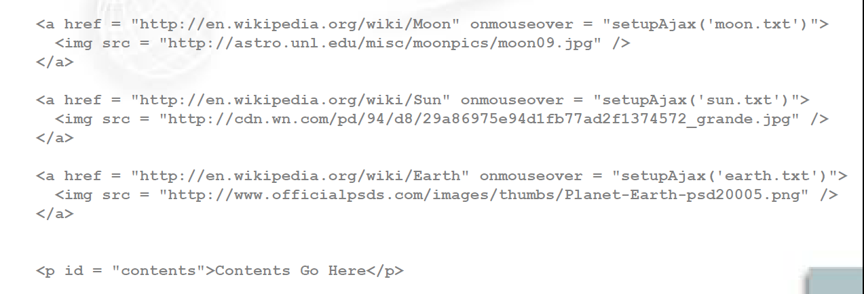
A second Ajax Application - 1
In our second example, we are going to bind mouseover events to an Ajax function:

Slide 65
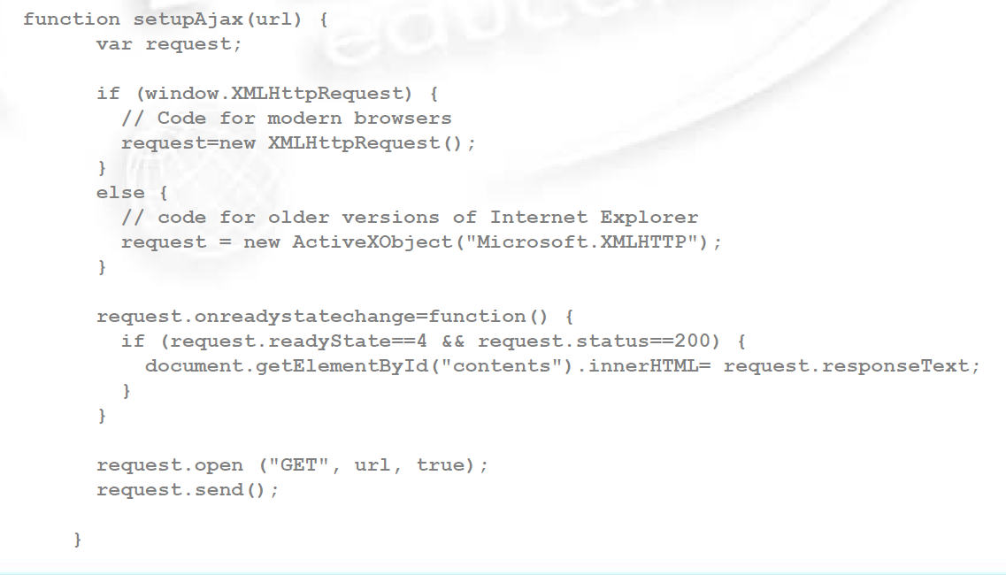
A Second Ajax Application - 2

Slide 66
Topic 1 – Introduction to the Module
Any Questions?
Notes:
NCC Education - End Slide Master

