Slide 1



Designing a Website
Topic 4:
PHP Laravel FrameWork
Notes:
NCC Education - Title Master

Slide 2
Topics
Laravel Overview
Laravel Install

Slide 3
Overview - 1
Laravel is a powerful MVC PHP framework, designed for developers who need a simple and elegant toolkit to create full-featured web applications.
Offers a rich set of functionalities which incorporates the basic features of PHP frameworks like CodeIgniter, Yii and other programming languages like Ruby on Rails.
Saves a lot time if you are planning to develop a website from scratch.

Slide 4
Overview - 2
Laravel is an open-source PHP framework, which is robust and easy to understand. It follows a model-view-controller design pattern. Laravel reuses the existing components of different frameworks which helps in creating a web application. The web application thus designed is more structured and pragmatic

Slide 5
Advantages of Laravel
The web application becomes more scalable, owing to the Laravel framework.
Considerable time is saved in designing the web application, since Laravel reuses the components from other framework in developing web application.
It includes namespaces and interfaces, thus helps to organize and manage resources.

Slide 6
Composer
Composer is a tool which includes all the dependencies and libraries.
Allow a user to create a project with respect to the mentioned framework.
Third party libraries can be installed easily with help of composer.
All the dependencies are noted in composer.json file which is placed in the source folder.
Install composer
https://getcomposer.org

Slide 7
Artisan
Command line interface used in Laravel is called Artisan.
Include a set of commands which assists in building a web application.
These commands are incorporated from Symphony framework.

Slide 8
Features of Laravel - 1
Laravel offers the following key features:
Modularity
Testability
Routing
Configuration management
Query builder and ORM (Object Relational Mapper)
Schema builder, migrations, and seeding
Template engine
•
Notes:
Modularity
Laravel provides 20 built in libraries and modules which helps in enhancement of the application. Every module is integrated with Composer dependency manager which eases updates.
Testability
Laravel includes features and helpers which helps in testing through various test cases. This feature helps in maintaining the code as per the requirements.
Routing
Laravel provides a flexible approach to the user to define routes in the web application. Routing helps to scale the application in a better way and increases its performance.
Configuration Management
A web application designed in Laravel will be running on different environments, which means that there will be a constant change in its configuration. Laravel provides a consistent approach to handle the configuration in an efficient way.
Query Builder and ORM
Laravel incorporates a query builder which helps in querying databases using various simple chain methods. It provides ORM (Object Relational Mapper) and ActiveRecord implementation called Eloquent.
Schema Builder
Schema Builder maintains the database definitions and schema in PHP code. It also maintains a track of changes with respect to database migrations.
Template Engine
Laravel uses the Blade Template engine, a lightweight template language used to design hierarchical blocks and layouts with predefined blocks that include dynamic content.

Slide 9
Features of Laravel - 2
E-mailing
Authentication
Redis
Queues
Event and command bus
Notes:
E-mail
Laravel includes a mail class which helps in sending mail with rich content and attachments from the web application.
Authentication
User authentication is a common feature in web applications. Laravel eases designing authentication as it includes features such as register, forgot password and send password reminders.
Redis
Laravel uses Redis to connect to an existing session and general-purpose cache. Redis interacts with session directly.
Queues
Laravel includes queue services like emailing large number of users or a specified Cron job. These queues help in completing tasks in an easier manner without waiting for the previous task to be completed.
Event and Command Bus
Laravel 5.1 includes Command Bus which helps in executing commands and dispatch events in a simple way. The commands in Laravel act as per the application’s lifecycle.

Slide 10
Laravel project
Installing Laravel
Use command prompt
composer create-project laravel/laravel [your-project-name] [--prefer-dist]
Example
composer create-project laravel/laravel project1
View project in public folder
Direct : localhost\project1\public
Server : php –S localhost:port –t public

Slide 11
Example
Create a Laravel project
composer create-project laravel/laravel demo
Run project in xampp and open it on browser
http://localhost/demo/public

Slide 12
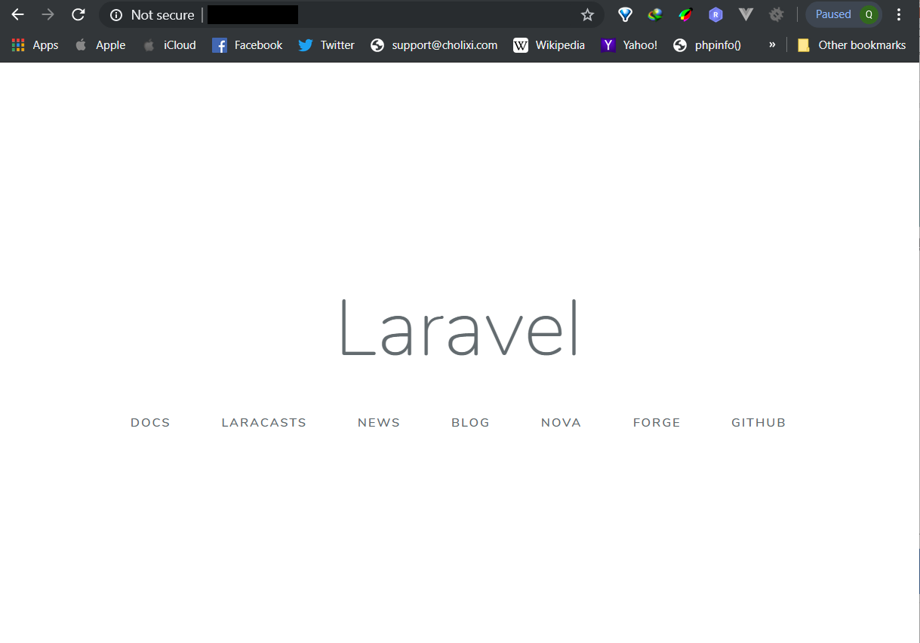
Example - result

Slide 13
Why Laravel?
Composer
All in one dependency installer / downloader
Artisan
Php model/script generator
Database Migration and Seeds
Easy to migrate between database
MVC ORM architecture
RESTful Routing
Security

Slide 14
Application Structure
The default Laravel application structure is intended to provide a great starting point for both large and small applications.
You are free to organize your application.
Laravel imposes almost no restrictions on where any given class is located - as long as Composer can autoload the class.

Slide 15
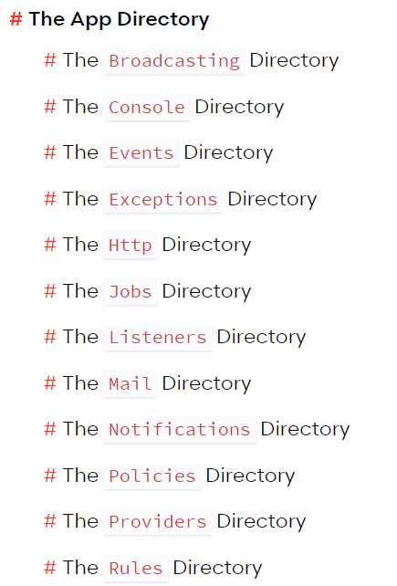
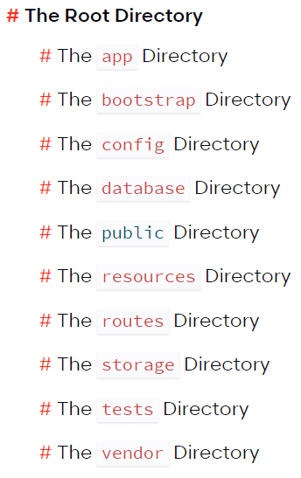
Basic Structure

Slide 16
The Root Directory - 1
The App Directory
Contain the core code of your application.
The Bootstrap Directory
Contain the app.php file which bootstraps the framework.
The Config Directory
Contain all of your application's configuration files

Slide 17
The Root Directory - 2
The Database Directory
Contain your database migrations, model factories, and seeds.
The Public Directory
Contain the index.php file, which is the entry point for all requests and configures autoloading.
Houses assets: images, JavaScript, and CSS.

Slide 18
The Root Directory - 3
The Resources Directory
Contain your views un-compiled assets: LESS, SASS, JavaScript and language files.
The Routes Directory
Contain all of the route definitions for your application: web.php, api.php, console.php and channels.php.

Slide 19
The Root Directory - 4
The Storage Directory
Contain compiled Blade templates, file based sessions, file caches.
The Tests Directory
Contain automated tests.
The Vendor Directory
Contain Composer dependencies.

Slide 20
The App Directory - 1
The majority of your application is housed in the app directory.
This directory is namespaced under App and is autoloaded by Composer using the PSR-4 autoloading standard.
The app directory contains a variety of additional directories such as Console, Http, and Providers.
Console directory contains Artisan commands.
Http directory contains controllers, middleware, and requests.

Slide 21
The App Directory - 2
The Broadcasting Directory
Contain broadcast channel classes for application.
These classes are generated using the make:channel command.
The Console Directory
Contain custom Artisan commands for application.
These commands may be generated using the make:command command.

Slide 22
The App Directory - 3
The Events Directory
Default doesn’t exist, but will be created by the event:generate and make:event Artisan commands.
Events directory houses event classes.
The Exceptions Directory
Contain application's exception handler.
The Http Directory
Contain controllers, middleware, and form requests.

Slide 23
The App Directory - 4
The Jobs Directory
Default doesn’t exist, but will be created by execute the make:job Artisan command.
House the queueable jobs for application.
Jobs may be queued by your application or run synchronously within the current request lifecycle.
The Listeners Directory
Default doesn’t exist, but will be created by execute the event:generate or make:listener Artisan commands.
Contain the classes that handle events.

Slide 24
The App Directory - 5
The Mail Directory
Default doesn’t exist, but will be created by execute the make:mail Artisan command.
Contain classes that represent emails sent by application.
The Notifications Directory
Default doesn’t exist, but will be created by execute the event:notification Artisan commands.
Contain "transactional" notifications that are sent by application.

Slide 25
The App Directory - 6
The Policies Directory
Default doesn’t exist, but will be created by execute the make:policy Artisan command.
Contain the authorization policy classes for your application.
The Providers Directory
Contain service providers for application.
Service providers bootstrap application by binding services in the service container, registering events, or performing tasks to prepare application for incoming requests.

Slide 26
The App Directory - 7
The Rules Directory
Default doesn’t exist, but will be created by execute the make:rule Artisan command.
Contain the custom validation rule objects for your application.

Slide 27
Configuration
All of the configuration files for the Laravel framework are stored in the config directory.
In a fresh Laravel installation, the root directory will contain a .env.example file. And you should rename the file manually to .env.
Any variable in your .env file can be overridden by external environment variables such as server-level or system-level environment variables.

Slide 28
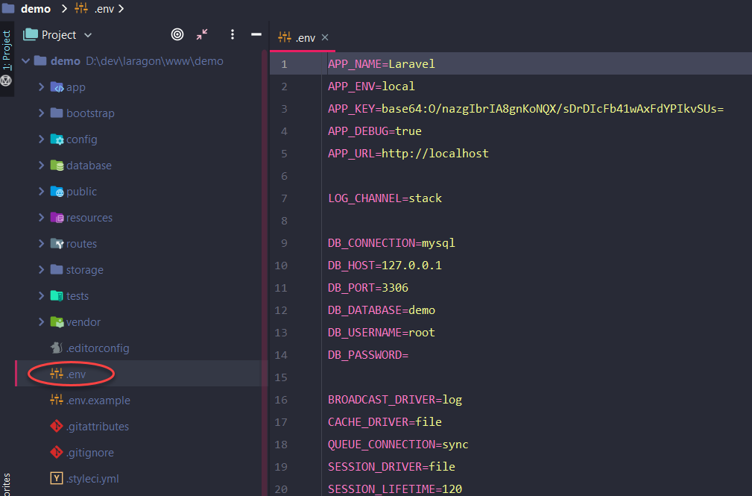
File .env

Slide 29
Environment Variable Types
All variables in your .env files are parsed as strings.
Some reserved values have been created in order to return a wider range of types from the env() function.
To define an environment variable with a value that contains spaces, enclosing the value in double quotes.
APP_NAME="My Application"

Slide 30
Environment Variable Types
.env Value | env() Value
true | (bool) true
(true) | (bool) true
false | (bool) false
(false) | (bool) false
empty | (string) ''
(empty) | (string) ''
null | (null) null
(null) | (null) null

Slide 31
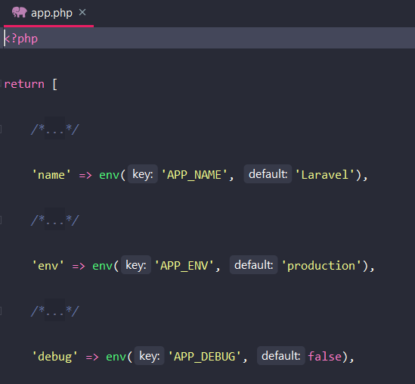
Retrieving Environment Configuration
All of the variables in .env will be loaded into the $_ENV PHP super-global when application receives a request.
Use the env helper to retrieve values from these variables in your configuration files
'debug' => env('APP_DEBUG', false),

Slide 32
Accessing Configuration Values
Using the global config helper function to access configuration values from anywhere in application.
The configuration values may be accessed using "dot" syntax, which includes the name of the file and option need to access.
To set configuration values at runtime, pass an array to the config helper:
$value = config('app.timezone');
config(['app.timezone' => 'America/Chicago']);

