Slide 1



Designing a Website
Topic 4:
PHP Laravel FrameWork
Notes:
NCC Education - Title Master

Slide 2
Topics
Laravel Route
Laravel Controller

Slide 3
Basic Routing
The most basic Laravel routes accept a URI and a Closure
Route::get('foo', function () {
return 'Hello World’;
});

Slide 4
The Default Route Files - 1
All Laravel routes are defined in your route files, located in the routes directory.
These files are automatically loaded by the framework.
The routes/web.php file defines routes that are for your web interface.
assigned the web middleware group
The routes in routes/api.php are stateless
assigned the api middleware group.

Slide 5
The Default Route Files - 2
We will define routes in routes/web.php file.
The routes defined in routes/web.php may be accessed by entering the defined route's URL in browser.
For example, the following route is accessed by navigating to http://demo.test:806/user.
Route::get('/user', 'UserController@index');

Slide 6
Available Router Methods - 1
The router allows you to register routes that respond to any HTTP verb:
Route::get($uri, $callback);
Route::post($uri, $callback);
Route::put($uri, $callback);
Route::patch($uri, $callback);
Route::delete($uri, $callback);
Route::options($uri, $callback);

Slide 7
Available Router Methods - 2
Using the match method to register a route that responds to multiple HTTP verbs.
Using the any method to register a route that responds to all HTTP verbs
Route::match(['get', 'post'], '/', function () {
//
});
Route::any('/', function () {
//
});

Slide 8
Redirect Routes
If you are defining a route that redirects to another URI, you may use the Route::redirect method.
Route::redirect('/here', '/there');

Slide 9
View Routes
If your route only needs to return a view, you may use the Route::view method.
Route::view('/welcome', 'welcome’);
Route::view('/welcome', 'welcome', ['name' => 'Taylor']);

Slide 10
Required Parameters
To capture segments of the URI within route. You do so by defining route parameters:
Route::get('user/{id}', function ($id) {
return 'User '.$id;
});
Route::get('posts/{post}/comments/{comment}’,
function ($postId, $commentId) {
//
});

Slide 11
Optional Parameters
If you need to specify a route parameter, but make the presence of that route parameter optional.
Placing a ? mark after the parameter name.
Route::get('user/{name?}', function ($name = null) {
return $name;
});
Route::get('user/{name?}', function ($name = 'John') {
return $name;
});

Slide 12
Regular Expression Constraints
Constrain the format of your route parameters using the where method on a route instance.
Route::get('user/{name}', function ($name) {
//
})->where('name', '[A-Za-z]+’);
Route::get('user/{id}', function ($id) {
//
})->where('id', '[0-9]+’);
Route::get('user/{id}/{name}', function ($id, $name) {
//
})->where(['id' => '[0-9]+', 'name' => '[a-z]+']);

Slide 13
Named Routes
Named routes allow the convenient generation of URLs or redirects for specific routes.
a name for a route is specified by chaining the name method onto the route definition:
You may also specify route names for controller actions:
Route::get('user/profile', function () {
//
})->name('profile');
Route::get('user/profile', 'UserProfileController@show')->name('profile');

Slide 14
Generating URLs To Named Routes
Using the route's name when generating URLs or redirects via the global route function:
$url = route('profile’);
return redirect()->route('profile’);
Route::get('user/{id}/profile', function ($id) {
//
})->name('profile’);
$url = route('profile', ['id' => 1]);

Slide 15
Route Groups
Route groups allow to share route attributes, such as middleware or namespaces, across a large number of routes.
Shared attributes are specified in an array format as the first parameter to the Route::group method.

Slide 16
Middleware
To assign middleware to all routes within a group, using the middleware method before defining the group.
Middleware are executed in the order they are listed in the array:
Route::middleware(['first', 'second'])->group(function () {
Route::get('/', function () {
// Uses first & second Middleware
});
Route::get('user/profile', function () {
// Uses first & second Middleware
});
});

Slide 17
Namespaces
Assigning the same PHP namespace to a group of controllers using the namespace method:
Route::namespace('Admin')->group(function () {
// Controllers Within The
// "App\Http\Controllers\Admin" Namespace
});

Slide 18
Route Prefixes
The prefix method may be used to prefix each route in the group with a given URI.
Route::prefix('admin')->group(function () {
Route::get('users', function () {
// Matches The "/admin/users" URL
});
});

Slide 19
Accessing The Current Route
using the current, currentRouteName, and currentRouteAction methods on the Route facade to access information about the route handling the incoming request:
$route = Route::current();
$name = Route::currentRouteName();
$action = Route::currentRouteAction();

Slide 20
Controllers
Instead of defining all of request handling logic as Closures in route files, organizing this behavior using Controller classes.
Controllers can group related request handling logic into a single class.
Controllers are stored in the app/Http/Controllers directory.

Slide 21
Defining Controllers
The controller extends the base controller class included with Laravel.
The base class provides a few convenience methods such as the middleware method.

Slide 22
Example
<?php
namespace App\Http\Controllers;
use App\User;
use App\Http\Controllers\Controller;
class UserController extends Controller {
/** * Show the profile for the given user.
* @param int $id
* @return View
*/
public function show($id) {
return view('user.profile', ['user' => User::findOrFail($id)]);
}
}

Slide 23
A route to controller action
When a request matches the specified route URI, the show method on the UserController class will be executed.
The route parameters will also be passed to the method.
Route::get('user/{id}', 'UserController@show');

Slide 24
Controllers & Namespaces
We did not need to specify the full controller namespace when defining the controller route.
The RouteServiceProvider loads your route files within a route group that contains the namespace.
We only specified the portion of the class name that comes after the App\Http\Controllers portion of the namespace

Slide 25
Resource Controllers - 1
Laravel resource routing assigns the typical "CRUD" routes to a controller with a single line of code.
Using the make:controller Artisan command, we can quickly create such a controller:
This command will generate a controller at app/Http/Controllers/PhotoController.php. The controller will contain a method for each of the available resource operations.
php artisan make:controller PhotoController --resource

Slide 26
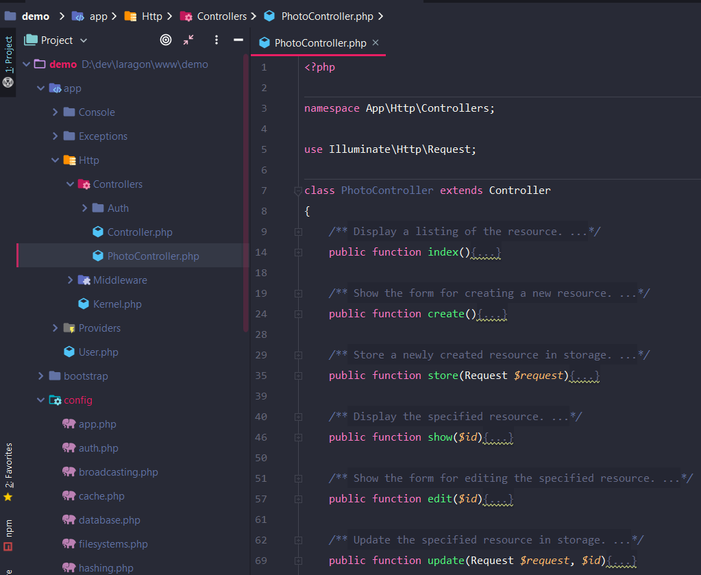
PhotoController.php

Slide 27
Resource Controllers - 2
Register a resourceful route to the controller:
Register many resource controllers at once by passing an array to the resources method:
Route::resource('photos', 'PhotoController');
Route::resources([
'photos' => 'PhotoController’,
'posts' => 'PostController’
]);

Slide 28
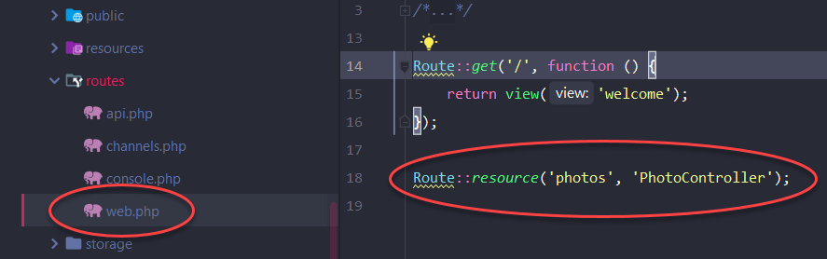
File routes/web.php

Slide 29
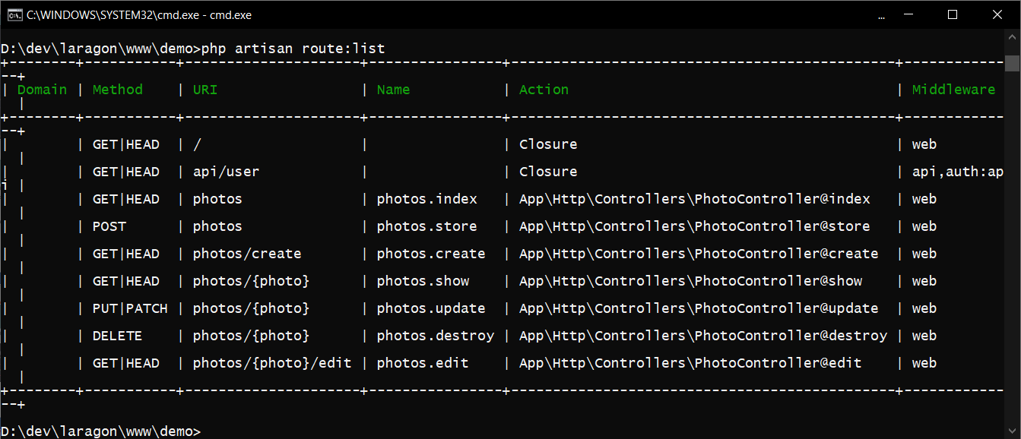
route:list

Slide 30
Specifying The Resource Model
If you are using route model binding and would like the resource controller's methods to type-hint a model instance, you may use the --model option when generating the controller:
php artisan make:controller PhotoController --resource --model=Photo

