Slide 1



Designing a Website
Topic 4:
PHP Laravel FrameWork
Notes:
NCC Education - Title Master

Slide 2
Topics
Laravel Database
Laravel Form
Laravel Eloquent

Slide 3
Laravel Database
Database configuration
/config/database.php
'default' => 'db_type'
Local development => .env file
DB_HOST
DB_DATABASE
DB_USERNAME
DB_PASSWORD

Slide 4
Migration
Already included Version control for Database
Resolve consistency issues between developers
Represent instruction toward database in form of php class
Migration class files directory
/database/migrations/

Slide 5
Migration Class - 1
Create a new migration Class to create new table
php artisan make:migration class_name --create="table_name"
Example
php artisan make:migration create_students_table --create="students"
File created = '[date]_create_students_table.php'

Slide 6
Migration Class - 2
Automatically generated function script
Up function
Function that called when the migration executed
Default : generate column id and timestamp
Down function
Function that called when we rollback the migration
Default : Drop table
Automatically add the filename with Date created
For version controlling

Slide 7
Migration Class - 3
Up method
Define the blueprint to create or modify table
Down method
Define the schema to drop or modify table
public function up() {
Schema::create('students', function (Blueprint $table) {
$table->increments('id');
$table->timestamps();
});
}
public function down() {
Schema::drop('students');
}

Slide 8
Migration Class - 4
Table blueprint
$table->increments('column_name');
$table->string ('column_name');
$table->text ('column_name');
$table->timestamp('column_name')
$table->timestamps()
$table->rememberToken ();
Option
->unique();
->nullable();

Slide 9
Migration Class - 5
Example students migration class
Table blueprint
…
public function up() {
Schema::create('students', function (Blueprint $table) {
$table->increments('id');
$table->string('name');
$table->string('major');
$table->timestamp('birthdate');
$table->timestamps();
});
}
…

Slide 10
Run the Migration
Migrate all migration class into database
php artisan migrate
Call UP function from all class under migrations directory
Create table as defined in each blueprint
Rollback the last modification in database
Undo 1 last migration
php artisan migrate:rollback
Call DOWN function
Drop table

Slide 11
Modifying Table - 1
Table is already migrated, and some modification is needed
2 possible conditions :
Project status still in development stage
Database dummy
Project is already at production stage
Real data already inside database

Slide 12
Modifying Table - 2
Assumed that the project is still in the development stage
Rollback migration
php artisan migrate:rollback
Edit the blueprint
Rename column, Add column, etc.
Re-run the migration
php artisan migrate

Slide 13
Modifying Table - 3
When it is already in production stage
No rollback is possible anymore
Create a new migration to modify the existing table
php artisan make:migration class_name --table="table_name"
Example
php artisan make:migration add_students_description --table="students"

Slide 14
Modifying Table - 4
Add blueprint to modify the existing table
…
public function up() {
Schema::table('students', function (Blueprint $table) {
// add new column
$table->text('description')->nullable();
});
}
public function down() {
Schema::table('students', function (Blueprint $table) {
// drop the new column
$table->dropColumn('description');
});
}
…

Slide 15
Rollback after Modification
Laravel require special package to drop a column
composer require doctrine/dbal
After installing the requirement, then the database can be rolled-back
php artisan migrate:rollback

Slide 16
Laravel Form
Generate Form
Composer require illuminate/html
Functions that we will use
HTML builder
HTML Service Providers
Form builder
Form Facade

Slide 17
Setting
Modify file \config\app.php
Add new providers
Add new alias
'providers' => [
...
'Illuminate\Html\HtmlServiceProvider',
...
],
'aliases' => [
...
'Form' => 'Illuminate\Html\FormFacade',
'Html' => 'Illuminate\Html\HtmlFacade',
],

Slide 18
New Form
Open-close syntax
Form Components
{!! Form::open(['url' => 'target', option]) !!}
Form components
{!! Form::close() !!}
{!! Form::comp_type('comp_name', 'value', [option]) !!}
{!! Form::label('name', 'Name') !!}
{!! Form::text('name') !!}
{!! Form::textarea('name', ['class' => 'class name') !!}
{!! Form::submit('name') !!}

Slide 19
Example: Student Form
@extends('layout')
@section('content')
{!! Form::open(['url'=>'student', 'class'=>'pure-form']) !!}
<div class="pure-control-group">
{!! Form::label('name','Name') !!}
{!! Form::text('name', null,['placeholder'=>'student name']) !!}
</div>
<div class="pure-control-group">
{!! Form::label('major','Major') !!}
{!! Form::text('major') !!}
</div>
<div class="pure-control-group">
{!! Form::label('description','Description') !!}
{!! Form::textarea('description', null,['rows'=>'4', 'cols'=>'40']) !!}
</div>
<div class="pure-control-group">
{!! Form::label('birthdate','birthdate') !!}
{!! Form::input('date', 'birthdate',date('Y-m-d')) !!}
</div>
<div class="pure-control-group">
{!! Form::submit('Submit',['class'=>'pure-button']) !!}
</div>
{!! Form::close() !!}
@stop

Slide 20
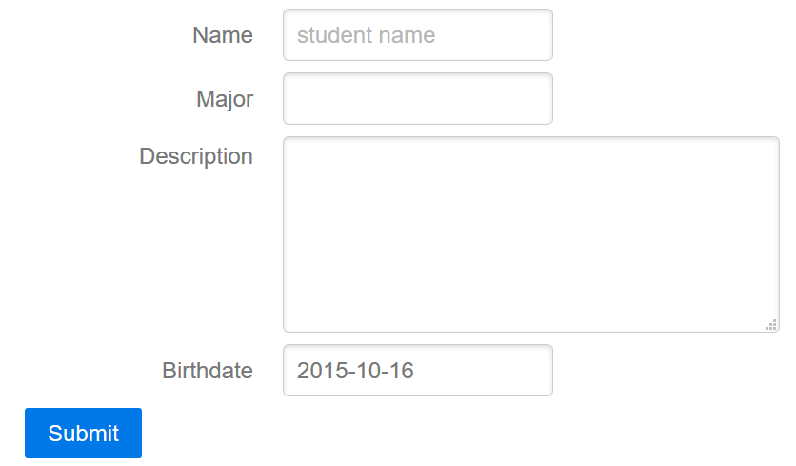
Result: Student Form

Slide 21
Receive Post Action - 1
Routes.php
Route::post('target', 'controllerClass@method');
Modify controllerClass.php
Change use Illuminate\Http\Request; => use Requests;
Receive post data
$input = Request::all();
$input = Request::get('name');

Slide 22
Receive Post Action - 2
Add post route
Add function to receive the post data
…
Route::post('students', 'studentsController@store');
…
routes/web.php
…
use Request; // changed from use Illuminate\Http\Request;
…
public function store(Request $request){
$input = Request::all();
return $input;
}
…
App/Http/Controllers/studentsController.php

Slide 23
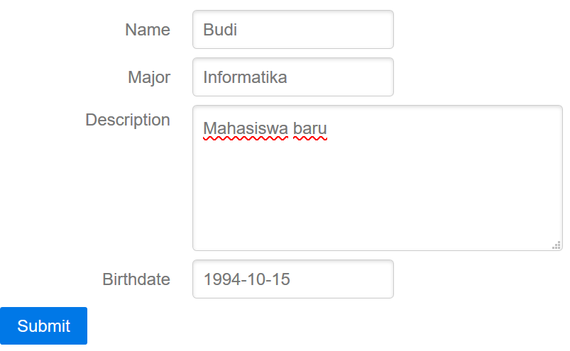
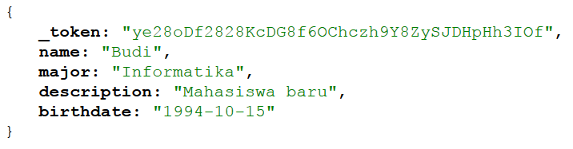
Laravel Form example
…/public/students/create

Slide 24
Laravel Eloquent - 1
Laravel Active Record Implementation
Create a Model class for each table
Object Oriented
Persistence Scheme
Class to represent each row from a table
php artisan make:model [options] [--] <name>

Slide 25
Laravel Eloquent - 2
Naming format for Table and Model Class
Users table => User class
Cars table => Car class
Students table => Student class
Example
php artisan make:model student
PHP model files
File created : /app/student.php

Slide 26
save new data - 1
Saving new data to database
Using Store function at controller page
Add use model to controller page
Use App\className;
<?php
namespace App\Http\Controllers;
use App\student;
…

Slide 27
save new data - 2
Two ways to persist data :
One by one initialization
save() method
Mass assignment
::create() method
::firstOrCreate() method
::firstOrNew() method

Slide 28
save() - 1
One by One Initialization
$data = new \App\class_name;
$data->column_name = 'value';
Etc…
Use Request::all() or Request::get('column')

Slide 29
save() - 2
…
public function store(Request $request){
$student = new \App\student;
$student ->name = Request::get('name');
$student->major = Request::get('major');
$student->description = Request::get('description');
$student->birthdate= Request::get('birthdate');
return $student;
}
…
…
public function store(Request $request){
$input = Request::all();
$student = new \App\student;
$student->name = $input['name'];
$student->major = $input['major'];
$student->description = $input['description'];
$student->birthdate= $input['birthdate'];
return $student;
}
…
App/Http/Controllers/studentsController.php

Slide 30
save() - 3
Add use App\class_name; to simplify things
…
use App\student;
…
public function store(Request $request){
$input = Request::all();
$student = new student; // no need /App/
$student->name = $input['name'];
$student->major = $input['major'];
$student->description = $input['description'];
$student->birthdate= $input['birthdate'];
return $student;
}
…

Slide 31
save() - 4
Persist Data
save data to database, then redirect back to student page
$data->save();
…
public function store(Request $request){
$input = Request::all();
$student = new student;
$student->name = $input['name'];
$student->major = $input['major'];
$student->description = $input['description'];
$student->birthdate= $input['birthdate'];
$student->save();
return redirect('student');
}
…
App/Http/Controllers/studentsController.php

Slide 32
::create()
Use Create Function to initialize the data
\App\class_name::create($array);
or simplify it
…
public function store(Request $request){
$input = Request::all();
student::create($input);
return redirect('student');
}
App/Http/Controllers/studentsController.php
…
public function store(Request $request){
student::create( Request::all() );
return redirect('student');
}
App/Http/Controllers/studentsController.php

Slide 33
Retrieve Data - 1
Select all
$data = \App\class_name::all();
Search by Query
$data = \App\class_name::find('id');
$data = \App\class_name::where('column','query')->get();
$data = \App\class_name::where('column','query')->first();

Slide 34
Retrieve Data - 2
Select sorted
$data = \App\class_name::latest('column')->get();
$data = \App\class_name::oldest('column')->get();
$data = \App\class_name::orderBy('column', 'asc')->get();

Slide 35
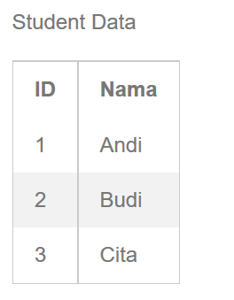
View Data
…
public function index(){
$students = student::all();
return view('student.index', compact('students'));
}
…
App/Http/Controllers/studentsController.php
@extends('layout')
@section('content')
<h1>This is Result</h1>
<p> Student Data</p>
<table >
<th>ID</th><th>Nama</th>
@foreach ($students as $student)
<tr><td> {{$student ->id}}</td>
<td>{{$student->name}}</td></tr>
@endforeach
</table>
@stop
Resources/views/students/index.blade.php

Slide 36
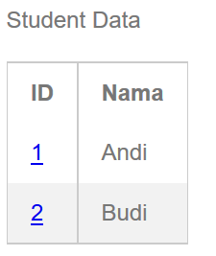
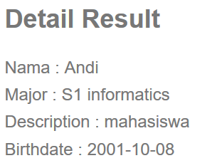
View Detail Data - 1
Create hyperlink in list data
Open page to view detail data when the link is clicked
…/public/students
…/public/students/1

Slide 37
View Detail Data - 2
Passing ID of a data to another view
Add hyperlink
@extends('layout')
@section('content')
<h1>This is Result</h1>
<p> Student Data</p>
<table >
<th>ID</th><th>Nama</th>
@foreach ($students as $student)
<tr><td>
<a href="{{ url('/students', $student ->id) }}">{{$student->id }}</td>
<td>{{$student->name}}</td></tr>
@endforeach
</table>
@stop
Resources/views/students/index.blade.php

Slide 38
View Detail Data - 3
When the link is clicked, the ID will be passed
Add route to receive passed ID
Create find function in show method in studentsController.php to process the request
…
Route::get('students/{id}','studentsController@show');
…
Routes/web.php

Slide 39
View Detail Data - 4
Use find function
or Use findOrFail function
…
public function show($id){
$student = student::find($id);
if(!$student){ abort(404); }
return view('student.show', compact('student'));
}
…
…
public function show($id){
$student = student::findOrFail($id);
return view('student.show', compact('student'));
}
…

Slide 40
View Detail Data - 5
Create page to show Detail view
@extends('layout')
@section('content')
<h2>Detail Result</h2>
<p>
Nama : {{ $student->name }} <br>
Major : {{ $student->major }} <br>
Description : {{ $student->description }} <br>
Birthdate : {{ $student->birthdate }} <br>
</p>
@stop
…/public/students/1
Resources/views/students/show.blade.php

Slide 41
Class Mutator - 1
Setter function
Initialize the attribute when the data created
function set[AttributeName]Attribute($data)
Example
Setter attribute major
function setMajorAttribute($data){ … }
Setter attribute name
function setNameAttribute($data){ … }

Slide 42
Class Mutator - 2
Get class attribute
Use $this->attributes['attribute_name']
Example
Add String 'S1 ' to major attribute
…
public function setMajorAttribute($major){
$this->attributes['major'] = 'S1 '. $major;
}
…
App/student.php

Slide 43
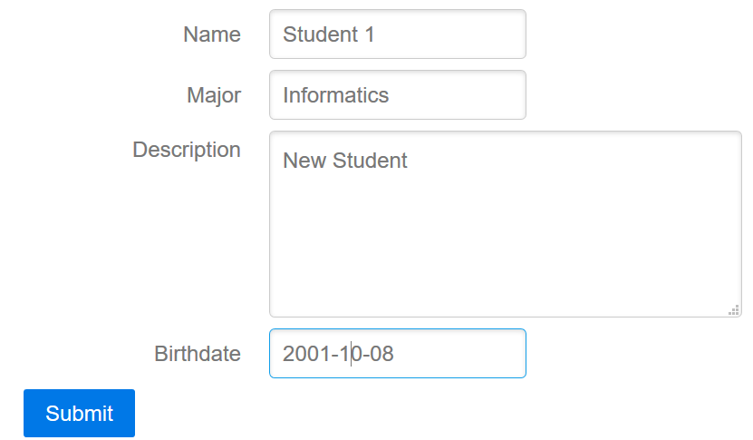
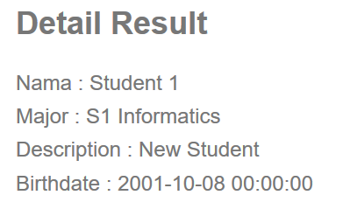
Class Mutator - 3
…/public/students/create
…/public/students/3

Slide 44
Class Accessor - 1
Getter function
Retrieve the named attribute using specific manner
function get[AttributeName]Attribute($data)
Example
Getter attribute major
function getMajorAttribute($data){ … }
Getter attribute age
function getNameAttribute($data){ … }

Slide 45
Class Accessor - 2
Example
Calculate age from birthdate attribute
Update show detail view
use Carbon\Carbon;
…
public function getAgeAttribute(){
$ca = Carbon::parse($this->attributes['birthdate']);
return $ca->diffInYears();
}
…
App/student.php
…
Description : {{ $student->description }} <br>
Birthdate : {{ $student->birthdate }} <br>
Age : {{ $student->age }} <br>
</p>
@stop
Resources/views/students/show.blade.php

Slide 46
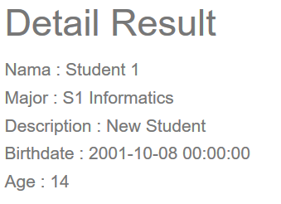
Class Accessor - 3
…/public/students/create
…/public/students/3

Slide 47
Query Scope - 1
Easily re-use query logic
Create a scope function to clean the 'where-code'
Example using query
Select only S1 Informatics major students in index
…
public function index(){
$students = student::where('major', 'S1 informatics')->get();
return view('student.index', compact('students'));
}
…
App/Http/Controllers/studentsController.php

Slide 48
Query Scope - 2
Scope function
Select predefined query
function scope[ScopeName]($query)
Call scope
Call only the scope name
\App\ClassName::ScopeName

Slide 49
Query Scope - 3
Scope Example
Create scope to select student with S1 Informatics major
…
public function scopeInformaticsMajor($query){
$query->where('major', 'S1 informatics');
}
public function scopeOtherMajor($query){
$query->where('major', '!=', 'S1 informatics');
}
…
App/student.php

Slide 50
Query Scope - 3
Select using scope
View only S1 Informatics major students in index
View other than S1 Informatics major students in index
…
public function index(){
$students = student::informaticsMajor()->get();
return view('student.index', compact('students'));
}
…
App/Http/Controllers/studentsController.php
…
public function index(){
$students = student::otherMajor()->get();
return view('student.index', compact('students'));
}
…
App/Http/Controllers/studentsController.php

Slide 51
Utilizing Query Scope
…
public function scopeInformaticsMajor($query){
$query->where('major', 'S1 informatics');
}
public function scopeMale($query){
$query->where('gender', 'l');
}
…
App/student.php
…
public function index(){
$students = student::informaticsMajor()-> male()-> orderBy('birthdate')-> get();
return view('student.index', compact('students'));
}
…
App/Http/Controllers/studentsController.php

