Slide 1



Designing a Website
Topic 4:
PHP Laravel FrameWork
Notes:
NCC Education - Title Master

Slide 2
Topics
Laravel Form Validation
Laravel Partial View

Slide 3
Form Request Validation - 1
Laravel-built form validation
Create request class
php artisan make:request <name>
File directory : /app/Http/Requests/
Generated 2 function
authorize() function
Define who is authorized
rules() function
Define the rules

Slide 4
Form Request Validation - 2
Example
php artisan make:request StudentRequest
File created :
/app/Http/Requests/StudentRequest.php
…
public function authorize(){
return false;
}
public function rules(){
return [ // ];
}
…
/app/Http/Requests/StudentRequest.php

Slide 5
Form Request Validation - 3
Authorize function
Define who has the authorization to perform the request
Define return true / false
Return true means anyone can make the request
…
public function authorize(){
return true;
}
…
/app/Http/Requests/StudentRequest.php

Slide 6
Form Request Validation - 4
Rules function
Add term for the request
'attribute' => 'option | option | … '
…
public function rules(){
return [
'name' => 'required | min:3',
'major' => 'required',
'birthdate' => 'required'
];
}
…
/app/Http/Requests/StudentRequest.php

Slide 7
Form Request Validation - 5
Modify store method in studentsController
Add import use StudentRequest
Change Request store to StudentRequest
Get request using $request->all();
…
use App\Http\Requests\StudentRequest;
…
public function store(StudentRequest $request){
student::create( $request -> all() );
return redirect('student');
}
…
App/Http/Controllers/studentsController.php

Slide 8
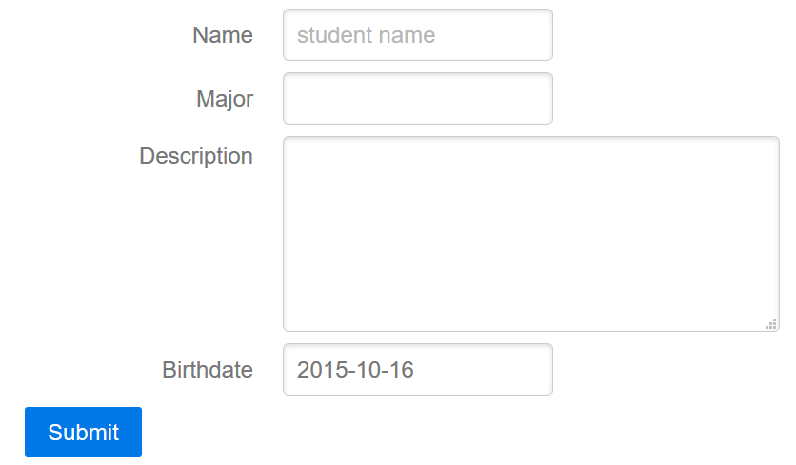
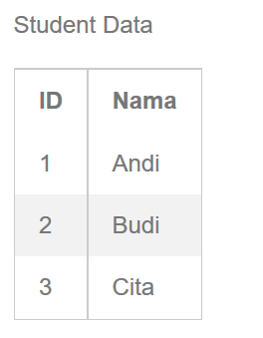
Validation Routing
Validation passed
yes
no
/students/create
/student
Add show error here

Slide 9
Show Error Validation - 1
Laravel provide $errors variable that store all error message during each operation
Error bag
Messages
Check if there is any error using
@if ( $errors->any() )

Slide 10
Show Error Validation - 2
Add syntax to show $errors data
…
…
<div class="pure-control-group">
{!! Form::submit('Submit',['class'=>'pure-button']) !!}
</div>
{!! Form::close() !!}
@if ( $errors->any() )
<ul class="alert alert-danger">
@foreach ($errors->all() as $error)
<li> {{ $error }} </li>
@endforeach
</ul>
@endif
@stop
Resources/views/students/create.blade.php

Slide 11
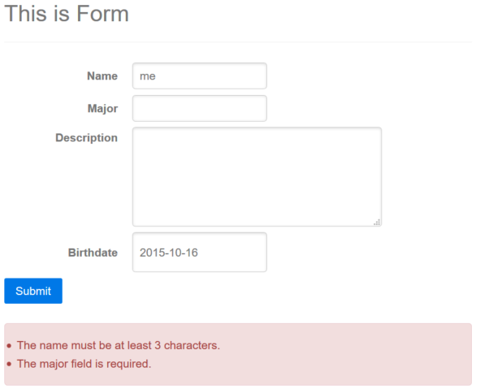
Show Error Validation - 2
…/public/students/create

Slide 12
View Partial
Prevent duplicated sections view codes
Break down view into components
Reuse using @include
Clean code

Slide 13
View Partial – Example - 1
@extends('layout')
@section('content')
{!! Form::open(['url'=>'student', 'class'=>'pure-form']) !!}
<div class="pure-control-group">
{!! Form::label('name','Name') !!}
{!! Form::text('name', null,['placeholder'=>'student name']) !!}
</div>
<div class="pure-control-group">
{!! Form::label('major','Major') !!}
{!! Form::text('major') !!}
</div>
<div class="pure-control-group">
{!! Form::label('description','Description') !!}
{!! Form::textarea('description', null,['rows'=>'4', 'cols'=>'40']) !!}
</div>
<div class="pure-control-group">
{!! Form::label('birthdate','birthdate') !!}
{!! Form::input('date', 'birthdate',date('Y-m-d')) !!}
</div>
<div class="pure-control-group">
{!! Form::submit('Submit',['class'=>'pure-button']) !!}
</div>
{!! Form::close() !!}
@if ( $errors->any() )
<ul class="alert alert-danger">
@foreach ($errors->all() as $error)
<li> {{ $error }} </li>
@endforeach
</ul>
@endif
@stop
Form Component
Error Display
Component
Resources/views/students/create.blade.php

Slide 14
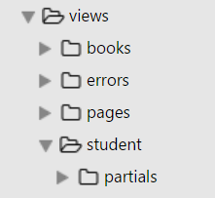
View Partial – Example - 2
Partial views
Create ‘partials’ directory inside the view partial
Error views
Use ‘errors’ directory

Slide 15
View Partial – Example - 3
<div class="pure-control-group">
{!! Form::label('name','Name') !!}
{!! Form::text('name', null,['placeholder'=>'student name']) !!}
</div>
<div class="pure-control-group">
{!! Form::label('major','Major') !!}
{!! Form::text('major') !!}
</div>
<div class="pure-control-group">
{!! Form::label('description','Description') !!}
{!! Form::textarea('description', null,['rows'=>'4', 'cols'=>'40']) !!}
</div>
<div class="pure-control-group">
{!! Form::label('birthdate','birthdate') !!}
{!! Form::input('date', 'birthdate',date('Y-m-d')) !!}
</div>
<div class="pure-control-group">
{!! Form::submit('Submit',['class'=>'pure-button']) !!}
</div>
Resources/views/students/partials/form.blade.php
@if ( $errors->any() )
<ul class="alert alert-danger">
@foreach ($errors->all() as $error)
<li> {{ $error }} </li>
@endforeach
</ul>
@endif
Resources/views/errors/form_error.blade.php

Slide 16
View Partial – Example - 4
Clean code using include
@extends('layout')
@section('content')
{!! Form::open(['url'=>'student', 'class'=>'pure-form']) !!}
@include('students.partials.form')
{!! Form::close() !!}
@include('errors.form_error')
@stop
Include Form
Component
Include Error Display
Component
Resources/views/students/create.blade.php

Slide 17
Update Data - 1
Suppose we want to edit a value
$data = \App\class_name::find(1);
Edit column value
$data->column = 'new value';
$data->save();
Use update function
$data->update(['column'=>'value]);

Slide 18
Update Data - 2
Add new routes for updating data
…
Route::get('students/{id}/edit','studentsController@edit');
Route::put('students/{id}', 'studentsController@update');
Route::patch('students/{id}', 'studentsController@update');
…
Routes/web.php

Slide 19
Update Data - 3
Update Controller
Add update(Request $request, $id) function
Retrieve the data using find $id
Update the data using update->($request->all())
Get request data using validated Request
…
public function update(StudentRequest $request, $id) {
$student = student::findOrFail($id);
$student->update($request->all());
return redirect('students');
}
…
App/Http/Controllers/studentsController.php

Slide 20
Update Data - 4
Create edit form using form partial
Form eloquent model binding
Form::model( $data, [‘option’] )
Option = method => PATCH, url => students/id
@extends('layout')
@section('content')
{!! Form::model($student, ['method'=>'PATCH','url'=>'student/'. $student->id]) !!}
@include('students.partials.form')
{!! Form::close() !!}
@include('errors.form_error')
@stop
Resources/views/students/edit.blade.php

Slide 21
Update Data - 5
Another approach
Target Form Edit using action method from controller
Avoid using hard code url target
@extends('layout')
@section('content')
{!! Form::model($student, ['method'=>'PATCH',
'action'=> ['studentController@update', $student->id]]) !!}
@include('students.partials.form')
{!! Form::close() !!}
@include('errors.form_error')
@stop
Resources/views/students/edit.blade.php

Slide 22
Custom Partial View - 1
Form submit button text
Create page -> ‘Add Student’
Edit Page -> ‘Update Student’
Modify form partial
Set a variable as text for submit button
…
<div class="pure-control-group">
{!! Form::submit($submitText, ['class'=>'pure-button']) !!}
</div>
Resources/views/students/partials/form.blade.php

Slide 23
Custom Partial View - 2
Set the $submitText when calling include view
@extends('layout')
@section('content')
{!! Form::open(['url'=>'student', 'class'=>'pure-form']) !!}
@include('students.partials.form', ['submitText'=>'Add Student'])
{!! Form::close() !!}
…
Resources/views/students/create.blade.php
@extends('layout')
@section('content')
{!! Form::model($student, ['method'=>'PATCH',
'action'=> ['studentController@update', $student->id]]) !!}
@include('students.partials.form', ['submitText'=>'Update Student'])
{!! Form::close() !!}
…
Resources/views/students/edit.blade.php

Slide 24
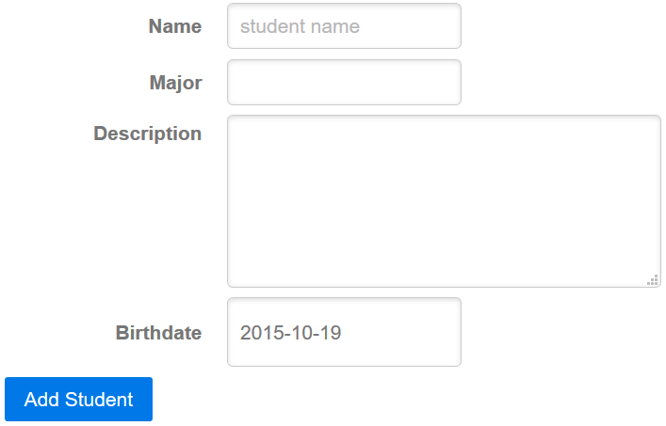
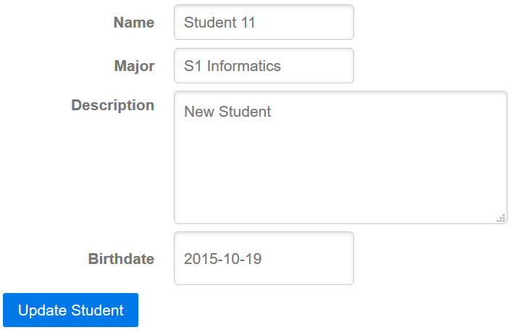
Custom Partial View - 3
…/public/students/3/edit
…/public/students/create

