Slide 1
Network Security and Cryptography
Topic 1:
Cryptography Fundamentals
Notes:
NCC Education - Title Master

Slide 2
Network Security and Cryptography
Topic 1 – Lecture 1:
Module Overview & Overview of Security
Notes:
NCC Education - Title Master

Slide 3
Scope and Coverage
This topic will cover:
  Introduction to module
  Overview of security
  Overview of cryptography
  Block ciphers
  Public-key ciphers
  Hash algorithms
Notes:
NCC Education - Slide Master

Slide 4
Learning Outcomes
By the end of this topic students will be able to:
  Explain the most common types of cryptographic algorithm (i.e. block ciphers, public-key ciphers and hash algorithms)
  Select and justify an appropriate algorithm for a particular purpose

Slide 5
Module Aims
  This module will provide you with the underlying theory and practical skills required to secure networks and to send data safely and securely over network communications (including securing the most common Internet services).

Slide 6
Module Syllabus - 1
  Cryptography Fundamentals
  Public-Key Infrastructure
  Web Security
  Email Security
  Data Protection
  Vulnerability Assessment
  Authentication

Slide 7
Module Syllabus - 2
  Access Control
  Firewalls
  VPN
  Remote Access
  Wireless Security

Slide 8
Module Delivery
  The teacher-led time for this module is comprised of lectures and laboratory sessions.
  Lectures are designed to start each topic.
    You will be encouraged to be active during lectures by raising questions and taking part in discussions.
  Laboratory sessions are designed to follow the respective topic lecture.
    During these sessions, you will be required to work through practical tutorials and various exercises.
Notes:
NCC Education - Slide Master

Slide 9

Private Study
  You are also expected to undertake private study to consolidate and extend your understanding.
  Exercises are provided in your Student Guide for you to complete during this time.
Notes:
NCC Education - Slide Master

Slide 10

Assessment
  This module will be assessed by:
    an examination worth 50% of the total mark
    an assignment worth 50% of the total mark
Notes:
NCC Education - Slide Master

Slide 11
Computer Security – Definition
  “The protection afforded to an automated information system in order to attain the applicable objectives of preserving the integrity, availability and confidentiality of information system resources (includes hardware, software, firmware, information/data, and telecommunications).”
    National Institute of Standards and Technology, Special Publication 800-12, (October 1995).
Notes:
NCC Education - Slide Master

Slide 12
Cryptography – Definition
  “The discipline that embodies the principles, means, and methods for the transformation of data in order to hide their semantic content, prevent their unauthorized use, or prevent their undetected modification.”
    National Institute of Standards and Technology, Special Publication 800-59, (August 2003).
Notes:
NCC Education - Slide Master

Slide 13
Security Objectives
  NIST gives three objectives (FIPS199):
    Confidentiality: Preserving authorized restrictions on information access and disclosure, including means for protecting personal privacy and proprietary information.
    Integrity: Guarding against improper information modification or destruction, including ensuring information non-repudiation and authenticity.
    Availability: Ensuring timely and reliable access to and use of information.

Slide 14
Loss of Security
  The following defines a loss of security in each objective:
    Loss of Confidentiality: Unauthorized disclosure of information.
    Loss of Integrity: Unauthorized modification or destruction of information.
    Loss of Availability: Disruption of access to or use of information or information systems.

Slide 15
The CIA Triad
  These requirements (Confidentiality, Integrity, Availability) are commonly known as the CIA triad.
  There are many critiques that suggest that this does not provide a complete picture of security requirements.
  The two most commonly cited “extra” requirements are:
    Authenticity
    Accountability

Slide 16
Authenticity
  Being genuine, verified and trusted.
  Confidence in the validity of:
    A transmission
    A message
    A message originator
  Verifying that users are who they say they are and that each message came from a trusted source.

Slide 17
Accountability
  Actions of an entity can be traced uniquely to that entity.
  Supports:
    Non-repudiation
    Deterrence
    Fault isolation
    Intrusion detection and prevention
    Recovery
    Legal action

Slide 18
OSI Security Architecture
  ITU-T Recommendation X.800, Security Architecture for OSI, provides a systematic way for:
    Defining the requirements for security
    Characterising the approaches to satisfying those requirements
  ITU-T stands for ‘International Telecommunication Union Telecommunication Standardization Sector’
  OSI stands for ‘Open Systems Interconnection’

Slide 19
OSI Security Architecture
  The following concepts are used:
    Security attack: Any actions that compromise the security of information owned by an organisation (or a person).
    Security mechanism: a mechanism that is designed to detect, prevent, or recover from a security attack.
    Security service: a service that enhances the security of the data processing systems and the information transfers of an organisation. The services make use of one or more security mechanisms to provide the service.

Slide 20
Security Attacks
  It is useful to categorise attacks as:
    Passive attacks
    Active attacks
  Passive attacks make use of information from a system but do not affect the system resources.
  Active attacks alter system resources or affect their operation.

Slide 21
Passive Attacks
  Release of message contents: The information in a message is read.
  Traffic analysis: message information cannot be read but traffic patterns are analysed to glean information.

Slide 22
Active Attacks
  Masquerade: one entity pretends to be another entity.
  Replay: passive capture of data and its retransmission to produce an unauthorized effect.
  Message modification: a message is altered to produce an unauthorized effect.
  Denial of service: preventing or hindering the use of network resources.

Slide 23
Security Services
  A security service is a service which ensures adequate security of the systems or of data transfer.
  X.800 Recommendation divides security services into 5 categories:
    Authentication
    Access control
    Data confidentiality
    Data integrity
    Non-repudiation

Slide 24
Security Mechanisms
  Security mechanisms are used to implement security services. They include:
    Encipherment
    Digital signature
    Access Control mechanisms
    Data Integrity mechanisms
    Authentication Exchange
    Traffic Padding
    Routing Control
    Notarisation

Slide 25
Number Theory
  Many public-key cryptosystems use non-trivial number theory.
  The RSA public-key cryptosystem is based on the difficulty of factoring large numbers.
  We will outline the basic ideas of:
    divisors
    prime numbers
    modular arithmetic

Slide 26
Divisors and Prime Numbers
  Divisors
    Let a and b be integers where b is not equal to 0
    Then we say b is a divisor of a if there is an integer m such that a = mb;
  Prime numbers
    An integer p is a prime number if its only divisors are 1, -1, p, -p

Slide 27
GCD & Relatively Prime Numbers
  Greatest Common Divisor (gcd)
    gcd(a,b) is a greatest common divisor of a and b (the largest number that divides into both numbers)
    Examples:
      gcd(12, 15) = 3
      gcd(49,14) = 7
  Relatively Prime Numbers
    a and b are relatively prime if gcd(a,b) = 1
    Example: gcd (9,14) = 1

Slide 28
Modular Arithmetic
  If a is an integer and n is a positive integer, we define a mod n to be the remainder when a is divided by n:
    Example, 10 mod3 = 1
  If (a mod n) = (b mod n), then a and b are congruent modulo n
  (a mod n) = (b mod n) if n is a divisor of a-b

Slide 29
Network Security and Cryptography
Topic 1 – Lecture 2:
Overview of Cryptography
Notes:
NCC Education - Title Master

Slide 30
Cryptography
  A collection of mathematical techniques for protecting information
  Most important technique is encryption/decryption
  Symmetric encryption (symmetric key encryption):
    encrypt/decrypt a message using the same key
    Key: a piece of information or sequence of bits
  Asymmetric encryption (asymmetric key encryption):
    one key used for encryption (public key), another key used for decryption (private key)

Slide 31
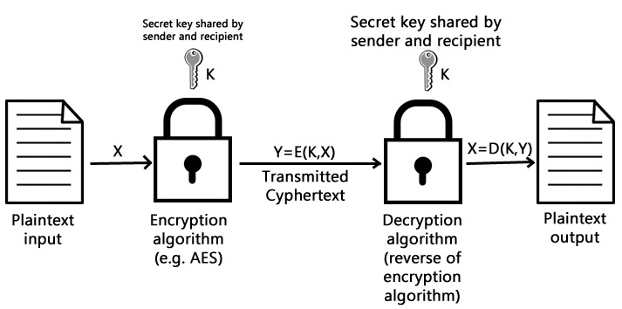
Symmetric Encryption

Slide 32
Elements of Symmetric Encryption
  Plaintext
  Encryption algorithm
  Secret key
  Ciphertext (encrypted text)
  Decryption algorithm

Slide 33
Principle of Symmetric Encryption
  Security of symmetric encryption depends on the secrecy of the key.
  It does not depend on the secrecy of the algorithm.
  Why?
  It is difficult to invent new algorithms and keep them secret.
  It is relatively simple to produce keys.

Slide 34
Requirements for Symmetric Encryption
  Strong encryption algorithm:
    The attacker should be unable to decrypt encrypted text, even if he/she knows several matching pairs of plaintext and encrypted plaintext.
  The private key must be kept secret:
    Sender and receiver must have obtained copies of the secret key (private key) in a secure way and must keep the key secure.

Slide 35
Classifying Cryptosystems
  As well as classifying as symmetric or asymmetric there are two other main classifications:
    Type of operations used:
      Substitutions
      Transpositions
    The way in which plaintext is processed:
      Block cipher where a block of elements is transformed to the output block in one go.
      Stream cipher where the input elements are processed continuously one element at a time.

Slide 36
Substitutions
  Each element of the plaintext (bit, letter, group of bits) is mapped to another element.
  A → B HELLO MISTER
  B → C becomes
  …
  Z → A IFMMP NJTUFS

Slide 37
Transpositions
  Elements of the plaintext are re-arranged.
  HEL becomes
  LO
  MIS HLMTEOIEL SR
  TER

Slide 38
Real World Encryption
  Modern algorithms have multiple stages in converting the plaintext to ciphertext.
  They usually involve multiple substitutions and transpositions.
  The encryption uses a key (unlike the simple examples on the previous slides).

Slide 39
Cryptanalysis
  The main objective of an attacker is to recover the key rather than the plaintext.
  Relies on knowledge of the nature of the algorithm plus knowledge of the plaintext or access to some plaintext/ciphertext pairs.
  An encryption scheme is computationally secure if:
    The cost of breaking the scheme exceeds the value of the encrypted information.
    The time required to break to the scheme is more than lifetime of the information.

Slide 40
Brute Force Attacks
  Try every possible key until correct translation of the encrypted text into plaintext is obtained.
  The problem is the time required to do this.
  On average, an attacker must try half of all possible keys before successfully translating a ciphertext.
  For a key size of 32 bits:
    there are 232 (4.3 x 109) alternative keys
    At 1 decryption per microsecond = 35.8 minutes
    At 1 million decryptions per microsecond = 2.15 ms!!

Slide 41
Brute Force Attacks – Increasing Key Size
  For a key size of 56 bits:
    There are 256 (7.2 x 1016) alternative keys
    At 1 decryption per microsecond = 1142 yrs
    At 1 million decryptions per microsecond = 10.01 hours
  For a key size of 128 bits:
    There are 2128 (3.4 x 1038) alternative keys
    At 1 decryption per microsecond = 5.4 x 1024 yrs
    At 1 million decryptions per microsecond = 5.9 x 1030 yrs

Slide 42
Block Ciphers v Stream Ciphers
  Block ciphers use algorithms to encrypt and decrypt a fixed-size block of plaintext and ciphertext, respectively, usually a multiple of 64 bits.
  Stream ciphers continuously encrypt any amount of data as it is presented, usually by mathematically combining the data with a keystream, an infinitely long key sequence that is generated based on a finite key starting value.

Slide 43
The Feistel Cipher
  A scheme used by almost all modern block ciphers.
    The input is broken into two equal size blocks, generally called left (L) and right (R), which are then repeatedly cycled through the algorithm.
    At each cycle, a function (f) is applied to the right block and the key, and the result is XORed into the left block.
    The blocks are then swapped.
    The XORed result becomes the new right block and the unaltered right block becomes the left block.
    The process is then repeated a number of times.

Slide 44
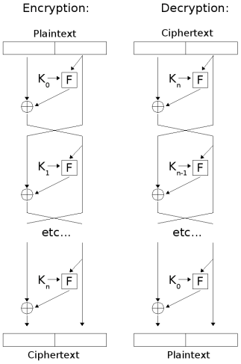
The Feistel Cipher

Slide 45
Data Encryption Standard (DES)
  A standardized encryption algorithm approved by the U.S. government in 1977.
  It uses a 56-bit key, which is sometimes stored with additional parity bits, extending its length to 64 bits.
  DES is a block cipher and encrypts and decrypts 64-bit data blocks.
  It is now considered insecure.
  In 1998, a cracker could crack the key in 3 days.

Slide 46
Advanced Encryption Standard (AES)
  AES replaced DES.
  A fast block cipher, with variable key length and block sizes (each can be independently set to 128, 192 or 256 bits).
  An official U.S. government standard since 2002.
  Now widely used for commercial and private encryption purposes.
  The algorithm is public, and its use is unrestricted, with no royalties or license fees owed to the inventors or the government.

Slide 47
AES
  Design uses theory of finite fields, a branch of algebra.
  Every block of 128 bits is presented as 4 by 4 array of bytes.
  Every round except start and end has 4 steps:
    Substitution
    Shift Rows
    Mix Columns
    Add Round Key

Slide 48
AES – The Algorithm - 1
  KeyExpansion - round keys are derived from the cipher key
  Initial Round
    AddRoundKey - each byte of the state is combined with the round key using bitwise XOR.

Slide 49
AES – The Algorithm - 2
  Rounds
    SubBytes - a non-linear substitution step where each byte is replaced with another according to a lookup table.
    ShiftRows - a transposition step where each row of the state is shifted cyclically a certain number of steps.
    MixColumns - a mixing operation which operates on the columns of the state, combining the four bytes in each column.
    AddRoundKey

Slide 50
AES – The Algorithm - 3
  Final Round (no MixColumns)
    SubBytes
    ShiftRows
    AddRoundKey

Slide 51
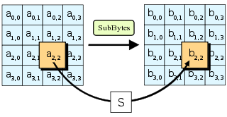
AES – SubBytes
  Each byte is replaced with another based on a lookup table

Slide 52
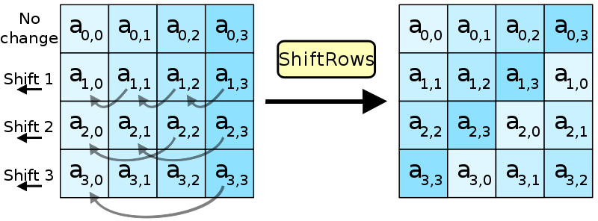
AES – ShiftRows
  A transposition step where each row of the state is shifted cyclically a certain number of steps

Slide 53
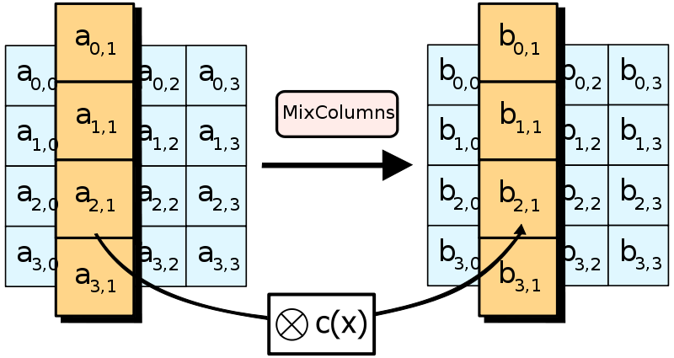
AES – MixColumns
  A mixing operation which operates on the columns of the state, combining the four bytes in each column

Slide 54
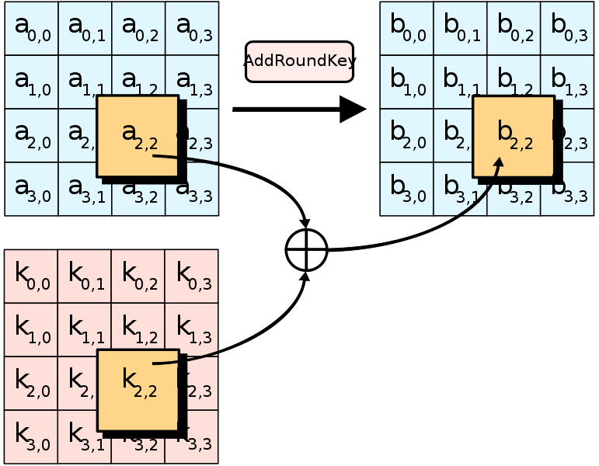
AES – AddRoundKey
  Each byte of the state is combined with the round key using bitwise XOR

Slide 55
Network Security and Cryptography
Topic 1 – Lecture 3:
Asymmetric Algorithms
Notes:
NCC Education - Title Master

Slide 56
Public Key Cryptography - 1
  Uses asymmetric key algorithms
  The key used to encrypt a message is not the same as the key used to decrypt it.
  Each user has a pair of cryptographic keys:
    a public encryption key, publicly available and widely distributed.
    a private decryption key, known only to the recipient.

Slide 57
Public Key Cryptography - 2
  Messages are encrypted with the recipient's public key and can only be decrypted with the corresponding private key.
  The keys are related mathematically.
  Parameters are chosen so that determining the private key from the public key is prohibitively expensive.

Slide 58
Public Key Cryptography – The Steps
  Each user generates a pair of keys to be used for encryption/decryption.
  Each user places one of the keys (the public key) in a public register – each user maintains a collection of public keys obtained from others.
  If Bob sends a message to Alice, he encrypts it using Alice’s public key.
  Alice decrypts it using her private key that no-one else has access to.

Slide 59
Public Key Cryptography - Analogy
  An analogy to public-key encryption is that of a locked mailbox for an office.
    The mail slot is exposed and accessible to the public.
    Its location (the street address) is like the public key.
    Anyone knowing the street address can go to the door and drop a written message through the slot.
    Only the person who possesses the key can open the mailbox and read the message.

Slide 60
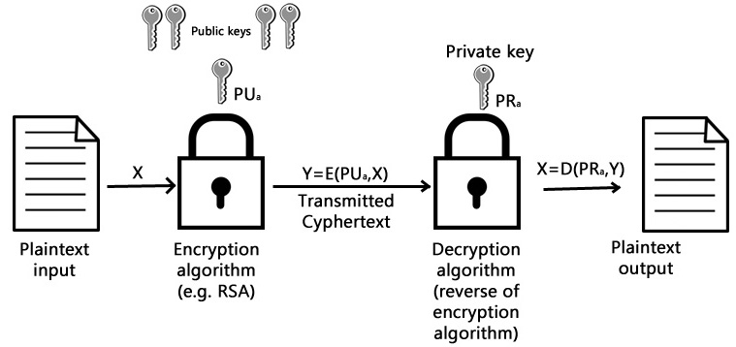
Public Key Cryptography

Slide 61
Public Key Cryptography - Applications
  Encryption/decryption: the sender encrypts a message with the recipient’s public key.
  Digital signature (authentication): the sender “signs” the message with its private key; a receiver can verify the identity of the sender using sender’s public key.
  Key exchange: both sender and receiver cooperate to exchange a (session) key.

Slide 62
The RSA Algorithm
  Stands for Rivest, Shamir and Adleman who first publicly described it.
  The RSA algorithm involves three steps:
    key generation
    encryption
    decryption

Slide 63
RSA – Key Generation - 1
  Choose two distinct prime numbers p and q.
    p and q should be chosen at random, and should be of similar bit-length
  Compute n = pq.
    n is used as the modulus for both the public and private keys
  Compute φ(n) = (p – 1)(q – 1)
  Choose an integer e such that 1 < e < φ(n) and gcd(e,φ(n)) = 1, i.e. e and φ(n) are coprime.
    e is released as the public key exponent

Slide 64
RSA – Key Generation - 2
  Determine d = e–1 mod φ(n); i.e. d is the multiplicative inverse of e mod φ(n).
    This is more clearly stated as solve for d given (d*e)mod φ(n) = 1, d is kept as the private key exponent.
  The public key consists of the modulus n and the public (or encryption) exponent e. The private key consists of the private (or decryption) exponent d which must be kept secret.

Slide 65
RSA Encryption
  Alice transmits her public key (n,e) to Bob and keeps the private key secret. Bob then wishes to send message M to Alice.
  He first turns M into an integer m, such that 0 < m < n by using an agreed-upon reversible protocol known as a padding scheme.
  He then computes the ciphertext c corresponding to c = me (mod n). Bob then transmits c to Alice.
  Note that at least nine values of m will yield a ciphertext c equal to m, but this is very unlikely to occur in practice.

Slide 66
RSA Decryption
  Alice can recover m from c by using her private key exponent d via computing m = cd (mod n).
  Given m, she can recover the original message M by reversing the padding scheme.
  A simplified example of the whole process is given in the laboratory exercises.

Slide 67
RSA Security
  Relies upon the complexity of the factoring problem.
  Nobody knows how to factor big numbers in a reasonable time.
  However, nobody has shown that the fast factoring is impossible!

Slide 68
Hash Functions
  A hash function is a mathematical function that converts a large, possibly variably-sized amount of data into a small datum.
  Hashing is a method of binding the file contents together to ensure integrity.
    Like using sealing wax on an envelope.
    Only by breaking the seal can the contents be accessed, and any tampering is readily apparent.

Slide 69
Hash Function Requirements
  To be suitable for message authentication, a hash function H should have the following properties:
    H can be applied to a block of data of any size
    H produces a fixed-length output
    H(x) is easy to compute for any given x
    For any value h it is very difficult (infeasible) to compute x such that H(x)=h
    For any given x, it is very difficult (infeasible) to find y (not equal to x) such that H(x) = H(y)
    It is very difficult (infeasible) to find any pair (x,y) such that H(x) = H(y)

Slide 70
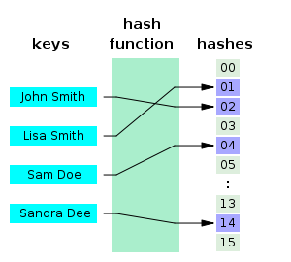
One-Way Hash Functions
A method for message authentication is to use one-way hash functions.
“One-way” in the name refers to the property of such functions:
  they are easy to compute
  but their reverse functions are very difficult to compute

Slide 71
The SHA-1 Secure Hash Algorithm
  Takes as input a message with a maximum length less than 2 to power 64 bits and produces as output a 160-bit message digest.
  The input is processed in 512-bit blocks.
  Each bit of the output is computed using all bits of the input.

Slide 72
SHA-1 Examples
  SHA1("The quick brown fox jumps over the lazy dog") = 2fd4e1c6 7a2d28fc ed849ee1 bb76e739 1b93eb12
  A small change in the message will, with overwhelming probability, result in a completely different hash.
  SHA1("The quick brown fox jumps over the lazy cog") = de9f2c7f d25e1b3a fad3e85a 0bd17d9b 100db4b3

Slide 73
References
  NIST (Feb. 2004). Standards for Security Categorization of Federal Information and Information Systems. FIPS 199. [Available Online] http://csrc.nist.gov/publications/fips/fips199/FIPS-PUB-199-final.pdf
  Stallings, W. (2010). Cryptography and Network Security: Principles and Practice. Pearson Education.

Slide 74
Topic 1 – Cryptography Fundamentals
Any Questions?
Notes:
NCC Education - End Slide Master

