Slide 1
Network Security and Cryptography
Topic 10:
Virtual Private Networks
Notes:
NCC Education - Title Master

Slide 2
Network Security and Cryptography
Topic 10 – Lecture 1:
Introduction to VPN
Notes:
NCC Education - Title Master

Slide 3
Scope and Coverage
This topic will cover:
  Virtual Private Network technologies
  Issues with Virtual Private Networks
Notes:
NCC Education - Slide Master

Slide 4
Learning Outcomes
By the end of this topic students will be able to:
  Configure access control mechanisms
  Explain Virtual Private Networks

Slide 5
What is VPN?
  A private network that uses public telecommunication, such as the Internet, instead of leased lines to communicate
  Remote network communication via the Internet
  Used by companies/organisations who want to communicate confidentially
  Two parts:
    Protected or “inside” network
    “Outside” network or segment (less trustworthy)

Slide 6
The User’s Perspective
  From the user’s perspective, it appears as a network consisting of dedicated network links
  These links appear as if they are reserved for the VPN clients only
    Hence it appears to be a private connection
  Because of encryption, the data appears to be private

Slide 7
How VPN Works
  Two connections - one is made to the Internet and the second is made to the VPN
  Datagrams - contain data, destination and source information
  Firewalls - VPNs allow authorised users and data to pass through the firewalls
  Protocols - protocols create the VPN tunnels that allow a private connection over a public network

Slide 8
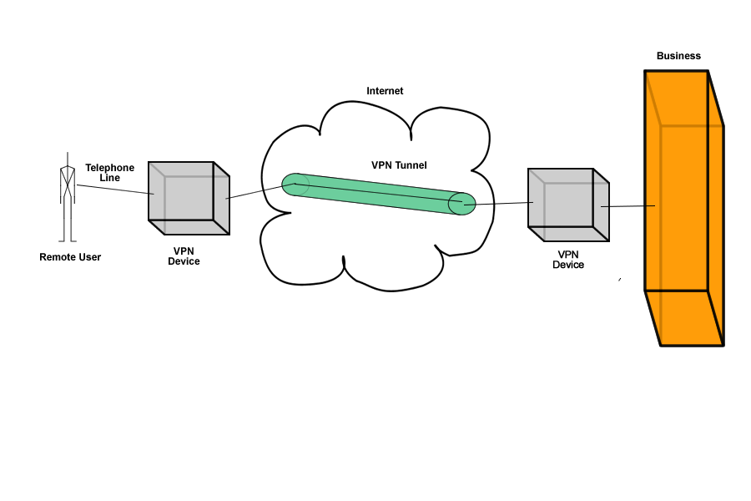
How VPN Works

Slide 9
Key Functions
  Authentication - validates that the data was sent from the sender
  Access Control - preventing unauthorised users from accessing the network
  Confidentiality - preventing the data from being read or copied as the data is being transported
  Data Integrity - ensuring that the data has not been altered

Slide 10
Encryption & Tunnelling
  Encryption – public key encryption techniques are used
  Authentication – digital signatures
  A virtual connection is made through the Internet
  Datagrams are sent along the virtual connection
  The outer part of the datagram contains a header and may or may not be encrypted
  The inner part is encrypted

Slide 11
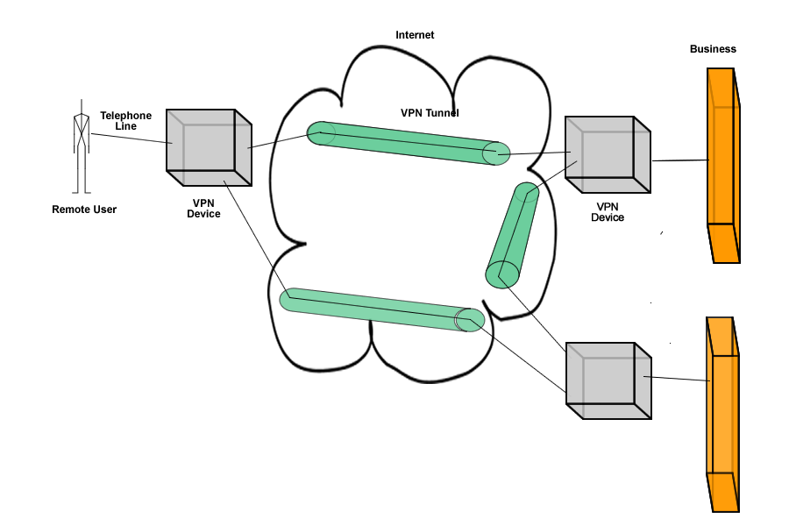
A Network
  Multiple VPN connections can be made to create a genuine network

Slide 12
Protocols
  There are three main protocols used:
    IP Security (IPsec)
    Point-to-Point Tunneling Protocol (PPTP)
    Layer 2 Tunneling Protocol (L2TP)

Slide 13
IPsec
  An open standard protocol suite
  Provides privacy and authentication services
  Has two modes of operation
  Transport Mode encrypts data but not the header
  Tunnel Mode encrypts both data and header
  Each connection is a security association (SA)
    Has one security identifier for each direction
    Each security identifier is carried in packets and used to look up keys, etc.

Slide 14
IPsec Transport Mode
  IPsec header is inserted just after the IP header
  Protocol field of IP header is modified to indicate that the IPsec header follows
  IPsec header contains security information:
    SA identifier
    Sequence number
    Possibly an integrity check on the payload

Slide 15
IPsec Tunnel Mode
  Whole IP packet including header is encapsulated in a new IP packet with a IPsec header
  Useful when the tunnel end is not the final destination
    E.g. tunnel ends at company firewall
    Firewall deals with encapsulating IP packets into IPsec packets and decapsulating
    Machines on internal network do not have to be aware of IPsec as they receive and send IP packets

Slide 16
PPTP
  A data link protocol
  Used to establish a direct connection between two networking nodes
  Creates the virtual connection across the Internet
  Can provide:
    Connection authentication
    Transmission encryption
    Compression

Slide 17
L2TP
  A tunnelling protocol
  Does not provide encryption or confidentiality but relies on an encryption protocol that it passes within the tunnel
  The entire L2TP packet, including payload and header, is sent within a UDP datagram

Slide 18
Protocols Working Together
  It is common to carry PPTP sessions within an L2TP tunnel
  L2TP does not provide confidentiality or strong authentication by itself
  IPsec is often used to secure L2TP packets by providing confidentiality, authentication and integrity
  The combination of these two protocols is generally known as L2TP/IPsec

Slide 19
Advantages
  Cost effective
  Greater scalability
  Easy to add/remove users
  Mobility
  Security

Slide 20
Disadvantages
  Understanding of security issues
  Unpredictable Internet traffic
  Difficult to accommodate products from different vendors

Slide 21
Network Security and Cryptography
Topic 10 – Lecture 2:
VPN Connections
Notes:
NCC Education - Title Master

Slide 22
VPN Connections
  A VPN is a secure, private communication tunnel between two or more devices across a public network (e.g. the Internet)
  VPN devices can be:
    a computer running VPN software
    a special device like a VPN enabled router
  Remote computer can connect to an office network
  Two computers in different locations can connect over the Internet

Slide 23
VPN Categories
  There are several types of VPN
  There are different ways of classifying VPNs
  We use two broad categories based upon architecture:
    Client-initiated VPNs
    Network access server (NAS)-initiated VPNs

Slide 24
Client-Initiated VPNs
  Users establish a tunnel across the ISP shared network to the customer network
  Customer manages the client software that initiates the tunnel
  Advantage is that they secure the connection between the client and ISP
  Disadvantage is that they are not as scalable and are more complex than NAS-initiated VPNs

Slide 25
NAS-Initiated VPNs
  Users connect to the ISP NAS which establishes a tunnel to the private network
  More robust than client-initiated VPNs
  Do not require the client to maintain the tunnel-creating software
  Do not encrypt the connection between the client and the ISP
    not a concern for most customers because the Public Switched Telephone Network (PSTN) is much more secure than the Internet

Slide 26
VPNs and the Workplace
  VPNs can run from a remote client PC or remote office router across the Internet or an IP service provider network to one or more corporate gateway routers (remote access)
  VPNs between a company’s offices are a company intranet
  VPNs to external business partners are extranets

Slide 27
Extranet
  An extranet is where the Internet or one or two Service Providers are used to connect to business partners
  Extends network connectivity to:
    Customers
    Business partners
    Suppliers
  Security policy is very important as potentially the VPN could be used for large orders or contracts

Slide 28
Intranet
  Intranet VPNs extend a basic remote access VPN to other corporate offices
  Connectivity is across the Internet or across the Service Provider IP backbone
  Service levels are likely to be maintained and enforced within a single Service Provider
  For VPNs across the Internet (multiple Service Providers) there are no performance guarantees
    no one is in charge of the Internet!

Slide 29
Remote Access VPN
  Encrypted connections between mobile or remote users and their corporate networks
  Remote user can make a local call to an ISP, as opposed to a long distance call to the corporate remote access server
  Ideal for a telecommuter or mobile sales people
  VPN allows mobile workers & telecommuters to take advantage of broadband connectivity

Slide 30
Remote Access VPN
  Utilises access technologies to allow remote users to become part of a corporate VPN
  Usually involves the use of the Point-to-Point Protocol (PPP) and tunnels that extend the PPP connection from the access server to the corporate network
  In Microsoft’s Point-to-Point Tunneling Protocol (PPTP) it also extends the tunnel from the access server out to the end-user PC

Slide 31
Virtual Private Dial-Up Networking
  Virtual private dial-up networking (VPDN) enables users to configure secure networks that rely upon ISPs to tunnel remote access traffic
  Remote users can connect using local dial-up
  Dial-up service provider forwards the traffic
  Network configuration and security remains in the control of the client
  The dial-up service provider provides a virtual pipe between the sites

Slide 32
VPN in Industry
  Healthcare: transferring confidential patient information within a health care provider
  Manufacturing: suppliers can view inventories & allow clients to purchase online safely
  Retail: securely transfer sales data or customer info between stores & headquarters
  Banking: enables account information to be transferred safely within departments & branches

Slide 33
VPN in Small Businesses
  Operating systems often have built-in VPN protocols
  These often rely on usernames and passwords
    Not very secure or private
  Standard VPNs require the deployment of software and clients
    Costs money and time
  SSL VPNs are easy to install and use ports already available for secure traffic over the Internet

Slide 34
SSL VPNs
  Connect securely via a standard Web browser
  No special software required on client computers
  Traffic between Web browser and the SSL VPN device is encrypted with the SSL protocol
  Support access control by:
    User
    Device
    Location

Slide 35
SSL & Data Protection
  SSL encrypts data
  Each SSL certificate uses public key encryption techniques
  The SSL handshake either authenticates the server and client or blocks unauthorized users
  Keeps data confidential and protected

Slide 36
SSL Portal VPN
  Allows a single SSL connection to a website
  User securely accesses multiple network services from the website
  Can use any modern browser
  User is authenticated via method supported by the portal
  User then has access to a web page that acts as the portal to other services

Slide 37
SSL Tunnel VPN
  Allows a web browser to securely access multiple network services through a tunnel running under SSL
    Includes applications and protocols that are not web-based
  Requires a web browser that can run active content
  Can provide functionality not accessible via SSL portal VPNs

Slide 38
SSL Costs
  Initial costs are higher
    Requires purchase of SSL Certificate
  Can save money in the long run
    Reduced management/administration costs
    Plus the savings from having secure communications

Slide 39
References
  Sybex, (2001). Hacking Exposed: Networking Complete. 2nd Edition. John Wiley & Sons.
  Tanenbaum, A.S. (2003). Computer Networks. 4th Edition. Prentice Hall.

Slide 40
Topic 10 – Virtual Private Networks
Any Questions?
Notes:
NCC Education - End Slide Master

