Slide 1
Network Security and Cryptography
Topic 12:
Wireless Security
Notes:
NCC Education - Title Master

Slide 2
Network Security and Cryptography
Topic 11 – Lecture 1:
Introduction to Wireless Security & WEP
Notes:
NCC Education - Title Master

Slide 3
Scope and Coverage
This topic will cover:
  Security issues specific to wireless networks
  Wireless security (WEP, WPA, WPA2)
  Secure network architectures for wireless deployments
Notes:
NCC Education - Slide Master

Slide 4
Learning Outcomes
By the end of this topic students will be able to:
  Explain the vulnerabilities inherent in wireless networks
  Deploy a secure network architecture for wireless access
  Configure Access Control Lists
  Encrypt and protect the wireless link

Slide 5
Wireless Networks
  A wireless network typically has a number of wireless-enabled devices connecting to an access point
  Each access point connects to a wider network
    In a home wireless network this wider network may be the Internet
    In a business network this wider network is typically a LAN
  Wireless networks are less secure than wired

Slide 6
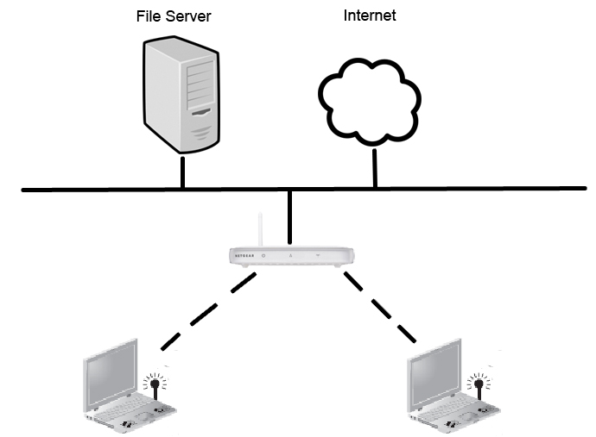
WLAN

Slide 7
Wireless Network Security
  Essentially a broadcast network between access point and devices
  Boundary of network is limited by signal strength
  Signal can usually be received outside of the building in which the network is based
  Access to network must be restricted
  Transmissions must be encrypted

Slide 8
General Security Options
  In closed networks (home or an organisation) restrictions are put in place on access to the access point
  In open, public networks there are no access restrictions so the network is isolated from all networks that need a level of security
  End to end encryption may be used for secure traffic in wireless networks that are mixed

Slide 9
WLAN Access Control
  In 1997, the IEEE approved the IEEE 802.11 WLAN standard
  Access may be controlled via access to the access point (AP)
  Only authorised devices can connect to the AP
  One way: Media Access Control (MAC) address filtering

Slide 10
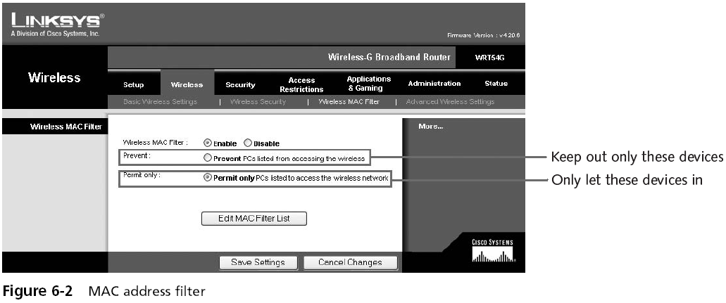
MAC Address Filtering
  Usually implemented to permit rather than prevent

Slide 11
Wired Equivalent Privacy (WEP)
  Original security component of 802.11
  Aim: only authorized parties can view transmitted wireless information
  Uses encryption to protect traffic
  Designed as an efficient and reasonably strong security
  Has numerous security flaws and has been superseded by Wi-Fi Protected Access (WPA)

Slide 12
WEP Encryption
  Uses the RC4 stream cipher for confidentiality
  Uses the CRC-32 checksum for integrity
  Secret keys can be 64 or 128 bits long
    Some vendors do supply 256-bit key version
  Can hold up to four shared secret keys
    One key is designated as the default key
  Key size is one of the security limitations in WEP

Slide 13
WEP Encryption Keys
  A 64-bit WEP key has a 40-bit key (10 hexadecimal characters) plus a 24-bit initialisation vector (IV)
  A 128-bit WEP key has a 104-bit key (26 hexadecimal characters) plus a 24-bit IV
  An IV is a continuously changing value used in combination with a secret key to encrypt data
    Prevents sequences of identical text from producing the same exact ciphertext when encrypted

Slide 14
Open System Authentication
  Client device, e.g. laptop, does not provide any authentication to the Access Point
    Any wireless-enabled device within range can authenticate with the Access Point
  The effect is that no real authentication occurs
  WEP encryption keys are used for encrypting data frames on the wireless network
  The client must have the correct keys at this point

Slide 15
Shared Key Authentication
  A five step handshake process:
  Authentication request from client to Access Point
  Access Point replies with a clear-text challenge
  Client encrypts challenge-text using the WEP key
  Client sends encrypted text back in another authentication request
  AP decrypts the response – if it matches the challenge-text, AP sends a positive reply

Slide 16
Shared Key Authentication
  After authentication the WEP key is used for encryption using RC4
  Shared Key authentication is less secure than Open System authentication
  The key used for the handshake can be derived by capturing the challenge frames
  Both authentication mechanisms are weak

Slide 17
WEP Weaknesses
  The 24-bit IV is too short and repeats after some time
    there is a 50% probability the same IV will repeat after 5000 packets
  Packets can be replayed so that the access point broadcasts Ivs
  With the right equipment, WEP can be cracked in a few minutes at most

Slide 18
Network Security and Cryptography
Topic 12 – Lecture 2:
WPA, WPA2 and Wireless Architecture
Notes:
NCC Education - Title Master

Slide 19
Wi-Fi Protected Access (WPA)
  Aim: to protect present and future wireless devices
    Authentication
    Encryption
  Developed in response to the weaknesses in WEP
  WPA implements most of the IEEE 802.11i standard
  WPA2 is fully compliant with the IEEE 802.11i standard
    This has been incorporated into IEEE 802.11-2007

Slide 20
IEEE 802.11i
  Implemented as WPA2
  Uses Counter Mode with Cipher Block Chaining Message Authentication Code Protocol, also known as CCM mode Protocol (CCMP)
    AES based block cipher
    Replacing the RC4 stream cipher of WEP
  Has been mandatory for Wi-Fi certified devices since 2006

Slide 21
CCMP
  More secure than the protocols in WEP & WPA
  Uses a 128-bit key
  Uses a 128-bit block size
  Provides:
    Data Confidentiality - only authorized parties have access
    Authentication – proves user identity
    Access control - in conjunction with layer management

Slide 22
Pre-shared Key (PSK) Mode
  Also known as Personal mode
  Used for home and small office networks
    No advanced server capabilities
  Does not require an authentication server
  Wireless network client devices authenticate directly with the access point
  They all use the same 256-bit key
  Keys are automatically changed and authenticated after a set period of time

Slide 23
PSK Mode Weaknesses
  Keys sent via e-mail or other insecure methods
  Changing the PSK key is awkward:
    Must type new key on every wireless device
    Must type new key on all access points
  In order to allow a guest user to have access to a network the key must be given to that guest
  PSK is a 64-bit hexadecimal number generated from a passphrase
    Passphrase could be open to dictionary attack

Slide 24
Enterprise Mode
  Designed for enterprise networks
  Provides authentication using IEEE 802.1X and Extensible Authentication Protocol (EAP)
  Requires a Remote Authentication Dial In User Service (RADIUS) authentication server or similar
  More complex but provides additional security
    For example against dictionary attacks

Slide 25
IEEE 802.1X
  IEEE Standard for Port-based Network Access Control (PNAC)
  Requires three parties:
    a supplicant – the client device wishing to connect
    an authenticator – the access point
    an authentication server – a host running software that supports RADIUS and EAP
  Client device only has access through the authenticator when validated and authorized

Slide 26
EAP
  The authentication framework utilised by wireless networks
  Supplies functions and negotiation of authentication methods
    Called EAP methods
  Provides a secure authentication mechanism
  Negotiates a secure private key between authenticator and client

Slide 27
IEEE 802.1X Authentication
  Initialisation - when new supplicant detected, the port on the authenticator is enabled and set to the unauthorised state
  Initiation
    Authenticator transmits EAP-Request Identity frames
    Supplicant listens and responds with an EAP-Response Identity frame containing an identifier, e.g. user ID
    Authenticator then encapsulates this in a RADIUS Access-Request packet and sends to authentication server

Slide 28
IEEE 802.1X Authentication
  Negotiation
    Authentication server replies to the authenticator with EAP Request specifying the EAP Method
    Authenticator encapsulates the EAP Request and transmits to supplicant
  Authentication
    If EAP Method is agreed, EAP Requests and Responses are sent between supplicant and authentication server until the server responds with EAP-Success message
    Authenticator sets port to the authorised state and traffic is allowed

Slide 29
RADIUS
  Protocol providing a centralised Authentication, Authorization, and Accounting (AAA) service
  Management for the authorisation of computers wishing to connect to a network
  Client/server protocol
  Runs in the application layer of the OSI model
  Uses UDP for transport
    assigned UDP ports 1812 for RADIUS Authentication and 1813 for RADIUS Accounting

Slide 30
RADIUS Functions
  A RADIUS Server has three main functions:
    Authenticating users and/or devices and providing permission for them to access the network
    Authorising users and/or devices for specific services on the network
    Accounting for usage of network services

Slide 31
WPA2 Sessions Key
  WPA2 creates a new session key with every association
  The encryption key for each client is unique and specific to that client
  Every packet is encrypted with a unique key
  Never reusing keys is good security practice

Slide 32
Wireless Network Architecture
  When planning a wireless network you need to determine which WLAN architecture to adopt
  Architecture comes in two main categories:
    Standalone access points
    Centrally coordinated access points
  Both have benefits
  Suited to different environments.

Slide 33
Standalone Access Points
  Functionality of each access point enables wireless services, authentication and security
    All access points operate independently
    Encryption/decryption at the access point
    Each access point has its own configuration file
    Large networks rely on a management application
    Network configuration is static and does not respond to changing network conditions

Slide 34
Standalone Access Points
  Well suited in environments where:
    There is a small isolated wireless coverage area requiring only a few access points
    There is a need for wireless bridging from a main building to another building
  The operational overhead to manage and maintain a wireless network increases with the size of the network

Slide 35
Co-ordinated Access Points
  Has “thin” access points
  Centralized controller handles:
    Roaming
    Authentication
    Encryption/decryption
    Load balancing
    RF monitoring
    Performance monitoring
    Location services

Slide 36
Co-ordinated Access Points
  Configuration is done at the controller
  Adding additional APs is simple, just plug in to network
  Redundancy can be provided through extra redundant controllers
    Become active if problems with a neighbouring AP

Slide 37
Co-ordinated Access Points
  Ideal where:
    There are large wireless coverage areas
      requiring multiple radio ports
      perhaps alongside smaller isolated coverage areas
    Network self-healing is required
    Redundancy is required

Slide 38
Benefits of Co-ordinated APs
  Lower operational costs.
  Ease of deployment and management
  Greater availability
  Easier to respond to changes in the network performance
  Better return on investment
  Fast client roaming
  Better Quality-of-Service

Slide 39
References
  Tanenbaum, A.S. (2003). Computer Networks. 4th Edition. Prentice Hall.
  Stallings, W. (2010). Cryptography and Network Security: Principles and Practice. 5th Edition. Pearson Education.

Slide 40
Topic 12 – Wireless Security
Any Questions?
Notes:
NCC Education - End Slide Master

