Slide 1
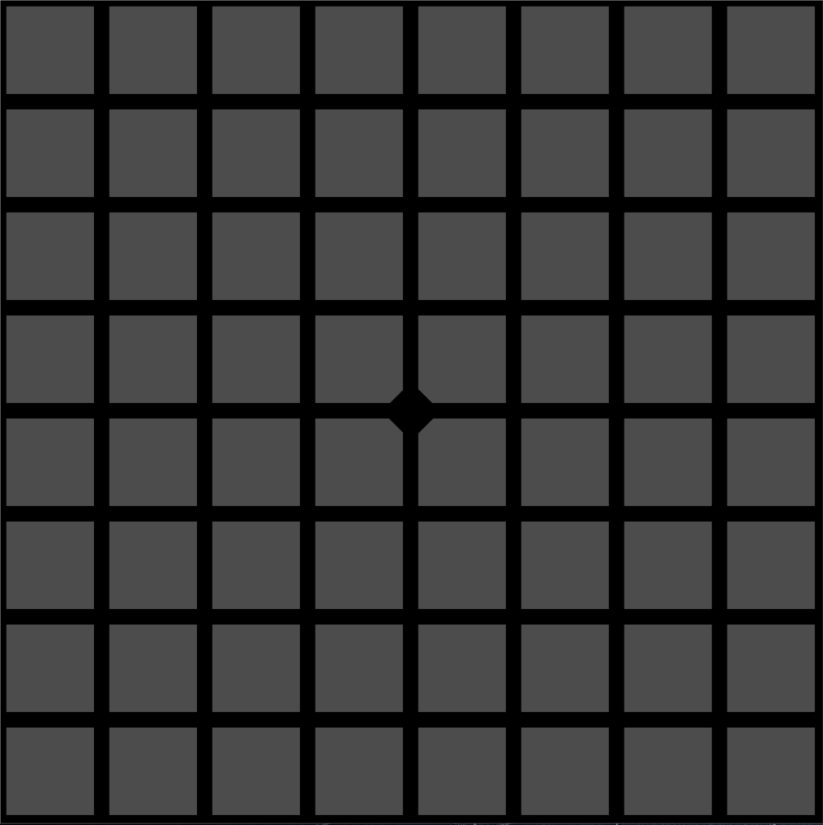
Hi-hat
Drum
Set
Snare
Cymbal
Kick
초기화/종료

Slide 2
Melody
Melody
No. 1
Beat1
Beat2
Beat3
초기화/종료

Slide 3
Melody
Melody
No. 2
Beat1
Beat2
Beat3
초기화/종료

Slide 4
Melody
Melody
No. 3
Beat1
Beat2
Beat3
초기화/종료

