Slide 1
DESIGN
A CAMPUS NETWORK FORA MANSOURA UNIVERSITY USING CISCO PACKET TRACER

Slide 2
About us
Sobhi Rafiq Sami
Abdulrahman Rajab Ahmed
Kamal Ahmed Abdel Majed Ali
Ahmed Tarek Elsayed
Mohamed Ashraf Mohamed

Slide 3
AGENDA
PROJECT OVERVIEW
GOALS
BUSINESS MODEL
PRJECT PHASES &RESULTS

Slide 4

PROJECT
OVERVIEW
0.1 OBJECTIVE
0.2 DESCRIPTTION
0.3 TOOLS USSED

Slide 5
0.1 OBJECTIVE
To design and implement a secure, efficient, and scalable network infrastructure for Mansoura University, ensuring reliable communication, data management, and future scalability.

Slide 6
0.2 DESCRIPTION
This project involves designing and implementing a network for Mansoura University, spanning two campuses. It includes VLANs, DHCP, RIPv2, and static routing to ensure secure and efficient connectivity across various departments and buildings

Slide 7
0.3 TOOLS
Cisco Packet Tracer: A network simulation tool for designing networks.
Network devices:
Routers
switches
access points

Slide 8
GOALS
01. BEFORE THE PROJECT
02. AFTER THE PROJECT
03. SECURITY & EFFICIENCY IMPROVEMENTS
04. IMPROVED NETWORK MANAGEMENT
05. GETTER COMMUNICATION & EFFICIENCY

Slide 9
01. BEFORE THE PROJECT
The university’s network was inefficient, leading to delays in communication and data management. The existing setup lacked VLANs and security protocols, making it vulnerable to breaches and inefficiencies. Challenges included security risks, lack of scalability, and reliance on third-party IT services.

Slide 10
02.GOALS – AFTER THE PROJECT
The new network design for Mansoura University incorporates advanced technologies, including VLAN segmentation, RIPv2 routing, DHCP, and cloud-hosted email servers, to secure communication and optimize network performance. This design replaces the manual system with a scalable, digital infrastructure that supports efficient data flow, redundancy, and secure access to university resources.The features of the new system include: VLAN Segmentation: Separates network traffic between departments, enhancing security and minimizing congestion.RIPv2 Routing Protocol: Ensures reliable data routing between the main and branch campuses.DHCP Server: Provides dynamic IP addresses to devices in Building A, simplifying network management.Cloud-Hosted Email Server: Ensures secure and reliable email communication for staff and students.Hierarchical Network Design: Utilizes core, distribution, and access layers to improve scalability and performance.Security Measures: Configured VLANs and security settings on switches to protect the network from unauthorized access and attacks.

Slide 11
03.GOALS –ENHANCED SECURITY
This project aims to enhance network security across Mansoura University's main and branch campuses. Security is strengthened by configuring VLANs and implementing security protocols within each department to ensure data isolation and controlled access within and between networks. Switches are configured with appropriate VLAN IDs and security settings, safeguarding sensitive data from unauthorized access.
The security strategy supports network separation by department, allowing secure communication only among authorized devices and departments, which is crucial for protecting sensitive university data.

Slide 12
04. GOALS – IMPROVED NETWORK MANAGEMENT
1. Hierarchical Network Design: Core, distribution, and access layers for organized management.
2. Dynamic IP Management with DHCP: Automated IP assignments across departments.
3. Inter-VLAN Routing: Enables secure, segmented communication among departments.

Slide 13
05.GOALS-GETTER COMMUNICATION & EFFICIENCY
1. Interdepartmental Connectivity: VLANs enable secure and efficient data flow across departments.
2. Layered Network Structure: Optimizes communication pathways, reducing latency and enhancing speed.
3. Enhanced Device Interoperability: Standardized configurations ensure seamless communication among devices.

Slide 14
BUSINESS MODEL
01. MAIN PROBLEMS
02. KEY ACTIVITIES
03. VALUEPROPOSITION

Slide 15
03.BUSINESS MODEL MAIN PROBLEMS
Reliance on a paper-based system, which slowed down operations.
Lack of secure communication across departments and locations.
Inefficient IT management using third-party services.
Data vulnerabilities due to the lack of security protocols.

Slide 16
03.BUSINESS MODEL KEY ACTIVITIES
Designing a secure network infrastructure tailored to healthcare needs.
Testing the network for reliability, security, and performance.
Configuring VLANs, , DHCP, and port-security protocols.
Maintaining and monitoring the network for future scalability and enhancements.

Slide 17
03.BUSINESS MODEL REVENUE & COSTS
1. Revenue Generation: Service contracts, scalable network packages, training fees
2. Cost Structure: Hardware setup, software licensing, labor costs
3. Cost Management: Modular equipment, automated monitoring, cloud hosting

Slide 18
03.BUSINESS MODEL KEY PARTNERS
1. Technology Vendors: Suppliers of network hardware and software (e.g., Cisco, HP).
2. Educational Institutions: Universities or schools benefiting from the network setup.
3. Consulting and Support Partners: IT service providers for maintenance, upgrades, and training.

Slide 19
03.BUSINESS MODEL RESOURCES
1. Network Infrastructure: Routers, switches, servers, cabling
2. Technical Expertise: Skilled network engineers and support staff
3. Software and Tools: Network design software, monitoring tools, licenses

Slide 20
03.BUSINESS MODEL VALUE PROPOSITION
1. Enhanced Connectivity: Reliable and fast network access across campuses
2. Scalable Solutions: Easily adaptable network design for future growth
3. Improved Security: Segmented networks with advanced security configurations

Slide 21
03.BUSINESS MODEL TARGET CUSTOMERS
1. Educational Institutions: Universities, colleges, and schools needing network infrastructure
2. IT Departments: Internal teams responsible for network management and security
3. Remote and Distributed Campuses: Multi-location institutions requiring integrated network solutions

Slide 22
OUR STRATEGY
GOAL
Build a robust and secure university network infrastructure to enhance students and staff operations
Marketing
Partnership
Promote the university technological advancements,staff and students care quality through targeted marketing strategies.
Collaborate with technology providers and educational organizations to optimize network solutions and services.

Slide 23
PROJECT PHASES & RESULTS
01. NETWORK PLANNING AND DESIGN
02. DEVICE AND IP CONFIGURATION
03. DHCP SERVER CONFIGURATION
04. ROUTING PROTOCOL CONFIGURATION
05. VERIFICATION AND TESTING

Slide 24
NETWORK PLANNING AND DESIGN
Topology Layout : The network topology is planned to accommodate both main and branch campuses, with detailed arrangements for buildings, departments, and devices.
Hierarchical Model: The design follows a hierarchical approach, dividing the network into core, distribution, and access layers.

Slide 25
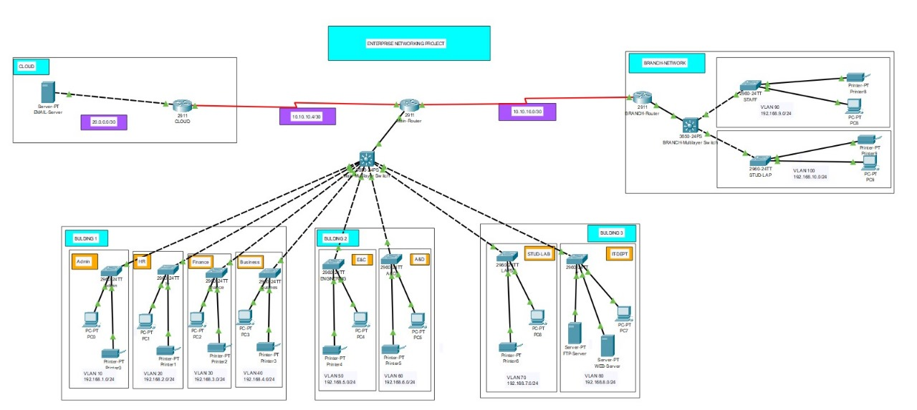
DESIGN PICTURE

Slide 26
DEVICE AND IP CONFIGURATION
Router Setup: Routers are set up with appropriate IP addressing, ensuring connectivity across various segments.
Layer 3 and Layer 2 Switch Configuration: VLANs are configured on switches, and each department is assigned a unique VLAN for better network segmentation
Interface Configuration: Interfaces are configured on routers, including setting up subinterfaces for each VLAN and defining IP addresses for each network segment.

Slide 27
DHCP SERVER CONFIGURATION
DHCP Pools Creation: Each department’s subnet receives a separate DHCP pool, allowing devices to acquire IP addresses dynamically.
Gateway Assignment: Default gateways are configured on the DHCP pools, allowing devices within each VLAN to communicate with each other.

Slide 28
ROUTING PROTOCOL CONFIGURATION
RIP Version 2 Setup: RIP v2 is enabled on routers to manage internal routing across subnets, allowing for communication between VLANs on both main and branch networks.
Static Routes: Static routing is configured for access to external servers, ensuring network traffic reaches both internal and cloud-based resources.

Slide 29
VERIFICATION AND TESTING
Connectivity Testing: The video emphasizes testing by pinging devices across VLANs to confirm proper connectivity.
End-to-End Testing: The end-to-end connectivity between main and branch networks is validated to ensure that all departments can communicate effectively.

Slide 30
CONCLUSION
The project successfully designed and implemented a secure, scalable, and efficient network infrastructure for the university services.
The University now has a system that ensures fast communication, high data security, and the ability to scale as needed

Slide 31
THANKS
QUESTIONS ARE WELCOMED

