Slide 1
All you need to know about the fmt package

Slide 2
F-M-T/fumpt/format
formatted I/O with functions analogous to C's printf and scanf. The format 'verbs' are derived from C's but are simpler.

Slide 3
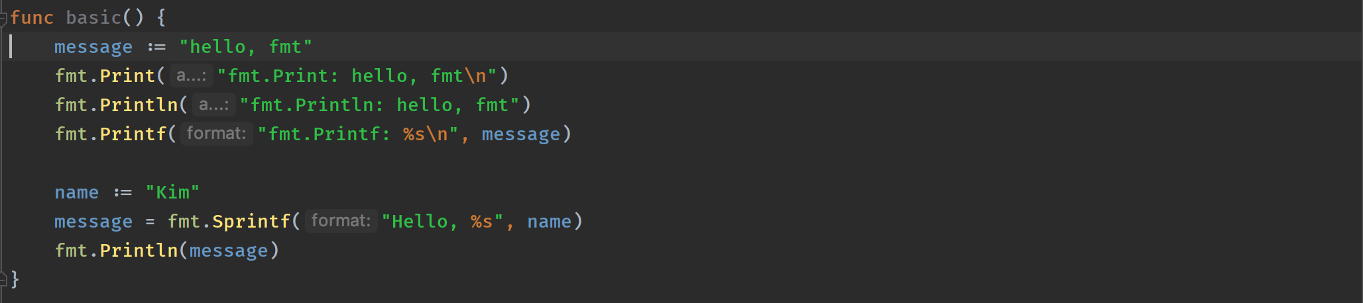
The basics

Slide 4
Follows common patterns
Print
Printf
Println
Sprint
Sprintf
Sprintln
Scan
Scanf
Scanln

Slide 5
Fprint, Fscan – uses io.Writer and io.Reader
Sprint, Sscan – uses strings

Slide 6
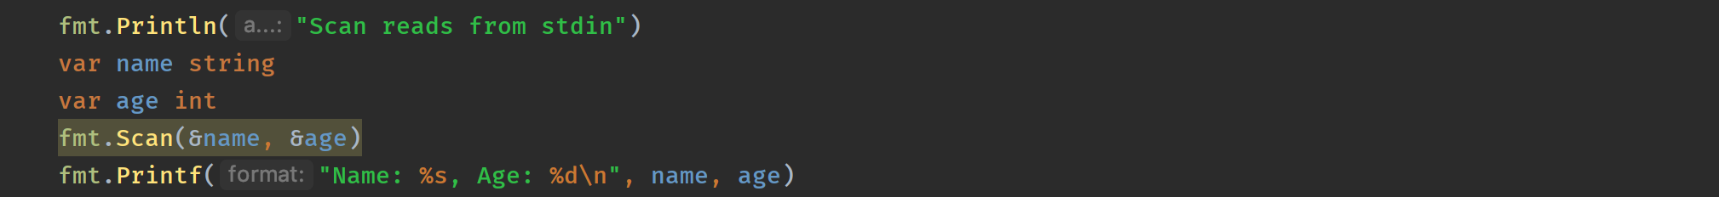
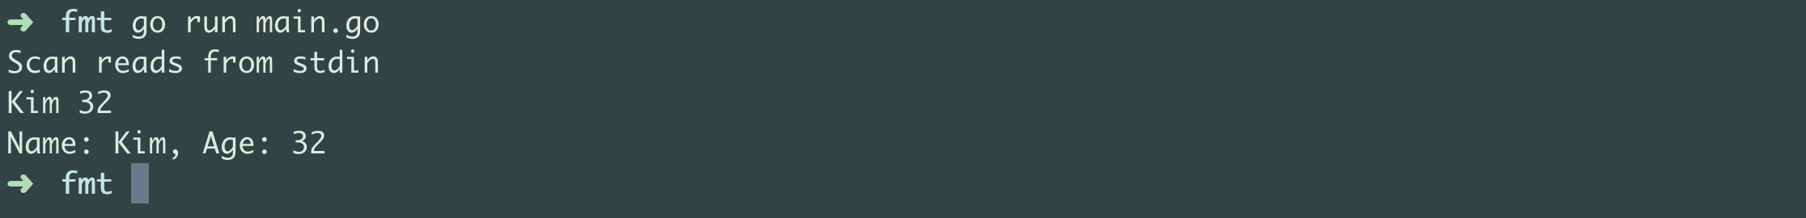
Scan – Reads from stdin

Slide 7
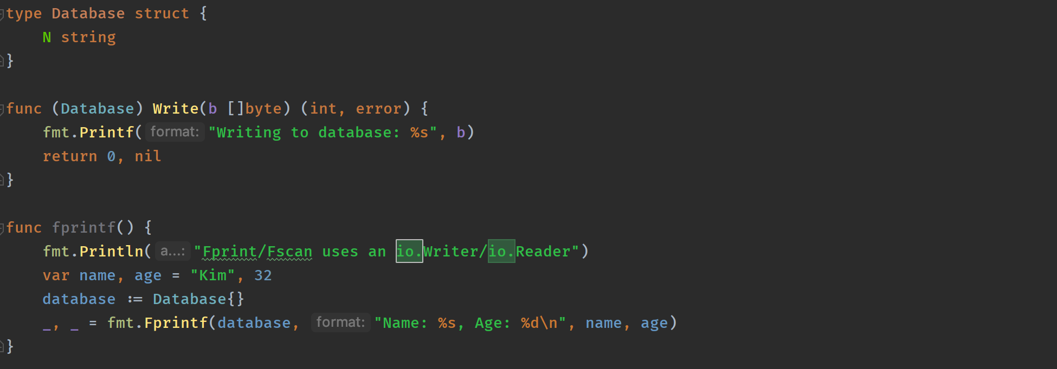
Fprintf

Slide 8
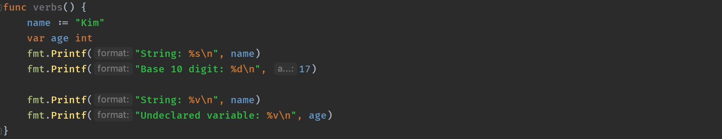
Verbs

Slide 9
Structs

Slide 10
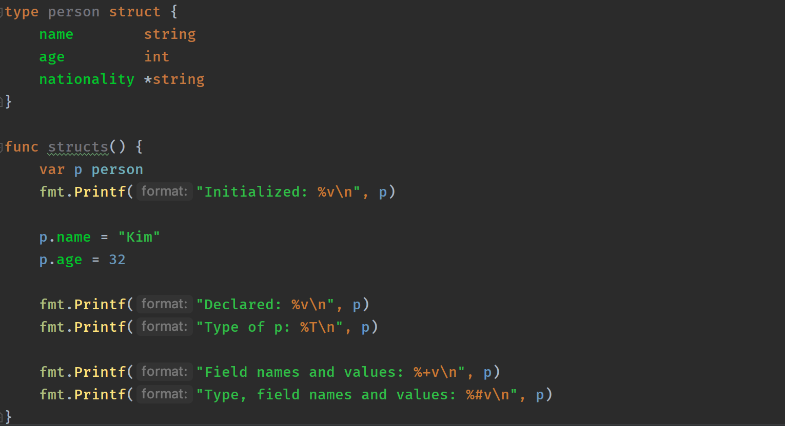
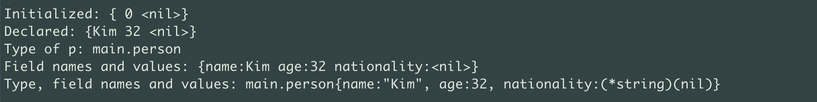

Slide 11
Numbers

Slide 12
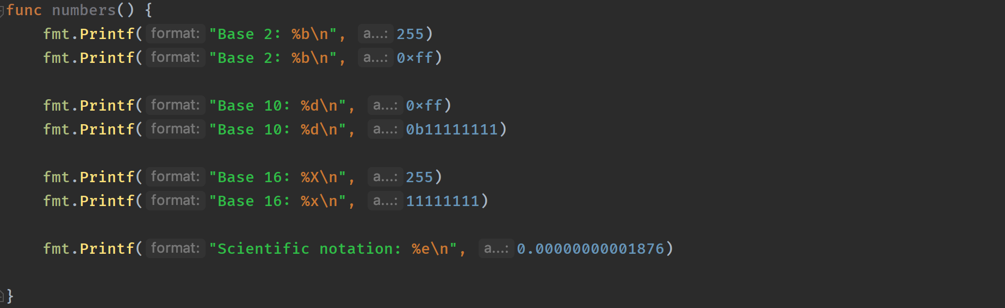
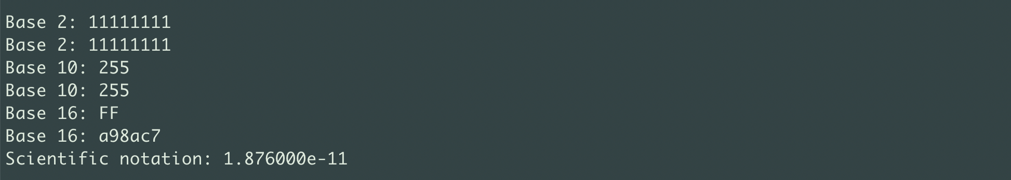

Slide 13
Unicode

Slide 14
Casting a pointer to a string. AKA »I hate future myself»

Slide 15
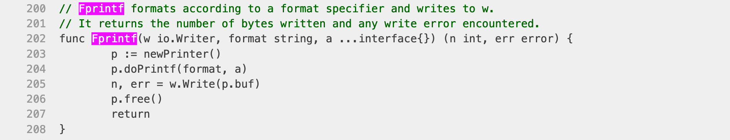
«The Go thing»

