Slide 1
FIFO CONTROL UNIT 동작정의
0: IDLE
push = 0, pop =0
wptr = 0 , rptr = 0
empty = 1, full = 0
1: PUSH_ONLY
push = 1, pop = 0,
2: POP_ONLY
3:PUSH/POP
FIFO CONTROL UNIT input / output 정의
input
clk,
reset,
pop
push
output
wptr
rptr
full
empty

Slide 2
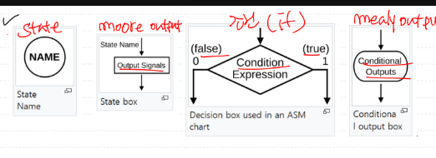
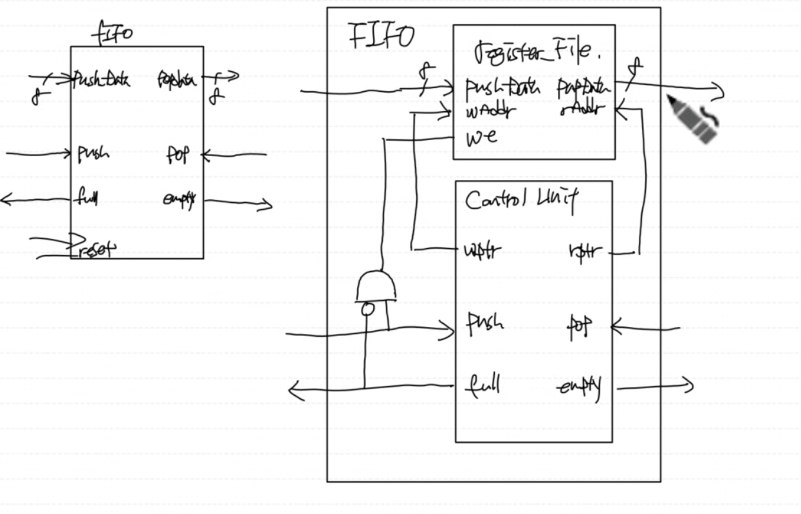
FIFO CONTROL UNIT 동작정의
0: IDLE
push = 0, pop =0
wptr = 0 , rptr = 0
empty = 1, full = 0
1: PUSH_ONLY
push = 1, pop = 0,
!full wptr ++;
empty = 0,
wptr == rptr -> full = 1
2: POP_ONLY
3:PUSH/POP
FIFO CONTROL UNIT input / output 정의
input
clk,
reset,
pop
push
output
wptr
rptr
full
empty
PUSH_ONLY
!full
T
wptr == rptr
wptr ++
empty == 0

Slide 3
FIFO CONTROL UNIT input / output 정의
input
clk,
reset,
pop
push
output
wptr
rptr
full
empty

Slide 4


