Slide 1
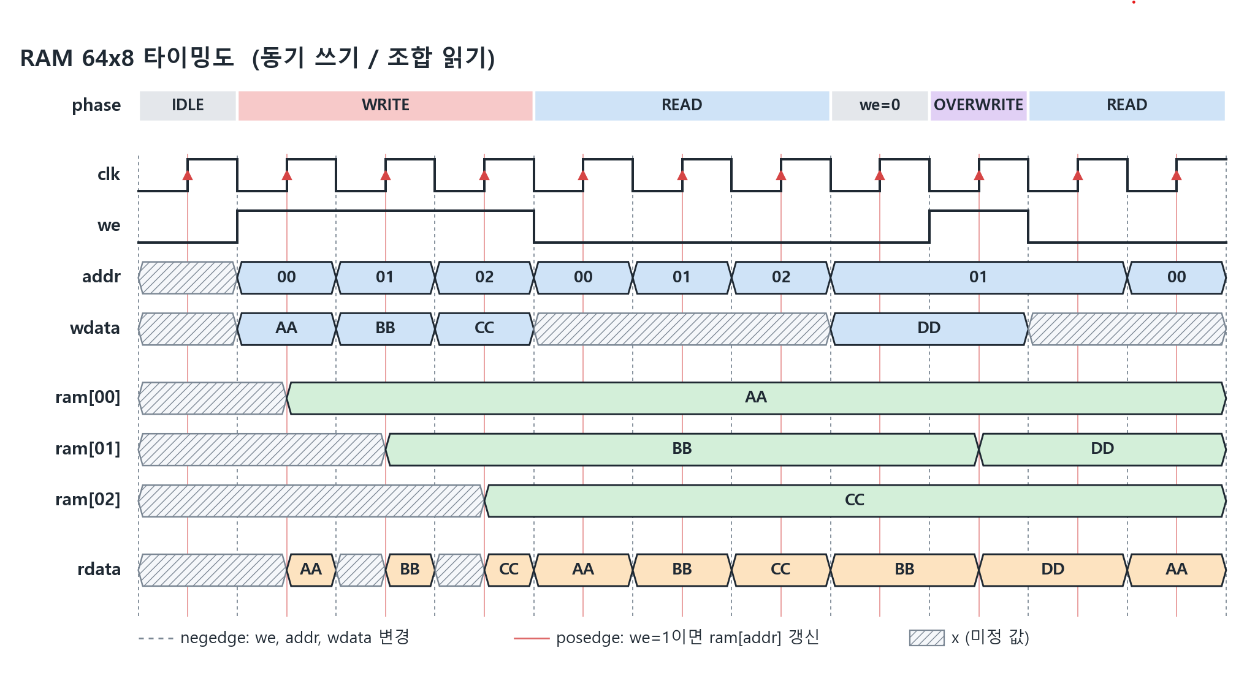
gen
drv
mon
scb
put
get
put
get
posedge
we,
addr,
wdata,
rdata
we ==1
logic expect
ram에 저장
else
rdata와 addr의 logic ram과 값을 비교
negedge
start
randomize

Slide 2
environment (heap)
tr : we,wdata,rdata,addr
generator
tr
scoreboard
tr
기대값 계산 · 조합별 pass / fail
gen2drv_mbox
mon2scb_mbox
driver
tr
monitor
tr
ram_vif
ram_vif
clk
addr
wdata
rdata
clk
rdata
addr
rdata
wdata
ram_vif (virtual interface)
clk
rdata
wdata
addr
we
count
ram_if (ram_interface · hardware)
tb clk
(#5 토글)
i_clk
rdata
wdata
addr
we
DUT (ram.sv)

