Slide 2
The 10-K includes five distinct sections
Business. This provides an overview of the company’s main operations, including its products and services (i.e., how it makes money).
Risk factors. These outline any and all risks the company faces or may face in the future. The risks are typically listed in order of importance.
Selected financial data. This section details specific financial information about the company over the last five years. This section presents more of a near-term view of the company’s recent performance.
Management’s discussion and analysis of financial condition and results of operations. Also known as MD&A, this gives the company an opportunity to explain its business results from the previous fiscal year. This section is where the company can tell its story in its own words.
Financial statements and supplementary data. This includes the company’s audited financial statements including the income statement, balance sheets, and statement of cash flows. A letter from the company’s independent auditor certifying the scope of their review is also included in this section.4

Slide 3
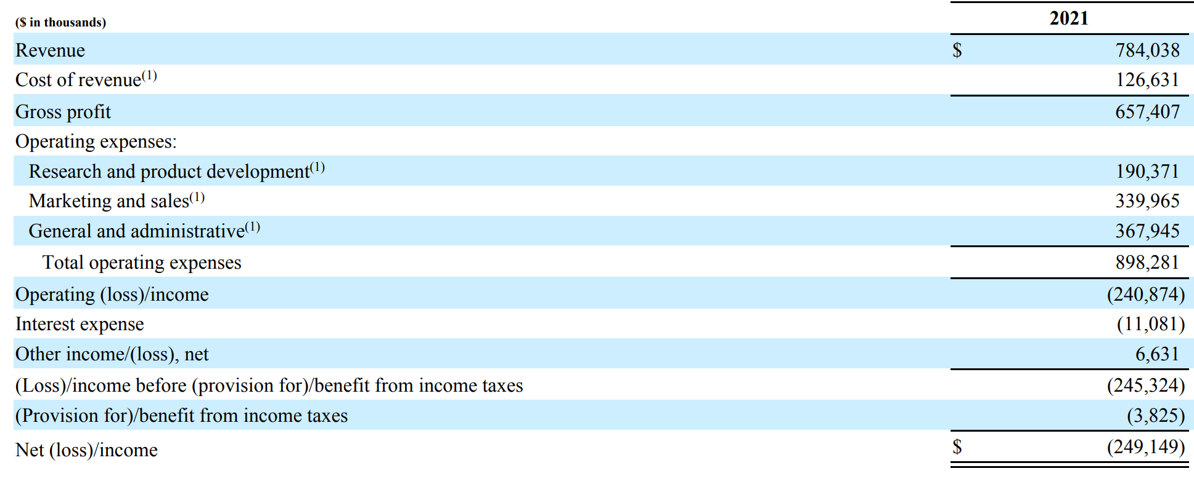
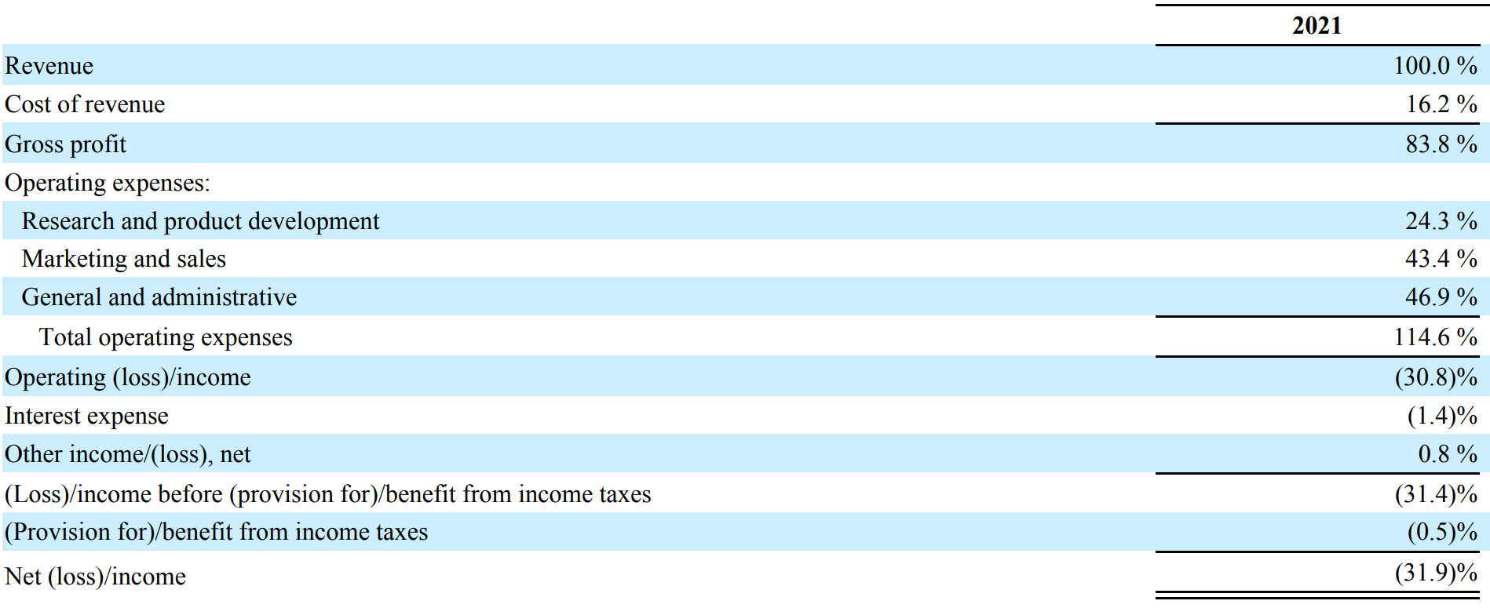
SQUARESPACE, INC. Income Statement

Slide 4
Aragon Income Statement
 | 2021 | percentage of total revenue
Revenue | $ xxx,xxx
Cost of revenue | xxx,xxx | 16.2%
Gross profit | xxx,xxx | 83.8%
Operating expenses: | xxx,xxx
Community Development & Support | xxx,xxx
DAO Education | xxx,xxx
Governance Development & Support | xxx,xxx
Reporting & Insights | xxx,xxx
Research and product development | xxx,xxx | 24.3%
Salaries and other compensation | xxx,xxx
Tech Support | xxx,xxx
Treasury & Finance Management | xxx,xxx
Marketing and sales | xxx,xxx | 43.4%
Miscellaneous | xxx,xxx | 46.9%
Total operating expenses | xxx,xxx
Operating (loss)/income | xxx,xxx
Interest expense | xxx,xxx | -1.4%
Other income/(loss), net | xxx,xxx | 0.8%
(Loss)/income before (provision for)/benefit from income taxes | xxx,xxx
(Provision for)/benefit from income taxes | xxx,xxx
Net (loss)/income | $ xxx,xxx

Slide 5
Financial statements componets
Cost of revenue:
the total cost of manufacturing and delivering a product or service to consumers. It represent the direct costs associated with the goods and services the company provides.
Cost of revenue is different from cost of goods sold because the former also includes external production, such as distribution and marketing.
Although the cost of revenue factors in many costs associated with sales, it does not take into account the indirect costs, such as salaries paid to managers. The costs considered part of the cost of revenue include a multitude of items, such as the cost of labor, commission, materials, and sales discounts.

Slide 6
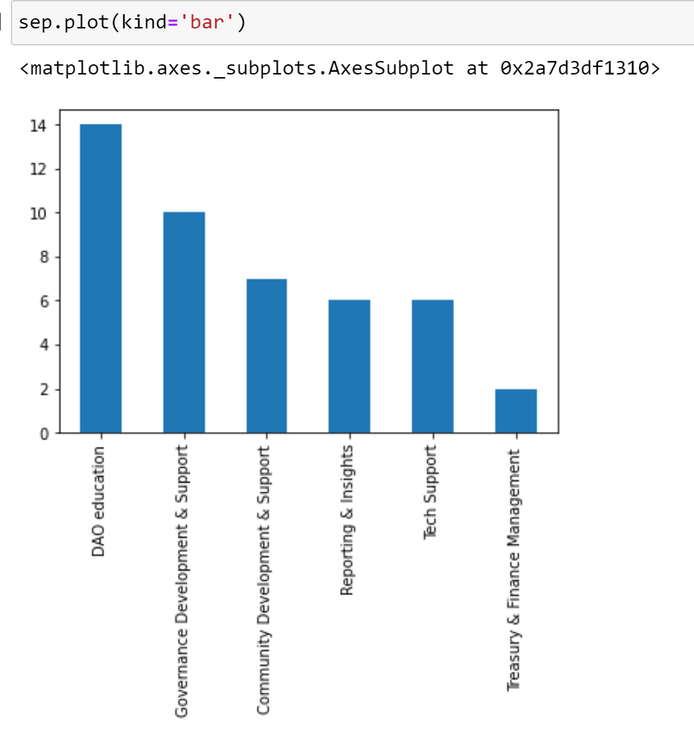
Example of a monthly summary

Slide 7
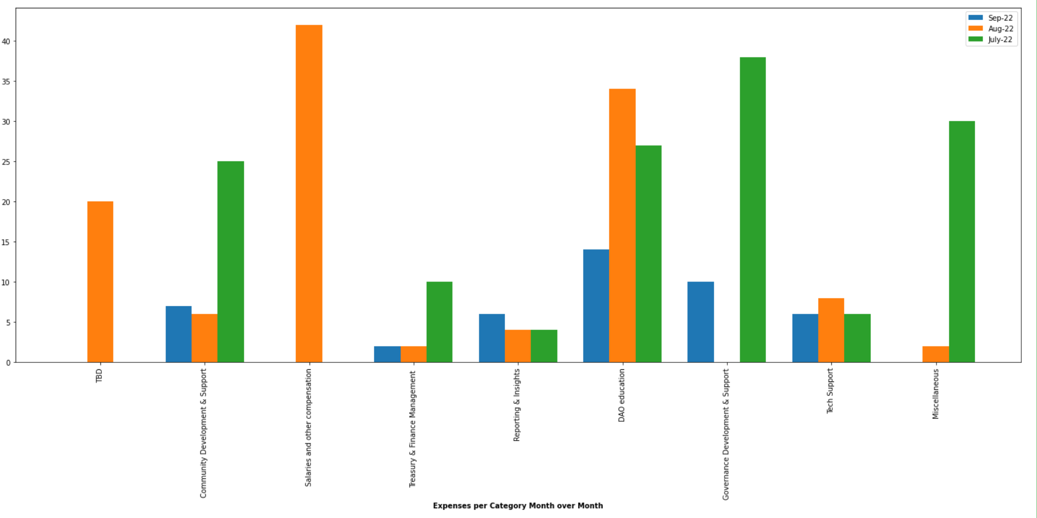
Example of categorical trends over time

Slide 8
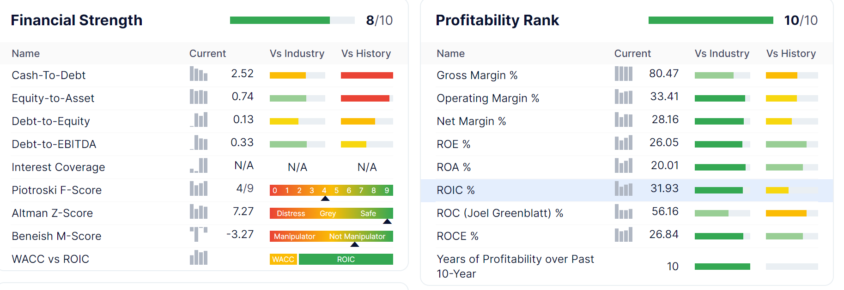
Examples of stats

Slide 9
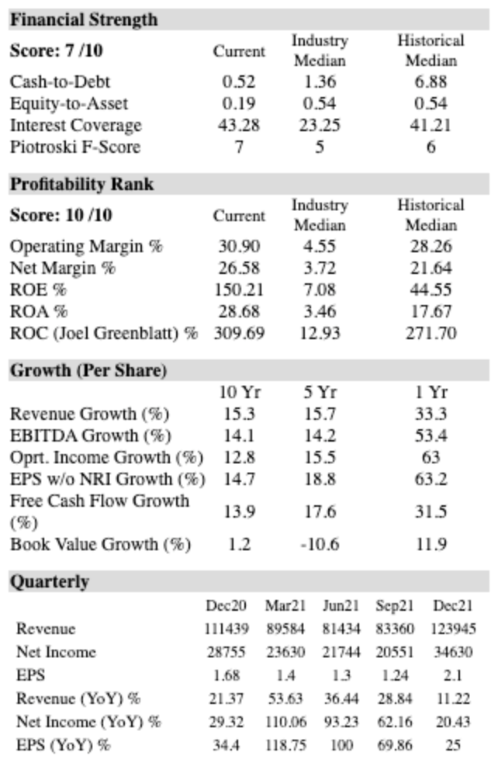
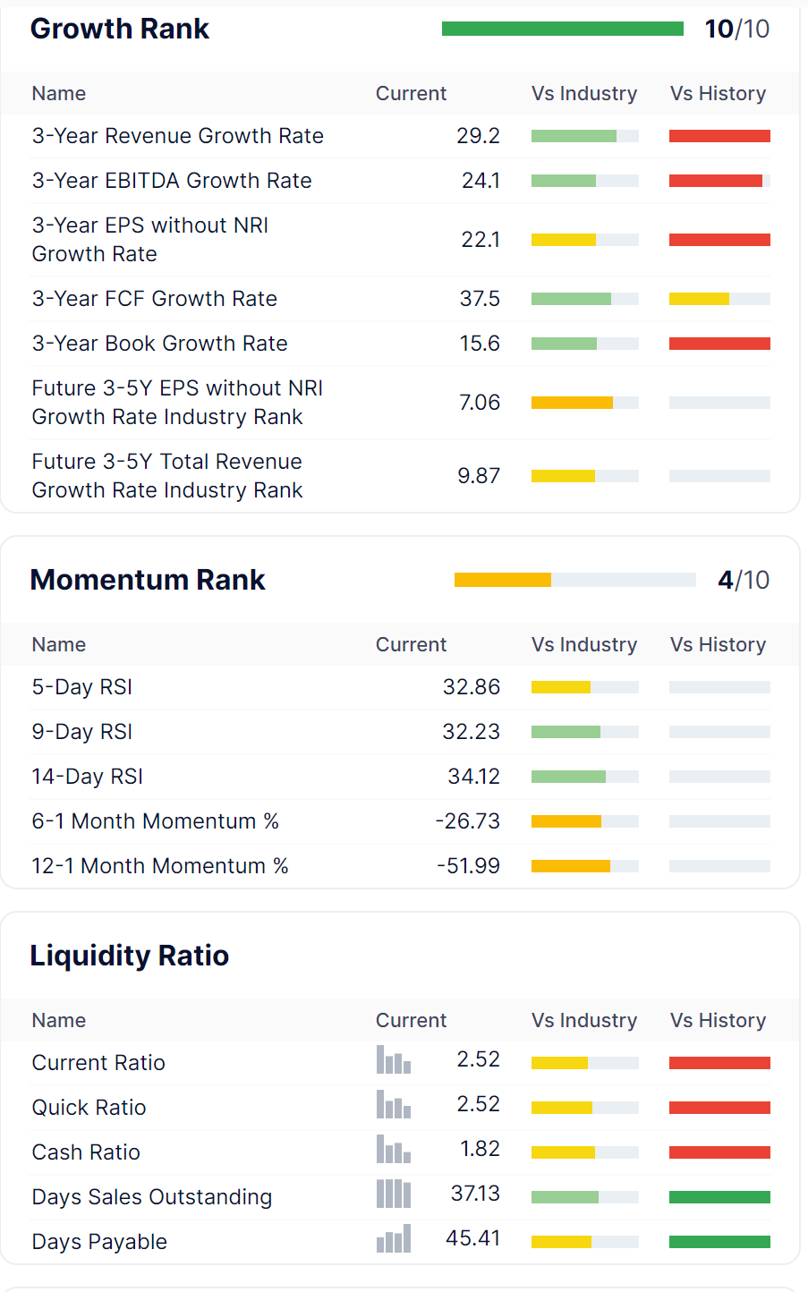

Slide 10
