Slide 1
LAB Ⅱ LECTURE 04
Git Remote / GitHub
Seoul National University
Graphics & Media Lab
Donghoon Han

Slide 2
Lab Objectives
Working with Remote
Introduce to GitHub / Setup
Contributing to a GitHub Project

Slide 3
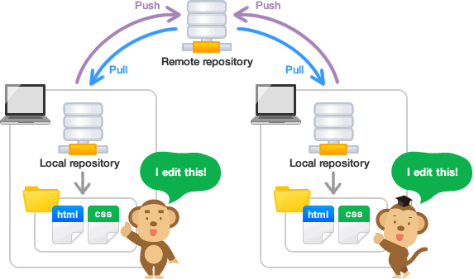
Introduction
Local repository
Reside on a local machine of an individual user
Remote repository
Reside on a remote server
Shared among multiple team members
Image courtesy of https://backlog.com/git-tutorial

Slide 4
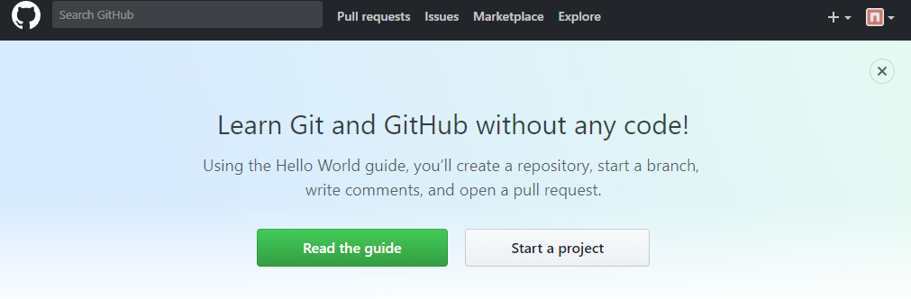
Creating Remote Repository (GitHub)
The single largest host for Git repositories
A large percentage of all Git repositories are hosted on GitHub, and many open-source projects use it for Git hosting, issue tracking, code review, and other things

Slide 5
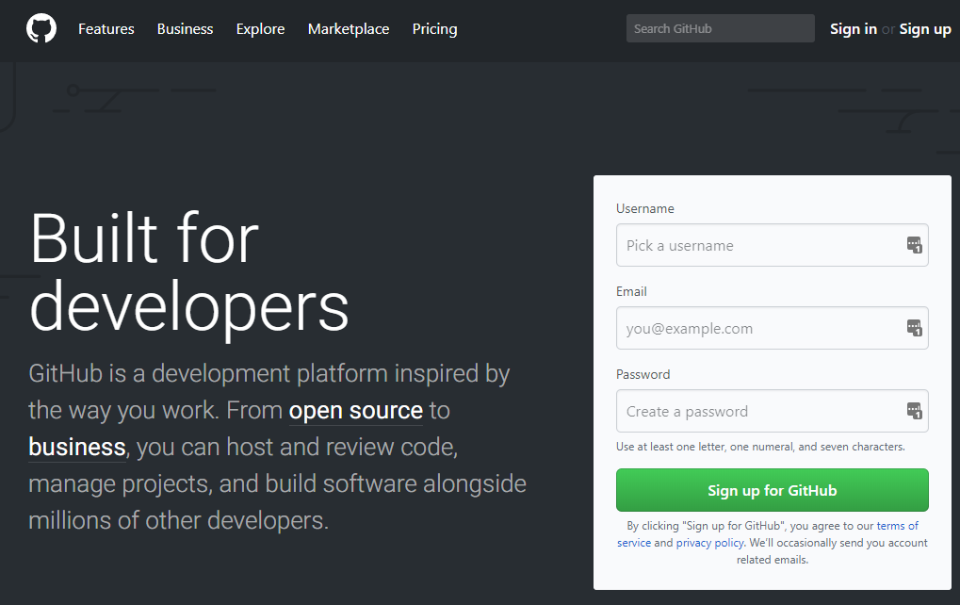
GitHub Setup
Create account
Choose username and password, then enter your e-mail address.
Confirm e-mail to activate your account
Update your profile if necessary
Sign in to the Github, then go to ‘Settings’ menu on top

Slide 6
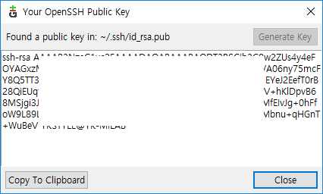
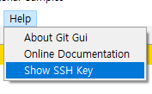
GitHub Setup
SSH keys / E-mails
As mentioned earlier, only permissioned user can push to your repository
User is identified by SSH key (unique to each PC) and e-mail, so your key and working e-mail (other than account e-mail) should be added
For SSH key, your key can be generated and viewed in Git GUI -> Help -> Show SSH Key

Slide 7
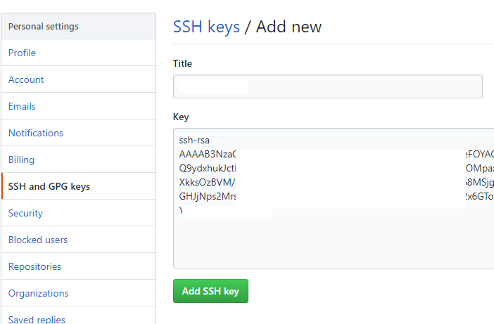
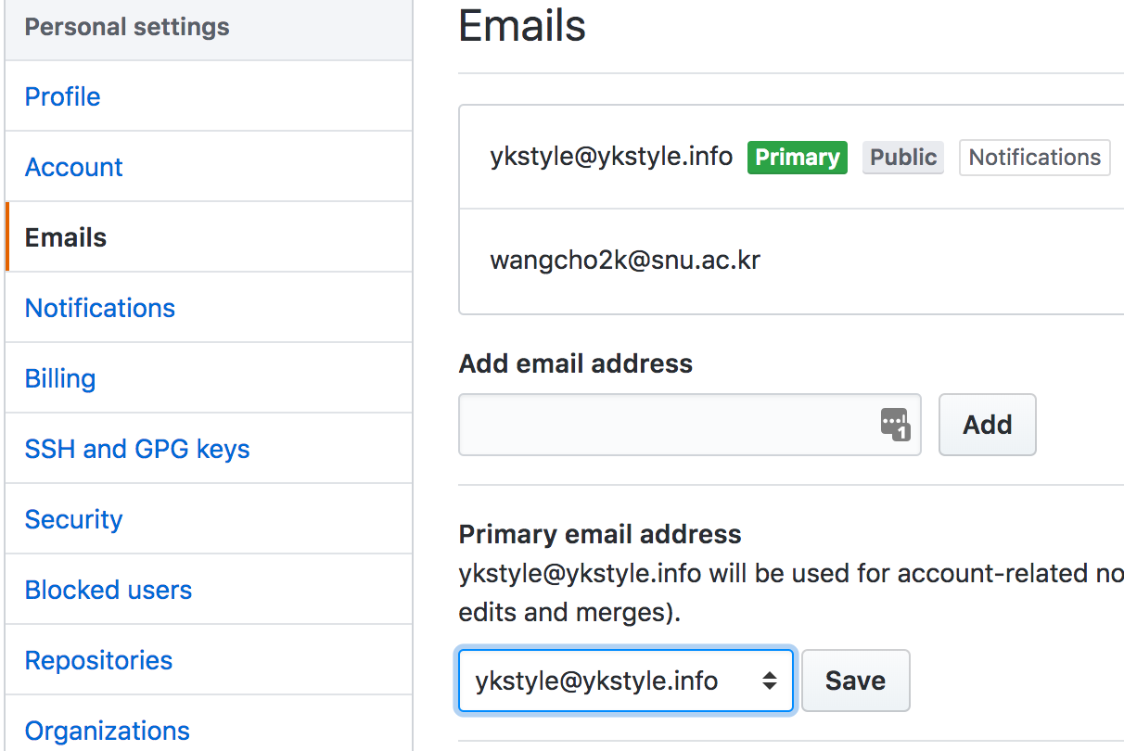
GitHub Setup
SSH keys / E-mails
Add your key to GitHub in account settings menu
Go to SSH and GPG keys, then select ‘New SSH Key’
Additional e-mail can be added in ‘Emails’ menu

Slide 8
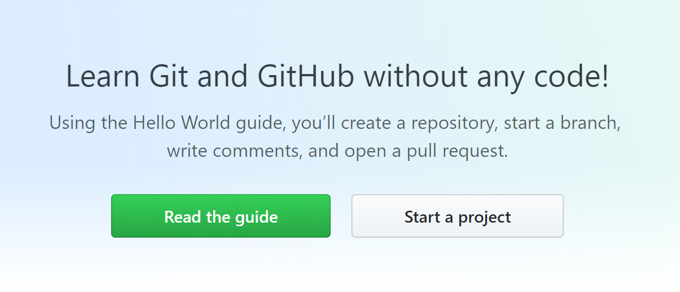
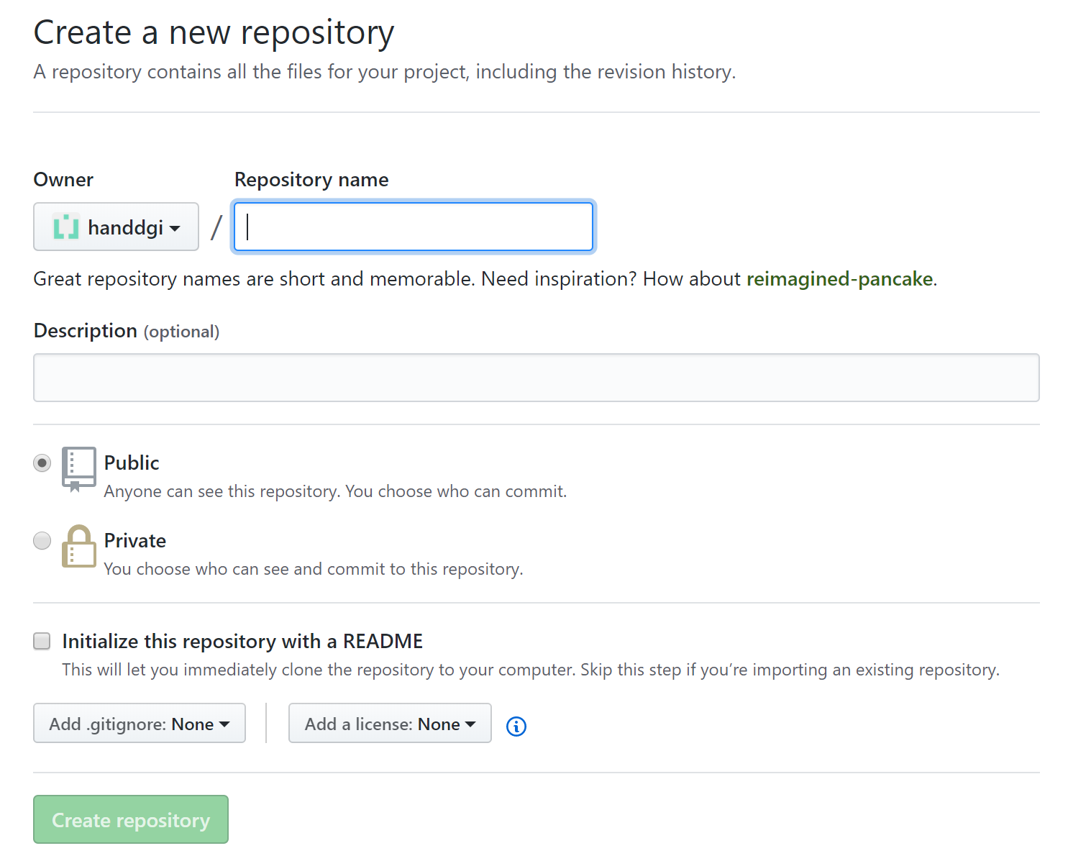
Create a Remote Repository on GitHub
Click “Start a Project” button
Setting your repository

Slide 9
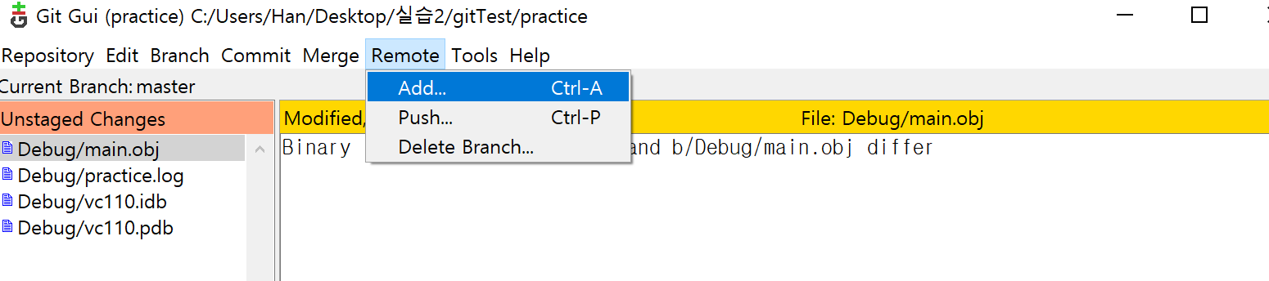
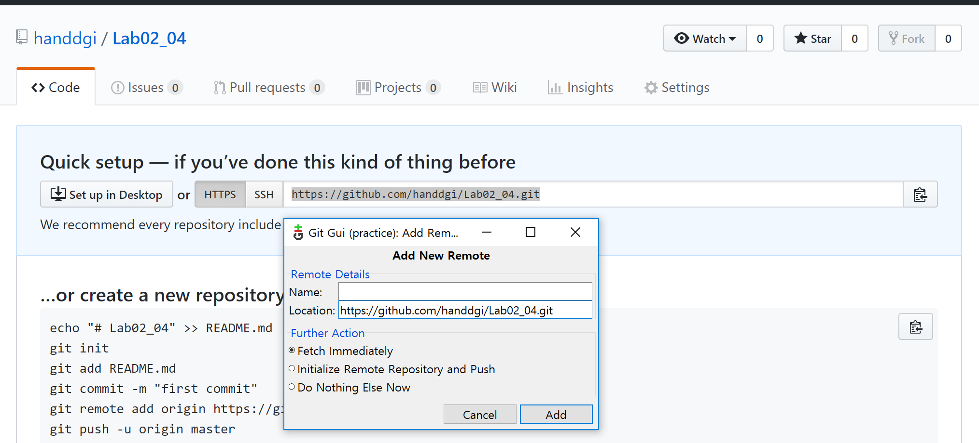
Add Existing Local Repository
Git GUI
“Remote” -> “Add”

Slide 10
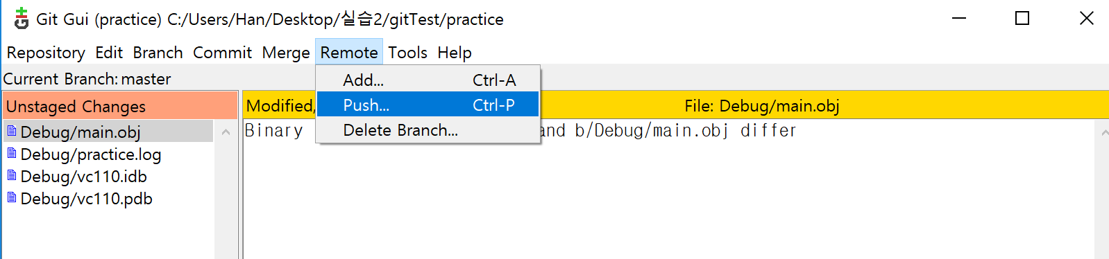
Add Existing Local Repository
Git GUI
“Remote” -> “Push”
Update remote repository from local changes

Slide 11
Clone Remote Repository
Create local copy on your computer from existing remote repository
On GitHub, navigate to the main page of the repository
Under the repository name, click Clone or download
Copy the clone URL for the repository
Open Git Bash
Change the current working directory to the location where you want the cloned directory
Type “git clone”, and then paste the URL you copied

Slide 12
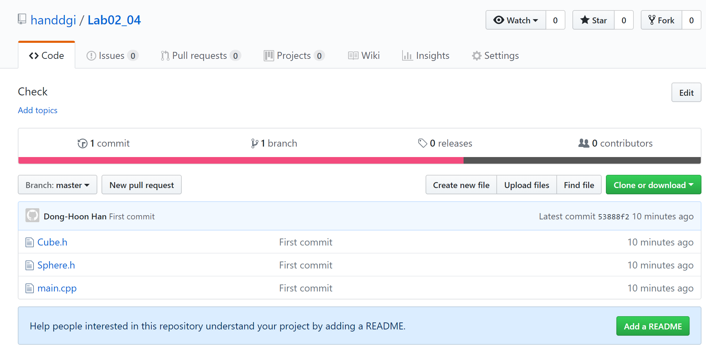
Mission #1
Create remote repo on GitHub
Clone your remote repo into your local workspace
Add cpp file from ETL to local git
Main.cpp, Sphere.cpp, Cube.cpp
Commit and push to the remote repo
Capture the screen

Slide 13
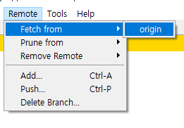
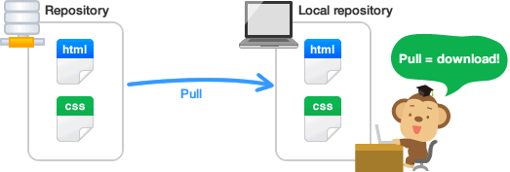
Working with remotes
If your local repository has been set with or cloned from remote, keep up to date with the remote using following operations
Fetch
Download the latest contents from remote
Fetched changes should be merged using merge menu
On CLI, pull command does both by fetch from the remote first, then automatically merge into local branches
Image courtesy of https://backlog.com/git-tutorial

Slide 14
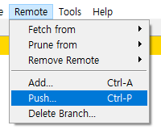
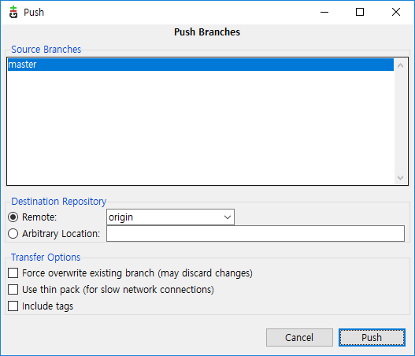
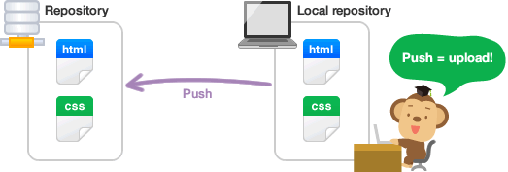
Working with remotes
Push command
Update remote repository with local one
Only users have access to the remote can push their modifications into the remote
Image courtesy of https://backlog.com/git-tutorial

Slide 15
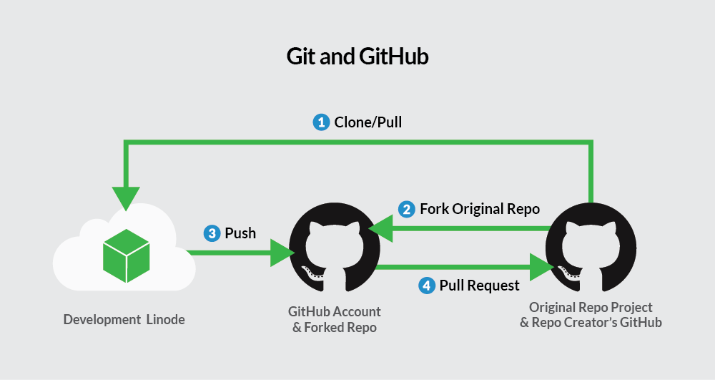
Contributing to a GitHub Project
Unless you’re working as one of the core developers in a project (able to push to the repo directly), participating in a GitHub project starts from forking (copying) the repo to your account
Create a topic branch in the forked repo, and make changes
If modifications done, a pull request could be issued to merge your branch into the original project
Image courtesy of https://linode.com/docs/development/version-control/how-to-install-git-and-clone-a-github-repository/

Slide 16

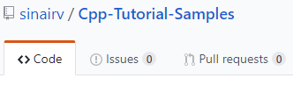
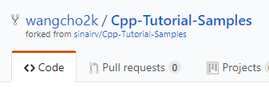
Contributing to a GitHub Project
Forking a project
Click ‘Fork’ button on GitHub page will fork the project into your account
Resulting project indicates that it is a forked project
Original
Forked

Slide 17
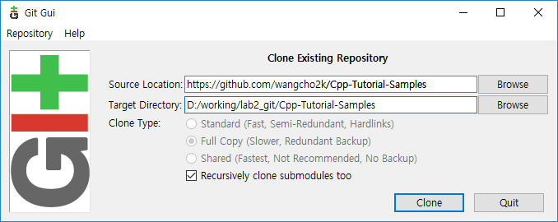
Contributing to a GitHub Project
Clone the forked project and add remote
Clone the repo first

Slide 18

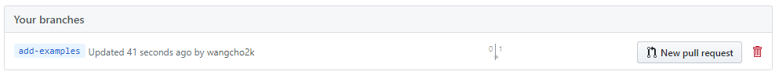
Contributing to a GitHub Project
Make changes and push
First create a topic branch which you will work in
Modify the code as you want, then commit and push to ‘forked’ repo
Create a pull request
Go to the forked project in GitHub
Click ‘branches’
Locate your topic branch and click ‘New pull request’

Slide 19
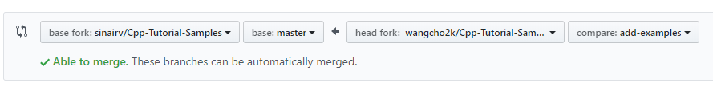
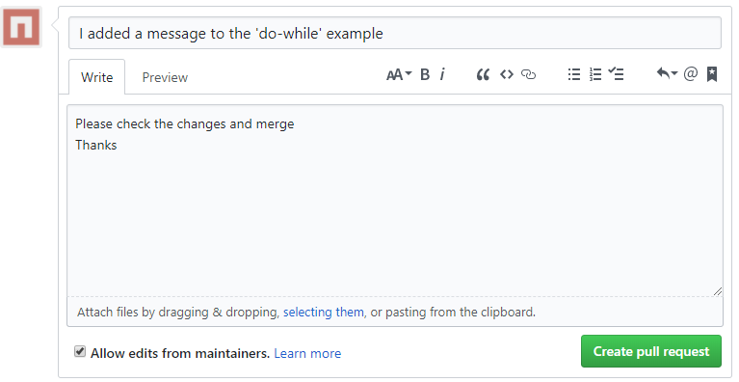
Contributing to a GitHub Project
Create a pull request
Make sure that your topic branch is merging into original’s master
Add message and click ‘Create pull request’

Slide 20
Mission #2
Fork our repo, https://github.com/handdgi/Lab02_04.git
Clone your forked repo into your local workspace
Create a ‘Lab2-YOUR_STUDENT_NUMBER’ branch
E.g. ‘Lab2-2014-12345’
Copy and paste the screen shot from mission #1
Commit and push to the forked repo
Create a pull request into the original repo

