Slide 1
Incremental GPMap

Slide 2
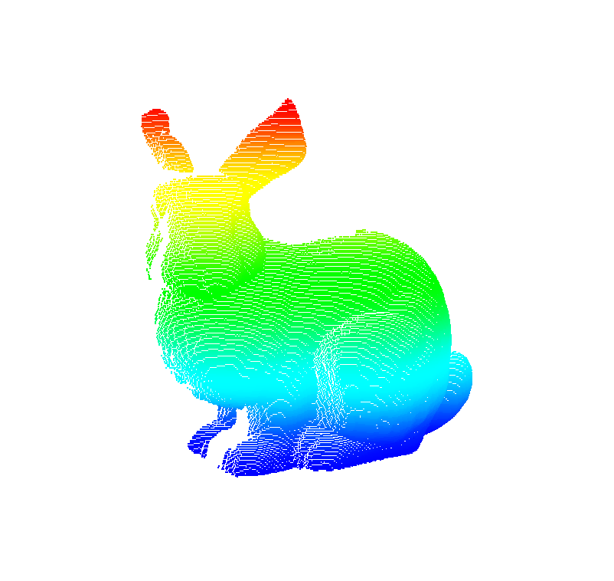
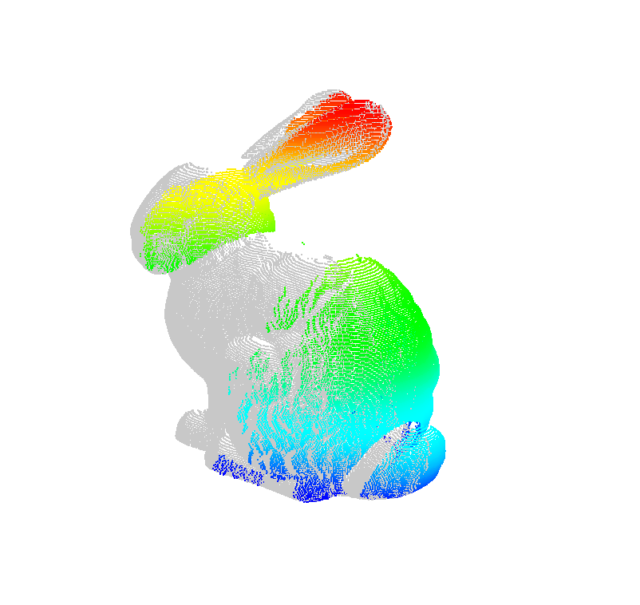
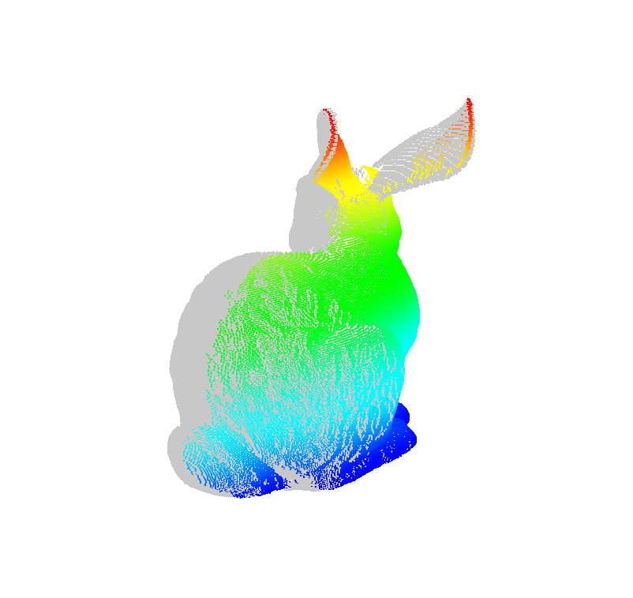
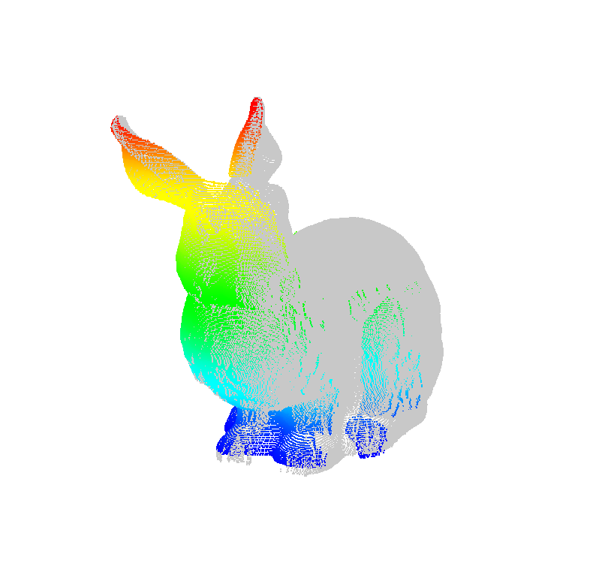
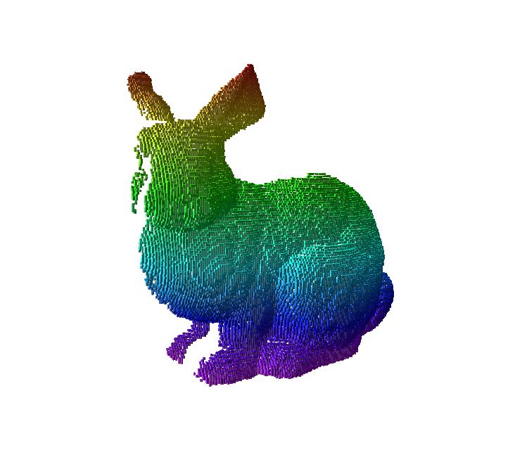
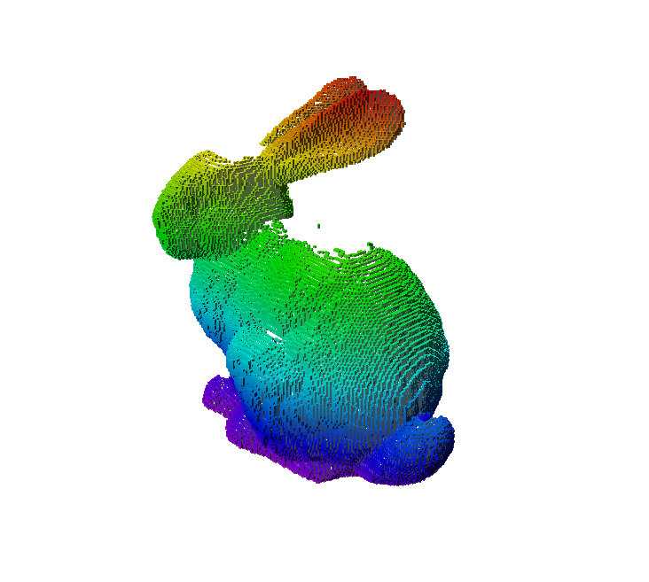
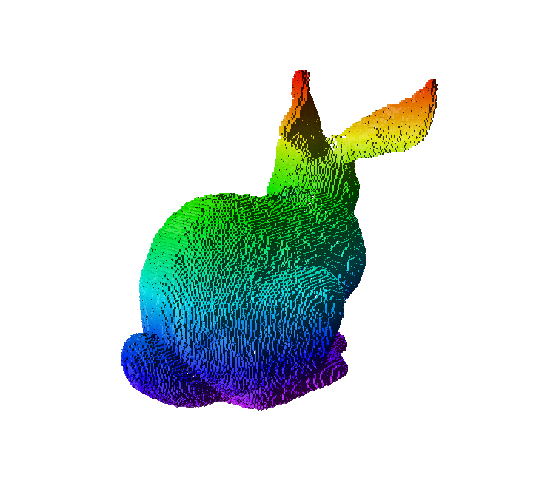
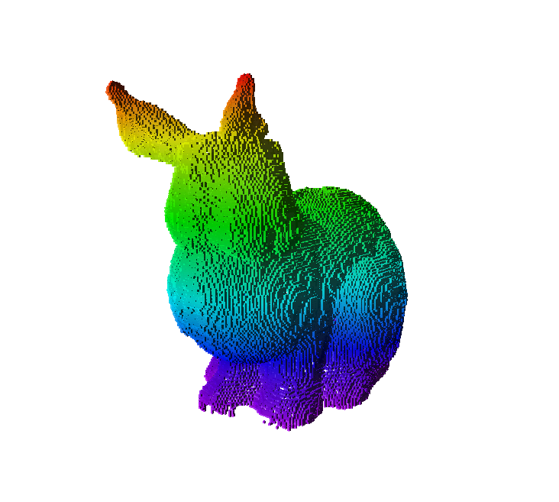
Incremental Update – OctoMap
View 1
View 2
View 3
View 4
Hit Points (New/Old Observations in Color/Gray)
OctoMap (Color by Height)
Note that they are sparse when looking closely.

Slide 3
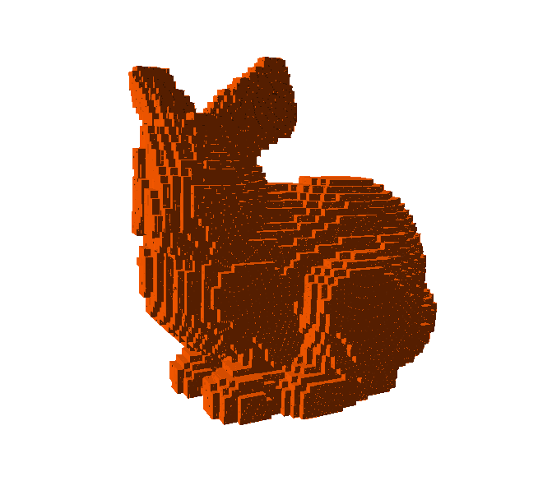
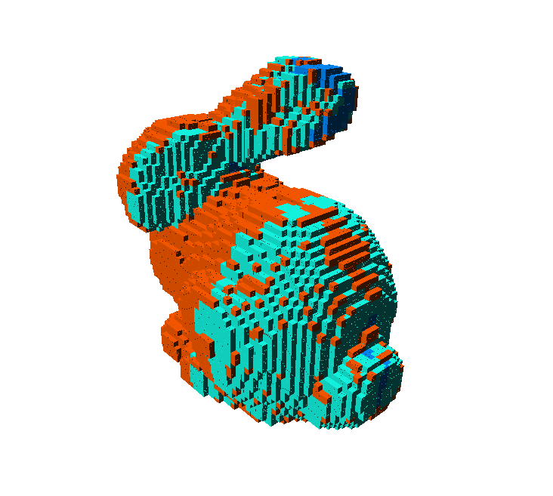
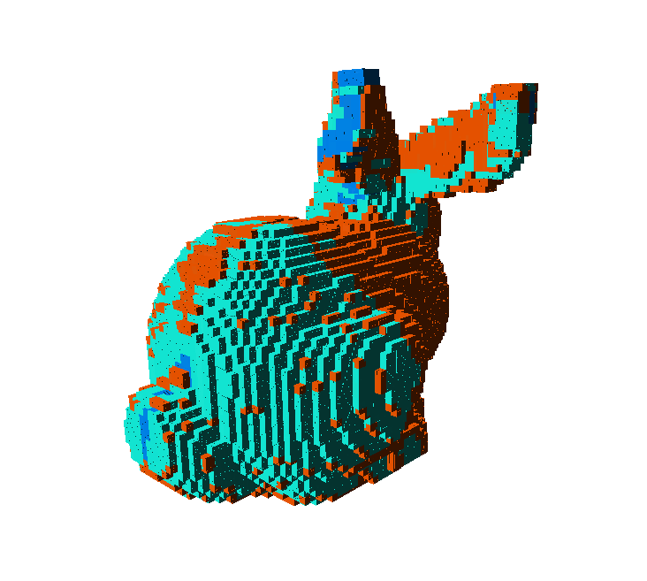
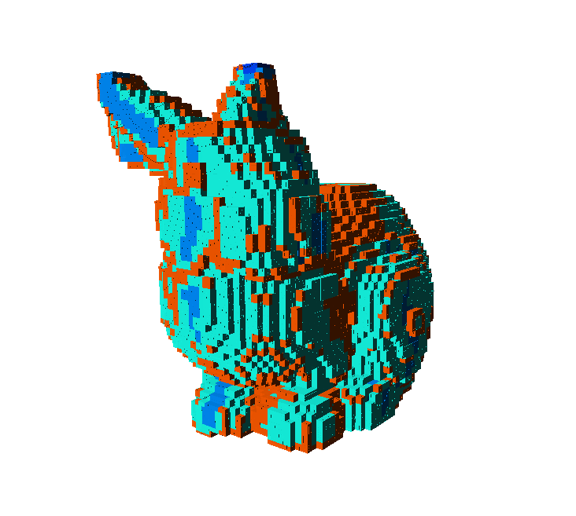
Incremental Update – GPMap + iBCM
View 1
View 2
View 3
View 4
Hit Points (New/Old Observations in Color/Gray)
Gaussian Process Occupancy Map With Independent BCM (High/Low Uncertainty in Red/Blue Colors)
Note that the uncertainties are reduced with newly introduced observations.

Slide 4
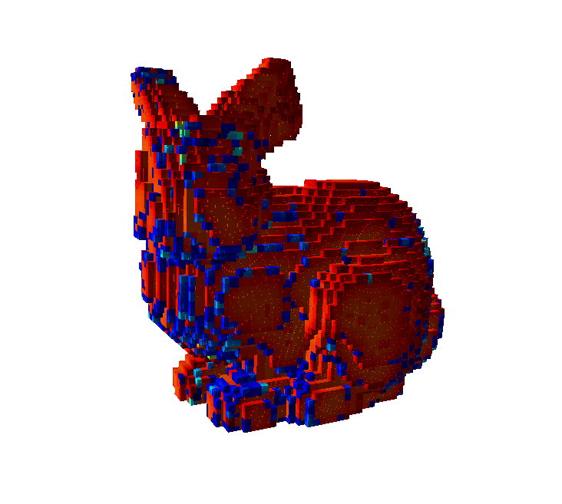
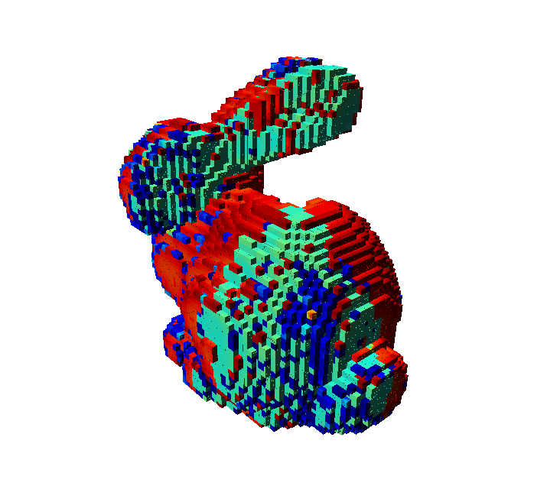
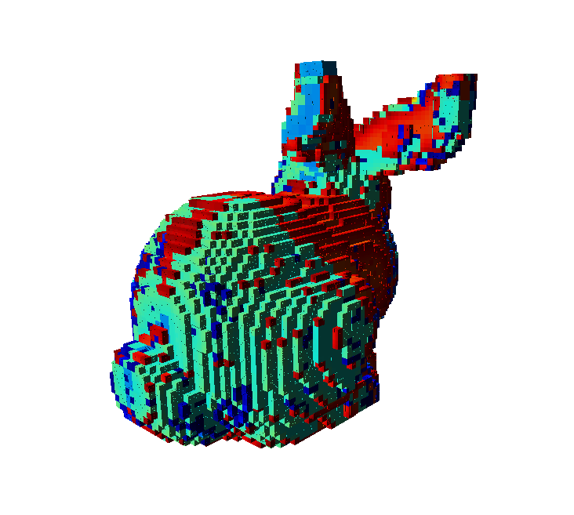
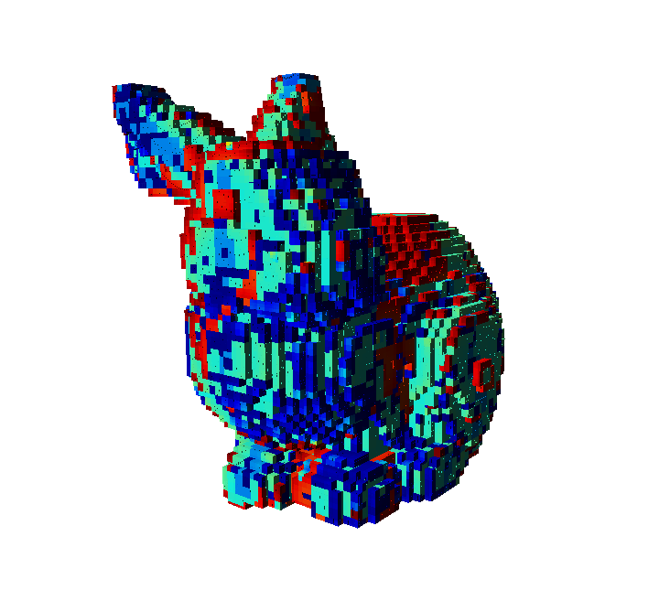
Incremental Update – GPMap + iBCM Surface
View 1
View 2
View 3
View 4
Hit Points (New/Old Observations in Color/Gray)
Gaussian Process Occupancy Map With BCM (High/Low Uncertainty in Red/Blue Colors)
Note that the uncertainties are reduced with newly introduced observations.

Slide 5
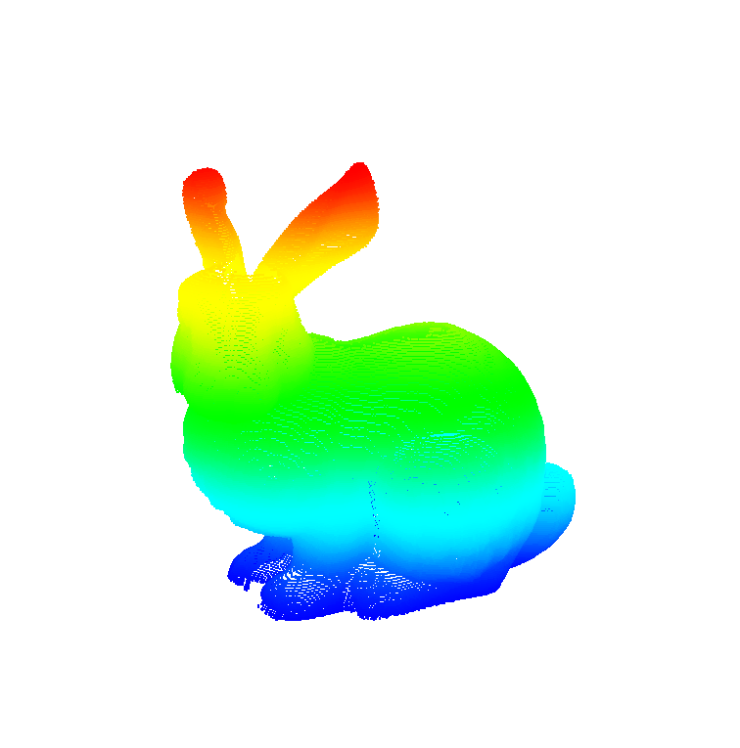
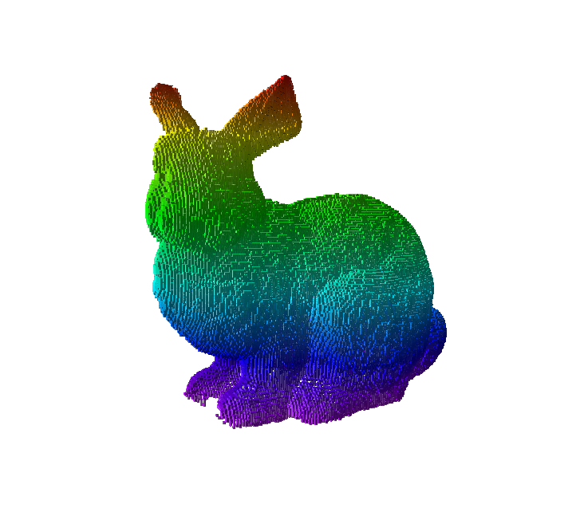
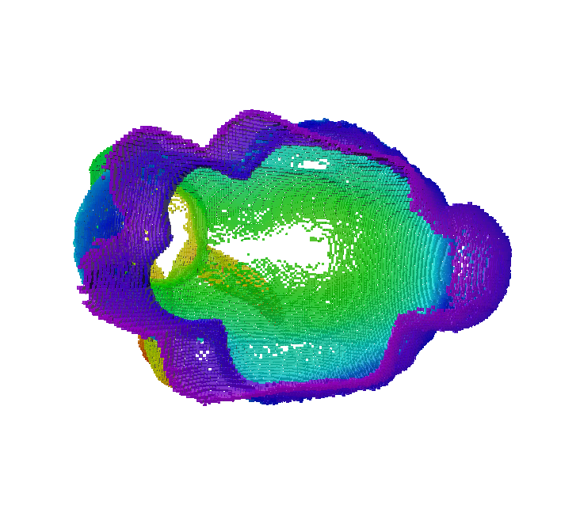
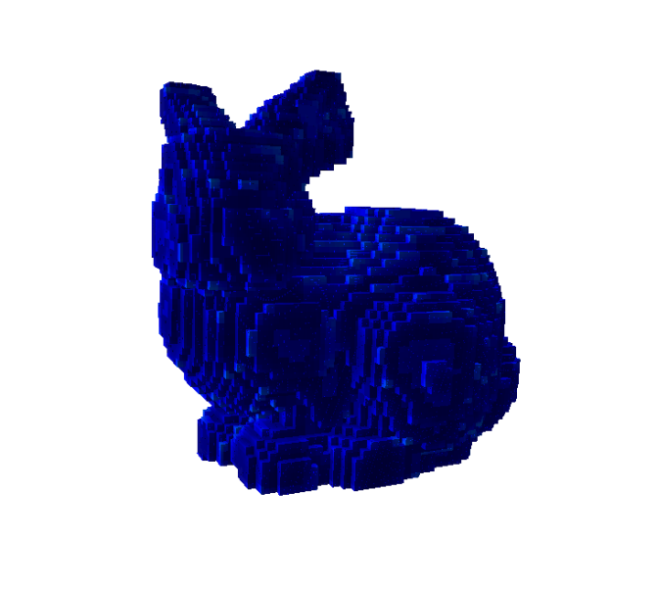
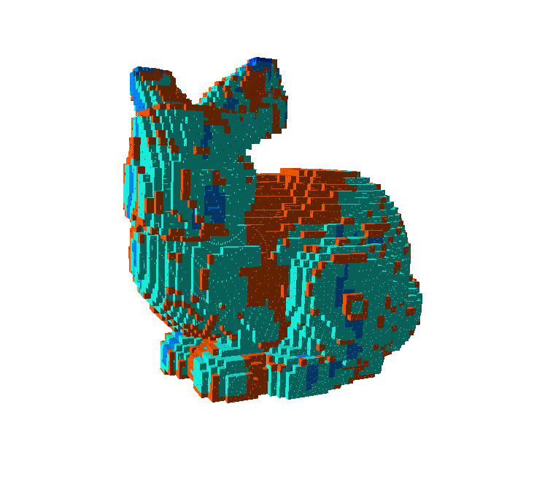
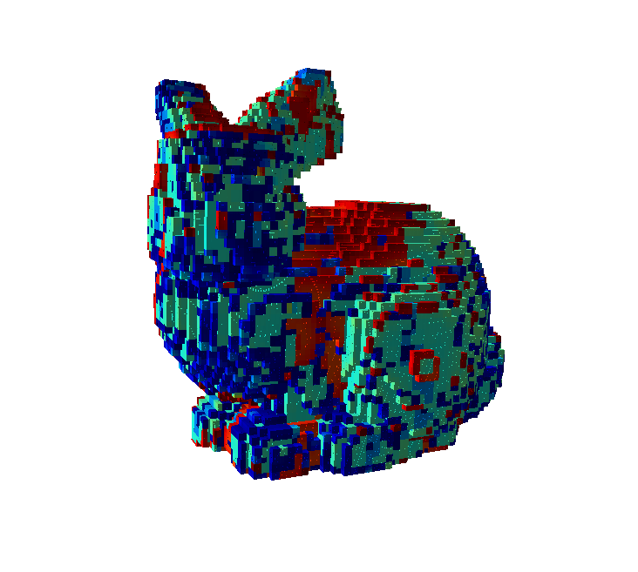
Comparison
All Hit Points
OctoMap
OctoMap - Bottom View
GPMap - Batch
GPMap - iBCM
GPMap - BCM
Speed
AccuracyOctomap Gaussian Process Occupancy Map With BCM (High/Low Uncertainty in Red/Blue Colors)
Note that the uncertainties are reduced with newly introduced observations.

Slide 6
Conclusions
Data
Each # of points: (1) 40,256 (2) 30,379 (3) 40,251 (4) 31,701
Total 142,587 points
Accuracy
OctoMap: Precise but Sparse, No Uncertainty
GPMap – Batch: Low Uncertainty
GPMap – iBCM: Relatively High Uncertainty
GPMap – BCM: Relatively Low Uncertainty
Speed
OctoMap: 39.7491 sec
OctoMap – Batch: 2.221 hr
OctoMap – iBCM: 4489.4 sec(prediction) + 0.2496 sec(fusion) = 1.247 hr
OctoMap – BCM: 4272.9 sec(prediction) + 11.310 sec(fusion) = 1.190 hr
Conclusion
Expectation: GPMap – iBCM is balanced in both accuracy and speed.
Actual Result: GPMap – BCM is better??? (Need more experiments)

