Slide 1
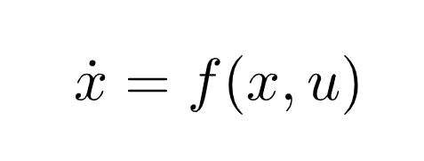
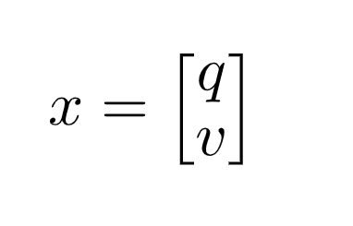
Lec1. Dynamics
M dimension input Vector
N dimension state Vector
Derivative of State X
System Dynamics
This can also be expressed like this
Pose, of “Configuration”
Velocity

Slide 2
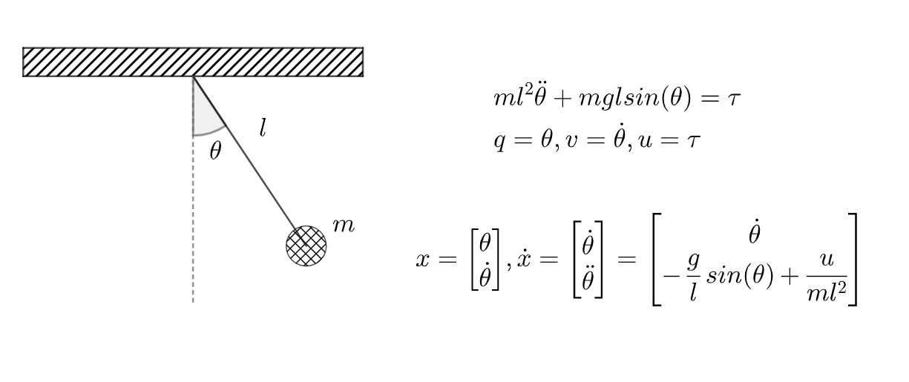
Lec1. Dynamics
Convert Dynamics Equations into
Vector Form

Slide 3
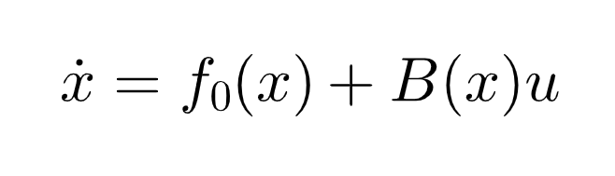
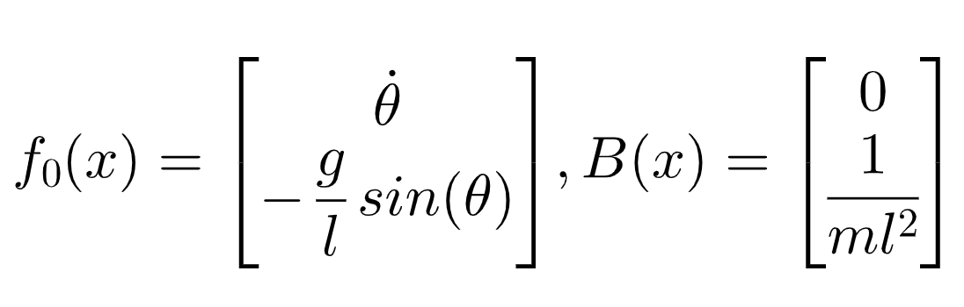
Lec1. Dynamics
Control Affine Systems
Drift
Input Jacobian
In case of pendulum,

Slide 4
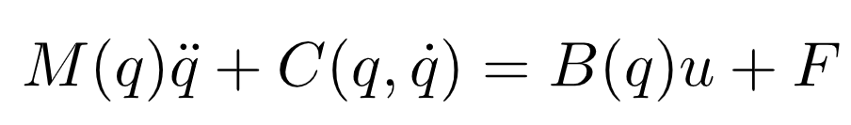
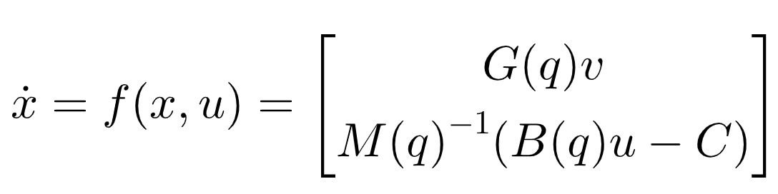
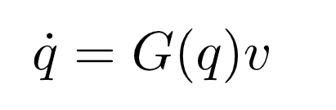
Lec1. Dynamics
Manipulator Dynamics
Mass Matrix
Dynamics Bias
(corilois + gravity term)
Input Jacobian
External Force
We can get this from easily by using symbolic toolbox in python/matlab
Velocity Kinematics

Slide 5
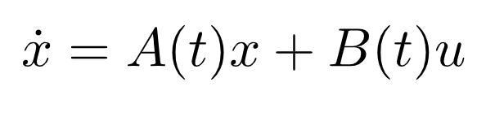
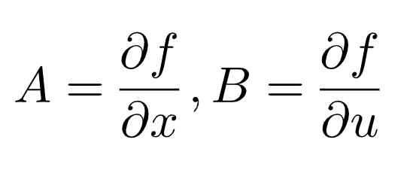
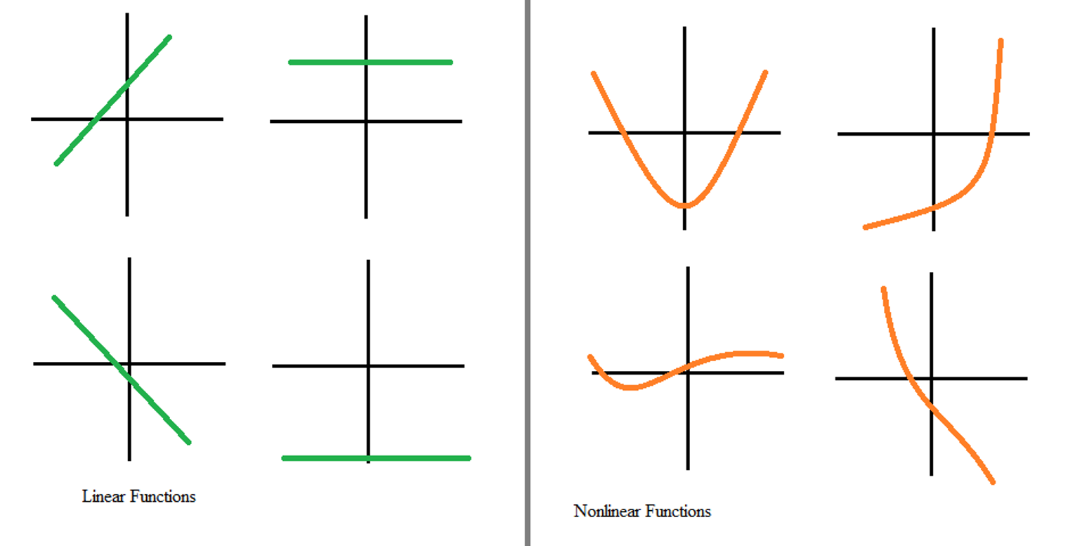
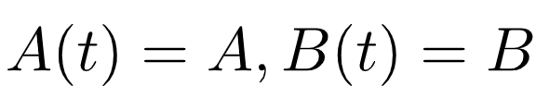
Lec1. Dynamics
Linear Systems
Linear Approximate
System Martix
Control Martix
It has no relationship btw
Time Invariant & Linear Approx ex) TDLQR
“Time Invariant” if fulfill below conditions
image from : https://study.com/academy/lesson/how-to-recognize-linear-functions-vs-non-linear-functions.html

Slide 6
Lec1. Dynamics
Equilibria

Slide 7
Lec1. Dynamics

Slide 8
Lec1. Dynamics

