Slide 1
Lec1. Dynamics

Slide 2
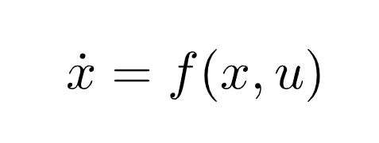
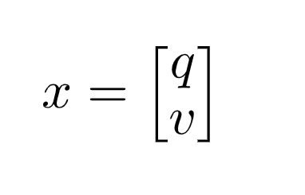
Lec1. Dynamics
M dimension input Vector
N dimension state Vector
Derivative of State X
System Dynamics
This can also be expressed like this
Pose, of “Configuration”
Velocity

Slide 3
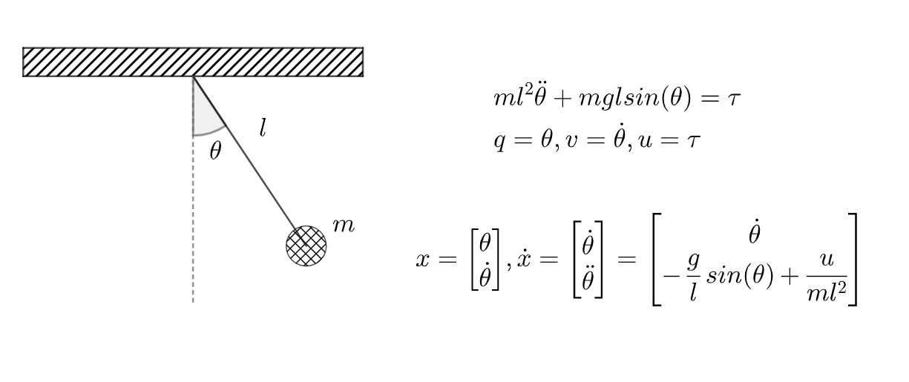
Lec1. Dynamics
Convert Dynamics Equations into
Vector Form

Slide 4
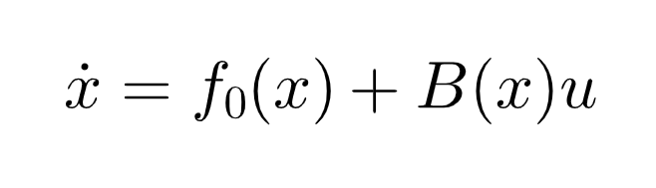
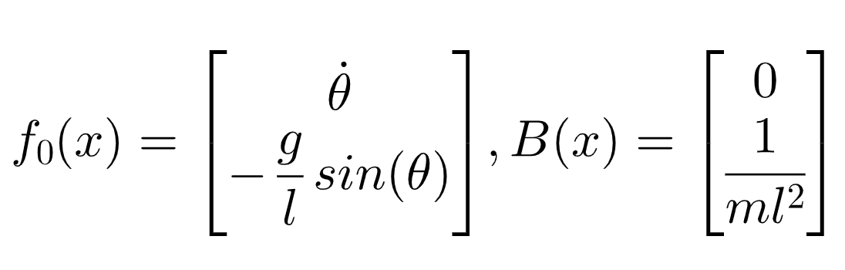
Lec1. Dynamics
Control Affine Systems
Drift
Input Jacobian
In case of pendulum,

Slide 5
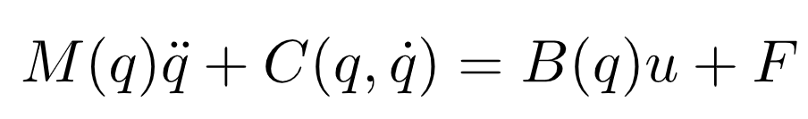
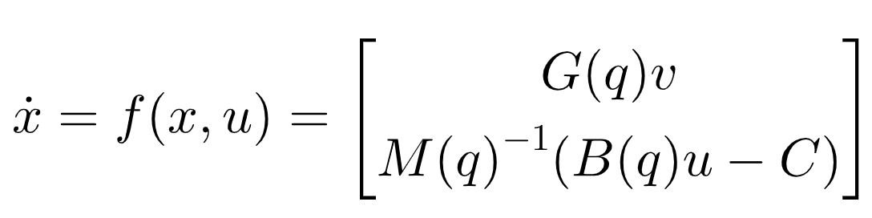
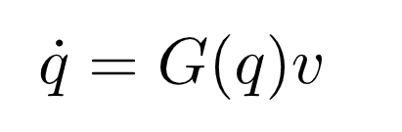
Lec1. Dynamics
Manipulator Dynamics
Mass Matrix
Dynamics Bias
(coriolis + gravity term)
Input Jacobian
External Force
We can get this from easily by using symbolic toolbox in python/matlab
Velocity Kinematics

Slide 6
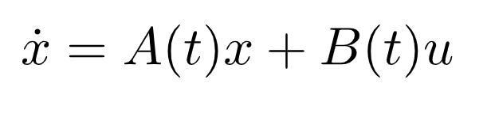
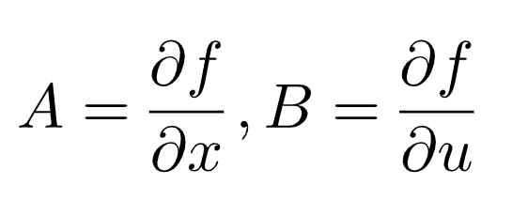
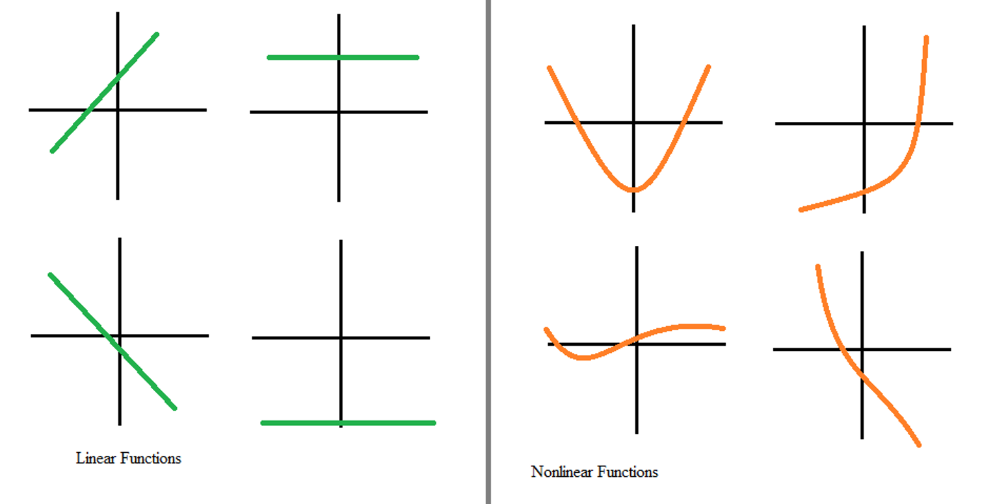
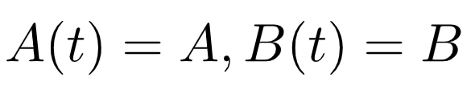
Lec1. Dynamics
Linear Systems
Linear Approximate
System Matrix
Control Matrix
It has no relationship btw
Time Invariant & Linear Approx ex) TDLQR
“Time Invariant” if fulfill below conditions
image from : https://study.com/academy/lesson/how-to-recognize-linear-functions-vs-non-linear-functions.html

Slide 7
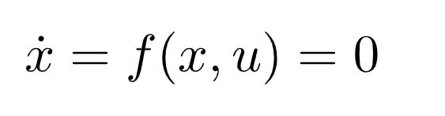
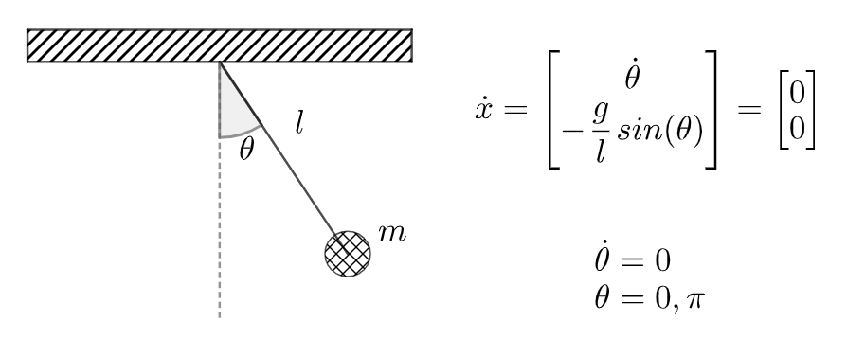
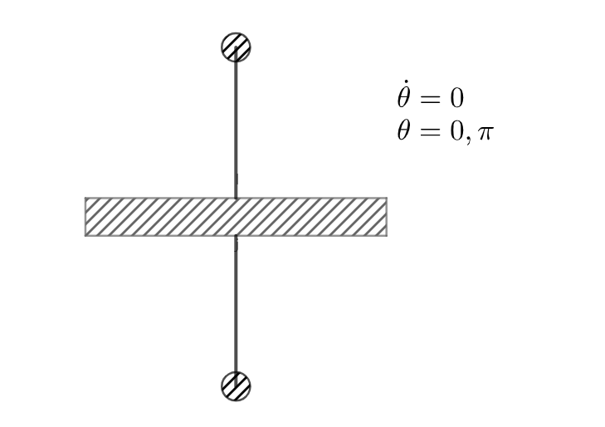
Lec1. Dynamics
Equilibria – A point where the system becomes “Stable”
Let’s find (0,0) point in pendulum case

Slide 8
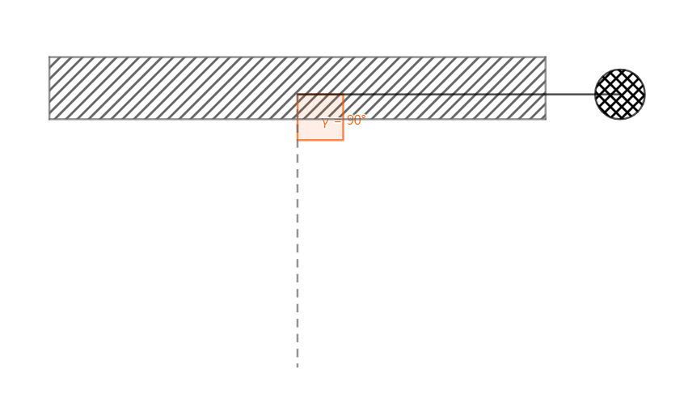
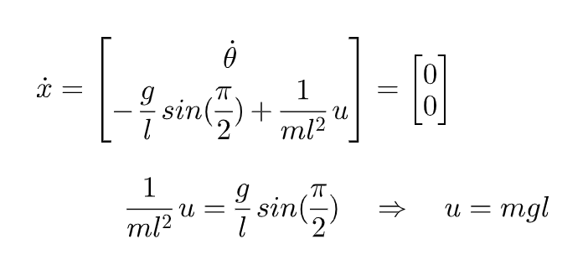
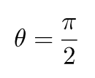
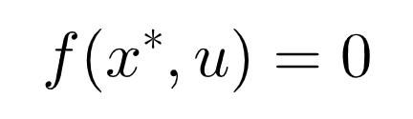
Lec1. Dynamics
First Control Problem
Manipulate
For new Equilibria
Stabilization
Find control signal that satisfy new equilibria state x*

Slide 9
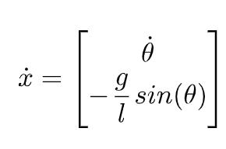
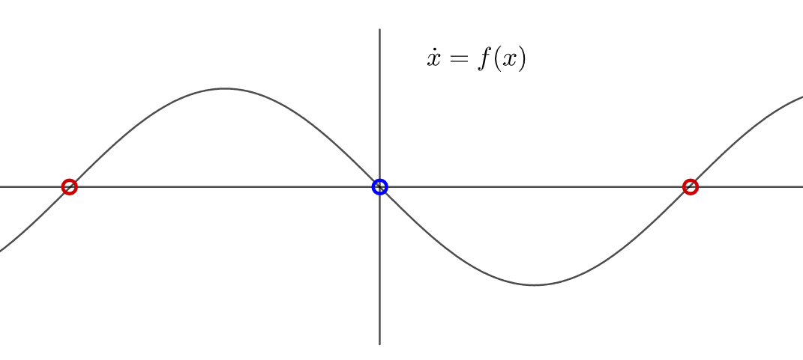
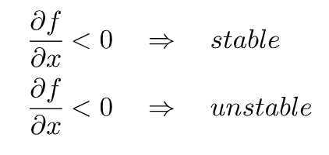
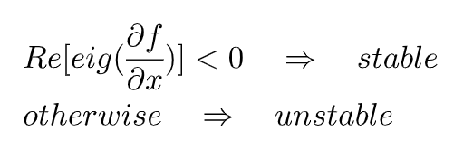
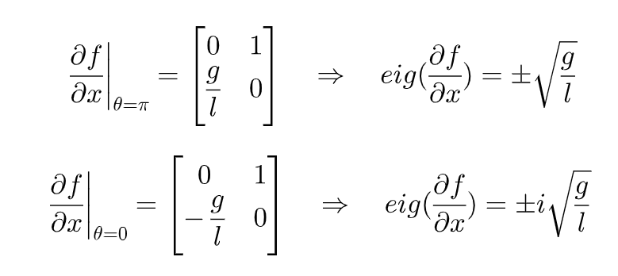
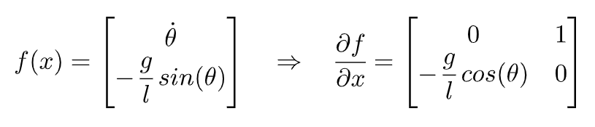
Lec1. Dynamics
Stability of Equilibria
Scalar Case
Vector Case
Unstable Point
Stable Point
Unstable Point
In case of pendulum,
Unstable
Pure Imaginary
What does this mean…?

Slide 10
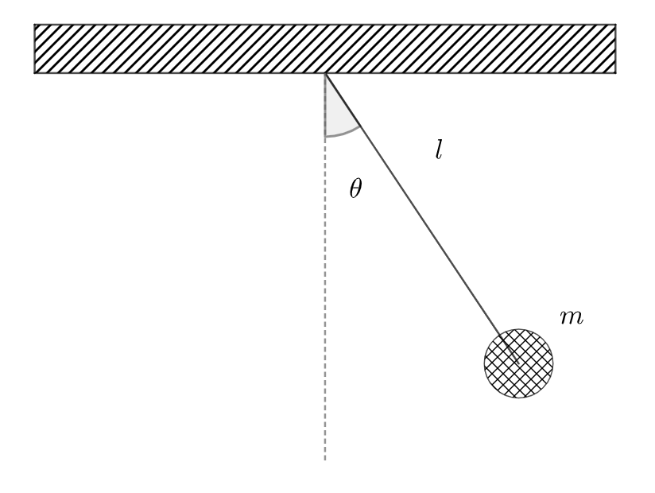
Lec1. Dynamics
Summary
Various Dynamics Formulations
Equilibria and Stability
True Meaning of Control
System
Dynamics
Stabilization
Control

