Slide 1

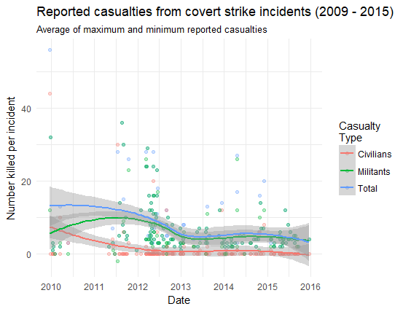
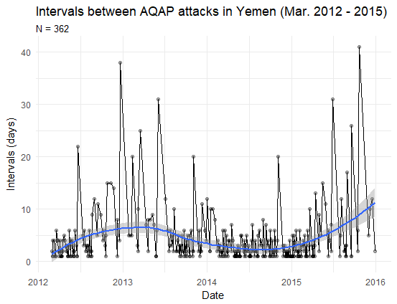
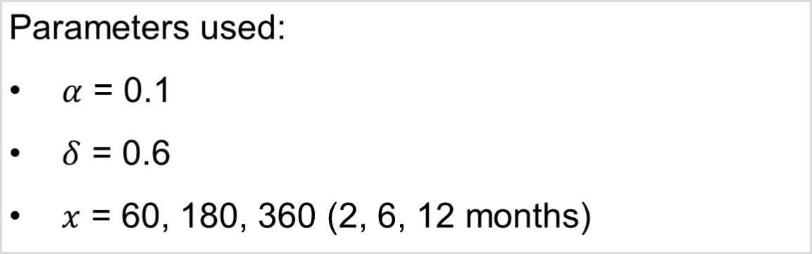
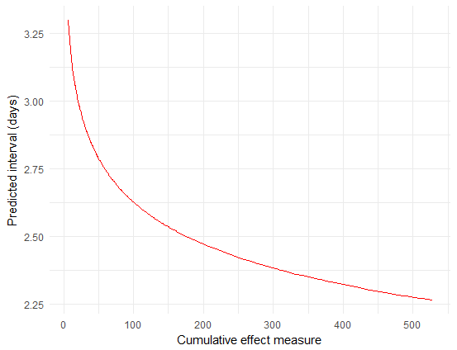

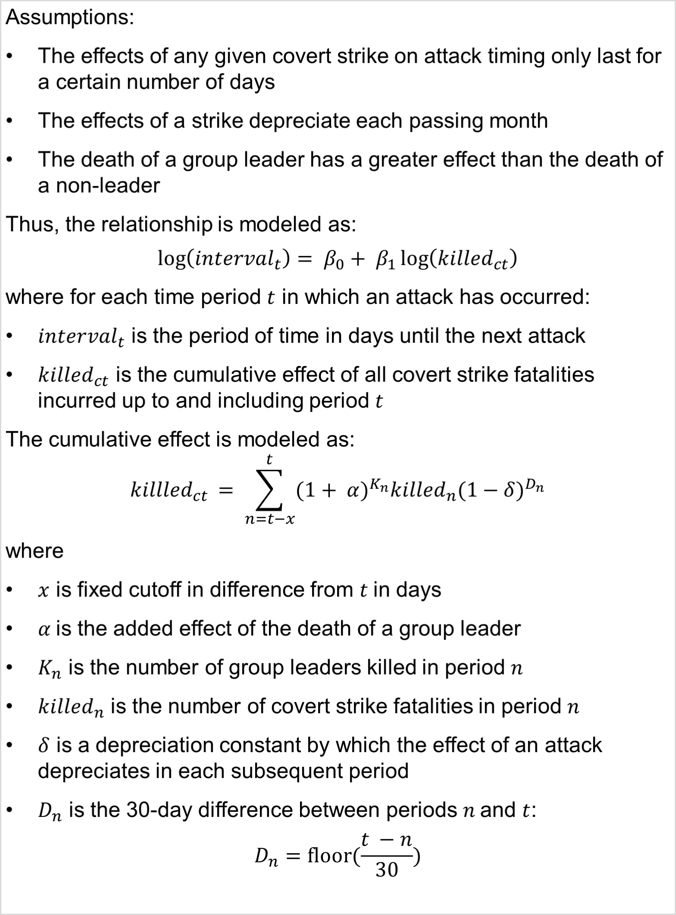
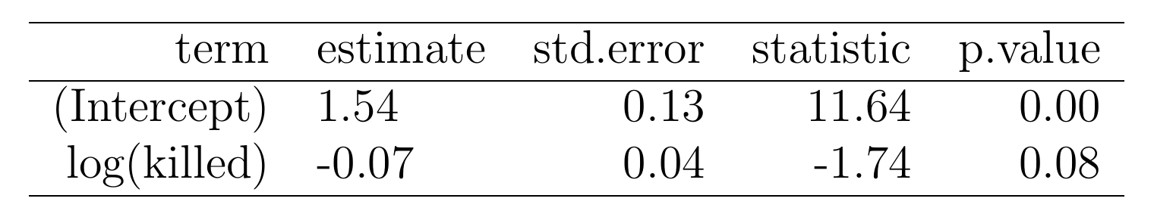
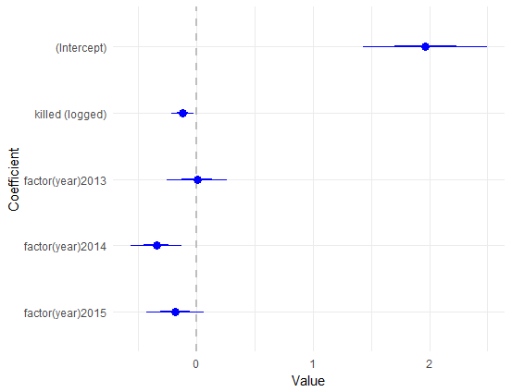
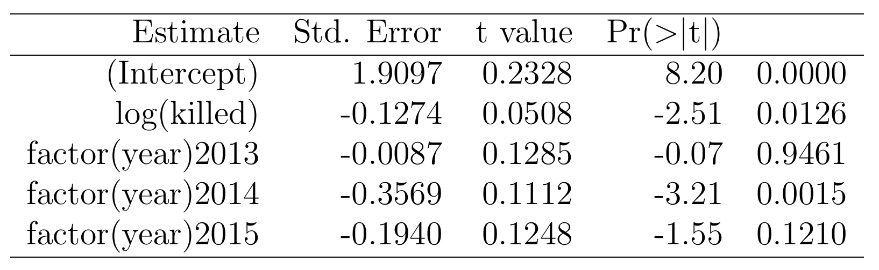
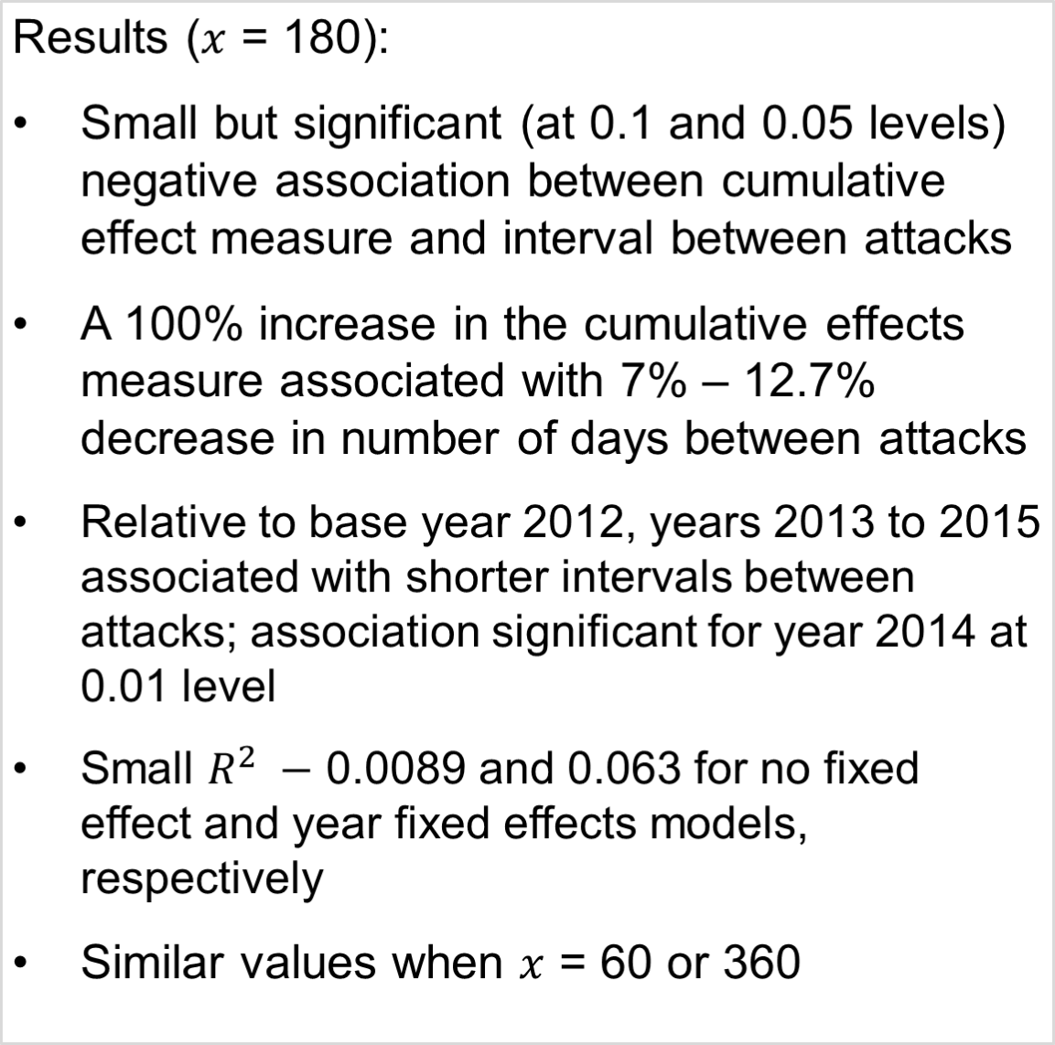
Do Covert Air Strikes Slow Terrorists Down?
The Effect of Covert Air Strike Fatalities on the Timing of Terrorist Attacks
Soo Wan Kim (kimsw@uchicago.edu)
MAPSS, SSD, University of Chicago
Background
Findings
Predicted intervals without fixed effects
Covert operation:
  “An operation that is so planned and executed as to conceal the identity of or permit plausible denial by the sponsor."
(U.S. Department of Defense Dictionary
of Military and Associated Terms)
The US conducted covert drone and other air strikes abroad to target terrorist groups since at least 2002
The Obama administration greatly increased the use of covert air strikes in counter-terror operations
Pros: precision, speed, reduced military footprint
Cons: murky legality, widely publicized collateral damage, controversy due to secretive nature
Model
No fixed effects
Year fixed effects (baseline 2012)
LM of log intervals with fixed effects
Research question
Do covert air strikes against terrorist groups increase or decrease the intervals between terrorist attacks?
Design
Scope: Yemen, 2012 – 2015; covert air campaign against al-Qaeda in the Arabian Peninsula, and contemporary AQAP attacks
Independent variable: time-smoothed measure of fatalities from covert air strikes
Dependent variable: intervals between AQAP-perpetrated attacks in days
Methods: simple linear regression and fixed effects models
Data: Global Terrorism Database (AQAP attacks), the Bureau of Investigative Journalism (reported covert strike incidents and related casualties), New America Foundation (group leader deaths from covert strike incidents)
N = 362
Conclusion
Slight negative association between covert strike fatalities and terrorist attack intervals
Parsimonious model ignores many potentially important factors (e.g. geospatial) and explains only a small part of total variation
Measuring intervals in days (rather than hours or minutes) may be too blunt as many attacks occur in quick succession, sometimes on the same date

