Slide 1
Opensource Software class Final Project (Internet Of Things)
Flask Web Server & ESP8266 Board – IOT System
Tae Hwan, Kim
21300210

Slide 2
Raspberry Pi3 Flask & MQTT Install
Connect with your raspberry pi.
Python package manager pip install.
sudo apt-get install python-pip
Flask install by using pip
sudo pip install flask
Install python MQTT module.
sudo pip install paho-mqtt

Slide 3
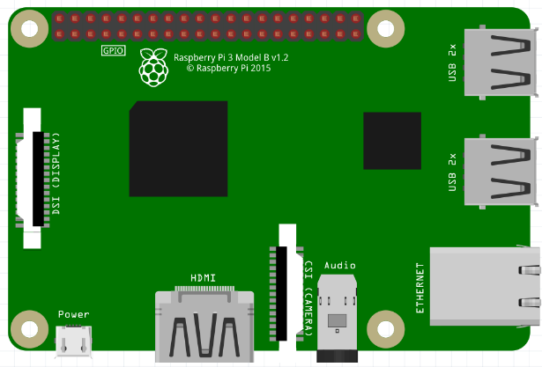

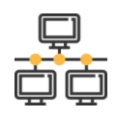
Raspberry Pi3 Flask & MQTT Install
Flask Server
&
MQTT Broker
1. MQTT Broker Check
sudo /etc/init.d/mosquitto stop/start/restart/status 2. sudo nano project.py – python file add.

Slide 4

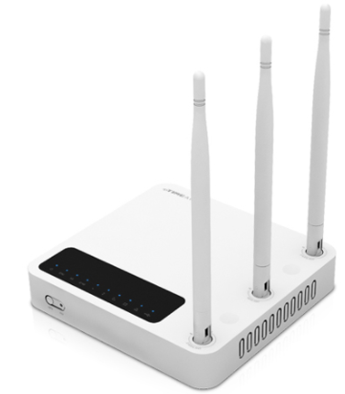
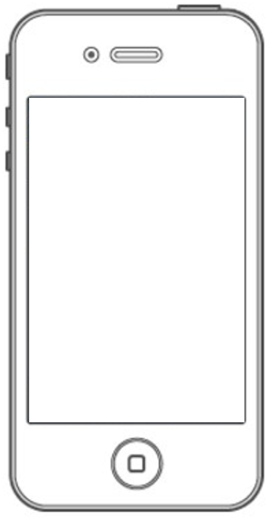

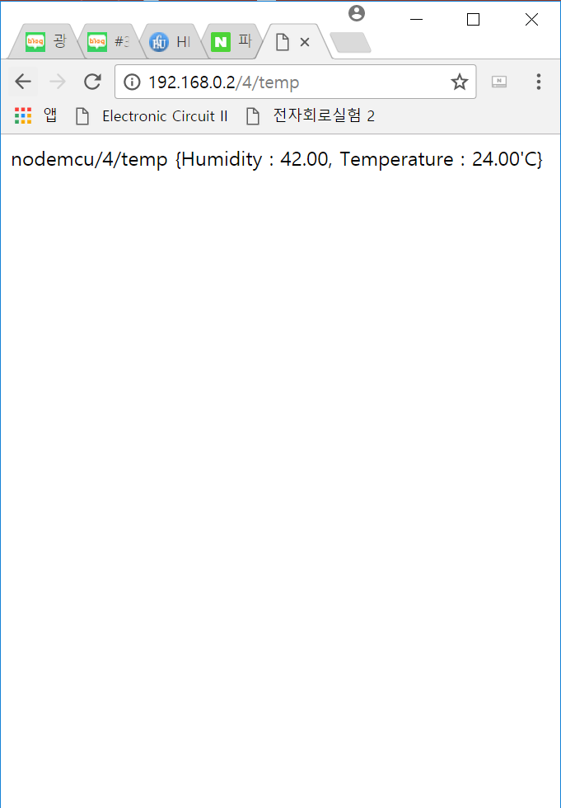


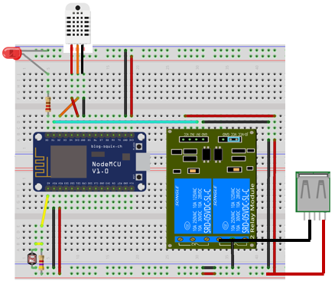
Final Project Scenario & Purpose
<Flask Server, MQTT Broker>
Connect with web
Publish/Client
Command
Publish/Client
Receive result
ESP8266 board 1
Living room
ESP8266 board 2
Kitchen
…
Check Sensor DATA
<Led, Door, DHT22, CDS>

Slide 5
Final Project Scenario & Purpose
Web Server (Smart Phone)
LED Control
ESP8266 - Temperature, Humidity, CDS(light sensor) receive
Raspberry Pi3
Flask Server – Web
MQTT Broker – Publish/Client (connect with ESP8266 & Web)
Gateway – Control many ESP8266 (Each Room) simultaneously.
NodeMCU
LED Toggle
DHT22 sensor
CDS(조도센서) sensor
Door sensor

Slide 6
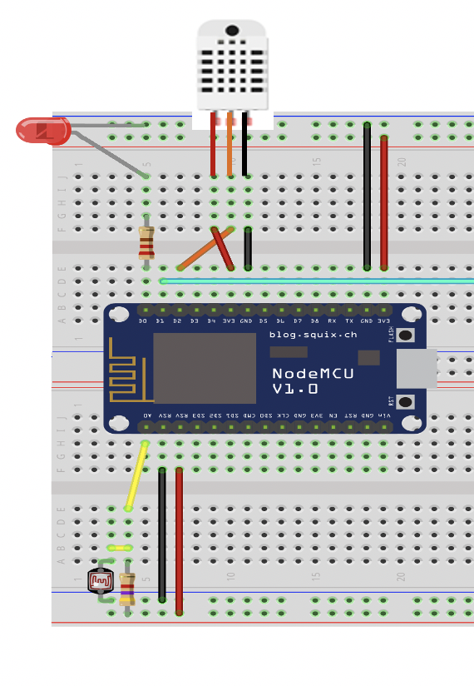



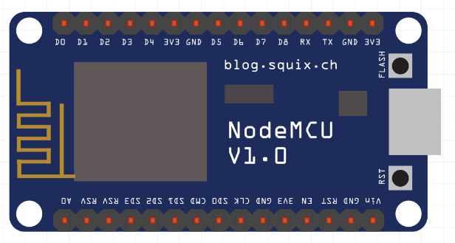

ESP8266 board circuit composition
4.7kΩ
CDS
DHT22
GND

Slide 7
URL Command
LED Control
http://IP/iot/num/(command)
led – led Toggle command
ledon – led ON
ledoff – led OFF
2. DOOR sensor value Receive
http://IP/iot/num/DOOR
3. DHT22 value Receive
http://IP/iot/num/DHT22
4. CDS value Receive
http://IP/iot/num/CDS

Slide 8
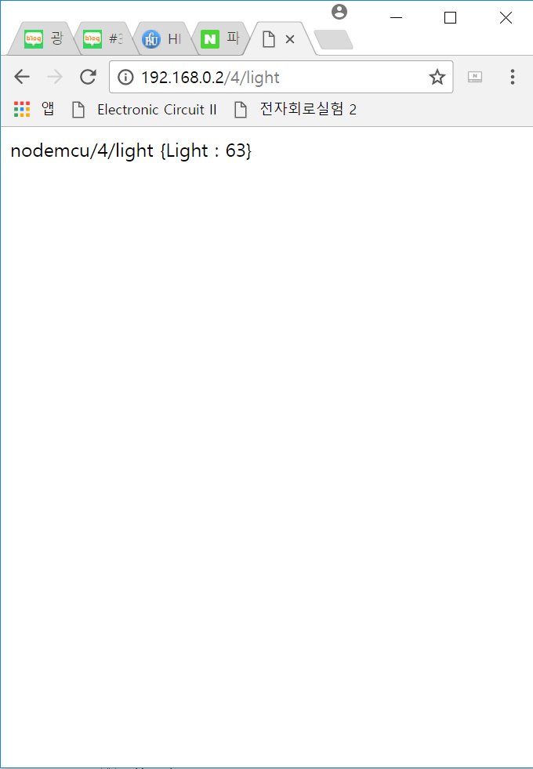
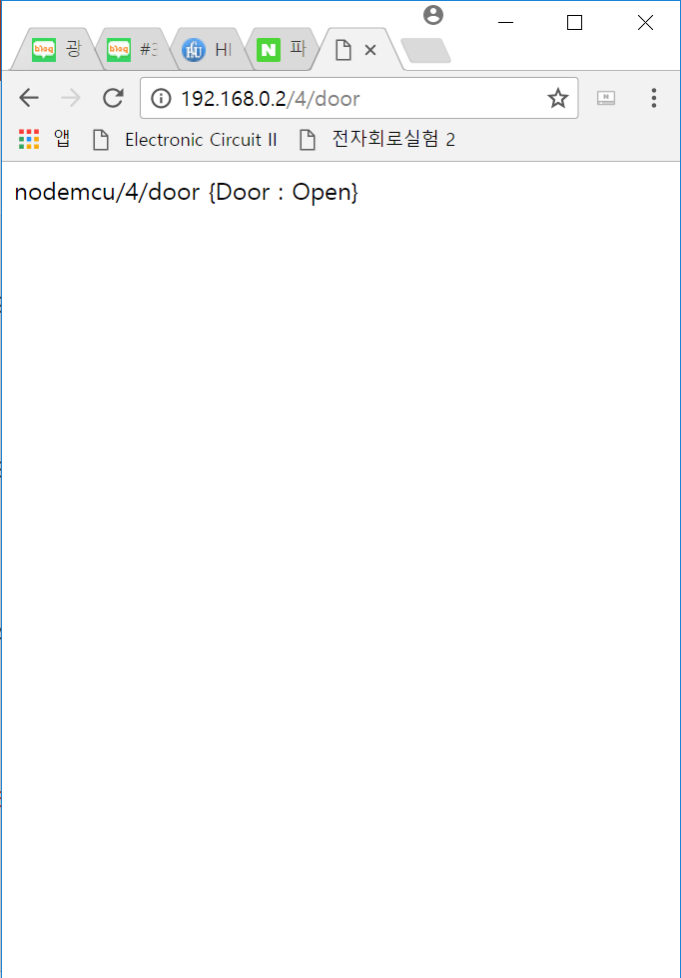
Check Result (Read Sensor value at web)
<Temperature Check>
IP/iot/(num)/DHT22
<Light Check>
IP/iot/(num)/CDS
<Door Check>
IP/iot/(num)/DOOR

