Slide 1
Example of a Bad Color Scheme
Fonts in the same color family as the background do not show up well.
Here are some tips for good color combinations
  Use the Design Templates
    Go under the format menu and select Slide Design
  Use the Standard Color schemes
    You can’t go wrong with the dark blue background and yellow or white text

Slide 2
Another Bad Color Scheme
Dark text on dark background
Beware of shaded backgrounds
The dark text is harder to read down here

Slide 3
Distracting Backgrounds
Color
  Too bright
  Not enough contrast
  Some colors will look different when projected
Distracting designs

Slide 4
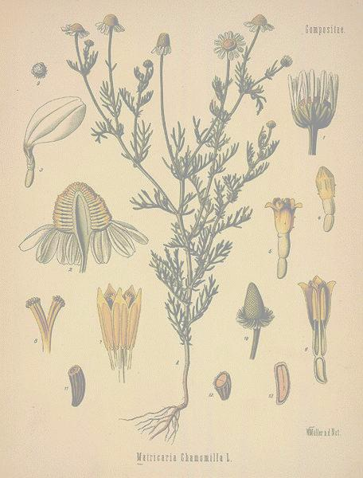
Regulation of Herbs and Drugs
Regulation varies from country to country
Herbs are classified as dietary supplements in United States
  Manufacturers are limited in claims they can make
US Regulating Agencies
  American Herbal Products Association
  Natural Nutritional Foods Association
Safety with herbs
  Be informed
  Dosage
  Side effects

Slide 5
THE CENTRAL DOGMA OF MOLECULAR BIOLOGY
Transcription of DNA to RNA to protein:
1.The DNA replicates its information in a process
that involves many enzymes: replication.
2. The DNA codes for the production of messenger RNA (mRNA) during transcription.
3. In eucaryotic cells, the mRNA is processed and migrates from the nucleus to the cytoplasm.
4. Messenger RNA carries coded information to ribosomes. The ribosomes "read" this information and use it for protein synthesis. This process is called translation.

Slide 6
RNA information (in the form of
nucleotide sequences) is then
TRANSLATED into proteins
(long polypeptide chains) by
complex units called ribosomes.
Proteins are the work horses of
biological systems, i.e. enzymes,
messengers, and building blocks.

Slide 7
Hydrophobic and Hydrophilic
Hydrophilic-- water loving or a molecule that is capable of forming a hydrogen bond with water.
Hydrophobic-- water hating or a molecule that repels water.
Important function in cell’s membrane structure.

Slide 8

How Do Neural Networks Compute?
Activation = the final value of a particular unit.
Calculated by adding inputs and bias
Activation function
W1
Bias
W2
Σ
Final Activation
W3
Net Input
Activation Function

