Slide 1
Plainly:
medical words, explained
Notes:
Plainly turns phrases from discharge notes and lab reports into plain English.
Live site: https://plainly-medical-explainer.kimtastico.workers.dev
Code: https://github.com/kimtastico/Applied-Agentic-Healthcare-Demo

Slide 2
Your reports should make sense to you
Why it matters to me
[Your reason, in your own words: 1–2 sentences]
The goal
Paste a phrase like “hyponatremia”
Plain English, grade 6
Temperature 0: creativity is a bug
Save the term, never the person
Notes:
Why: [say your personal reason here, in your own words].
Goal, from my project brief: paste a phrase from a discharge note or lab report, like “mild bilateral pleural effusion,” and get a plain-English explanation at a 6th-grade reading level. Supabase logs only the term, not the user, building a public glossary of the most-searched phrases. Temperature 0: “Creativity is a bug for these tasks.”
Running example for the whole deck: hyponatremia (low sodium in the blood).
Source: my project brief.

Slide 3
The glossary is checked before any AI
You paste “hyponatremia”
Worker looks in the glossary
Saved?
No
Yes
Show saved answer: instant
Notes:
1. The visitor pastes a phrase, here “hyponatremia.”
2. The Cloudflare Worker (the site’s server code) looks the term up in the Supabase glossary.
3. The Worker decides: if this exact term was already answered and reviewed under the current instructions, it shows that saved answer instantly, with no AI call. Otherwise the flow continues on the next slide.
Source: project code, src/worker.js (handleExplain) and README “How it works.”

Slide 4
A second AI checks every new answer
Writer AI drafts
(Llama 3.3 70B)
Code checks:
grade, causes,
privacy
Reviewer AI
approves or fixes
(gpt-oss-120b)
Answer with review badge
Final check,
then saved
Notes:
4. The writer AI (Llama 3.3 70B on Cloudflare Workers AI) drafts the explanation at temperature 0, following worked examples.
5. Code checks what a computer can: reading grade, phrases that sound like causes or advice, personal details.
6. The reviewer AI (gpt-oss-120b) checks the draft against the five rules — no causes or advice, grade 6 or below, correct word roots, no personal details, care-team questions — and approves it or returns a corrected version.
7. Final check: if the reviewer rewrote the answer, the code checks run again on its version, because nobody else has checked that text. Only answers that pass are saved, so no small problem gets locked into the glossary. The next search for the term is then instant.
8. The visitor sees the answer with a badge: “Checked by reviewer AI” or “Corrected by reviewer AI.”
If the final check flags something, or the reviewer is unavailable, the answer is still shown, with a badge saying so, but it isn’t saved; the next search tries again.
Source: project code, src/pipeline.js and src/models.js; README “How it works.”

Slide 5
A different model checks the writer
 | Writer | Reviewer
Model | Llama 3.3 70B | gpt-oss-120b
Made by | Meta | OpenAI
Runs on | Cloudflare Workers AI | Cloudflare Workers AI
Why | Clear, fast writing | Reasons through rules
Backup if Workers AI fails: NVIDIA Nemotron
Notes:
Both models are open-weight: their makers publish them, and Cloudflare runs its own copies, so there is no OpenAI or Meta account and no cost beyond Cloudflare’s free daily Workers AI allowance.
Why two different makers: a reviewer from a different model family is less likely to share the writer’s blind spots, and models tend to rate their own writing too kindly. (This is our design reasoning, based on general research on AI models judging AI output; we did not run a controlled test of it.)
Writer: Llama 3.3 70B — clear plain writing, follows a fixed answer format, fast. Reviewer: gpt-oss-120b — larger, and a reasoning model that thinks through the rules before giving a verdict (set to low effort to stay quick). Both run at temperature 0.
Backups: NVIDIA’s free Nemotron 3 Ultra and Nemotron 3.5 Lightning. We started on NVIDIA, but its free trial was often overloaded and retired our first model, Llama 3.3, so the same Llama now runs on Cloudflare.
Sources: Cloudflare Workers AI model catalog (developers.cloudflare.com/workers-ai/models), read through Wrangler 4.154’s built-in Workers AI model definitions; NVIDIA API catalog (build.nvidia.com); project settings in wrangler.jsonc.

Slide 6
The database: one row per term
Supabase table: glossary_terms
term | search_count | explanation | model
hyponatremia | 3 (example) | “Less sodium in your blood…” Reviewed | Llama 3.3 70B
potassium | 1 (example) | None: the input had a number | None
Never stored: who searched or what they typed
Notes:
The whole database is one Supabase table, glossary_terms. Each row is one medical term: term, search_count, explanation (the reviewed answer plus what the reviewer found, as JSON), model (which AI wrote it, e.g. @cf/meta/llama-3.3-70b-instruct-fp8-fast), prompt_version (old answers are redone when the instructions change), and two timestamps.
Row 1: a real answer from the live site (hyponatremia, reviewed by gpt-oss-120b).
Row 2: what happens with “potassium 5.8 mmol/L”: the answer may mention that number, so only the term is counted and no explanation is saved.
The search counts shown are examples, not live numbers.
Privacy: anyone can read the glossary, but only the server can write to it (row-level security), and there is no column for a user, their IP address, or the text someone typed.
Source: project code, supabase/migrations/0001_glossary.sql and src/worker.js.

Slide 7
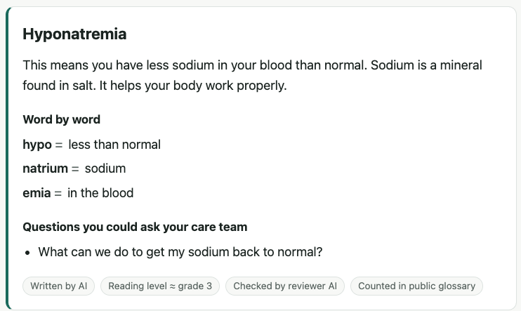
Try it: a reviewed answer in seconds
Search “hyponatremia”
Search it again: instant
Try “potassium 5.8 mmol/L”
Check /api/health/ai
plainly-medical-explainer.kimtastico.workers.dev
Notes:
Live: https://plainly-medical-explainer.kimtastico.workers.dev
1. Search “hyponatremia”: the writer drafts, the reviewer checks, about 5 seconds. Point out the badges.
2. Search it again: instant, “From the glossary,” word for word the same.
3. Try “potassium 5.8 mmol/L”: it explains what the test measures, doesn’t judge the number, and only “potassium” is counted.
4. Open https://plainly-medical-explainer.kimtastico.workers.dev/api/health/ai: it shows which models answered and how long each took.
Before presenting, search each demo term once so it’s saved and instant.
Screenshot: the live site’s hyponatremia answer, October 30, 2026.
References: project repository, https://github.com/kimtastico/Applied-Agentic-Healthcare-Demo; Cloudflare Workers AI models, https://developers.cloudflare.com/workers-ai/models/; NVIDIA API catalog, https://build.nvidia.com; Supabase, https://supabase.com.

