Slide 1
Welcome

Slide 2
I am introducing myself with the help of a collage. It is not just a collage, but a collection of my real-life experiences.

Slide 3
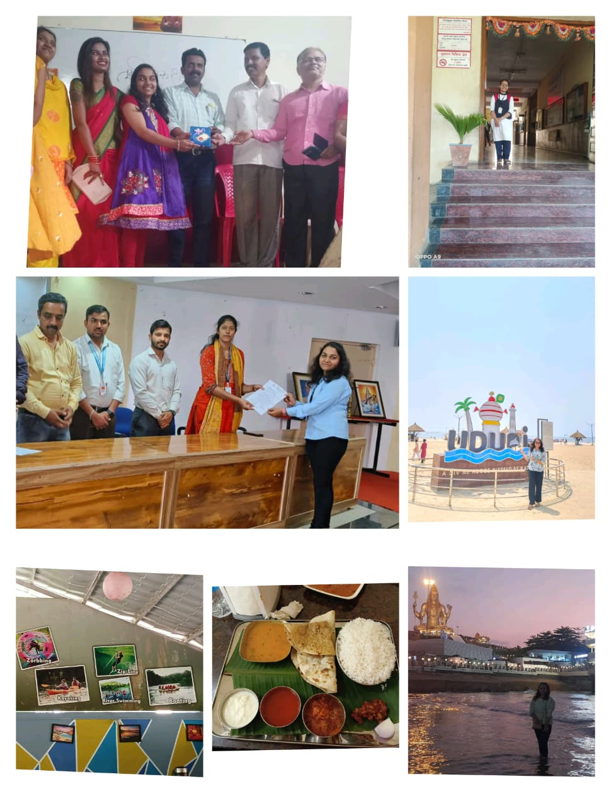
1.Zorbbing 2.kayaking 3.Zip –Lining 4.River Swimming

