Slide 1
Names in uniform
Spellings
Homework
Topics & trips
Year 5
Bikes
Reading
P.E - swimming
Partnership
Times tables

Slide 2

Teachers and TAs
Teachers
Mrs Fearn ( Monday,Tuesday)
Mrs Henstock (Wednesday,Thursday, Friday)
TAs
Mrs Beresford
Mr Crossfield

Slide 3
Topics
Autumn Term- The Tudors/The Rainforest
Spring Term – The Polar Regions/ The Greeks
Summer Term- The Seaside

Slide 4
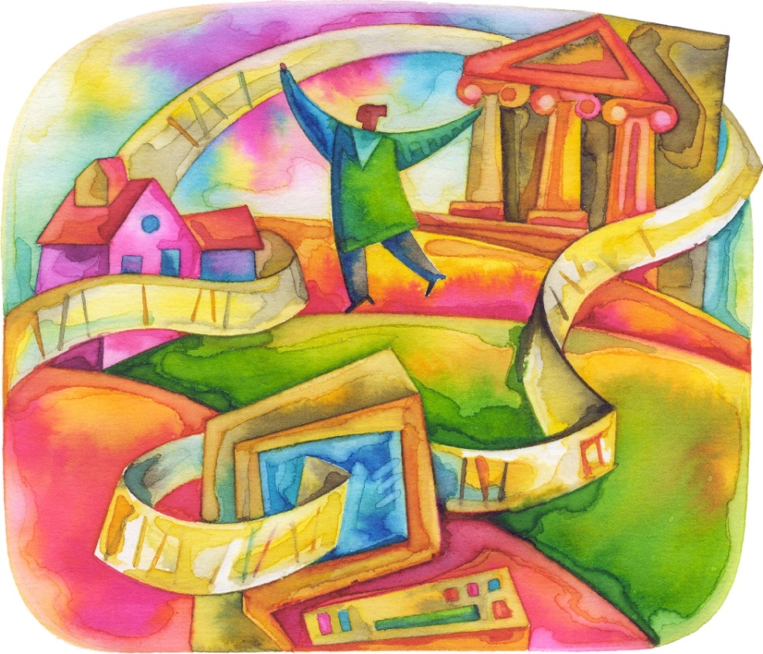
Curriculum in Year 5
Literacy/SPAG
Maths
Topic
Handwriting
Guided Reading
Spellings

Slide 5
Spellings and Reading
Handed out on a Wednesday, for testing the following Wednesday. Some given 8, 10 or 12 to learn.
Reading log will be checked every Monday by Mrs. Fearn. Expectation is 2.5 hours a week- which is about 20 mins per day. More independent - children can write their own comments.

Slide 6
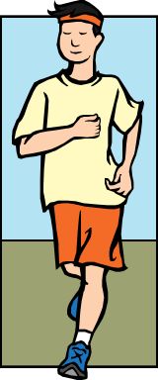
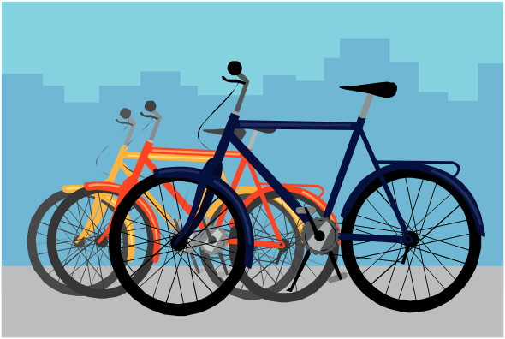

Curriculum in Year 5
Science
PE
Homework
Residential visit
Swimming
Bikeability

Slide 7
Bikeability
Mon 23rd September – Friday 27th September
Three groups – 1.5 hours each per day.
Tested on the Friday.
ALL bikes must be road worthy and ALL children must wear a helmet.

Slide 8

Trips
Murton Park in York
Cadbury World
MOSI
Scarborough residential
(Wed 13th – Fri 15th May 2020)
Weston Park Museum Sheffield

