Slide 1
Year 1 English
Meeting For Parents

Slide 2
Aim of the meeting – help you understand the expectations in English and how you can support your child.
Reading
Writing

Slide 3

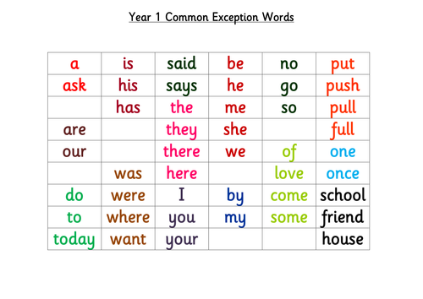
We teach reading through a mixture of phonics and whole word recognition
Whole Word Recognition
We call them ‘tricky red words’
Children need to learn to read them on sight
not blend the sounds.
We will be learning to read and write at least
one new word a week.

Slide 4

Phonics
Children learn 44 sounds and matching letters/letter groups
Fred...
Fred helps children learn to read
Fred can only talk in sounds...
(Fred can only say c_a_t, he can’t say cat)
We call this Fred Talk
Fred...
Fred helps children learn to spell as well!
Children convert words into sounds
They press the sounds they hear on to their fingers...
We call this Fred Fingers

Slide 5
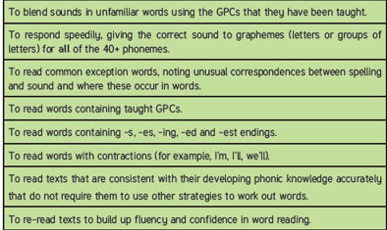
Fred talk
Working at the expected standard for Year 1
Tricky red words

Slide 6
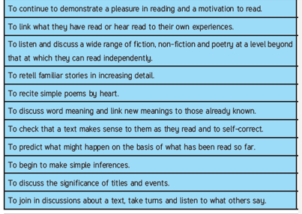
Working at the expected standard for Year 1

Slide 7

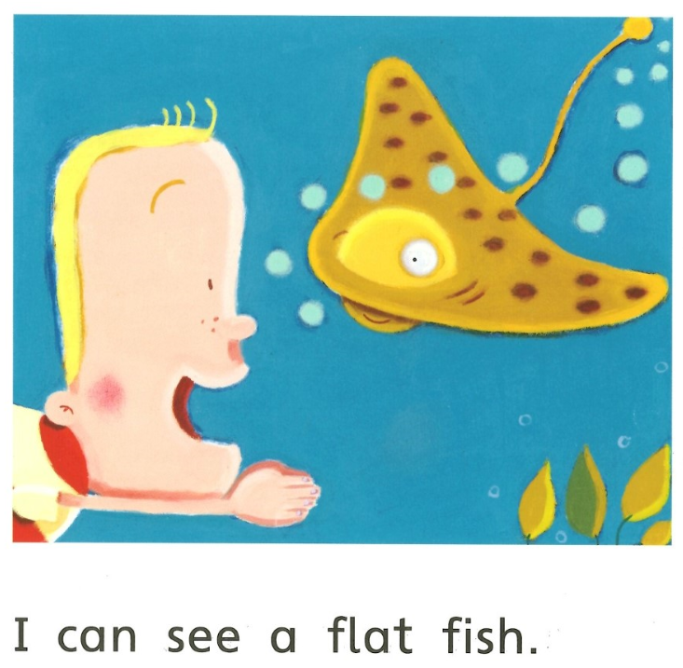
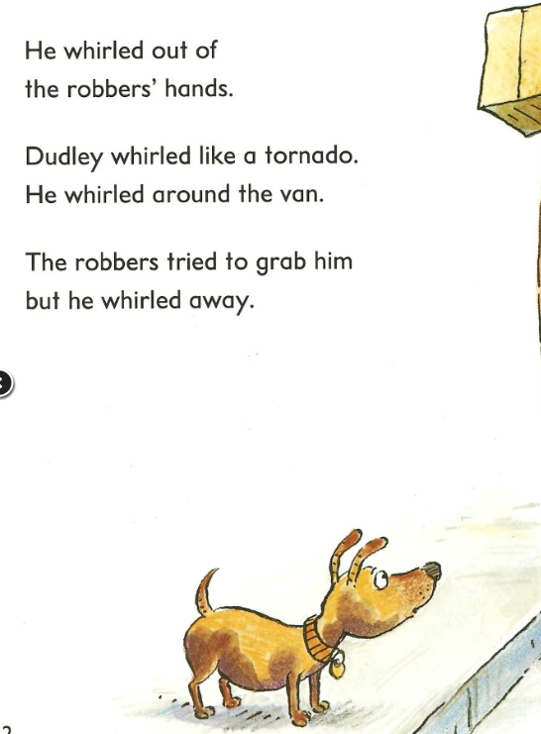
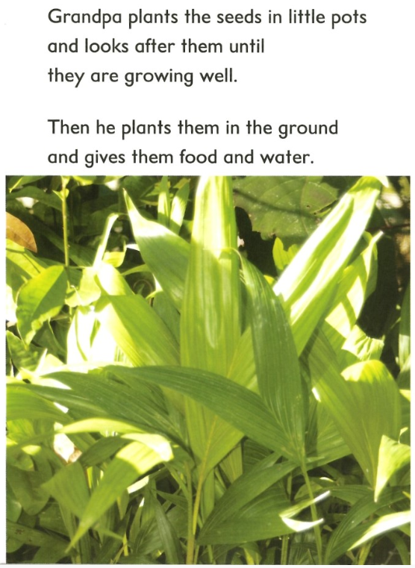
Book Bands

Slide 8
So how can you help your child?
By learning the sounds and words that come home each week.
By encouraging blending new words using Fred Talk for reading m_a_t
By encouraging Fred Fingers for spelling
By practising they’re reading every day.
Talk about what you are reading.

Slide 9

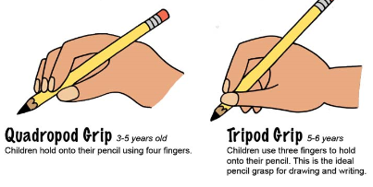

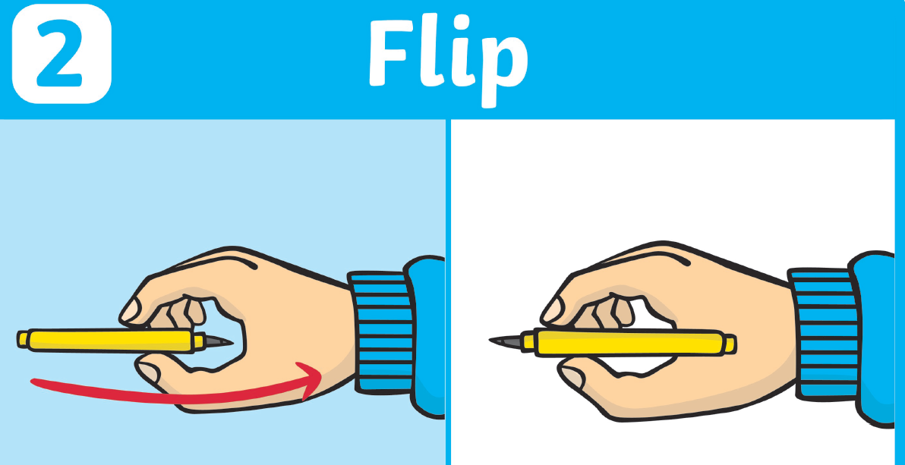

Please encourage a good tripod grip

Slide 10
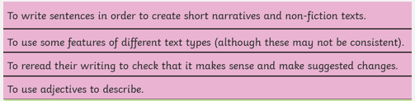
Composition
Working at the expected standard for Year 1

Slide 11
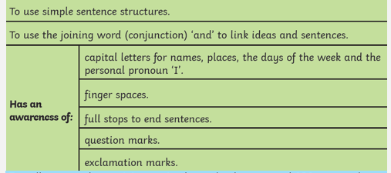
Grammar and Punctuation
Working at the expected standard for Year 1

Slide 12
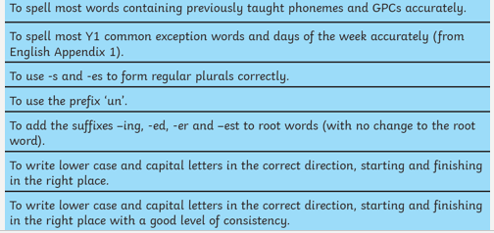
Working at the expected standard for Year 1
Transcription

Slide 13
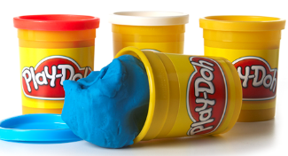
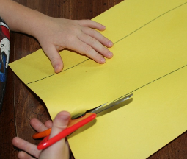
So how can you help your child?
Encourage speaking in full sentences.
Practise pencil grip and fine motor skills.
Practise letter and number formation.
Encourage fred talk when they are trying to write a word.
What sounds can you hear?

Slide 14



https://www.teachyourmonstertoread.com/?gclid=CjwKCAjwq4fsBRBnEiwANTahcOp6XNrxw9HcGNcbE6p2Wy476ZcDYN3RAhjiN9jdCRUCNcT9yhZiXBoCAnEQAvD_BwE
https://www.roythezebra.com/
https://www.oxfordowl.co.uk/for-home/kids-activities/games--1/

Slide 15
Questions

Slide 16

Time to look at resources

