Slide 1
Year 1 Maths
Meeting For Parents

Slide 2
Aim of the meeting – help you understand the expectations in Maths, how we teach it, and how you can support your child.
Numbers and place value
Addition and subtraction
Multiplication and division
Fractions
Measurement
Geometry
Notes:
These are the areas of maths we will cover in Year 1

Slide 3
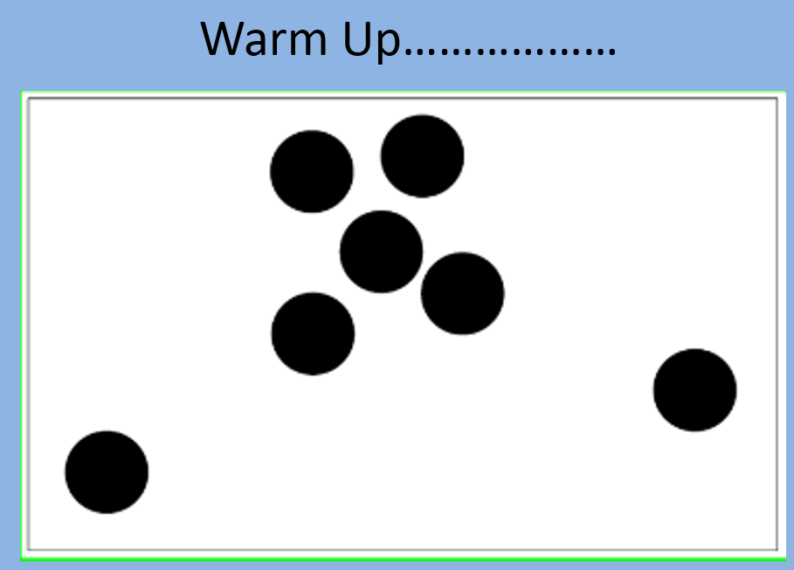
Notes:
Thumbs up when you know how many dots there are.
The people who got there very quickly how did you do it? What helped?
Subitising – automatic recognition (latin) without counting.

Slide 4
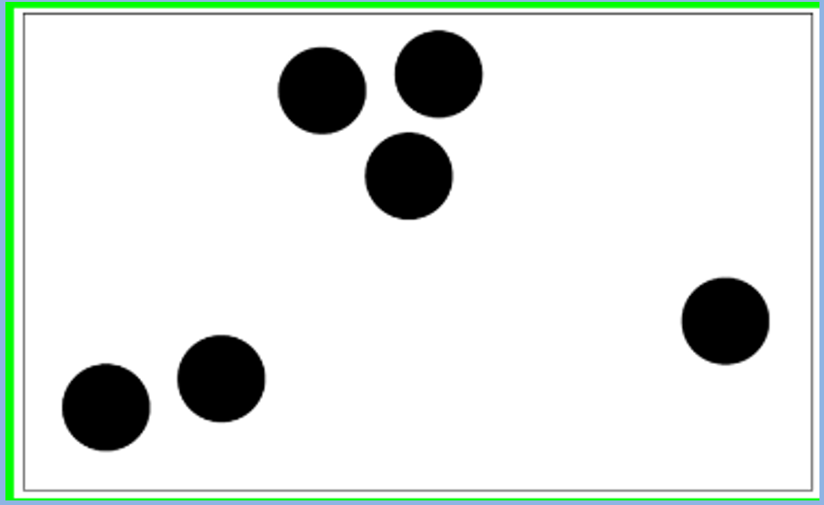

Slide 5
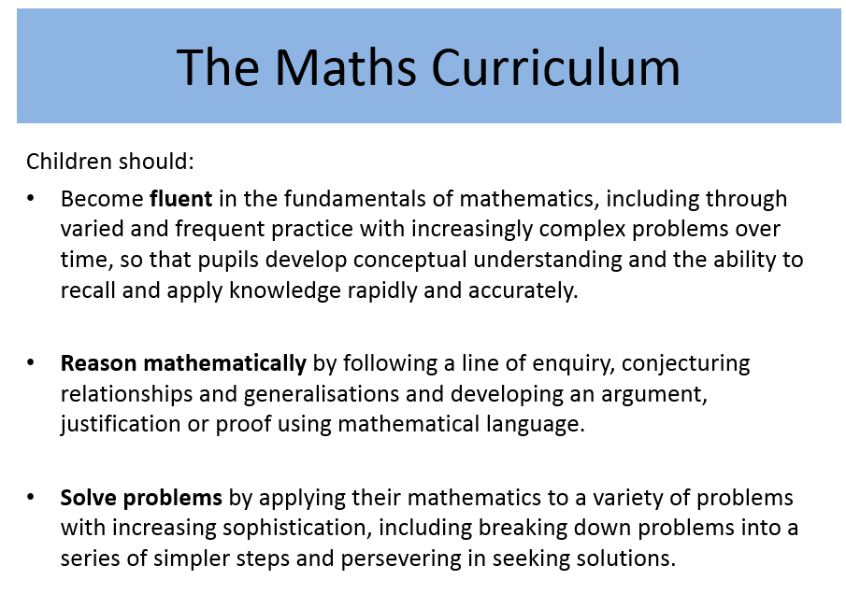
Notes:
2015 – New Maths Curriculum – called Mastery curriculum. This means that teachers should focus on key concepts and not move on until all children have mastered that particular area. Within Maths there are three main elements that inter-weave.
Fluent –
Reasoning –
Problem solving

Slide 6
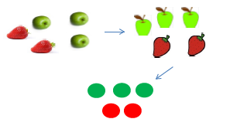
Concrete representation
Pictorial representation
Abstract representation
Notes:
Concrete- The DOING
A child is first introduced to an idea or a skill by acting it out with real objects. This is a 'hands on' component using real objects and it is the foundation for conceptual understanding.
Pictorial-The SEEING
A child has sufficiently understood the hands-on experiences performed and can now relate them to representations, such as a diagram or picture of the problem.
Abstract – The SYMBOLIC
A child is now capable of representing problems by using mathematical notation, for example: 12 ÷ 2 = 6

Slide 7

Reasoning
Which is the odd one out?
Why?

Slide 8
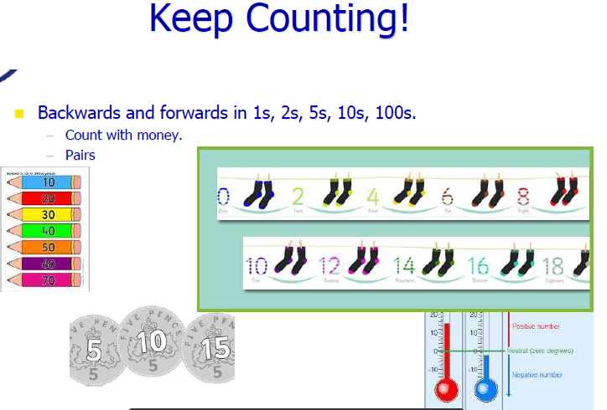

Slide 9

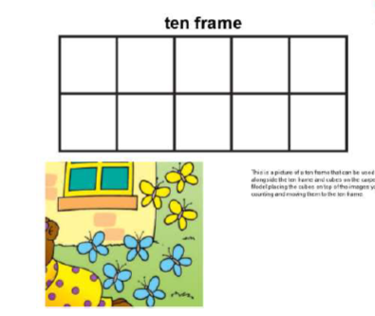
Notes:
Numbers can be represented, using counters or drawing dots, on a ten frame.
There are 5 blue butterflies.

Slide 10

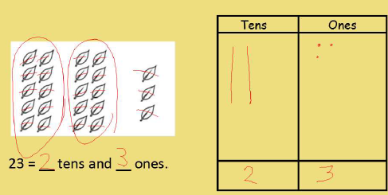
Notes:
Where numbers fit and what each digit represents / means. The value.

Slide 11
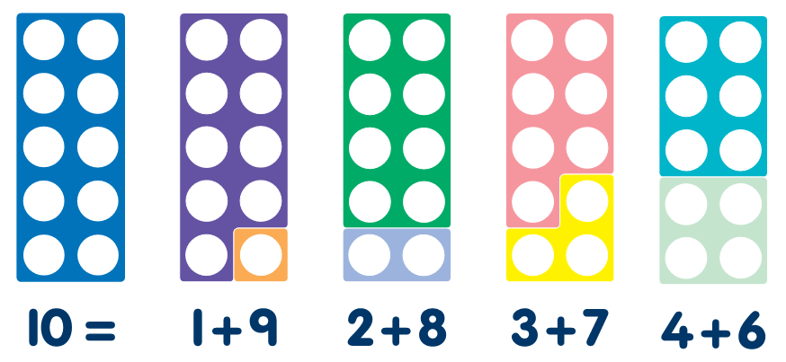
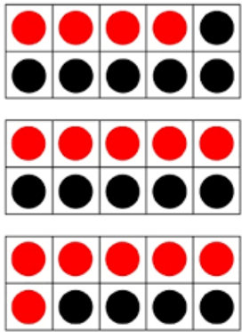
Bonds to 10 & 20
It is important that children recognise number bonds, different pairs of numbers with the same total and that they are fluent in this.
Children need to be secure on bonds to 10 by the end of Year 1.

Slide 12




https://www.oxfordowl.co.uk/for-home/kids-activities/fun-maths-games-and-activities/
https://www.topmarks.co.uk/maths-games/5-7-years/counting
https://www.mathplayground.com/
https://www.bbc.co.uk/bitesize/subjects/zjxhfg8

Slide 13
Questions

