Slide 1
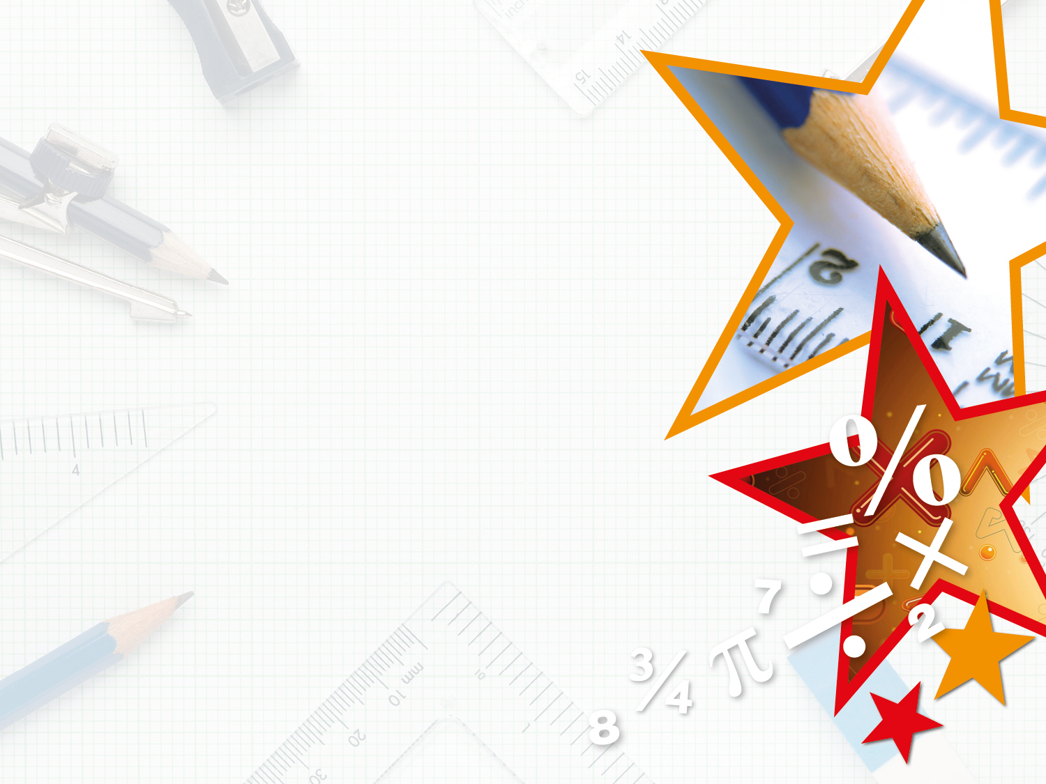

Year 2 – Spring Block 5 – Length and Height – Order Lengths
About This Resource:
This PowerPoint has been designed to support your teaching of this small step. It includes a starter activity and an example of each question from the Varied Fluency and Reasoning and Problem Solving resources also provided in this pack. You can choose to work through all examples provided or a selection of them depending on the needs of your class.
National Curriculum Objectives:
Mathematics Year 2: (2M1) Compare and order lengths, mass, volume/capacity and record the results using >, < and =
More Year 2 Length and Height resources.
Did you like this resource? Don’t forget to review it on our website.
© Classroom Secrets Limited 2019

Slide 2
Year 2 – Spring Block 5 – Length and Height
Step 4: Order Lengths
© Classroom Secrets Limited 2019

Slide 3
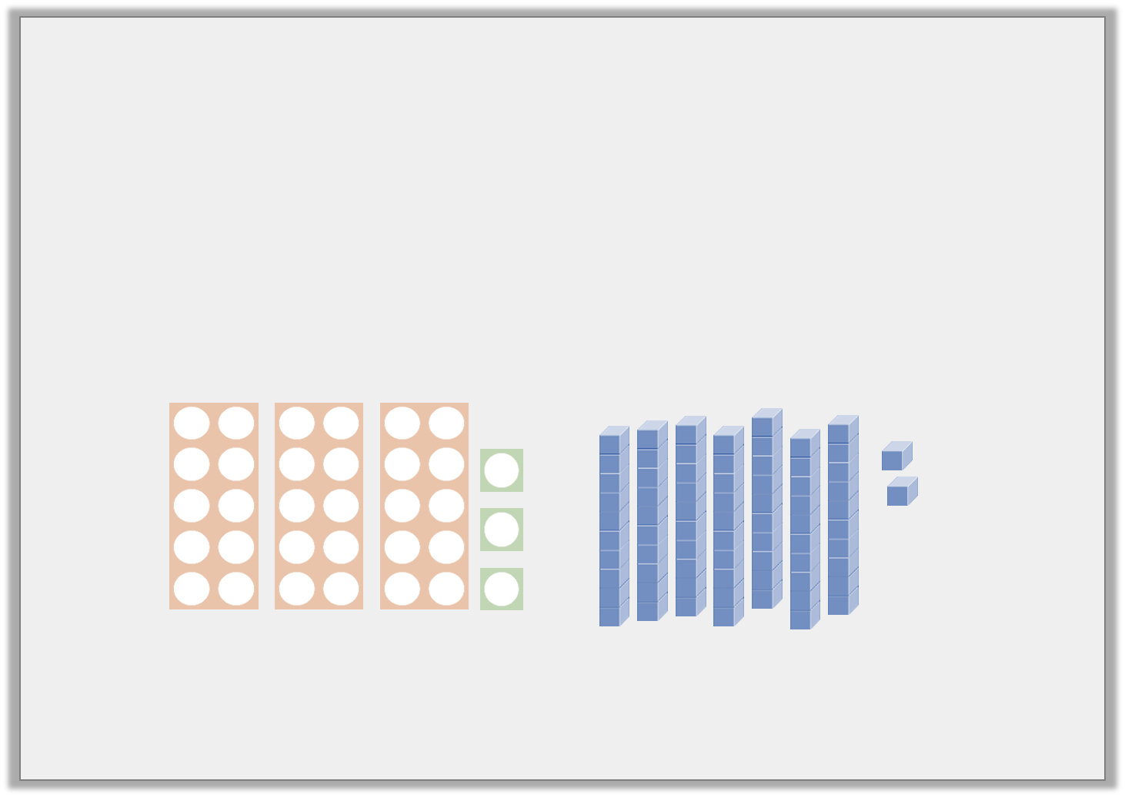
Introduction
Put these representations in ascending order.
1
1
10
T | O
1
10
1
1
10
1
10
1
1
10
© Classroom Secrets Limited 2019

Slide 4
Introduction
Put these representations in ascending order.
33, 47, 58, 72
1
1
10
T | O
1
10
1
1
10
1
10
1
1
10
© Classroom Secrets Limited 2019

Slide 5
Varied Fluency 1
Order these lengths from longest to shortest.
46cm
11cm
one metre and five centimetres
64cm
© Classroom Secrets Limited 2019

Slide 6
Varied Fluency 1
Order these lengths from longest to shortest.
one metre and five centimetres, 64cm, 46cm, 11cm
46cm
11cm
one metre and five centimetres
64cm
© Classroom Secrets Limited 2019

Slide 7
Varied Fluency 2
True or false?
8cm is shorter than 18cm.
© Classroom Secrets Limited 2019

Slide 8
Varied Fluency 2
True or false?
True
8cm is shorter than 18cm.
© Classroom Secrets Limited 2019

Slide 9
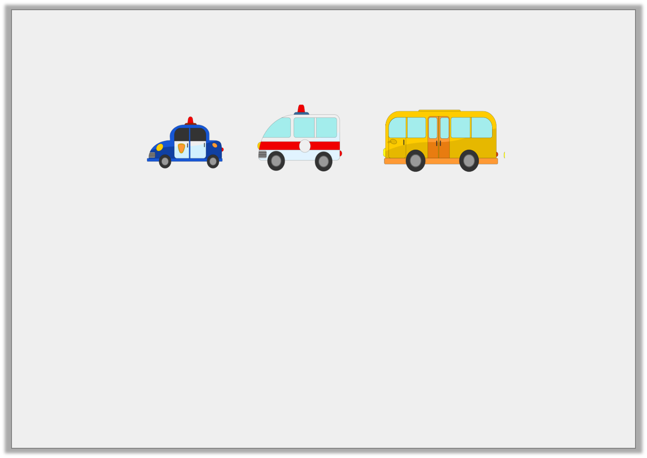
Varied Fluency 3
These toy vehicles have been ordered by their length from shortest to longest.
Using the table, tick where the aeroplane should be.
Vehicle | Length
police car | 56cm
aeroplane | 1m 15cm
ambulance | 65cm
bus | 87cm
© Classroom Secrets Limited 2019

Slide 10
Varied Fluency 3
These toy vehicles have been ordered by their length from shortest to longest.
Using the table, tick where the aeroplane should be.
To the right of the bus
✓
Vehicle | Length
police car | 56cm
aeroplane | 1m 15cm
ambulance | 65cm
bus | 87cm
© Classroom Secrets Limited 2019

Slide 11
Varied Fluency 4
Circle the numbers that could be used to complete the following statement.
14cm | > |  | > | 56cm
1m 11cm
thirty seven
centimetres
89cm
43cm
© Classroom Secrets Limited 2019

Slide 12
Varied Fluency 4
Circle the numbers that could be used to complete the following statement.
thirty seven centimetres, 43cm
14cm | > |  | > | 56cm
1m 11cm
thirty seven
centimetres
89cm
43cm
© Classroom Secrets Limited 2019

Slide 13
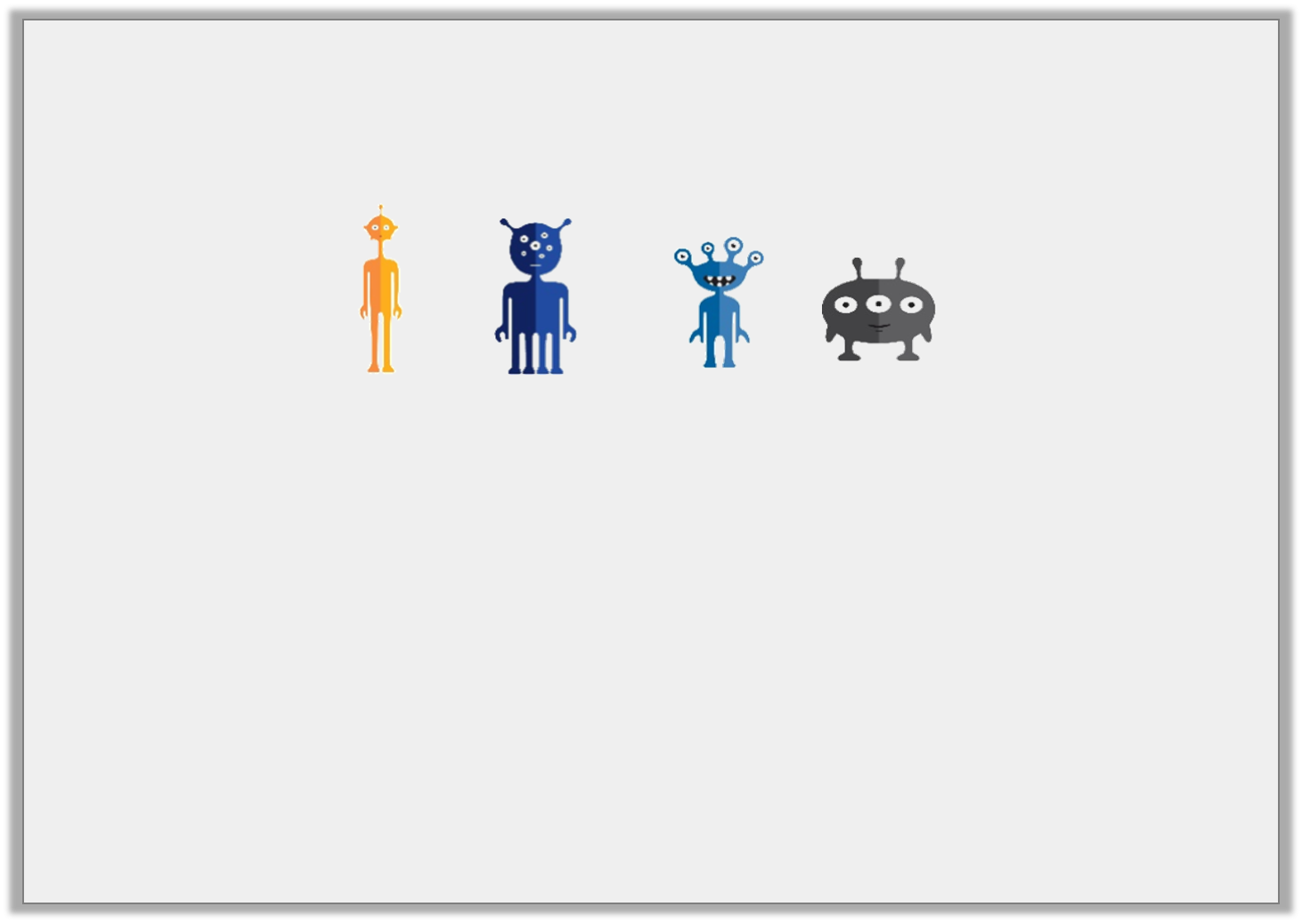
Problem Solving 1
These aliens have been placed in order of height from tallest to shortest.
Match the toy to its height.
2 eyes
3 eyes
4 eyes
6 eyes
1m 2cm
1m 35cm
65cm
45cm
© Classroom Secrets Limited 2019

Slide 14
Problem Solving 1
These aliens have been placed in order of height from tallest to shortest.
Match the toy to its height.
2 eyes – 1m 35cm, 3 eyes – 45cm, 4 eyes – 65cm, 6 eyes – 1m 2cm
2 eyes
3 eyes
4 eyes
6 eyes
1m 2cm
1m 35cm
65cm
45cm
© Classroom Secrets Limited 2019

Slide 15
Problem Solving 2
Here are the lengths of some models.
Use the symbol > to order the statements.
Model | Lengths
Car | 30cm
Plane | 1m 20cm
Train | 2m 50cm
Plane
2 cars
Plane and car
Train
© Classroom Secrets Limited 2019

Slide 16
Problem Solving 2
Here are the lengths of some models.
Use the symbol > to order the statements.
Train > Plane and car > Plane > 2 cars
Model | Lengths
Car | 30cm
Plane | 1m 20cm
Train | 2m 50cm
Plane
2 cars
Plane and car
Train
© Classroom Secrets Limited 2019

Slide 17
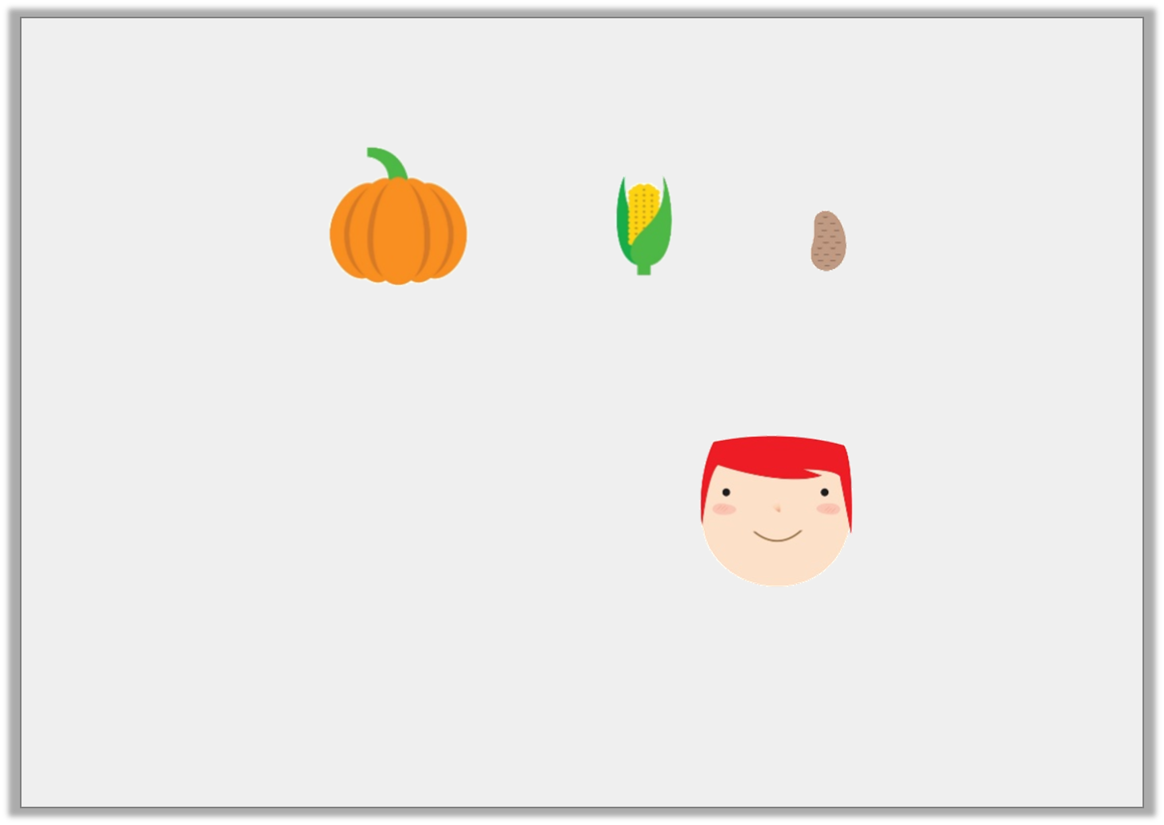
Reasoning 1
Harriet has grown and ordered these prize-winning vegetables.
Jack has grown some corn which is shorter than Harriet’s.
Jack says,
Is he correct? Convince me.
I have the smallest vegetable.
© Classroom Secrets Limited 2019

Slide 18
Reasoning 1
Harriet has grown and ordered these prize-winning vegetables.
Jack has grown some corn which is shorter than Harriet’s.
Jack says,
Is he correct? Convince me.
No he is not correct because…
I have the smallest vegetable.
© Classroom Secrets Limited 2019

Slide 19
Reasoning 1
Harriet has grown and ordered these prize-winning vegetables.
Jack has grown some corn which is shorter than Harriet’s.
Jack says,
Is he correct? Convince me.
No he is not correct because Harriet’s potato is shorter than her corn. We don’t know whether Jack’s corn is shorter than Harriet’s potato.
I have the smallest vegetable.
© Classroom Secrets Limited 2019

