Slide 1


Year 3 – Spring Block 4 – Length and Perimeter – Measure Perimeter
About This Resource:
This PowerPoint has been designed to support your teaching of this small step. It includes a starter activity and an example of each question from the Varied Fluency and Reasoning and Problem Solving resources also provided in this pack. You can choose to work through all examples provided or a selection of them depending on the needs of your class.
National Curriculum Objectives:
Mathematics Year 3: (3M7) Measure the perimeter of simple 2-D shapes
More resources which follow the same small steps as White Rose.
Did you like this resource? Don’t forget to review it on our website.
© Classroom Secrets Limited 2019

Slide 2
Year 3 – Spring Block 4 – Length and Perimeter
Step 7: Measure Perimeter
© Classroom Secrets Limited 2019

Slide 3
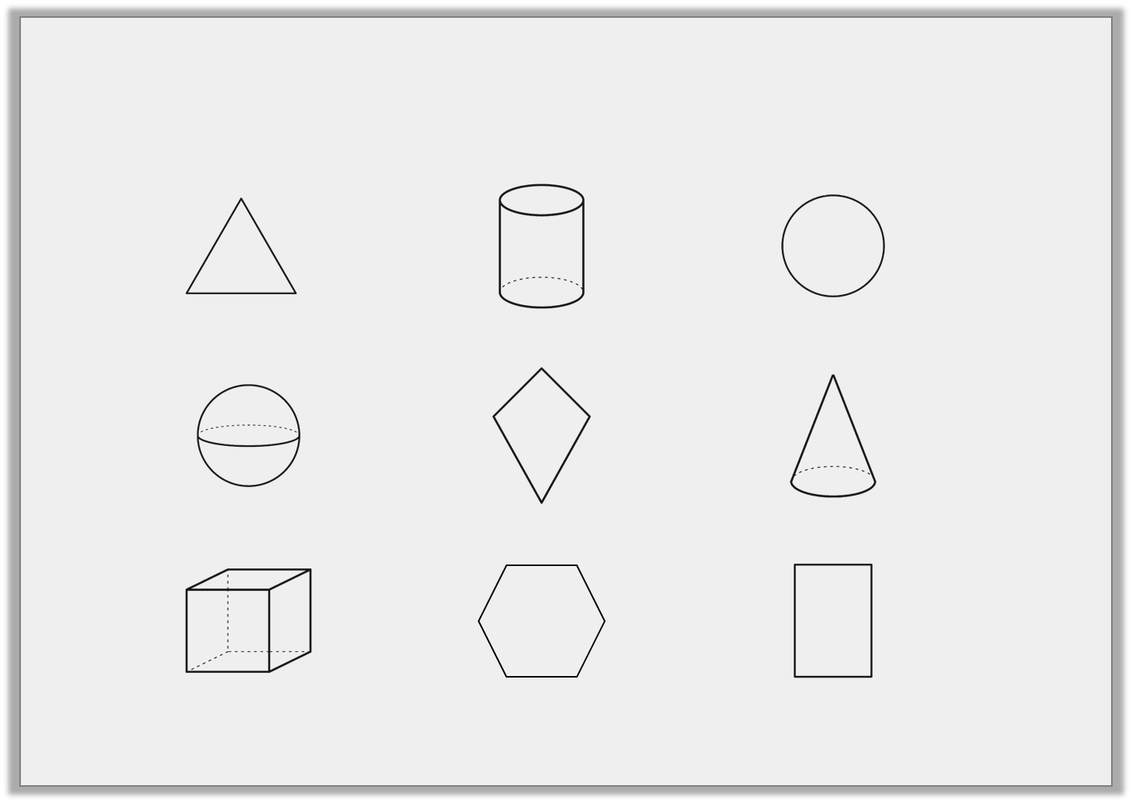
Introduction
Circle the 2D shapes below.
© Classroom Secrets Limited 2019

Slide 4
Introduction
Circle the 2D shapes below.
© Classroom Secrets Limited 2019

Slide 5
Varied Fluency 1
Which shape has a complete perimeter of 12cm?
 |  | A |  |  | B
cm squares not to scale
© Classroom Secrets Limited 2019

Slide 6
Varied Fluency 1
Which shape has a complete perimeter of 12cm?
 |  | A |  |  | B
cm squares not to scale
© Classroom Secrets Limited 2019

Slide 7
Varied Fluency 2
Circle the shape with the shortest perimeter.
 |  | A |  |  |  | B
cm squares not to scale
© Classroom Secrets Limited 2019

Slide 8
Varied Fluency 2
Circle the shape with the shortest perimeter.
 |  | A |  |  |  | B
cm squares not to scale
© Classroom Secrets Limited 2019

Slide 9
Varied Fluency 3
Find the perimeter of the shape below.
The perimeter is |  | cm.
cm squares not to scale
© Classroom Secrets Limited 2019

Slide 10
Varied Fluency 3
Find the perimeter of the shape below.
The perimeter is | 22 | cm.
cm squares not to scale
© Classroom Secrets Limited 2019

Slide 11
Reasoning 1
Circle the odd one out.
Explain your choice.
 | A |  |  |  |  | B
 |  |  | C |  | D
cm squares not to scale
© Classroom Secrets Limited 2019

Slide 12
Reasoning 1
Circle the odd one out.
Explain your choice.
D is the odd one out because…
 | A |  |  |  |  | B
 |  |  | C |  | D
cm squares not to scale
© Classroom Secrets Limited 2019

Slide 13
Reasoning 1
Circle the odd one out.
Explain your choice.
D is the odd one out because the other shapes have a 12cm perimeter but D has a 10cm perimeter.
 | A |  |  |  |  | B
 |  |  | C |  | D
cm squares not to scale
© Classroom Secrets Limited 2019

Slide 14
Problem Solving 1
The perimeter of the shape below is 18cm.
How long are the missing sides?
 |  |  |  | 3cm
 |  |  | C
 | 3cm |  |  |  |  |  | 3cm
B
 | A
cm squares not to scale
© Classroom Secrets Limited 2019

Slide 15
Problem Solving 1
The perimeter of the shape below is 18cm.
How long are the missing sides?
 |  |  |  | 3cm
 | 3cm |  |  |  |  |  | 3cm
 | A = 6cm
C = 2cm
B = 1cm
cm squares not to scale
© Classroom Secrets Limited 2019

Slide 16
Reasoning 2
Tim and Jenny each draw a shape.
The measurements for Tim’s shape are:
3cm, 1cm, 1cm, 2cm, 2cm, 3cm.
The measurements for Jenny’s shape are:
1cm, 1cm, 3cm, 2cm, 4cm, 3cm.
Which shape did they each draw? Convince me.
A |  |  |  |  |  | B
cm squares not to scale
© Classroom Secrets Limited 2019

Slide 17
Reasoning 2
Tim and Jenny each draw a shape.
The measurements for Tim’s shape are:
3cm, 1cm, 1cm, 2cm, 2cm, 3cm.
The measurements for Jenny’s shape are:
1cm, 1cm, 3cm, 2cm, 4cm, 3cm.
Which shape did they each draw? Convince me.
Jenny drew A and Tim drew B because…
A |  |  |  |  |  | B
cm squares not to scale
© Classroom Secrets Limited 2019

Slide 18
Reasoning 2
Tim and Jenny each draw a shape.
The measurements for Tim’s shape are:
3cm, 1cm, 1cm, 2cm, 2cm, 3cm.
The measurements for Jenny’s shape are:
1cm, 1cm, 3cm, 2cm, 4cm, 3cm.
Which shape did they each draw? Convince me.
Jenny drew A and Tim drew B because Jenny’s measurements give a 14cm perimeter and Tim’s give a 12cm perimeter. A has a longer perimeter than B.
A |  |  |  |  |  | B
cm squares not to scale
© Classroom Secrets Limited 2019

