Slide 1
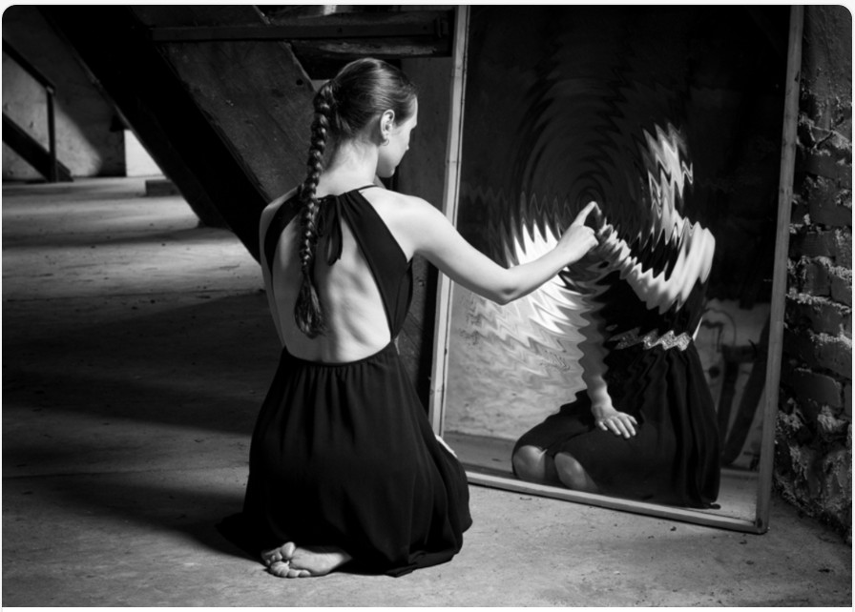
She had found it lying alone, deserted, abandoned in the attic. After making the discovery, Anna had gazed and marvelled at it for some time. Where had it come from? Why had no dust settled upon it, as it had done over everything else that resided in her attic? A layer of the thick dust blanketed the attic floor, and as the sunlight glared through the attic windows, the dust particles yet to settle were illuminated as they hovered in the stuffy air. Yet, the mirror looked flawless, untouched by age, not a finger print in sight.
Anna propped the mirror up against one of the thick, timber beams that jutted from the attic floor. Settling down into a comfortable position, she tentatively placed a finger against the glass…

Slide 2
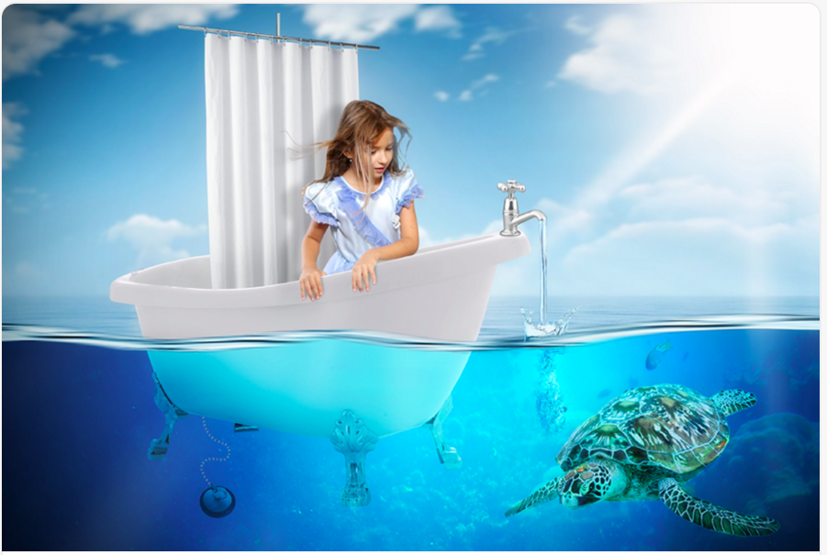
She knew that it hadn’t been a good idea to leave the tap running, but now she was starting to enjoy herself…

Slide 3
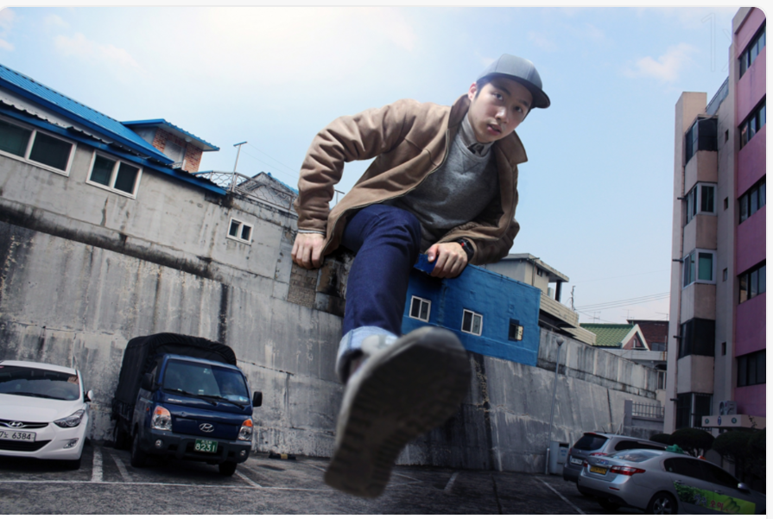
Being big had its advantages…

Slide 4
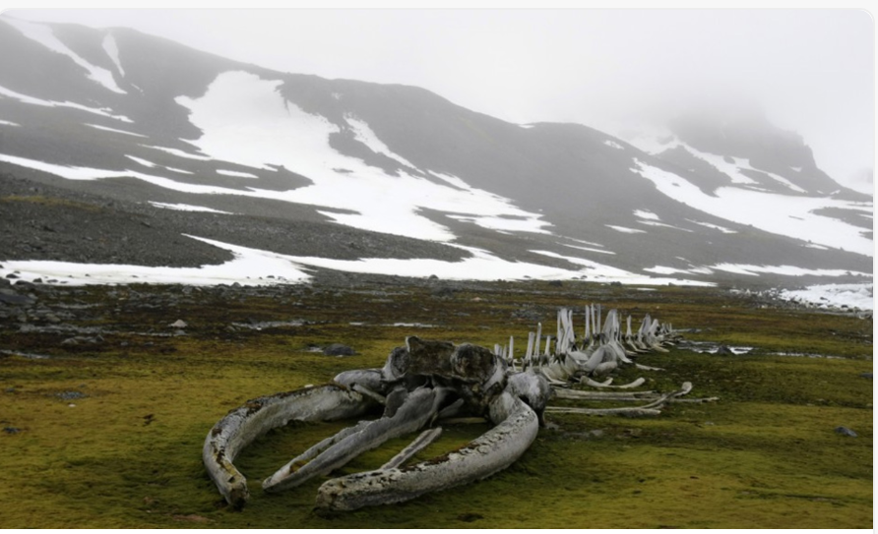
The children disembarked the bus, and stood huddled together on the road. It was a cold, foggy day, and so the children, wrapped up in coats and scarves, shivered as they waited.
Their teacher beckoned them closer, and as one they edged cautiously towards the skeleton. What was supposed to be a boring school trip had just got a whole lot more exciting! Were they on the verge of making a terrific discovery?

