Slide 1
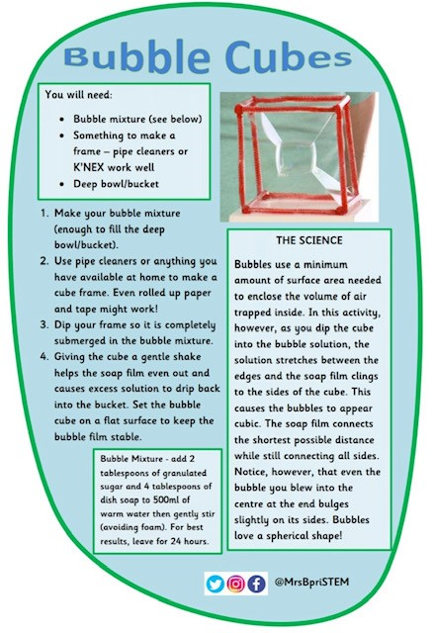
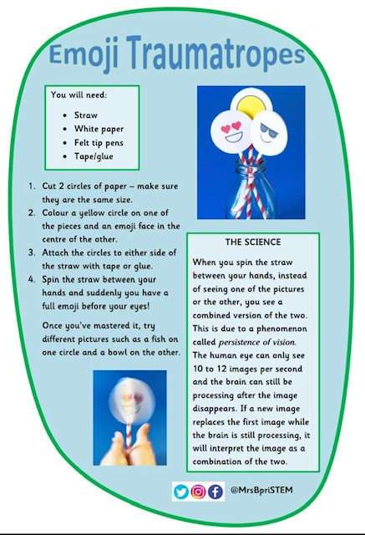
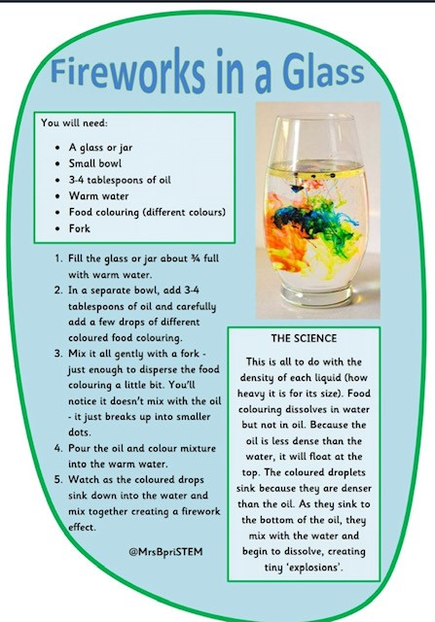

Slide 2
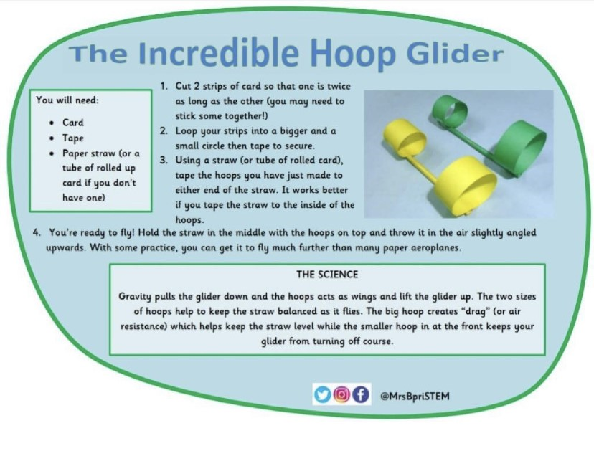
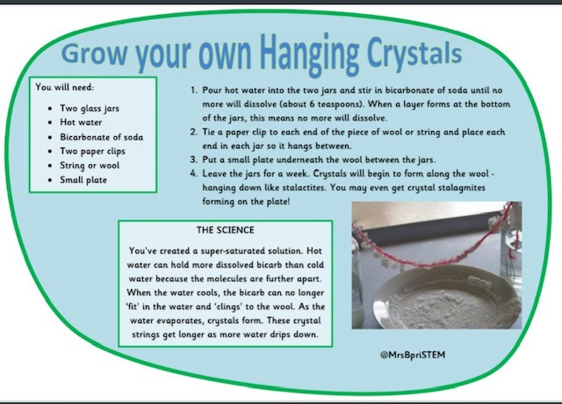
Adult supervision required due hot water being used.
Here are a few Science based activities for you to try during the summer break.
Feel free to post any pictures on Twitter or send an email to
j.alderson@springvaleprimary.org

