Slide 1
Year 1 English
Meeting For Parents
Notes:
Hello everyone and welcome.
Aim of this part of the meeting – help you understand how we teach English in Year 1 and how you can support your child.
Phonics
Reading
Writing

Slide 2

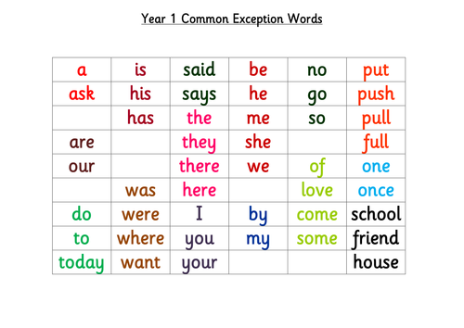
We teach reading through a mixture of phonics and whole word recognition
Whole Word Recognition
We call them ‘tricky red words’
Children need to learn to read them on sight
not blend the sounds.
We will be learning to read and write at least
one new word a week.
Notes:
In Year 1 there is a focus on the teaching of reading mainly through phonics but there are some words that don’t make sense if you just read them by blending the sounds together.
E.G – if you look at the word ‘said’ if you blend the sounds that you can see in the word ‘s-a-i-d’ the word should be ‘sa-id’.
Because of these anomalies in our language we also teach the children to recognise and read some whole words.
With the children we call these words ‘tricky red words’
They may also be referred to as common exception words/ high frequency words
On the slide you can see are all the tricky red words children are expected to be able to read by the end of Year 1. we also teach them more red words in addition to these through our phonics scheme.

Slide 3
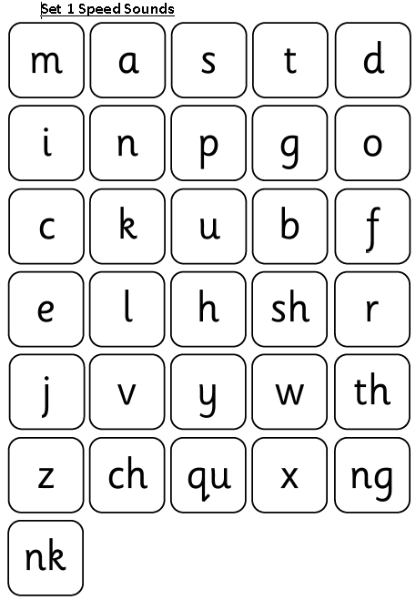
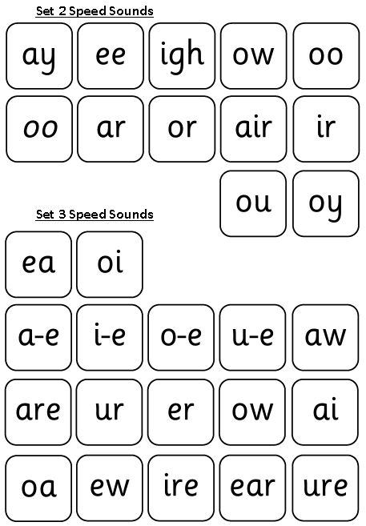
Phonics
Children learn 44 sounds and matching letters/letter groups
Notes:
A quick overview of phonics.
The children are split into groups for a phonics lesson every day.
We use the Read Write Inc. phonics scheme.
During phonics lessons your child is learning letters and the matching sounds, learning to blend the sounds into words and applying this knowledge to reading and writing.
Sounds are taught in sets. Set 1, 2 and 3 as you can see on the screen.
Once a set has been taught the sounds will be used to read and write words and sentences.
2 letters together make a new sound called a ‘special friend’ sound e.g s-h make the special friend sound sh.
In order to blend the sounds together to read words it is important how we say them. We use the shortest possible sound and try not to put an uh on the end or elongate the sound e.g; c not cuh and t not tuuuuuh. To a child first learning to blend it makes all the difference.
e.g: cuh-aaaaar-tuh blended becomes the word cuhaaartuh whe. it should be c-a-t becomes cat.
Oxford Owl website – under the reading tab. Search for RWI speed sounds;
Videos of how to pronounce the sounds in each set & lots of other useful info and resources to support phonics.

Slide 4
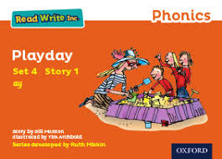
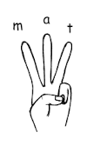
Reading and Writing words
Fred...
Fred helps children learn to read
Fred can only talk in sounds...
(Fred can only say c_a_t, he can’t say cat)
We call this Fred Talk
Fred...
Fred helps children learn to spell as well!
Children convert words into sounds
They press the sounds they hear on to their fingers...
We call this Fred Fingers
RWI Storybooks used in Phonics lessons
Notes:
As part of the RWI scheme a character ‘Fred Frog’ helps the children blend the sounds together to read words, because he can’t. he can only say the sounds the children have to blend the sounds together from left to right to read the word for him. This is Fred talk.
Children practise this skill in phonics lessons by reading storybooks.
When your child comes across an unfamiliar word in their book encourage them to Fred talk it. Look out for those special friends sounds first.
We use our Fred fingers to write words. Say the word you want to write, work out how many sounds you can hear in the word on your fingers then write the correct letter/letters for each sound in the right order.

Slide 5

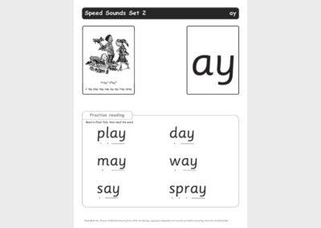
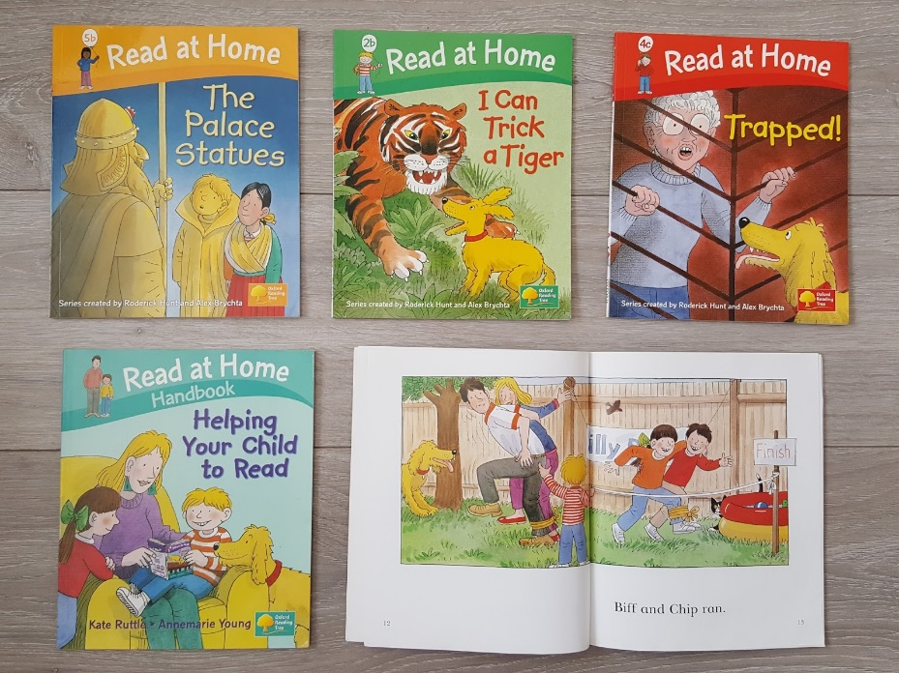
Reading Books
RWI Bookbag Books sent home to read.
New sound sheet sent home to read.
Levelled books sent home to read.
Notes:
Daily practise of phonics and reading is essential so your child will be sent home with reading materials.
When they learn new sounds in phonics they will be sent home with practise sheets to consolidate at home over the weekend. They will be stuck in their Phonics Home Learning book.
They will also be sent home with at least on book to read. These will be a mixture of RWI book bag books and levelled reading scheme books.
Please make sure phonics home learning books and reading logs and books are returned to school each day as we use them with the children daily.
We will swap reading books when we see from their reading log that they have read it to someone at home.
Children are assessed on their recall of sounds and word blending approximately every 6 weeks and their phonics group and reading level will be altered based on the outcome.

Slide 6
Reading Levels
Notes:
I thought I would take this opportunity to show you how the books are levelled and how the sets of sounds fit in to this.
1.Your child's reading journey begins with set 1 sounds and at this stage they will bring home sounds, words and ditties to read. Ditties are short sentences.
2.Once children are confident blending set 1 sounds to read words and short sentences they will read red storybooks in their phonics lessons, and bring home red spot books to read and green and red words to practise.
3.The next stage is for children to learn the set 2 sounds in phonics lessons and sound sheets will come home to practise. Then they will read green storybooks in phonics lessons and bring home green spot books and red and green words to practise.
4.Purple storybooks next and purple spot books to read at home.
This is usually the expected level of attainment for the end of F2.
5.The next level is pink storybooks in phonics lessons and pink spot books to read at home and red and green words to practise.
5.Next children learn the set 3 sounds and bring home pink/orange spot books to read.
6.When children know their set 3 sounds fluently they will read orange storybooks in phonics and bring home orange spot books to read with green and red words to practise.
We aim to have children at this standard by the national phonics screen test in June.
7. Yellow RWI – green book band
8.Blue RWI – orange book band then turquoise

Slide 7
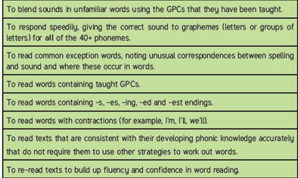
Year 1 Expectations - Reading
Fred talk
Speed sounds
Tricky red words
RWI Storybooks.
Boks sent home to read.
Books sent home to read
Notes:
So that’s how we teach phonics.
Your child will also do a mixture of reading 1:1 with an adult and participating in Group Reading with children at the same stage of reading and an adult.
These are the national expectations in Reading for the end of Year 1.

Slide 8
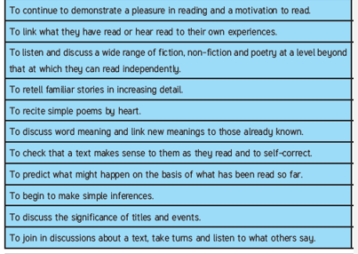
Year 1 Expectations - Reading
Notes:
These expectations are for what a typical child should be able to do by the end of Year 1.
They can be found at the front of your child’s reading Log.

Slide 9
So how can you help your child?
By learning the new sounds and words when they come home.
By encouraging blending new words using Fred Talk for reading m_a_t
By encouraging Fred Fingers for writing
By practising their reading every day.
Talk about what you are reading.

Slide 10

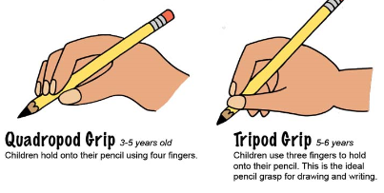



Please encourage a good tripod grip
Notes:
This term we will mainly be concentrating on phonics and reading.
Our writing teaching will focus on;
Speaking in whole sentences
Securing a good tripod grip
Letter formation
Between 5 and 6 years old children gain the necessary physical ability to hold a pencil in a tripod grip rather than a fist hold or quadropod grip. The grip is important to allow them control of the pencil so they can write recognisable letters.
We use the ‘nip, flip and grip method of teaching the tripod grip.

Slide 11
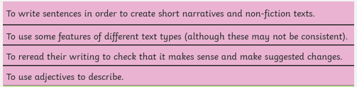
Composition
Working at the expected standard for Year 1

Slide 12
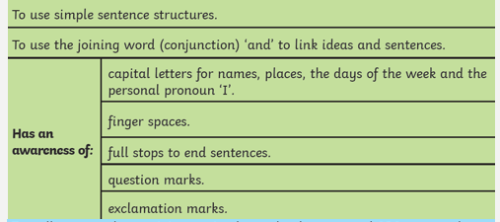
Grammar and Punctuation
Working at the expected standard for Year 1

Slide 13
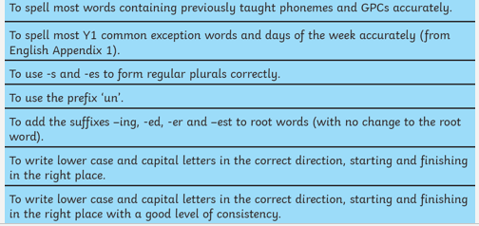
Working at the expected standard for Year 1
Transcription

Slide 14
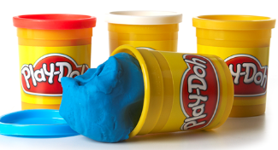
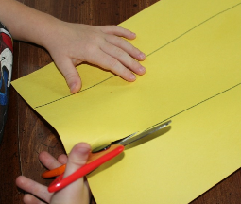
So how can you help your child?
Encourage speaking in full sentences.
Practise pencil grip and fine motor skills.
Practise letter and number formation.
Encourage fred talk when they are trying to write a word.
What sounds can you hear?
Notes:
Fine motor skills activities;
Playdough
Making crumble/pastry/bread
Cutting with scissors
Threading objects on laces or string

Slide 15




https://www.teachyourmonstertoread.com
https://www.roythezebra.com
https://www.oxfordowl.co.uk
Youtube – search: Ruth Miskin
Notes:
Ruth Miskin on youtube has video of speed sound pronunciation for parents.
Oxford owl have lots of helpful RWI phonics resources for parents.

