Slide 1
Year 1 Maths
Meeting For Parents
Notes:
Aim of the meeting – help you understand the expectations in Maths, how we teach it, and how you can support your child.
A quick walk through of some of the activities and terminology we use in Y1
From the number work done with the children so far I am really impressed with their ability. Number seems to be a strength for the class.
We’ll start with the 2 most important early number concepts in Y1; subitising and finger counting.
These 2 skills help with number fluency and speed when we come on to addition and subtraction later.

Slide 2
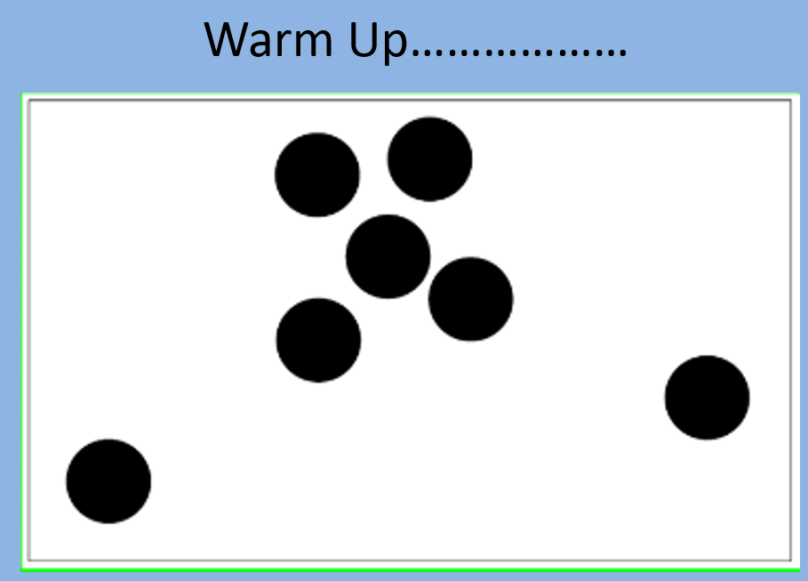
Notes:
Firstly subitising.
It’s easier to do than explain.
This warm up game is usually done in a face to face meeting but we’ll give it a go.
How many dots there are.
The people who got there very quickly how did you do it? What helped?
Did you recognise the group of 5 dots without counting them then add on another 2? That is subitising.

Slide 3
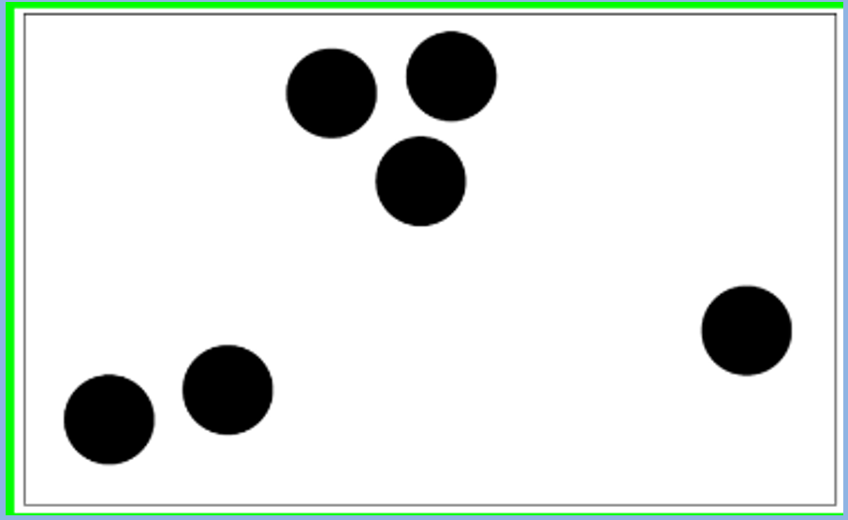
Notes:
How many now?
Did you see the group of 3 and the group of 2 and just know that they made 5, then add another 1?
A typical 5 year old would probably count them all. If you can spot the patterns it’s easier and quicker.
Subitising – automatic recognition (latin) without counting.
We might take this skill for granted but for young children just starting their journey with numbers it is not as obvious.
We do lots of subitising activities like this at the beginning of Y1 – encouraging the children to spot the pattern.

Slide 4
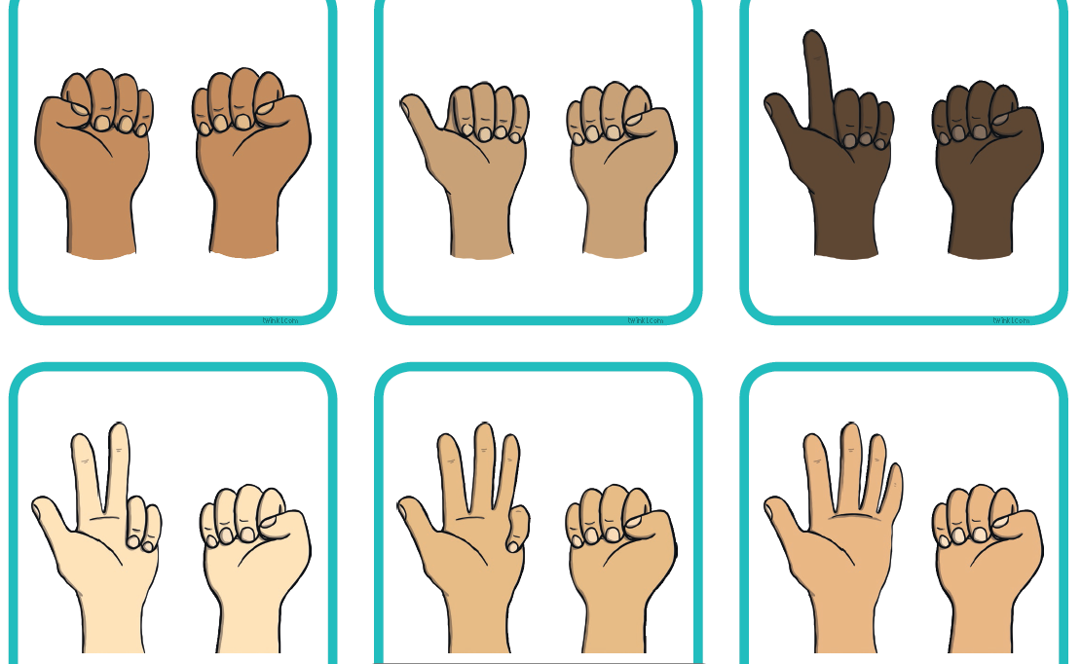
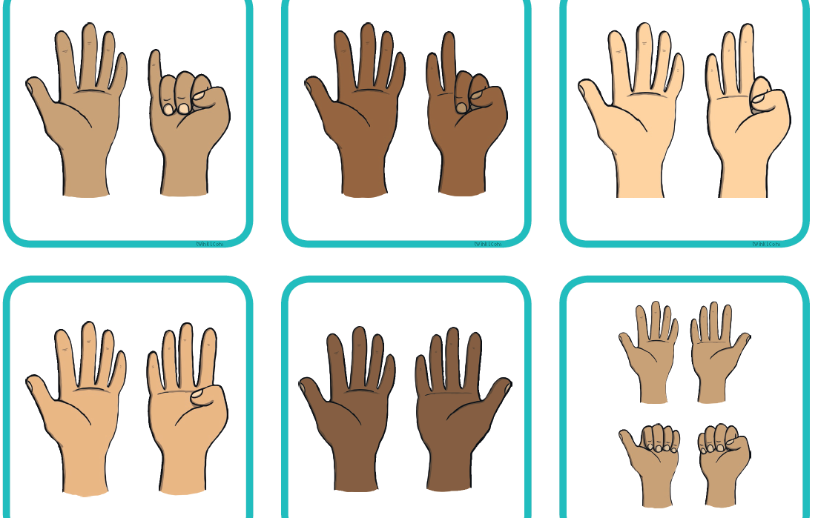
Finger
counting
Notes:
Start with the palms of your hand facing you, fingers curled in – this is zero.
Children say the next number as they extend the finger. They need to be able to count up to 10 using their fingers and back down again. The number should only be said with the finger being extended – not just rote saying numbers to 10.
They also need to be able to make any number when you say it and say any number when you show them the fingers.
Later on we use this skill to add and subtract.

Slide 5

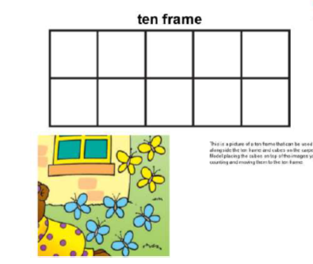
Notes:
Numbers can be represented, using counters or drawing dots, on a ten frame.
There are 5 blue butterflies.
Ten frames help us count quickly and find pairs of numbers that make 10. you can easily see from the ten frame that if there are already 5 butterflies, 5 more and there would be 10.

Slide 6
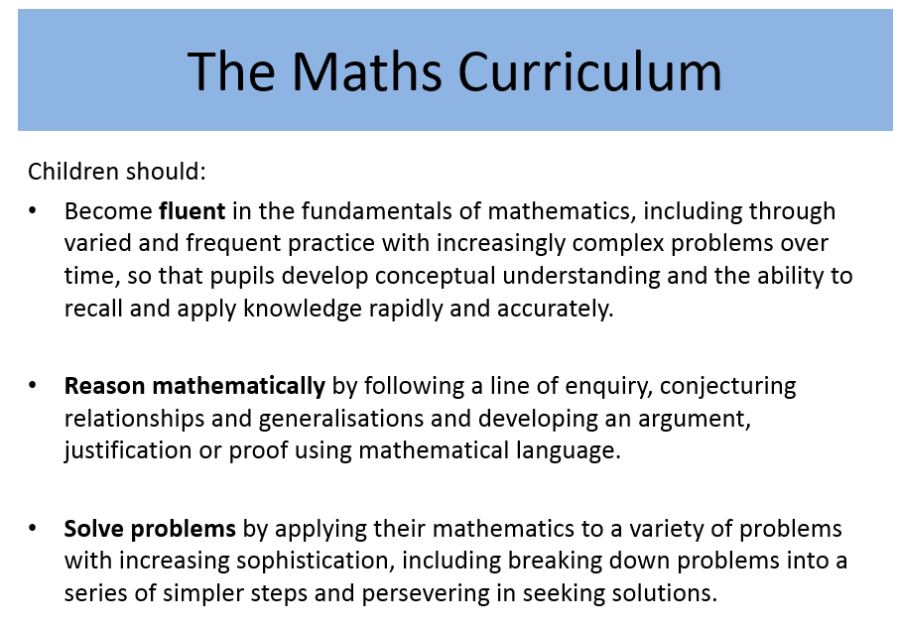
Notes:
Maths in primary schools is being taught in a completely different way probably from when you were taught.
2015 – New Maths Curriculum – called Mastery curriculum. This means that teachers should focus on key concepts and not move on until all children have mastered that particular area. Within Maths there are three main elements that inter-weave.
Fluency
Reasoning about numbers
Problem solving with numbers
We teach number in blocks. Your child will start with numbers to 10. we will learn to read, recognise, write, order, add and subtract fluently.
Then we will move on to numbers 10 to 20 and repeat the process.
It is important not to rush on to bigger numbers until they have mastered all the skills needed to be fluent with the smaller numbers.

Slide 7
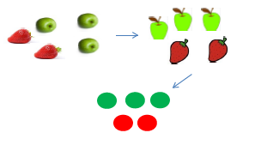
Concrete representation
Pictorial representation
Abstract representation
12 + 2 = 14
Notes:
We teach children with physical and practical objects first, then by representing numbers in pictures and finally in an abstract way.
Concrete- The DOING
A child is first introduced to an idea or a skill by acting it out with real objects. This is a 'hands on' component using real objects and it is the foundation for conceptual understanding.
Pictorial-The SEEING
A child has sufficiently understood the hands-on experiences performed and can now relate them to representations, such as a diagram or picture of the problem.
Abstract – The SYMBOLIC
A child is now capable of representing problems by using mathematical notation, for example: 12 + 2 = 14

Slide 8

Reasoning
Which is the odd one out?
Why?
Notes:
We also use the word ‘why’ a lot in our maths lessons. Or ask the children to ‘show me’ or ‘prove it to me’.

Slide 9
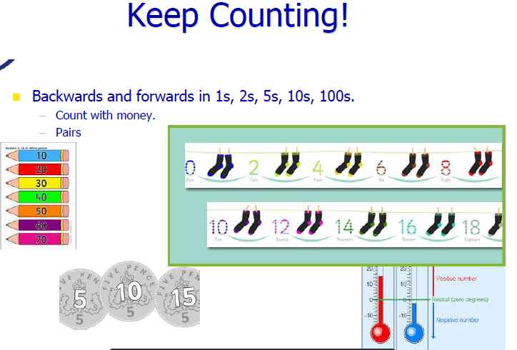
Notes:
As well as finger counting to 10 your child will learn finger and toes counting to 20, and counting in 2’s 5’s and 10’s forwards and backwards.

Slide 10

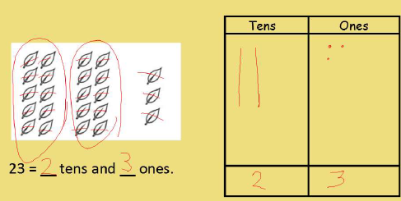
Notes:
When children are fluent with numbers up to 20 we will use numbers from 20 to 50, and then 50 to 100. part of these larger numbers is learning their place value.
Where numbers fit and what each digit represents / means. The value.

Slide 11
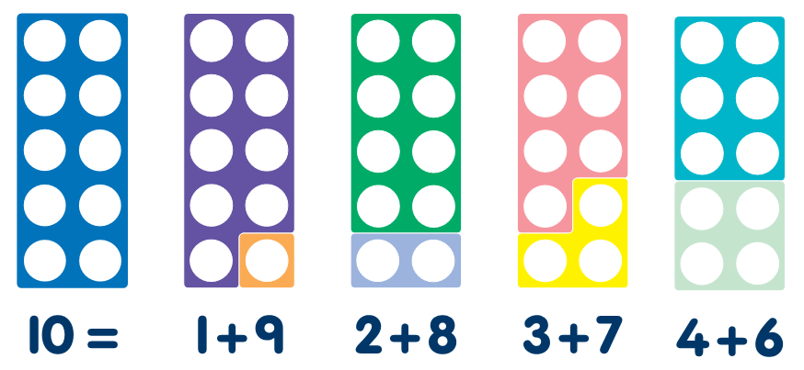
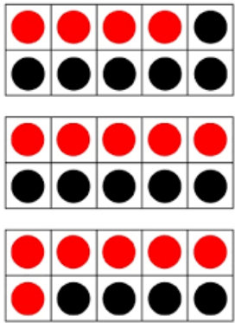
Bonds to 10 & 20
It is important that children recognise number bonds, different pairs of numbers with the same total and that they are fluent in this.
Children need to be secure on bonds to 10 by the end of Year 1.
Notes:
As part of the end of year 1 expectations your child will be learning number bonds to 10 and then to 20.
They need to know them off by heart so if I said 3 they would know they needed 7 more to make 10 – without counting on.
And if I said 9 they would know they needed 1 to make 10 and 11 to make 20.

Slide 12




https://www.oxfordowl.co.uk/for-home/kids-activities/fun-maths-games-and-activities/
https://www.topmarks.co.uk/maths-games/5-7-years/counting
https://www.mathplayground.com/
https://www.bbc.co.uk/bitesize/subjects/zjxhfg8
Notes:
Numbots – practises all the key skills discussed here.
Don’t worry about timestables we don’t mention the word until the summer term and even then only when they can fluently count forwards and backwards in 2’s 5’s 10’s to 100.
We do teach shape and measures as well

Slide 13
Questions
n.evans@springvaleprimary.org

