Slide 1
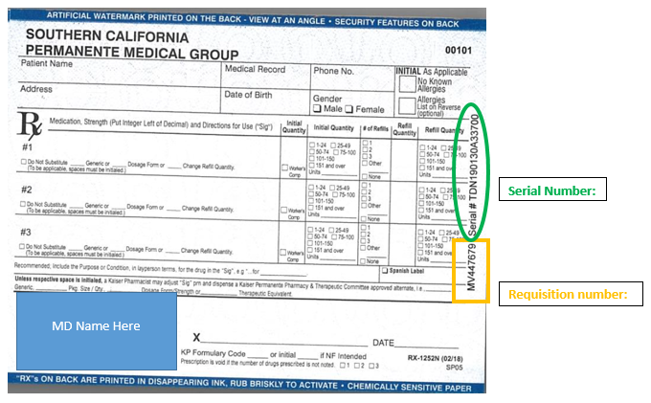
Prescription Pad Sign-Out Workflow
The physician will requests a new prescription pad from the Unit Manager, a Charge Nurse or an ACD
That person will go to the lock box in the physician suite and enter code to unlock keys
Using the key, the c-locker will be opened
A single prescription pad from the requesting physicians stock will be removed
The prescription pad will be signed out using the prescription log in the c-locker:
The physicians log will be located in the black 3-ring binder in the c-locker (all logs are filed alphabetically)
The person dispensing the prescription pad will:
Match the prescription pad being removed to the inventory information on the left hand side of the log
On the correct line they will fill in:
the date the prescription pad is being given out
Have the provider sign the for prescription pad
Sign as the witness dispensing the pad
The 3-ring binder is to be placed back in the c-locker
The c-locker is to be locked
Return the keys to the lock box on the wall

