Slide 1
MRSA Surveillance Culture and Vancomycin IV for Pneumonia
Presenter Dr. Sara Sirajuddin MD, MD, Infectious Diseases
Slides by Frances Wong, PharmD, MEd, MPH, BCPS, BCIDP
Kaiser Permanente Medical Center
Fontana, California
9/24/2024

Slide 2
Outline
Vancomycin IV Usages
Local Prevalence of MRSA
MRSA Surveillance Culture
Questions and Answers
Conclusions

Slide 3
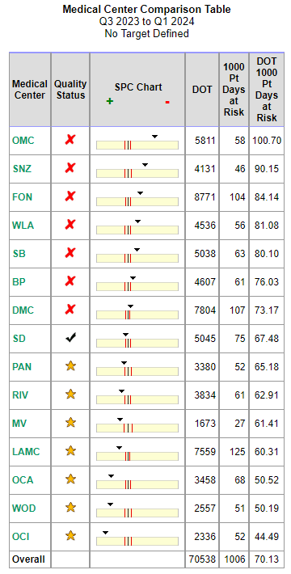
Situation
FMC and OMC have the highest rates of IV vancomycin use in all of SCAL KP.
Notes:
FMC and OMC have the highest rates of vancomycin use of all of Southern California Kaisers. This is problematic because overuse of vancomycin promotes increased drug resistant and like all antibiotics vancomycin is not benign. Vancomycin does have multiple side effects including rash due to infusion related reactions – aka RedMan syndrome or true allergy, nephrotoxicity, ototoxicity, and rarely bone marrow suppression. The nephrotoxic effects are one of the main issues associated with vancomycin use and can lead to AKI and in severe cases renal failure. These effects can be potentiated when vancomycin is combined with other nephrotoxic agents, in the antibiotic class we worry about the cumulative effects when it is combined with zosyn mainly, or in cases of MRSA endocarditis when we have to combine it with aminoglycosides.

Slide 4
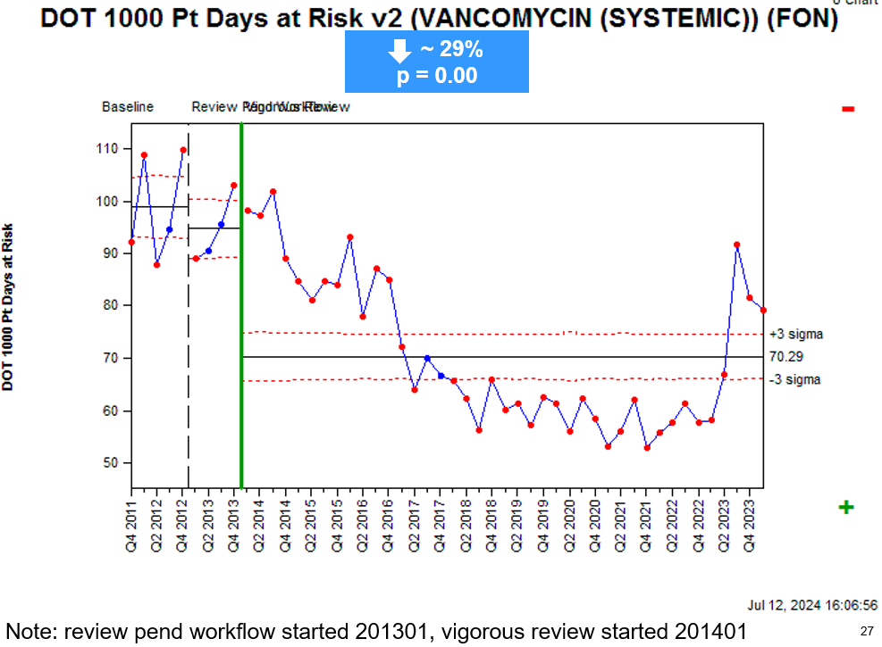
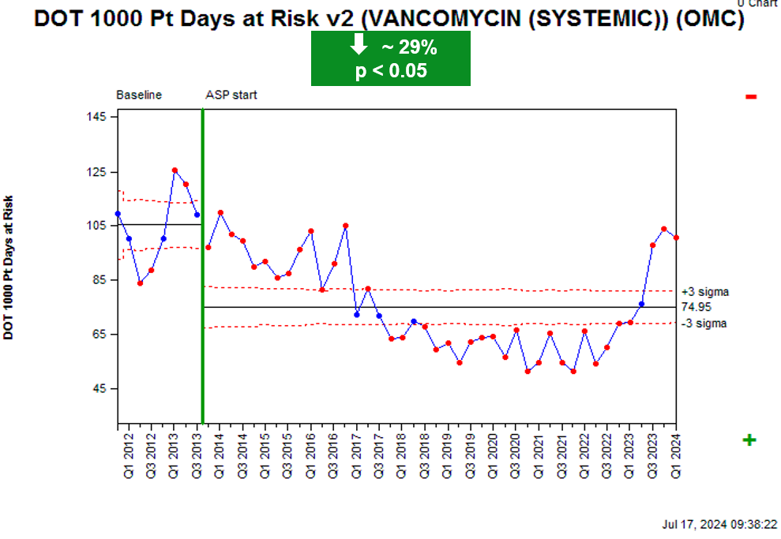
Situation Cont.
Notes:
The problem of overuse of vancomycin has persisted for over a decade, but with the implementation of ASP review of vancomycin in 2013 we had decreased the overall rate of vancomycin usage, though again still higher than compared to our regional colleagues. However around mid 2023 our rates of vancomycin usage have again increased.

Slide 5
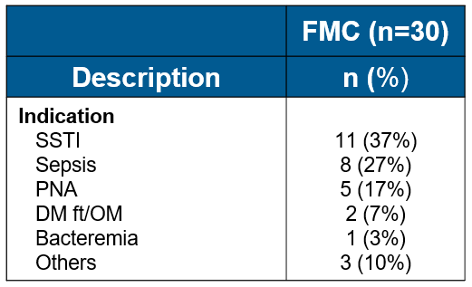
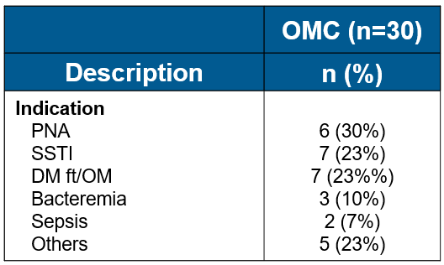
Background
Medication utilization evaluation revealed top indications for vancomycin IV usages are…
Notes:
To try to drill down into why are numbers are elevated in 2022 we randomly sampled 30 patients on Vancomycin at OMC and FMC and found that pneumonia was one of the top indications for vancomycin usage. Please note that often times “sepsis” may also include pneumonia. This was consistent with our review of vancomycin indications from 2019 as well.
Self note:
2022 first half: top indications were PNA and SSTI; 2021: PNA/SSTI/Sepsis;
2019 PNA, “others”, and PNA and SSTIs

Slide 6
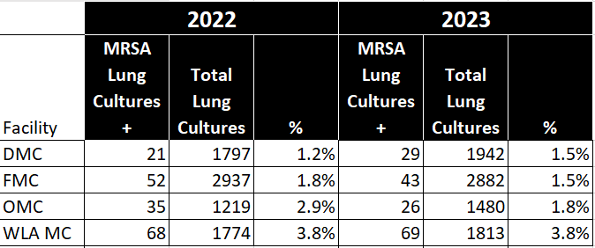
Assessment
How much MRSA pneumonia cases do we have here?
Overall: 2022 <3% and 2023 <2%
Notes:
However, do we really require the high rates of vancomycin use for our pneumonia patients. Do we really have THAT much MRSA PNA that requires antiMRSA treatment upfront for PNA?
Looking at our data, what we have found is that we have very low rates of MRSA in our lung cultures and in comparison to other facilities we have similar or lower rates of MRSA and yet our IV vancomycin usage still exceeds that of those service areas.

Slide 7
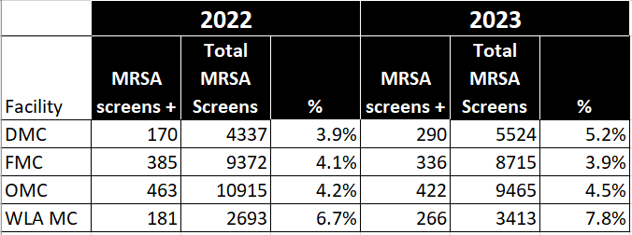
Assessment Cont.
How much MRSA colonization do we have here?
Overall: 2022 <5% and 2023 <5%
Notes:
Our MRSA colonization rates follow a similar trend, we have low rates of MRSA colonization at FMC and OMC, comparable or lower than our sister facilities. But again we use much more vancomycin.

Slide 8
Assessment Cont.
Community acquired pneumonia (CAP):
Pneumonia acquired outside of the hospital setting
NO MORE Healthcare-associated pneumonia or HCAP
From 2019 ATS and IDSA guideline*:
Risk factors for MRSA in non-severe CAP:
MRSA colonization OR infection of respiratory tract within 1 year
Risk factors for MRSA in severe CAP:
History of MRSA colonization/prior MRSA isolation especially from respiratory tract within 1 year OR
Hospitalization AND parenteral antibiotics in last 90 days
*Excludes: immunocompromising condition, such as inherited or acquired immune deﬁciency or drug-induced neutropenia, including patients actively receiving cancer chemotherapy, patients infected with HIV with suppressed CD4 counts, and solid organ or bone marrow transplant recipients.
Metlay JP, et al. Am J Respir Crit Care Med. 2019;200(7):E45–E67.
Notes:
So, what do the guidelines say about coverage for MRSA in pneumonia.
Here we will break it down by CAP versus HAP / VAP
One thing I want to make sure we highlight there is no HCAP (healthcare associated pneumonia) category anymore. This was originally proposed as a way to help discern risk factors for possible MDRO infections – and included residence in a nursing home and other long-term care facilities, hospitalization for ≥2 days in the last 90 days, receipt of home infusion therapy, chronic dialysis, home wound care, or a family member with a known antibiotic-resistant pathogen – HOWEVER many subsequent studies have show that use of these criteria have low positive predictive value for MDRO infections and actually increased unnecessary broad spectrum antibiotic use as these patients are NOT at risk for MDRP pathogens.
Instead of the list of criteria for MDROs espoused by the prior guidelines, the new guidelines focus on severity and well validated risk factors for MRSA.
So for patients with non-severe CAP you only add empiric vancomycin if the patient has prior respiratory isolation of MRSA. Remember, generally patients with MRSA pneumonias are sick. IF they have been hospitalized and received IV antibiotics in the last 90 days you should obtain cultures but HOLD antiMRSA antibiotics.
For patients with severe CAP, with symptoms such as septic shock, respiratory failure etc then you add empiric MRSA coverage if they have prior isolation of MRSA in a repository/surveillance culture within the last year OR if they have been hospitalized AND have received IV antibiotics within the last 90 days
These guidelines did exclude patients with immunocompromised conditions, thus in immunocompromised individuals, esp with severe CAP then empiric initiation of antiMRSA antibiotics is not unreasonable.

Slide 9
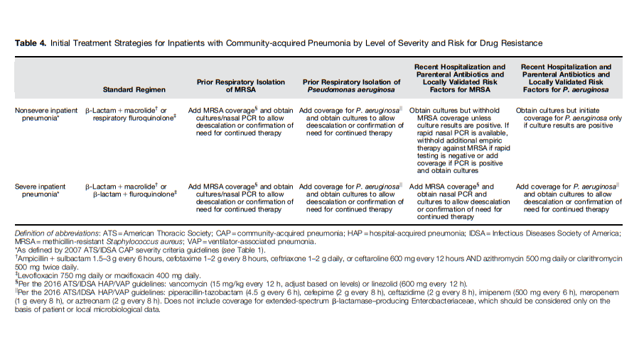

Slide 10
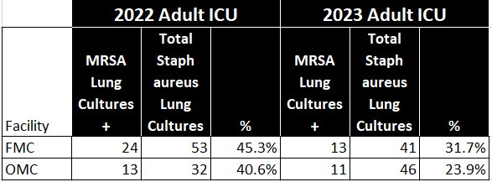
Assessment Cont.
Ventilator associated pneumonia and Hospital acquired pneumonia from ATS and IDSA 2016:
Risk factors for MRSA:
Prior IV antibiotics use within 90 days
Use anti-MRSA treatment:
Prior intravenous antibiotic use within 90 days,
Hospitalization in a unit where >20% of S. aureus isolates are methicillin resistant, or the prevalence of MRSA is not known, OR
Patients at high risk for mortality
Consider if prior recent isolation of MRSA from a respiratory specimen
Kalil AC, et al. CID. 2016;63(5)e61-e111.
Notes:
How about for our HAP and VAP patients, now remember Nosocomial pneumonia or hospital-acquired pneumonia (HAP) is defined as pneumonia that occurs 48 hours or more after hospital admission and is not present at the admission time. Ventilator-associated pneumonia (VAP) represents a significant sub-set of HAP occurring in intensive care units (ICUs) and is defined as pneumonia that occurs more than 48 to 72 hours after tracheal intubation and is thought to affect 10% to 20% of patients receiving mechanical ventilation for more than 48 hours
For our patients with HAP or VAP, the guidelines highlight that the most predictive risk factor for MRSA infection was prior antibiotic use within 90 days, however it does not specify which antibiotic or antibiotic class.
However, they also recommend that we use our local antibiograms and culture data to help determine if empiric vancomycin is indicated.
And locally the MRSA positive lung culture rate is >20% threshould in our ICU patient with staph aureus lung cultures. Thus if a patient is in septic shock and in ICU of course consider empiric antiMRSA treatment. Additionally, if they have received prior IV antibiotics in the last 90 days or are at high risk for mortality then empiric vancomycin use is recommended. And of course, if there is prior detection of MRSA in a surveillance culture or respiratory culture then empiric antiMRSA use is again indicated.
But what if your patients do not have any of these risk factors and we are still contemplating if we should start antiMRSA treatment or not?
Here clinical judgement is key, however if empiric vancomycin is started then we recommend surveillance cultures to help deescalate antibiotics.
Self note:
Per guideline MRSA PNA is more often seen in late-onset PNA than in early-onset PNA.

Slide 11
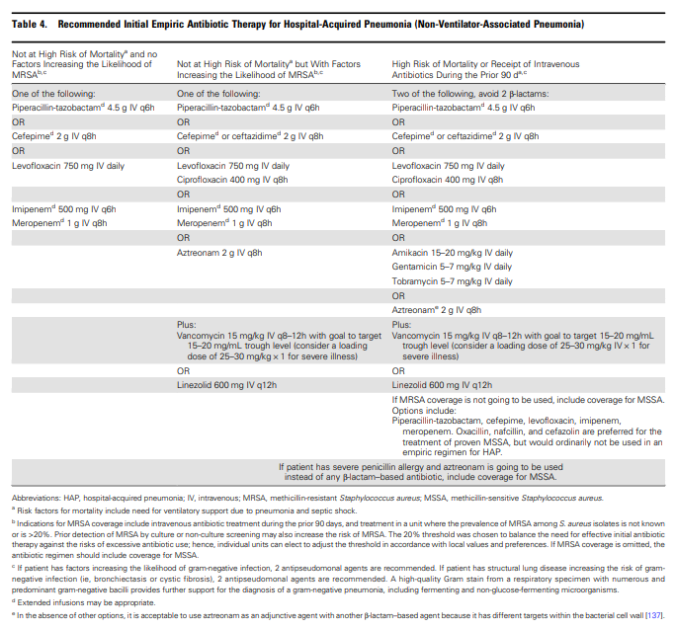

Slide 12
Do you have to given anti-MRSA coverage to meet Sepsis guidelines? NO!!!!
Notes:
Per CMS, to meet antibiotics requirements for sepsis protocol, as long as a broad spectrum antibiotic is ordered – and we have the list of what is/are considered broad spectrum antibitoics.

Slide 13
Assessment Cont.
MRSA surveillance culture:
Current mandate:
Have been previously discharged from a general acute care hospital within 30 days prior to current admission
Will receive inpatient dialysis [either peritoneal or hemodialysis] treatment
Are being transferred from a skilled nursing facility
Will be admitted/transferred to the ICU
Opportunities in ruling out MRSA pneumonia and sepsis cases
Kalil AC, et al. CID. 2016;63(5)e61-e111.
Notes:
Currently MRSA surveillance cultures are ordered for patients at high risk for MRSA colonization as per state mandates.
But there are still cases outside of those who can benefit from having MRSA surveillance cultures ordered to rule out MRSA PNA

Slide 14
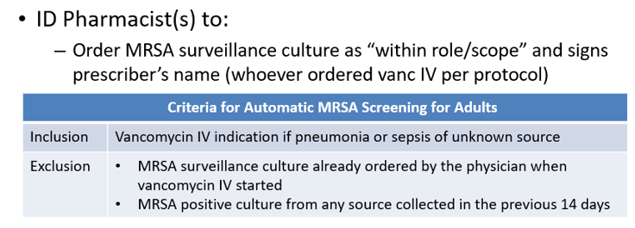
Assessment Cont.
MRSA Screening in pneumonia patients:
Negative predictive value HIGH > 95% (rule OUT MRSA pneumonia)
Positive predictive value LOW < 40% (rule IN MRSA pneumonia)
Current SBC Antimicrobial Stewardship Policy:
Smith MN, et al. J Crit Care 2017;38:168-171; Dangerfield B, et al. Antimicrobe Agents chemother 2014;58(2):859-864; Giancola ET, et al. Diagn Microbiol Infect Dis 2016;86(3):307-310; Smith Mn, et al. Ann Pharmacother 2019;53(60):627-638; Parente DM, et al. CID 2018;67(1):1-7; Mergenhagen KA, et al. CID 2020;71(5):1142-1148.
Notes:
Published data have shown above.
Policy updated 6/2023 with P&T approval

Slide 15
Conclusions/Recommendations
Vancomycin IV Usage
MRSA Prevalence
MRSA Risk Factors CAP
SBC is the top prescriber of vanc IV for the paste decade.
SBC has low positive MRSA lung cultures (<5%) in the past two years.
Non-severe: within past 1 year MRSA colonization/ infection.
Severe: above OR [last 90 days had hospitalization PLUS parenteral antibiotics].
MRSA Risk Factors HAP/VAP
MRSA Screening
To-Do Considerations
Last 90 days had IV antibiotics use OR
High risk for mortality.
>95% negative predictive value to rule OUT MRSA PNA.
Not always useful to rule IN MRSA PNA.
Hold anti-MRSA treatment when patient at low risk for MRSA PNA.
Order MRSA surveillance culture in PNA or sepsis if prescribing anti-MRSA treatment.
CAP = community acquired pneumonia, HAP = hospital acquired pneumonia, VAP = ventilator associated pneumonia, SBC = San Bernardino County Fontana and Ontario Med Centers

Slide 16

In which of the following patients would empiric anti-MRSA coverage be reasonable or indicated?
27-year-old otherwise healthy male admitted with a non-severe Community Acquired Pneumonia who was admitted to an outside facility one month prior to admission for colitis treated with 7 days of IV Ceftriaxone and Flagyl prior to discharge on oral vantin and flagyl.
31-year-old patient with AML admitted 2 weeks ago for induction chemo diagnosed with Healthcare Acquired Pneumonia.
46-year-old male with severe Community Acquired Pneumonia with prior history of positive MRSA surveillance cultures.
A and B
D and C
All the above

Slide 17
In which of the following patients would empiric anti-MRSA coverage be reasonable or indicated?
27-year-old otherwise healthy male admitted with a non-severe Community Acquired Pneumonia who was admitted to an outside facility one month prior to admission for colitis treated with 7 days of IV Ceftriaxone and Flagyl prior to discharge on oral Vantin and Flagyl.
31-year-old patient with AML admitted 2 weeks ago for induction chemo diagnosed with Healthcare Acquired Pneumonia.
46-year-old male with severe Community Acquired Pneumonia with prior history of positive MRSA surveillance cultures.
A and B
B and C
All the above

Slide 18
Questions??

Slide 19
Upcoming!
MRSA and Skin and Soft Tissue Infections
Consider empiric coverage for MRSA if:
Purulent cellulitis
Non-purulent cellulitis that does not respond to appropriate antibiotics after 48 hours
Risk factors for MRSA (prior MRSA colonization or isolation, recurrent infection, IVDA)
Necrotizing Fasciitis / Fournier’s Gangrene
Myonecrosis
MRSA and Diabetic foot infections
Consider empiric MRSA risk factors if:
History of colonization/infection with MRSA
Injection drug use
Previous hospitalization within past 3 months or current prolonged hospitalization > 2 weeks
Transfer from nursing home or sub-acute facility

Slide 20
Appendix
US MRSA Resistance Trend
CAP Severity Definition
MRSA Nasal Screening Detail
Additional MRSA Data

Slide 21
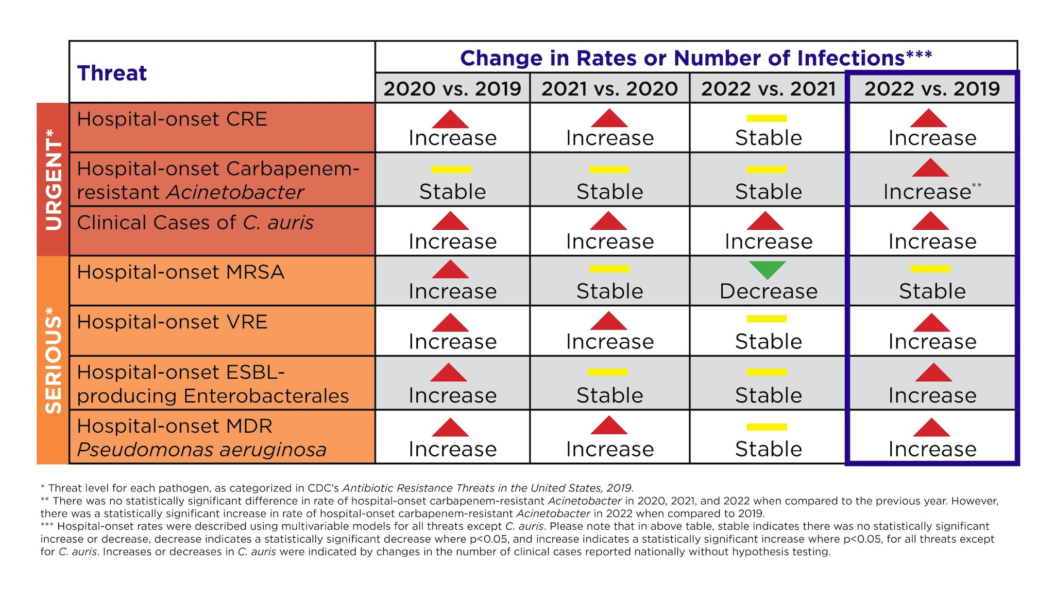
US Resistance Trends
Reference: Antimicrobial Resistance Threats in the United States, 2021-2022 | Antimicrobial Resistance | CDC

Slide 22
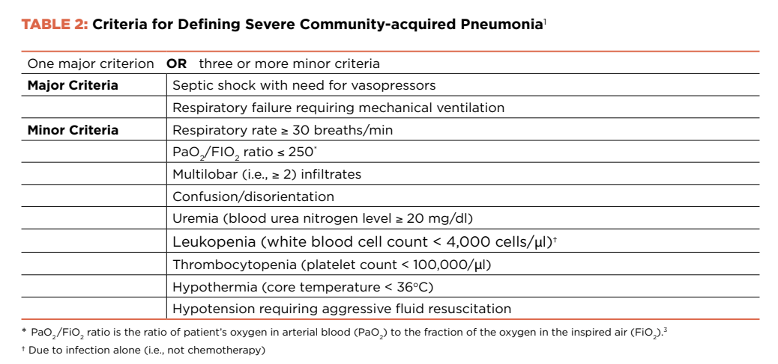
Definition CAP Severity

Slide 23
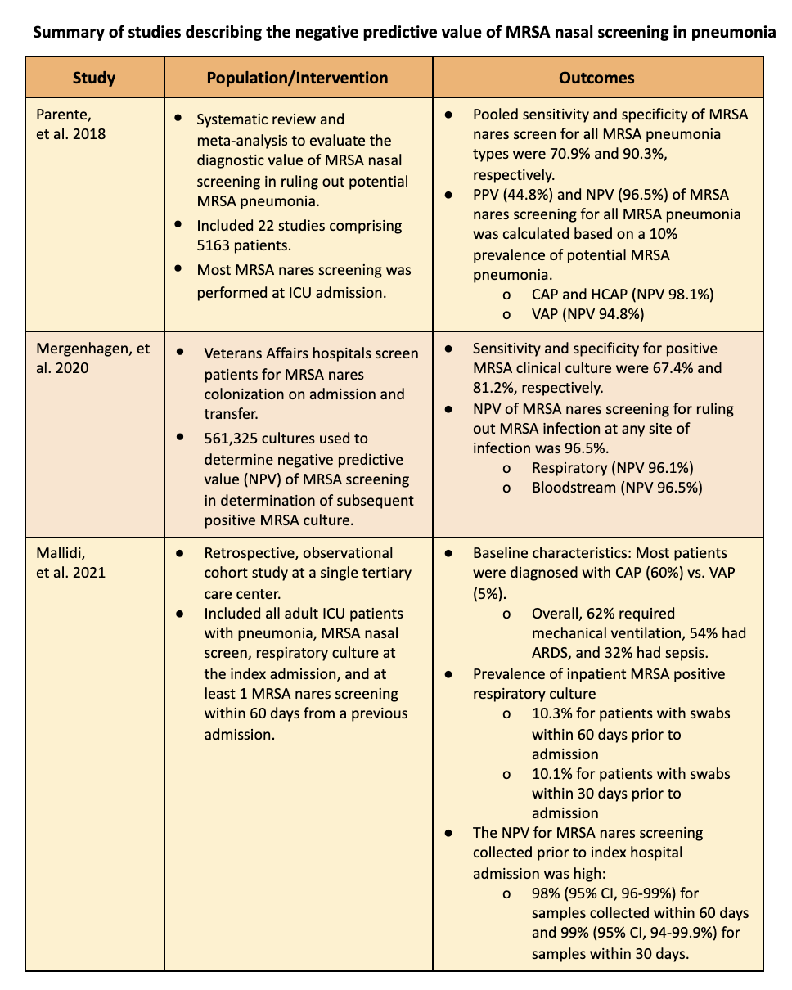
MRSA Nasal Screening in Pneumonia
Notes:
Reference: https://criticalcarenow.com/whats-in-your-toolbox-mrsa-screening/

