Slide 1
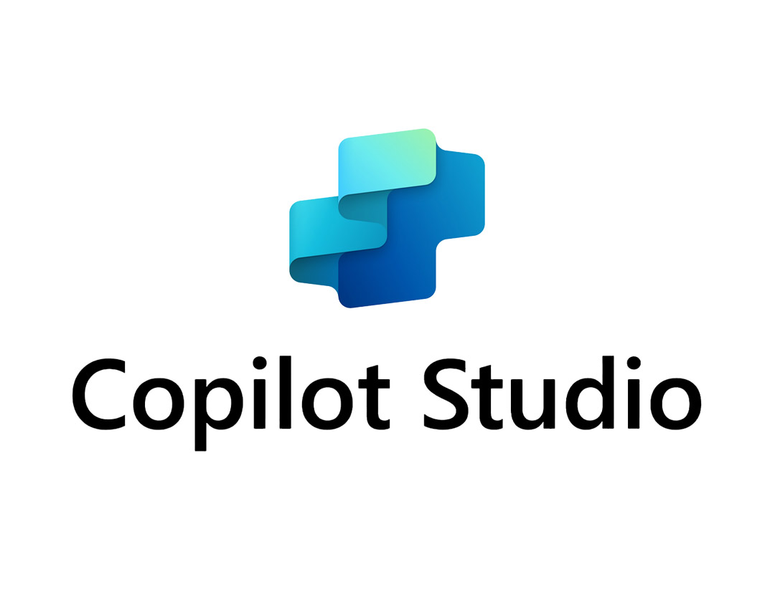
Microsoft Copilot Studio — Transform Operations with Low-Code AI Agents
The era of AI-driven operations is here — build with low-code, deploy on enterprise-grade infrastructure
Build intelligent AI agents with a low-code interface
Unified with the Microsoft 365 and Power Platform ecosystem
Adoption Guide 2026
1
Notes:
Opening slide sets the thesis: Copilot Studio enables any organization to build and deploy AI agents without deep technical expertise, backed by enterprise security.

Slide 2
Conclusion: Copilot Studio Wins on Speed, Integration, and Security
The only platform that delivers low-code development, enterprise integration, and robust governance simultaneously
Rapid Build
Deploy AI agents in hours without developers
Seamless Integration
Connect instantly to M365, Dynamics 365, and external APIs
Robust Governance
Maintain enterprise standards with DLP, audit logs, and MIP labels
2
Notes:
Pyramid conclusion first: present the three pillars that make Copilot Studio the optimal choice before diving into supporting evidence.

Slide 3
Reality Check: Three Barriers Block Enterprise AI Adoption
Talent shortages, data silos, and governance gaps are stalling AI initiatives beyond the PoC stage
Talent Gap — Data scientists and developers are scarce, stalling projects at the PoC stage
Integration Gap — Siloed data and processes prevent organization-wide AI deployment
Governance Gap — Security and compliance standards for generative AI remain undefined
Scale Gap — Transitioning from PoC to production takes too long and costs too much
3
Notes:
Frame the problem the audience faces. Each barrier maps directly to a Copilot Studio capability introduced in the next slide.

Slide 4
Solution: A Platform That Autonomizes Work with Agents and Flows
Conversational AI, task automation, knowledge integration, and multi-channel deployment — all in one platform
Agents
AI companions that converse, decide, and act autonomously using NLU and generative AI
Agent Flows
Automate repetitive tasks with natural language or a visual editor
Knowledge Integration
Retrieve real-time knowledge from SharePoint, Graph, and external connectors
Multi-Channel Deployment
Publish to Teams, Web, Mobile, WhatsApp, and more
4
Notes:
Map each capability to the barriers on the previous slide: agents solve the talent gap, flows solve the scale gap, knowledge solves the integration gap, channels solve reach.

Slide 5
Choose Your Tool: Agent Builder vs. Copilot Studio by Scope and Need
Use Agent Builder for lightweight Q&A; choose Copilot Studio for advanced workflows and external integrations
M365 Agent Builder
Copilot Studio
→ For individuals and small teams; natural language authoring; SharePoint Q&A focus
→ Create in Agent Builder → Copy to Copilot Studio to unlock advanced features
→ For departments, organizations, and external customers; multi-step workflows; Premium connectors
→ Select based on target audience size, feature requirements, and governance needs
5
Notes:
Based on the official Microsoft decision tree: audience scope, deployment breadth, functionality depth, and governance requirements determine the right tool.

Slide 6

Proof of Momentum: Six Major Releases in Six Months
GPT-5 support, Computer-Using Agents, MCP integration, and more — rapid innovation validates platform longevity
Sep 2025
Computer-Using Agents (CUA) preview, Client SDK for native apps
Oct 2025
GPT-4.1 as default model, MCP server integration, agent evaluation test sets
Nov 2025
GPT-5 GA rollout, multi-agent orchestration, SharePoint metadata filters
Jan 2026
VS Code extension GA, Cloud PC pooling, enhanced evaluation with activity maps
Feb 2026
Claude Sonnet 4.5 for CUA, prompt builder enhancements with new models
Mar 2026
Work IQ tool integration (preview) for real-time Microsoft 365 insights
6
Notes:
Chronological evidence proving continuous investment. Each release addresses real enterprise needs — governance, developer experience, model choice, and automation scope.

Slide 7
Adoption Cost: Three Paths to Start with Minimal Risk
Free trial → M365 subscription → Standalone license: a staged approach that minimizes financial risk
Free Trial
M365 Included
Standalone
Sign up and start immediately; extend 30 days; agents run 90 days post-expiry
Teams-only channel, standard connectors, basic capabilities
All channels, Premium connectors, generative orchestration, full ALM
Pay-As-You-Go
Flexible billing via Copilot Credits based on actual consumption
7
Notes:
Lower the financial objection by showing a clear on-ramp. The free trial removes all initial cost barriers; the M365 path leverages existing spend.

Slide 8
Governance: Enterprise-Grade Security Is Built In, Not Bolted On
DLP, audit logs, CMK, and MIP labels are embedded in the platform — no extra configuration for baseline security
Data Loss Prevention (DLP)
Power Platform data policies control connectors, channels, and generative AI usage
Audit & Monitoring
Microsoft Purview + Sentinel provide full visibility into maker and user activity
Encryption & Data Residency
Customer-managed keys (CMK) and geographic data residency compliance
Sensitivity Labels
MIP labels propagate consistently from SharePoint sources to agent responses
8
Notes:
Address the governance barrier head-on. Every control listed is available today, not on a roadmap. Link to the security-and-governance source for credibility.

Slide 9
Execution Plan: From Trial to Production in 90 Days
A three-phase roadmap that minimizes risk while accelerating time-to-value
Phase 1 (Days 1–30)
Sign up for free trial; build an IT helpdesk Q&A agent as PoC
01
Phase 2 (Days 31–60)
Finalize Agent Builder vs. Copilot Studio decision; design DLP policies
02
Phase 3 (Days 61–90)
Acquire standalone license; deploy to production channels; enable audit logging
03
9
Notes:
Concrete, time-boxed actions remove ambiguity. Each phase maps to a licensing tier introduced on the cost slide.

Slide 10


Start Today: Three Immediate Actions
Sign up, build your first agent, and set up governance — start moving now
Sign up, build your first agent, and set up governance — start moving now
① Sign up for a free trial at copilotstudio.microsoft.com
② Identify your top use case and build your first agent PoC
③ Partner with IT to design DLP policies and enable audit logging
10
Notes:
End with clear, actionable next steps. Each action is achievable within one business day to create immediate momentum.

