Slide 1
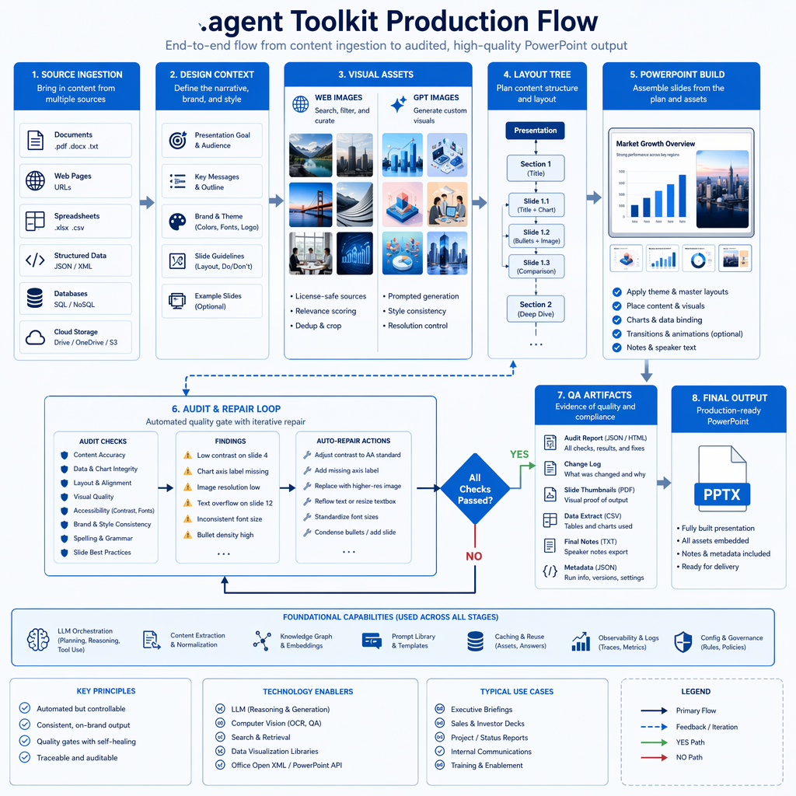
STRESS DEMO 01/81
primer-primitives turns .agent into an auditable slide-production toolkit
This slide uses the primer-primitives profile to demonstrate a concrete .agent capability. The layout combines explanatory copy, web-sourced imagery, native infographic primitives, and audit-ready coordinates.
source-backed
web image
audited
Layout family: editorial split
01
Semantic Tokens is represented as an editable, source-traceable slide object.
02
Spacing Scale is represented as an editable, source-traceable slide object.
03
Type Roles is represented as an editable, source-traceable slide object.
04
Surface Cards is represented as an editable, source-traceable slide object.
GPT image infographic.
11
profile patterns are combined with varied dense object systems.
style locks are combined with varied dense object systems.
layout families are combined with varied dense object systems.
dense slides are combined with varied dense object systems.
11
30
30
8
8
81
81
density layer
Generated from .agent context with OpenMoji web images and native infographic primitives.

Slide 2
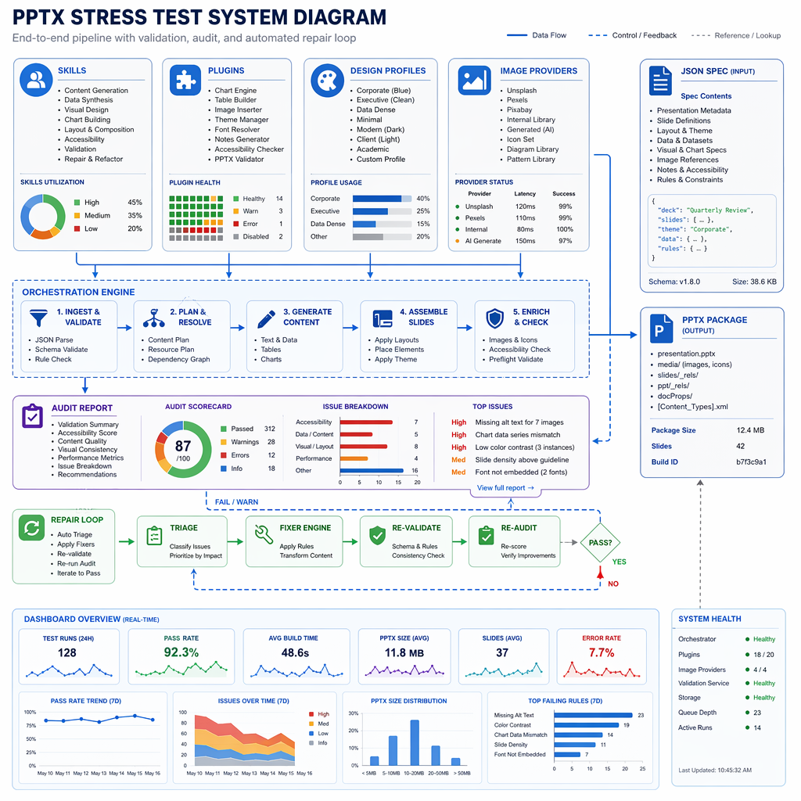
STRESS DEMO 02/81
fluent-ui-design-tokens turns .agent into an auditable slide-production toolkit
This slide uses the fluent-ui-design-tokens profile to demonstrate a concrete .agent capability. The layout combines explanatory copy, web-sourced imagery, native infographic primitives, and audit-ready coordinates.
source-backed
web image
audited
Layout family: bento overload
Theme Variant is represented as an editable, source-traceable slide object.
Token Categories is represented as an editable, source-traceable slide object.
Accessible Contrast is represented as an editable, source-traceable slide object.
Theme Variant is represented as an editable, source-traceable slide object.
Component Rhythm is represented as an editable, source-traceable slide object.
Audit Result is represented as an editable, source-traceable slide object.
11
profile patterns are combined with varied dense object systems.
style locks are combined with varied dense object systems.
layout families are combined with varied dense object systems.
dense slides are combined with varied dense object systems.
11
30
30
8
8
81
81
density layer
Generated from .agent context with OpenMoji web images and native infographic primitives.

Slide 3
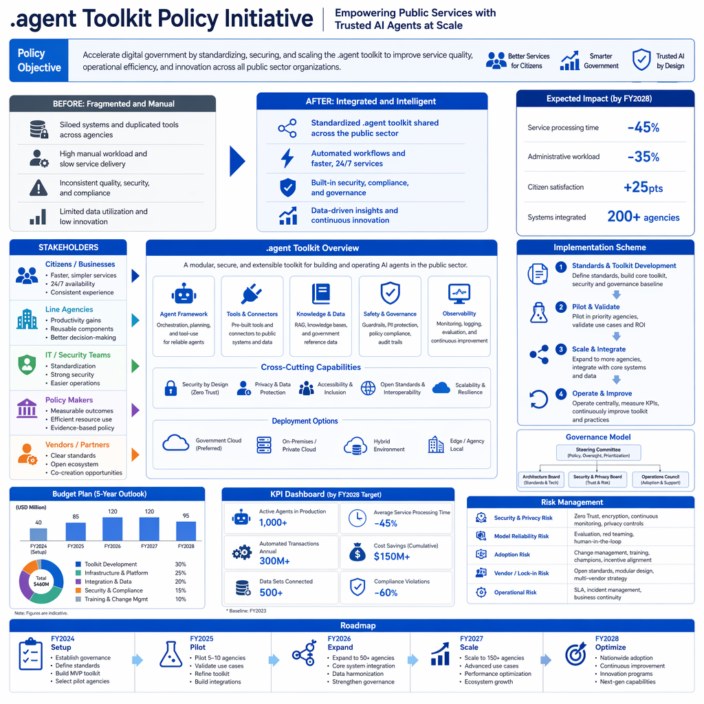
STRESS DEMO 03/81
awesome-copilot-design-agents turns .agent into an auditable slide-production toolkit
This slide uses the awesome-copilot-design-agents profile to demonstrate a concrete .agent capability. The layout combines explanatory copy, web-sourced imagery, native infographic primitives, and audit-ready coordinates.
source-backed
web image
audited
Layout family: radial control
Hierarchy
Accessibility
Discover
Critique
style lock
style lock
Hierarchy
Repair
Discover
11
profile patterns are combined with varied dense object systems.
style locks are combined with varied dense object systems.
layout families are combined with varied dense object systems.
dense slides are combined with varied dense object systems.
11
30
30
8
8
81
81
density layer
Generated from .agent context with OpenMoji web images and native infographic primitives.

Slide 4
STRESS DEMO 04/81
nexu-io-open-design turns .agent into an auditable slide-production toolkit
This slide uses the nexu-io-open-design profile to demonstrate a concrete .agent capability. The layout combines explanatory copy, web-sourced imagery, native infographic primitives, and audit-ready coordinates.
source-backed
web image
audited
Layout family: timeline matrix
1
Direction is represented as an editable, source-traceable slide object.
1
2
Sandbox is represented as an editable, source-traceable slide object.
2
3
Lint is represented as an editable, source-traceable slide object.
3
4
Critique is represented as an editable, source-traceable slide object.
4
5
Commit is represented as an editable, source-traceable slide object.
5
11
profile patterns are combined with varied dense object systems.
style locks are combined with varied dense object systems.
layout families are combined with varied dense object systems.
dense slides are combined with varied dense object systems.
11
30
30
8
8
81
81
density layer
Generated from .agent context with OpenMoji web images and native infographic primitives.

Slide 5
STRESS DEMO 05/81
alchaincyf-huashu-design turns .agent into an auditable slide-production toolkit
This slide uses the alchaincyf-huashu-design profile to demonstrate a concrete .agent capability. The layout combines explanatory copy, web-sourced imagery, native infographic primitives, and audit-ready coordinates.
source-backed
web image
audited
Layout family: layered map
Palette is represented as an editable, source-traceable slide object.
check 1
check 2
Neutral Scale is represented as an editable, source-traceable slide object.
check 3
check 4
Typeface is represented as an editable, source-traceable slide object.
check 5
check 6
Tone is represented as an editable, source-traceable slide object.
check 7
check 8
Editable Frames is represented as an editable, source-traceable slide object.
11
profile patterns are combined with varied dense object systems.
style locks are combined with varied dense object systems.
layout families are combined with varied dense object systems.
dense slides are combined with varied dense object systems.
11
30
30
8
8
81
81
density layer
Generated from .agent context with OpenMoji web images and native infographic primitives.

Slide 6
STRESS DEMO 06/81
sunbigfly-ppt-agent-skills turns .agent into an auditable slide-production toolkit
This slide uses the sunbigfly-ppt-agent-skills profile to demonstrate a concrete .agent capability. The layout combines explanatory copy, web-sourced imagery, native infographic primitives, and audit-ready coordinates.
source-backed
web image
audited
Layout family: magazine collage
SUNBIGFLY-PPT-AGEN
Interview is represented as an editable, source-traceable slide object.
Source Compression is represented as an editable, source-traceable slide object.
Outline is represented as an editable, source-traceable slide object.
Style Lock is represented as an editable, source-traceable slide object.
11
profile patterns are combined with varied dense object systems.
style locks are combined with varied dense object systems.
layout families are combined with varied dense object systems.
dense slides are combined with varied dense object systems.
11
30
30
8
8
81
81
density layer
Generated from .agent context with OpenMoji web images and native infographic primitives.

Slide 7
STRESS DEMO 07/81
likaku-mck-ppt-design-skill turns .agent into an auditable slide-production toolkit
This slide uses the likaku-mck-ppt-design-skill profile to demonstrate a concrete .agent capability. The layout combines explanatory copy, web-sourced imagery, native infographic primitives, and audit-ready coordinates.
source-backed
web image
audited
Layout family: command center
73
objects tracked in a dense control surface.
8
families tracked in a dense control surface.
0
collisions tracked in a dense control surface.
9pt
floor tracked in a dense control surface.
JSON
spec tracked in a dense control surface.
PPTX
native tracked in a dense control surface.
11
profile patterns are combined with varied dense object systems.
style locks are combined with varied dense object systems.
layout families are combined with varied dense object systems.
dense slides are combined with varied dense object systems.
11
30
30
8
8
81
81
density layer
Generated from .agent context with OpenMoji web images and native infographic primitives.

Slide 8
STRESS DEMO 08/81
corazzon-pptx-design-styles turns .agent into an auditable slide-production toolkit
This slide uses the corazzon-pptx-design-styles profile to demonstrate a concrete .agent capability. The layout combines explanatory copy, web-sourced imagery, native infographic primitives, and audit-ready coordinates.
source-backed
web image
audited
Layout family: lane weave
source
source handoff 1
source handoff 2
style
style handoff 1
style handoff 2
layout
layout handoff 1
layout handoff 2
assets
assets handoff 1
assets handoff 2
audit
audit handoff 1
audit handoff 2
11
profile patterns are combined with varied dense object systems.
style locks are combined with varied dense object systems.
layout families are combined with varied dense object systems.
dense slides are combined with varied dense object systems.
11
30
30
8
8
81
81
density layer
Generated from .agent context with OpenMoji web images and native infographic primitives.

Slide 9
STRESS DEMO 09/81
pptwork-oh-my-slides turns .agent into an auditable slide-production toolkit
This slide uses the pptwork-oh-my-slides profile to demonstrate a concrete .agent capability. The layout combines explanatory copy, web-sourced imagery, native infographic primitives, and audit-ready coordinates.
source-backed
web image
audited
Layout family: editorial split
01
Html Source is represented as an editable, source-traceable slide object.
02
Preview is represented as an editable, source-traceable slide object.
03
Raster Fidelity is represented as an editable, source-traceable slide object.
04
Editable Pptx is represented as an editable, source-traceable slide object.
GPT image infographic.
11
profile patterns are combined with varied dense object systems.
style locks are combined with varied dense object systems.
layout families are combined with varied dense object systems.
dense slides are combined with varied dense object systems.
11
30
30
8
8
81
81
density layer
Generated from .agent context with OpenMoji web images and native infographic primitives.

Slide 10
STRESS DEMO 10/81
erickittelson-slidemason turns .agent into an auditable slide-production toolkit
This slide uses the erickittelson-slidemason profile to demonstrate a concrete .agent capability. The layout combines explanatory copy, web-sourced imagery, native infographic primitives, and audit-ready coordinates.
source-backed
web image
audited
Layout family: bento overload
Card is represented as an editable, source-traceable slide object.
Text is represented as an editable, source-traceable slide object.
Line is represented as an editable, source-traceable slide object.
Card is represented as an editable, source-traceable slide object.
Image is represented as an editable, source-traceable slide object.
Manual Coordinates is represented as an editable, source-traceable slide object.
11
profile patterns are combined with varied dense object systems.
style locks are combined with varied dense object systems.
layout families are combined with varied dense object systems.
dense slides are combined with varied dense object systems.
11
30
30
8
8
81
81
density layer
Generated from .agent context with OpenMoji web images and native infographic primitives.

Slide 11
STRESS DEMO 11/81
gabberflast-academic-pptx-skill turns .agent into an auditable slide-production toolkit
This slide uses the gabberflast-academic-pptx-skill profile to demonstrate a concrete .agent capability. The layout combines explanatory copy, web-sourced imagery, native infographic primitives, and audit-ready coordinates.
source-backed
web image
audited
Layout family: radial control
Evidence
One Exhibit
Ghost Deck
Decision
style lock
style lock
Evidence
Owner
Ghost Deck
11
profile patterns are combined with varied dense object systems.
style locks are combined with varied dense object systems.
layout families are combined with varied dense object systems.
dense slides are combined with varied dense object systems.
11
30
30
8
8
81
81
density layer
Generated from .agent context with OpenMoji web images and native infographic primitives.

Slide 12
STRESS DEMO 12/81
Glassmorphism stress-tests editable infographic production
This slide uses the Glassmorphism style template to demonstrate a concrete .agent capability. The layout combines explanatory copy, web-sourced imagery, native infographic primitives, and audit-ready coordinates.
source-backed
web image
audited
Layout family: timeline matrix
1
Palette lock is visible in native fills, borders, and accent primitives.
1
2
Typography and hierarchy are intentionally varied without rasterizing text.
2
3
Signature motifs remain editable while the exhibit image stays cited.
3
4
Dense object stacks test agent repair on crowded but readable layouts.
4
5
Audit metadata records the design decision separately from the PPTX file.
5
11
profile patterns are combined with varied dense object systems.
style locks are combined with varied dense object systems.
layout families are combined with varied dense object systems.
dense slides are combined with varied dense object systems.
11
30
30
8
8
81
81
density layer
Generated from .agent context with OpenMoji web images and native infographic primitives.

Slide 13
STRESS DEMO 13/81
Neo-Brutalism stress-tests editable infographic production
This slide uses the Neo-Brutalism style template to demonstrate a concrete .agent capability. The layout combines explanatory copy, web-sourced imagery, native infographic primitives, and audit-ready coordinates.
source-backed
web image
audited
Layout family: layered map
Palette lock is visible in native fills, borders, and accent primitives.
check 1
check 2
Typography and hierarchy are intentionally varied without rasterizing text.
check 3
check 4
Signature motifs remain editable while the exhibit image stays cited.
check 5
check 6
Dense object stacks test agent repair on crowded but readable layouts.
check 7
check 8
Audit metadata records the design decision separately from the PPTX file.
11
profile patterns are combined with varied dense object systems.
style locks are combined with varied dense object systems.
layout families are combined with varied dense object systems.
dense slides are combined with varied dense object systems.
11
30
30
8
8
81
81
density layer
Generated from .agent context with OpenMoji web images and native infographic primitives.

Slide 14
STRESS DEMO 14/81
Bento Grid stress-tests editable infographic production
This slide uses the Bento Grid style template to demonstrate a concrete .agent capability. The layout combines explanatory copy, web-sourced imagery, native infographic primitives, and audit-ready coordinates.
source-backed
web image
audited
Layout family: magazine collage
BENTO GRID
Palette lock is visible in native fills, borders, and accent primitives.
Typography and hierarchy are intentionally varied without rasterizing text.
Signature motifs remain editable while the exhibit image stays cited.
Dense object stacks test agent repair on crowded but readable layouts.
11
profile patterns are combined with varied dense object systems.
style locks are combined with varied dense object systems.
layout families are combined with varied dense object systems.
dense slides are combined with varied dense object systems.
11
30
30
8
8
81
81
density layer
Generated from .agent context with OpenMoji web images and native infographic primitives.

Slide 15
STRESS DEMO 15/81
Dark Academia stress-tests editable infographic production
This slide uses the Dark Academia style template to demonstrate a concrete .agent capability. The layout combines explanatory copy, web-sourced imagery, native infographic primitives, and audit-ready coordinates.
source-backed
web image
audited
Layout family: command center
73
objects tracked in a dense control surface.
8
families tracked in a dense control surface.
0
collisions tracked in a dense control surface.
9pt
floor tracked in a dense control surface.
JSON
spec tracked in a dense control surface.
PPTX
native tracked in a dense control surface.
11
profile patterns are combined with varied dense object systems.
style locks are combined with varied dense object systems.
layout families are combined with varied dense object systems.
dense slides are combined with varied dense object systems.
11
30
30
8
8
81
81
density layer
Generated from .agent context with OpenMoji web images and native infographic primitives.

Slide 16
STRESS DEMO 16/81
Gradient Mesh stress-tests editable infographic production
This slide uses the Gradient Mesh style template to demonstrate a concrete .agent capability. The layout combines explanatory copy, web-sourced imagery, native infographic primitives, and audit-ready coordinates.
source-backed
web image
audited
Layout family: lane weave
source
source handoff 1
source handoff 2
style
style handoff 1
style handoff 2
layout
layout handoff 1
layout handoff 2
assets
assets handoff 1
assets handoff 2
audit
audit handoff 1
audit handoff 2
11
profile patterns are combined with varied dense object systems.
style locks are combined with varied dense object systems.
layout families are combined with varied dense object systems.
dense slides are combined with varied dense object systems.
11
30
30
8
8
81
81
density layer
Generated from .agent context with OpenMoji web images and native infographic primitives.

Slide 17
STRESS DEMO 17/81
Claymorphism stress-tests editable infographic production
This slide uses the Claymorphism style template to demonstrate a concrete .agent capability. The layout combines explanatory copy, web-sourced imagery, native infographic primitives, and audit-ready coordinates.
source-backed
web image
audited
Layout family: editorial split
01
Palette lock is visible in native fills, borders, and accent primitives.
02
Typography and hierarchy are intentionally varied without rasterizing text.
03
Signature motifs remain editable while the exhibit image stays cited.
04
Dense object stacks test agent repair on crowded but readable layouts.
GPT image infographic.
11
profile patterns are combined with varied dense object systems.
style locks are combined with varied dense object systems.
layout families are combined with varied dense object systems.
dense slides are combined with varied dense object systems.
11
30
30
8
8
81
81
density layer
Generated from .agent context with OpenMoji web images and native infographic primitives.

Slide 18
STRESS DEMO 18/81
Swiss International stress-tests editable infographic production
This slide uses the Swiss International style template to demonstrate a concrete .agent capability. The layout combines explanatory copy, web-sourced imagery, native infographic primitives, and audit-ready coordinates.
source-backed
web image
audited
Layout family: bento overload
Palette lock is visible in native fills, borders, and accent primitives.
Typography and hierarchy are intentionally varied without rasterizing text.
Signature motifs remain editable while the exhibit image stays cited.
Palette lock is visible in native fills, borders, and accent primitives.
Dense object stacks test agent repair on crowded but readable layouts.
Audit metadata records the design decision separately from the PPTX file.
11
profile patterns are combined with varied dense object systems.
style locks are combined with varied dense object systems.
layout families are combined with varied dense object systems.
dense slides are combined with varied dense object systems.
11
30
30
8
8
81
81
density layer
Generated from .agent context with OpenMoji web images and native infographic primitives.

Slide 19
STRESS DEMO 19/81
Aurora Neon Glow stress-tests editable infographic production
This slide uses the Aurora Neon Glow style template to demonstrate a concrete .agent capability. The layout combines explanatory copy, web-sourced imagery, native infographic primitives, and audit-ready coordinates.
source-backed
web image
audited
Layout family: radial control
Typography and hierarchy are intentionally varied without rasterizing text.
Signature motifs remain editable while the exhibit image stays cited.
Palette lock
Dense object stacks test agent repair on crowded but readable layouts.
style lock
style lock
Typography and hierarchy are intentionally varied without rasterizing text.
Audit metadata records the design decision separately from the PPTX file.
Palette lock
11
profile patterns are combined with varied dense object systems.
style locks are combined with varied dense object systems.
layout families are combined with varied dense object systems.
dense slides are combined with varied dense object systems.
11
30
30
8
8
81
81
density layer
Generated from .agent context with OpenMoji web images and native infographic primitives.

Slide 20
STRESS DEMO 20/81
Retro Y2K stress-tests editable infographic production
This slide uses the Retro Y2K style template to demonstrate a concrete .agent capability. The layout combines explanatory copy, web-sourced imagery, native infographic primitives, and audit-ready coordinates.
source-backed
web image
audited
Layout family: timeline matrix
1
Palette lock is visible in native fills, borders, and accent primitives.
1
2
Typography and hierarchy are intentionally varied without rasterizing text.
2
3
Signature motifs remain editable while the exhibit image stays cited.
3
4
Dense object stacks test agent repair on crowded but readable layouts.
4
5
Audit metadata records the design decision separately from the PPTX file.
5
11
profile patterns are combined with varied dense object systems.
style locks are combined with varied dense object systems.
layout families are combined with varied dense object systems.
dense slides are combined with varied dense object systems.
11
30
30
8
8
81
81
density layer
Generated from .agent context with OpenMoji web images and native infographic primitives.

Slide 21
STRESS DEMO 21/81
Nordic Minimalism stress-tests editable infographic production
This slide uses the Nordic Minimalism style template to demonstrate a concrete .agent capability. The layout combines explanatory copy, web-sourced imagery, native infographic primitives, and audit-ready coordinates.
source-backed
web image
audited
Layout family: layered map
Palette lock is visible in native fills, borders, and accent primitives.
check 1
check 2
Typography and hierarchy are intentionally varied without rasterizing text.
check 3
check 4
Signature motifs remain editable while the exhibit image stays cited.
check 5
check 6
Dense object stacks test agent repair on crowded but readable layouts.
check 7
check 8
Audit metadata records the design decision separately from the PPTX file.
11
profile patterns are combined with varied dense object systems.
style locks are combined with varied dense object systems.
layout families are combined with varied dense object systems.
dense slides are combined with varied dense object systems.
11
30
30
8
8
81
81
density layer
Generated from .agent context with OpenMoji web images and native infographic primitives.

Slide 22
STRESS DEMO 22/81
Typographic Bold stress-tests editable infographic production
This slide uses the Typographic Bold style template to demonstrate a concrete .agent capability. The layout combines explanatory copy, web-sourced imagery, native infographic primitives, and audit-ready coordinates.
source-backed
web image
audited
Layout family: magazine collage
TYPOGRAPHIC BOLD
Palette lock is visible in native fills, borders, and accent primitives.
Typography and hierarchy are intentionally varied without rasterizing text.
Signature motifs remain editable while the exhibit image stays cited.
Dense object stacks test agent repair on crowded but readable layouts.
11
profile patterns are combined with varied dense object systems.
style locks are combined with varied dense object systems.
layout families are combined with varied dense object systems.
dense slides are combined with varied dense object systems.
11
30
30
8
8
81
81
density layer
Generated from .agent context with OpenMoji web images and native infographic primitives.

Slide 23
STRESS DEMO 23/81
Duotone Color Split stress-tests editable infographic production
This slide uses the Duotone Color Split style template to demonstrate a concrete .agent capability. The layout combines explanatory copy, web-sourced imagery, native infographic primitives, and audit-ready coordinates.
source-backed
web image
audited
Layout family: command center
73
objects tracked in a dense control surface.
8
families tracked in a dense control surface.
0
collisions tracked in a dense control surface.
9pt
floor tracked in a dense control surface.
JSON
spec tracked in a dense control surface.
PPTX
native tracked in a dense control surface.
11
profile patterns are combined with varied dense object systems.
style locks are combined with varied dense object systems.
layout families are combined with varied dense object systems.
dense slides are combined with varied dense object systems.
11
30
30
8
8
81
81
density layer
Generated from .agent context with OpenMoji web images and native infographic primitives.

Slide 24
STRESS DEMO 24/81
Monochrome Minimal stress-tests editable infographic production
This slide uses the Monochrome Minimal style template to demonstrate a concrete .agent capability. The layout combines explanatory copy, web-sourced imagery, native infographic primitives, and audit-ready coordinates.
source-backed
web image
audited
Layout family: lane weave
source
source handoff 1
source handoff 2
style
style handoff 1
style handoff 2
layout
layout handoff 1
layout handoff 2
assets
assets handoff 1
assets handoff 2
audit
audit handoff 1
audit handoff 2
11
profile patterns are combined with varied dense object systems.
style locks are combined with varied dense object systems.
layout families are combined with varied dense object systems.
dense slides are combined with varied dense object systems.
11
30
30
8
8
81
81
density layer
Generated from .agent context with OpenMoji web images and native infographic primitives.

Slide 25
STRESS DEMO 25/81
Cyberpunk Outline stress-tests editable infographic production
This slide uses the Cyberpunk Outline style template to demonstrate a concrete .agent capability. The layout combines explanatory copy, web-sourced imagery, native infographic primitives, and audit-ready coordinates.
source-backed
web image
audited
Layout family: editorial split
01
Palette lock is visible in native fills, borders, and accent primitives.
02
Typography and hierarchy are intentionally varied without rasterizing text.
03
Signature motifs remain editable while the exhibit image stays cited.
04
Dense object stacks test agent repair on crowded but readable layouts.
GPT image infographic.
11
profile patterns are combined with varied dense object systems.
style locks are combined with varied dense object systems.
layout families are combined with varied dense object systems.
dense slides are combined with varied dense object systems.
11
30
30
8
8
81
81
density layer
Generated from .agent context with OpenMoji web images and native infographic primitives.

Slide 26
STRESS DEMO 26/81
Editorial Magazine stress-tests editable infographic production
This slide uses the Editorial Magazine style template to demonstrate a concrete .agent capability. The layout combines explanatory copy, web-sourced imagery, native infographic primitives, and audit-ready coordinates.
source-backed
web image
audited
Layout family: bento overload
Palette lock is visible in native fills, borders, and accent primitives.
Typography and hierarchy are intentionally varied without rasterizing text.
Signature motifs remain editable while the exhibit image stays cited.
Palette lock is visible in native fills, borders, and accent primitives.
Dense object stacks test agent repair on crowded but readable layouts.
Audit metadata records the design decision separately from the PPTX file.
11
profile patterns are combined with varied dense object systems.
style locks are combined with varied dense object systems.
layout families are combined with varied dense object systems.
dense slides are combined with varied dense object systems.
11
30
30
8
8
81
81
density layer
Generated from .agent context with OpenMoji web images and native infographic primitives.

Slide 27
STRESS DEMO 27/81
Pastel Soft UI stress-tests editable infographic production
This slide uses the Pastel Soft UI style template to demonstrate a concrete .agent capability. The layout combines explanatory copy, web-sourced imagery, native infographic primitives, and audit-ready coordinates.
source-backed
web image
audited
Layout family: radial control
Typography and hierarchy are intentionally varied without rasterizing text.
Signature motifs remain editable while the exhibit image stays cited.
Palette lock
Dense object stacks test agent repair on crowded but readable layouts.
style lock
style lock
Typography and hierarchy are intentionally varied without rasterizing text.
Audit metadata records the design decision separately from the PPTX file.
Palette lock
11
profile patterns are combined with varied dense object systems.
style locks are combined with varied dense object systems.
layout families are combined with varied dense object systems.
dense slides are combined with varied dense object systems.
11
30
30
8
8
81
81
density layer
Generated from .agent context with OpenMoji web images and native infographic primitives.

Slide 28
STRESS DEMO 28/81
Dark Neon Miami stress-tests editable infographic production
This slide uses the Dark Neon Miami style template to demonstrate a concrete .agent capability. The layout combines explanatory copy, web-sourced imagery, native infographic primitives, and audit-ready coordinates.
source-backed
web image
audited
Layout family: timeline matrix
1
Palette lock is visible in native fills, borders, and accent primitives.
1
2
Typography and hierarchy are intentionally varied without rasterizing text.
2
3
Signature motifs remain editable while the exhibit image stays cited.
3
4
Dense object stacks test agent repair on crowded but readable layouts.
4
5
Audit metadata records the design decision separately from the PPTX file.
5
11
profile patterns are combined with varied dense object systems.
style locks are combined with varied dense object systems.
layout families are combined with varied dense object systems.
dense slides are combined with varied dense object systems.
11
30
30
8
8
81
81
density layer
Generated from .agent context with OpenMoji web images and native infographic primitives.

Slide 29
STRESS DEMO 29/81
Hand-crafted Organic stress-tests editable infographic production
This slide uses the Hand-crafted Organic style template to demonstrate a concrete .agent capability. The layout combines explanatory copy, web-sourced imagery, native infographic primitives, and audit-ready coordinates.
source-backed
web image
audited
Layout family: layered map
Palette lock is visible in native fills, borders, and accent primitives.
check 1
check 2
Typography and hierarchy are intentionally varied without rasterizing text.
check 3
check 4
Signature motifs remain editable while the exhibit image stays cited.
check 5
check 6
Dense object stacks test agent repair on crowded but readable layouts.
check 7
check 8
Audit metadata records the design decision separately from the PPTX file.
11
profile patterns are combined with varied dense object systems.
style locks are combined with varied dense object systems.
layout families are combined with varied dense object systems.
dense slides are combined with varied dense object systems.
11
30
30
8
8
81
81
density layer
Generated from .agent context with OpenMoji web images and native infographic primitives.

Slide 30
STRESS DEMO 30/81
Isometric 3D Flat stress-tests editable infographic production
This slide uses the Isometric 3D Flat style template to demonstrate a concrete .agent capability. The layout combines explanatory copy, web-sourced imagery, native infographic primitives, and audit-ready coordinates.
source-backed
web image
audited
Layout family: magazine collage
ISOMETRIC 3D FLAT
Palette lock is visible in native fills, borders, and accent primitives.
Typography and hierarchy are intentionally varied without rasterizing text.
Signature motifs remain editable while the exhibit image stays cited.
Dense object stacks test agent repair on crowded but readable layouts.
11
profile patterns are combined with varied dense object systems.
style locks are combined with varied dense object systems.
layout families are combined with varied dense object systems.
dense slides are combined with varied dense object systems.
11
30
30
8
8
81
81
density layer
Generated from .agent context with OpenMoji web images and native infographic primitives.

Slide 31
STRESS DEMO 31/81
Vaporwave stress-tests editable infographic production
This slide uses the Vaporwave style template to demonstrate a concrete .agent capability. The layout combines explanatory copy, web-sourced imagery, native infographic primitives, and audit-ready coordinates.
source-backed
web image
audited
Layout family: command center
73
objects tracked in a dense control surface.
8
families tracked in a dense control surface.
0
collisions tracked in a dense control surface.
9pt
floor tracked in a dense control surface.
JSON
spec tracked in a dense control surface.
PPTX
native tracked in a dense control surface.
11
profile patterns are combined with varied dense object systems.
style locks are combined with varied dense object systems.
layout families are combined with varied dense object systems.
dense slides are combined with varied dense object systems.
11
30
30
8
8
81
81
density layer
Generated from .agent context with OpenMoji web images and native infographic primitives.

Slide 32
STRESS DEMO 32/81
Art Deco Luxe stress-tests editable infographic production
This slide uses the Art Deco Luxe style template to demonstrate a concrete .agent capability. The layout combines explanatory copy, web-sourced imagery, native infographic primitives, and audit-ready coordinates.
source-backed
web image
audited
Layout family: lane weave
source
source handoff 1
source handoff 2
style
style handoff 1
style handoff 2
layout
layout handoff 1
layout handoff 2
assets
assets handoff 1
assets handoff 2
audit
audit handoff 1
audit handoff 2
11
profile patterns are combined with varied dense object systems.
style locks are combined with varied dense object systems.
layout families are combined with varied dense object systems.
dense slides are combined with varied dense object systems.
11
30
30
8
8
81
81
density layer
Generated from .agent context with OpenMoji web images and native infographic primitives.

Slide 33
STRESS DEMO 33/81
Brutalist Newspaper stress-tests editable infographic production
This slide uses the Brutalist Newspaper style template to demonstrate a concrete .agent capability. The layout combines explanatory copy, web-sourced imagery, native infographic primitives, and audit-ready coordinates.
source-backed
web image
audited
Layout family: editorial split
01
Palette lock is visible in native fills, borders, and accent primitives.
02
Typography and hierarchy are intentionally varied without rasterizing text.
03
Signature motifs remain editable while the exhibit image stays cited.
04
Dense object stacks test agent repair on crowded but readable layouts.
GPT image infographic.
11
profile patterns are combined with varied dense object systems.
style locks are combined with varied dense object systems.
layout families are combined with varied dense object systems.
dense slides are combined with varied dense object systems.
11
30
30
8
8
81
81
density layer
Generated from .agent context with OpenMoji web images and native infographic primitives.

Slide 34
STRESS DEMO 34/81
Stained Glass Mosaic stress-tests editable infographic production
This slide uses the Stained Glass Mosaic style template to demonstrate a concrete .agent capability. The layout combines explanatory copy, web-sourced imagery, native infographic primitives, and audit-ready coordinates.
source-backed
web image
audited
Layout family: bento overload
Palette lock is visible in native fills, borders, and accent primitives.
Typography and hierarchy are intentionally varied without rasterizing text.
Signature motifs remain editable while the exhibit image stays cited.
Palette lock is visible in native fills, borders, and accent primitives.
Dense object stacks test agent repair on crowded but readable layouts.
Audit metadata records the design decision separately from the PPTX file.
11
profile patterns are combined with varied dense object systems.
style locks are combined with varied dense object systems.
layout families are combined with varied dense object systems.
dense slides are combined with varied dense object systems.
11
30
30
8
8
81
81
density layer
Generated from .agent context with OpenMoji web images and native infographic primitives.

Slide 35
STRESS DEMO 35/81
Liquid Blob Morphing stress-tests editable infographic production
This slide uses the Liquid Blob Morphing style template to demonstrate a concrete .agent capability. The layout combines explanatory copy, web-sourced imagery, native infographic primitives, and audit-ready coordinates.
source-backed
web image
audited
Layout family: radial control
Typography and hierarchy are intentionally varied without rasterizing text.
Signature motifs remain editable while the exhibit image stays cited.
Palette lock
Dense object stacks test agent repair on crowded but readable layouts.
style lock
style lock
Typography and hierarchy are intentionally varied without rasterizing text.
Audit metadata records the design decision separately from the PPTX file.
Palette lock
11
profile patterns are combined with varied dense object systems.
style locks are combined with varied dense object systems.
layout families are combined with varied dense object systems.
dense slides are combined with varied dense object systems.
11
30
30
8
8
81
81
density layer
Generated from .agent context with OpenMoji web images and native infographic primitives.

Slide 36
STRESS DEMO 36/81
Memphis Pop Pattern stress-tests editable infographic production
This slide uses the Memphis Pop Pattern style template to demonstrate a concrete .agent capability. The layout combines explanatory copy, web-sourced imagery, native infographic primitives, and audit-ready coordinates.
source-backed
web image
audited
Layout family: timeline matrix
1
Palette lock is visible in native fills, borders, and accent primitives.
1
2
Typography and hierarchy are intentionally varied without rasterizing text.
2
3
Signature motifs remain editable while the exhibit image stays cited.
3
4
Dense object stacks test agent repair on crowded but readable layouts.
4
5
Audit metadata records the design decision separately from the PPTX file.
5
11
profile patterns are combined with varied dense object systems.
style locks are combined with varied dense object systems.
layout families are combined with varied dense object systems.
dense slides are combined with varied dense object systems.
11
30
30
8
8
81
81
density layer
Generated from .agent context with OpenMoji web images and native infographic primitives.

Slide 37
STRESS DEMO 37/81
Dark Forest Nature stress-tests editable infographic production
This slide uses the Dark Forest Nature style template to demonstrate a concrete .agent capability. The layout combines explanatory copy, web-sourced imagery, native infographic primitives, and audit-ready coordinates.
source-backed
web image
audited
Layout family: layered map
Palette lock is visible in native fills, borders, and accent primitives.
check 1
check 2
Typography and hierarchy are intentionally varied without rasterizing text.
check 3
check 4
Signature motifs remain editable while the exhibit image stays cited.
check 5
check 6
Dense object stacks test agent repair on crowded but readable layouts.
check 7
check 8
Audit metadata records the design decision separately from the PPTX file.
11
profile patterns are combined with varied dense object systems.
style locks are combined with varied dense object systems.
layout families are combined with varied dense object systems.
dense slides are combined with varied dense object systems.
11
30
30
8
8
81
81
density layer
Generated from .agent context with OpenMoji web images and native infographic primitives.

Slide 38
STRESS DEMO 38/81
Architectural Blueprint stress-tests editable infographic production
This slide uses the Architectural Blueprint style template to demonstrate a concrete .agent capability. The layout combines explanatory copy, web-sourced imagery, native infographic primitives, and audit-ready coordinates.
source-backed
web image
audited
Layout family: magazine collage
ARCHITECTURAL BLUE
Palette lock is visible in native fills, borders, and accent primitives.
Typography and hierarchy are intentionally varied without rasterizing text.
Signature motifs remain editable while the exhibit image stays cited.
Dense object stacks test agent repair on crowded but readable layouts.
11
profile patterns are combined with varied dense object systems.
style locks are combined with varied dense object systems.
layout families are combined with varied dense object systems.
dense slides are combined with varied dense object systems.
11
30
30
8
8
81
81
density layer
Generated from .agent context with OpenMoji web images and native infographic primitives.

Slide 39
STRESS DEMO 39/81
Maximalist Collage stress-tests editable infographic production
This slide uses the Maximalist Collage style template to demonstrate a concrete .agent capability. The layout combines explanatory copy, web-sourced imagery, native infographic primitives, and audit-ready coordinates.
source-backed
web image
audited
Layout family: command center
73
objects tracked in a dense control surface.
8
families tracked in a dense control surface.
0
collisions tracked in a dense control surface.
9pt
floor tracked in a dense control surface.
JSON
spec tracked in a dense control surface.
PPTX
native tracked in a dense control surface.
11
profile patterns are combined with varied dense object systems.
style locks are combined with varied dense object systems.
layout families are combined with varied dense object systems.
dense slides are combined with varied dense object systems.
11
30
30
8
8
81
81
density layer
Generated from .agent context with OpenMoji web images and native infographic primitives.

Slide 40
STRESS DEMO 40/81
SciFi Holographic Data stress-tests editable infographic production
This slide uses the SciFi Holographic Data style template to demonstrate a concrete .agent capability. The layout combines explanatory copy, web-sourced imagery, native infographic primitives, and audit-ready coordinates.
source-backed
web image
audited
Layout family: lane weave
source
source handoff 1
source handoff 2
style
style handoff 1
style handoff 2
layout
layout handoff 1
layout handoff 2
assets
assets handoff 1
assets handoff 2
audit
audit handoff 1
audit handoff 2
11
profile patterns are combined with varied dense object systems.
style locks are combined with varied dense object systems.
layout families are combined with varied dense object systems.
dense slides are combined with varied dense object systems.
11
30
30
8
8
81
81
density layer
Generated from .agent context with OpenMoji web images and native infographic primitives.

Slide 41
STRESS DEMO 41/81
Risograph Print stress-tests editable infographic production
This slide uses the Risograph Print style template to demonstrate a concrete .agent capability. The layout combines explanatory copy, web-sourced imagery, native infographic primitives, and audit-ready coordinates.
source-backed
web image
audited
Layout family: editorial split
01
Palette lock is visible in native fills, borders, and accent primitives.
02
Typography and hierarchy are intentionally varied without rasterizing text.
03
Signature motifs remain editable while the exhibit image stays cited.
04
Dense object stacks test agent repair on crowded but readable layouts.
GPT image infographic.
11
profile patterns are combined with varied dense object systems.
style locks are combined with varied dense object systems.
layout families are combined with varied dense object systems.
dense slides are combined with varied dense object systems.
11
30
30
8
8
81
81
density layer
Generated from .agent context with OpenMoji web images and native infographic primitives.

Slide 42
LAYOUT VARIANT 1 / 42 OF 81
Overview map converts the .agent toolkit into a navigable production system.
The image is a visible exhibit, not a replacement for editable logic.
The right column keeps full-sentence claims in separate text frames.
The JSON spec records coordinates, source, license, and audit evidence.
micro KPI
GPT image infographic.
The layout variant uses a wide split instead of the default grid.
source
style
spec
render
audit
1
2
3
4
5
6
7
8
9
density layer
Layout variant deck: title, evidence, and body regions use different coordinate systems.

Slide 43
LAYOUT VARIANT 2 / 43 OF 81
Split image exhibit separates visual evidence from editable slide logic.
micro KPI
design is explicit.
sources is explicit.
assets is explicit.
.agent spec
.agent spec
render is explicit.
repair is explicit.
source
style
spec
render
audit
audit is explicit.
1
2
3
4
5
6
7
8
9
density layer
Layout variant deck: title, evidence, and body regions use different coordinate systems.

Slide 44
LAYOUT VARIANT 3 / 44 OF 81
Radial workflow shows how skills, plugins, and design context orbit the deck spec.
1
Intake becomes a visible checkpoint with its own editable text frame.
micro KPI
1
2
Source becomes a visible checkpoint with its own editable text frame.
2
3
Design Lock becomes a visible checkpoint with its own editable text frame.
3
4
Layout Tree becomes a visible checkpoint with its own editable text frame.
4
The right exhibit area stays visually separate from the process rail.
5
Pptx Build becomes a visible checkpoint with its own editable text frame.
5
6
Audit Repair becomes a visible checkpoint with its own editable text frame.
6
source
style
spec
render
audit
1
2
3
4
5
6
7
8
9
density layer
Layout variant deck: title, evidence, and body regions use different coordinate systems.

Slide 45
LAYOUT VARIANT 4 / 45 OF 81
Decision matrix tests consulting-style action titles and dense native tables.
81
slides are checked as part of the generated stress deck.
37
layout variants are checked as part of the generated stress deck.
11
profile patterns are checked as part of the generated stress deck.
30
style templates are checked as part of the generated stress deck.
4
web images are checked as part of the generated stress deck.
0
audit collisions are checked as part of the generated stress deck.
micro KPI
source
style
spec
render
audit
1
2
3
4
5
6
7
8
9
density layer
Layout variant deck: title, evidence, and body regions use different coordinate systems.

Slide 46
LAYOUT VARIANT 5 / 46 OF 81
Stage gate roadmap turns source ingestion into a controlled delivery pipeline.
Agent skills
Agent skills item 1 is placed on a separate lane card.
Agent skills item 2 is placed on a separate lane card.
Agent skills item 3 is placed on a separate lane card.
Design profiles item 1 is placed on a separate lane card.
Design profiles item 2 is placed on a separate lane card.
Design profiles item 3 is placed on a separate lane card.
micro KPI
Design profiles
Image assets
Image assets item 1 is placed on a separate lane card.
Image assets item 2 is placed on a separate lane card.
Image assets item 3 is placed on a separate lane card.
Quality gates
Quality gates item 1 is placed on a separate lane card.
Quality gates item 2 is placed on a separate lane card.
Quality gates item 3 is placed on a separate lane card.
source
style
spec
render
audit
1
2
3
4
5
6
7
8
9
density layer
Layout variant deck: title, evidence, and body regions use different coordinate systems.

Slide 47
LAYOUT VARIANT 6 / 47 OF 81
Brand lock canvas checks palette, tone, typography, and editable-frame discipline.
brief
source
design
spec
asset
audit
ship
micro KPI
source
style
spec
render
audit
1
2
3
4
5
6
7
8
9
density layer
Layout variant deck: title, evidence, and body regions use different coordinate systems.

Slide 48
LAYOUT VARIANT 7 / 48 OF 81
Primitive stack validates manual cards, lines, text, and image composition.
input
normalize
plan
render
validate
path 1
path 2
path 3
path 4
path 5
micro KPI
source
style
spec
render
audit
1
2
3
4
5
6
7
8
9
density layer
Layout variant deck: title, evidence, and body regions use different coordinate systems.

Slide 49
LAYOUT VARIANT 8 / 49 OF 81
Narrative gate board keeps evidence, decision, owner, and deadline visible.
agent
source
style
asset
audit
owner
br-ag
br-so
br-st
br-as
br-au
br-ow
sp-ag
sp-so
sp-st
sp-as
sp-au
sp-ow
pp-ag
pp-so
pp-st
pp-as
pp-au
pp-ow
re-ag
re-so
re-st
re-as
re-au
re-ow
sh-ag
sh-so
sh-st
sh-as
sh-au
sh-ow
micro KPI
source
style
spec
render
audit
1
2
3
4
5
6
7
8
9
density layer
Layout variant deck: title, evidence, and body regions use different coordinate systems.

Slide 50
LAYOUT VARIANT 9 / 50 OF 81
Style selector wall demonstrates a broader design-pattern chooser beyond Corazzon.
prompt
check 1
check 2
source corpus
check 3
check 4
design context
check 5
check 6
layout tree
check 7
check 8
pptx package
audit report
micro KPI
source
style
spec
render
audit
1
2
3
4
5
6
7
8
9
density layer
Layout variant deck: title, evidence, and body regions use different coordinate systems.

Slide 51
LAYOUT VARIANT 10 / 51 OF 81
Source ingestion funnel turns documents, URLs, and notes into a deck-ready corpus.
micro KPI
source
style
spec
render
audit
1
2
3
4
5
6
7
8
9
density layer
Layout variant deck: title, evidence, and body regions use different coordinate systems.

Slide 52
LAYOUT VARIANT 11 / 52 OF 81
RAPTOR summary tree shows how long sources become clustered slide evidence.
todo
doing
review
done
todo card 1
doing card 1
review card 1
done card 1
todo card 2
doing card 2
review card 2
done card 2
todo card 3
doing card 3
review card 3
done card 3
todo card 4
doing card 4
review card 4
done card 4
micro KPI
source
style
spec
render
audit
1
2
3
4
5
6
7
8
9
density layer
Layout variant deck: title, evidence, and body regions use different coordinate systems.

Slide 53
LAYOUT VARIANT 12 / 53 OF 81
Design token ledger records color, spacing, type, and source attribution.
module 1
module 2
module 3
module 4
module 5
module 6
module 7
module 8
module 9
module 10
micro KPI
source
style
spec
render
audit
1
2
3
4
5
6
7
8
9
density layer
Layout variant deck: title, evidence, and body regions use different coordinate systems.

Slide 54
LAYOUT VARIANT 1 / 54 OF 81
Image provider ladder separates web images, GPT images, SVG wrappers, and manifests.
The image is a visible exhibit, not a replacement for editable logic.
The right column keeps full-sentence claims in separate text frames.
The JSON spec records coordinates, source, license, and audit evidence.
micro KPI
GPT image infographic.
The layout variant uses a wide split instead of the default grid.
source
style
spec
render
audit
1
2
3
4
5
6
7
8
9
density layer
Layout variant deck: title, evidence, and body regions use different coordinate systems.

Slide 55
LAYOUT VARIANT 2 / 55 OF 81
Audit repair loop makes collision findings, font findings, and rebuild decisions visible.
micro KPI
design is explicit.
sources is explicit.
assets is explicit.
.agent spec
.agent spec
render is explicit.
repair is explicit.
source
style
spec
render
audit
audit is explicit.
1
2
3
4
5
6
7
8
9
density layer
Layout variant deck: title, evidence, and body regions use different coordinate systems.

Slide 56
LAYOUT VARIANT 3 / 56 OF 81
Coordinate contract map demonstrates bboxes, z order, roles, and content classification.
1
Intake becomes a visible checkpoint with its own editable text frame.
micro KPI
1
2
Source becomes a visible checkpoint with its own editable text frame.
2
3
Design Lock becomes a visible checkpoint with its own editable text frame.
3
4
Layout Tree becomes a visible checkpoint with its own editable text frame.
4
The right exhibit area stays visually separate from the process rail.
5
Pptx Build becomes a visible checkpoint with its own editable text frame.
5
6
Audit Repair becomes a visible checkpoint with its own editable text frame.
6
source
style
spec
render
audit
1
2
3
4
5
6
7
8
9
density layer
Layout variant deck: title, evidence, and body regions use different coordinate systems.

Slide 57
LAYOUT VARIANT 4 / 57 OF 81
Quality gate scorecard keeps production-readiness checks in a dashboard layout.
81
slides are checked as part of the generated stress deck.
37
layout variants are checked as part of the generated stress deck.
11
profile patterns are checked as part of the generated stress deck.
30
style templates are checked as part of the generated stress deck.
4
web images are checked as part of the generated stress deck.
0
audit collisions are checked as part of the generated stress deck.
micro KPI
source
style
spec
render
audit
1
2
3
4
5
6
7
8
9
density layer
Layout variant deck: title, evidence, and body regions use different coordinate systems.

Slide 58
LAYOUT VARIANT 5 / 58 OF 81
Reference deck extraction separates style facts from copied binary templates.
Agent skills
Agent skills item 1 is placed on a separate lane card.
Agent skills item 2 is placed on a separate lane card.
Agent skills item 3 is placed on a separate lane card.
Design profiles item 1 is placed on a separate lane card.
Design profiles item 2 is placed on a separate lane card.
Design profiles item 3 is placed on a separate lane card.
micro KPI
Design profiles
Image assets
Image assets item 1 is placed on a separate lane card.
Image assets item 2 is placed on a separate lane card.
Image assets item 3 is placed on a separate lane card.
Quality gates
Quality gates item 1 is placed on a separate lane card.
Quality gates item 2 is placed on a separate lane card.
Quality gates item 3 is placed on a separate lane card.
source
style
spec
render
audit
1
2
3
4
5
6
7
8
9
density layer
Layout variant deck: title, evidence, and body regions use different coordinate systems.

Slide 59
LAYOUT VARIANT 6 / 59 OF 81
Hidden appendix flow documents generated raster and SVG evidence without crowding slides.
brief
source
design
spec
asset
audit
ship
micro KPI
source
style
spec
render
audit
1
2
3
4
5
6
7
8
9
density layer
Layout variant deck: title, evidence, and body regions use different coordinate systems.

Slide 60
LAYOUT VARIANT 7 / 60 OF 81
Accessibility contrast grid stress-tests readable labels across dark and light layouts.
input
normalize
plan
render
validate
path 1
path 2
path 3
path 4
path 5
micro KPI
source
style
spec
render
audit
1
2
3
4
5
6
7
8
9
density layer
Layout variant deck: title, evidence, and body regions use different coordinate systems.

Slide 61
LAYOUT VARIANT 8 / 61 OF 81
Agent skill map shows how local skills cover ingestion, design, rendering, and gates.
agent
source
style
asset
audit
owner
br-ag
br-so
br-st
br-as
br-au
br-ow
sp-ag
sp-so
sp-st
sp-as
sp-au
sp-ow
pp-ag
pp-so
pp-st
pp-as
pp-au
pp-ow
re-ag
re-so
re-st
re-as
re-au
re-ow
sh-ag
sh-so
sh-st
sh-as
sh-au
sh-ow
micro KPI
source
style
spec
render
audit
1
2
3
4
5
6
7
8
9
density layer
Layout variant deck: title, evidence, and body regions use different coordinate systems.

Slide 62
LAYOUT VARIANT 9 / 62 OF 81
Style lock board prevents accidental mixing of palette, type, and motif choices.
prompt
check 1
check 2
source corpus
check 3
check 4
design context
check 5
check 6
layout tree
check 7
check 8
pptx package
audit report
micro KPI
source
style
spec
render
audit
1
2
3
4
5
6
7
8
9
density layer
Layout variant deck: title, evidence, and body regions use different coordinate systems.

Slide 63
LAYOUT VARIANT 10 / 63 OF 81
Source attribution table keeps licenses and URLs visible for every adapted context.
micro KPI
source
style
spec
render
audit
1
2
3
4
5
6
7
8
9
density layer
Layout variant deck: title, evidence, and body regions use different coordinate systems.

Slide 64
LAYOUT VARIANT 11 / 64 OF 81
Editable object taxonomy compares text, shape, image, line, and table primitives.
todo
doing
review
done
todo card 1
doing card 1
review card 1
done card 1
todo card 2
doing card 2
review card 2
done card 2
todo card 3
doing card 3
review card 3
done card 3
todo card 4
doing card 4
review card 4
done card 4
micro KPI
source
style
spec
render
audit
1
2
3
4
5
6
7
8
9
density layer
Layout variant deck: title, evidence, and body regions use different coordinate systems.

Slide 65
LAYOUT VARIANT 12 / 65 OF 81
Workflow command strip shows the exact sequence from prompt to audit artifact.
module 1
module 2
module 3
module 4
module 5
module 6
module 7
module 8
module 9
module 10
micro KPI
source
style
spec
render
audit
1
2
3
4
5
6
7
8
9
density layer
Layout variant deck: title, evidence, and body regions use different coordinate systems.

Slide 66
LAYOUT VARIANT 1 / 66 OF 81
Visual density test keeps dense copy readable with separated cards and lanes.
The image is a visible exhibit, not a replacement for editable logic.
The right column keeps full-sentence claims in separate text frames.
The JSON spec records coordinates, source, license, and audit evidence.
micro KPI
GPT image infographic.
The layout variant uses a wide split instead of the default grid.
source
style
spec
render
audit
1
2
3
4
5
6
7
8
9
density layer
Layout variant deck: title, evidence, and body regions use different coordinate systems.

Slide 67
LAYOUT VARIANT 2 / 67 OF 81
Brand system sandbox compares chosen palette, neutral scale, tone, and type rules.
micro KPI
design is explicit.
sources is explicit.
assets is explicit.
.agent spec
.agent spec
render is explicit.
repair is explicit.
source
style
spec
render
audit
audit is explicit.
1
2
3
4
5
6
7
8
9
density layer
Layout variant deck: title, evidence, and body regions use different coordinate systems.

Slide 68
LAYOUT VARIANT 3 / 68 OF 81
Asset manifest dashboard tracks web images, generated attempts, and local paths.
1
Intake becomes a visible checkpoint with its own editable text frame.
micro KPI
1
2
Source becomes a visible checkpoint with its own editable text frame.
2
3
Design Lock becomes a visible checkpoint with its own editable text frame.
3
4
Layout Tree becomes a visible checkpoint with its own editable text frame.
4
The right exhibit area stays visually separate from the process rail.
5
Pptx Build becomes a visible checkpoint with its own editable text frame.
5
6
Audit Repair becomes a visible checkpoint with its own editable text frame.
6
source
style
spec
render
audit
1
2
3
4
5
6
7
8
9
density layer
Layout variant deck: title, evidence, and body regions use different coordinate systems.

Slide 69
LAYOUT VARIANT 4 / 69 OF 81
Layout family gallery demonstrates split, radial, timeline, dashboard, and lane systems.
81
slides are checked as part of the generated stress deck.
37
layout variants are checked as part of the generated stress deck.
11
profile patterns are checked as part of the generated stress deck.
30
style templates are checked as part of the generated stress deck.
4
web images are checked as part of the generated stress deck.
0
audit collisions are checked as part of the generated stress deck.
micro KPI
source
style
spec
render
audit
1
2
3
4
5
6
7
8
9
density layer
Layout variant deck: title, evidence, and body regions use different coordinate systems.

Slide 70
LAYOUT VARIANT 5 / 70 OF 81
Decision owner rail connects evidence, decision, deadline, and owner into one path.
Agent skills
Agent skills item 1 is placed on a separate lane card.
Agent skills item 2 is placed on a separate lane card.
Agent skills item 3 is placed on a separate lane card.
Design profiles item 1 is placed on a separate lane card.
Design profiles item 2 is placed on a separate lane card.
Design profiles item 3 is placed on a separate lane card.
micro KPI
Design profiles
Image assets
Image assets item 1 is placed on a separate lane card.
Image assets item 2 is placed on a separate lane card.
Image assets item 3 is placed on a separate lane card.
Quality gates
Quality gates item 1 is placed on a separate lane card.
Quality gates item 2 is placed on a separate lane card.
Quality gates item 3 is placed on a separate lane card.
source
style
spec
render
audit
1
2
3
4
5
6
7
8
9
density layer
Layout variant deck: title, evidence, and body regions use different coordinate systems.

Slide 71
LAYOUT VARIANT 6 / 71 OF 81
Plugin boundary map clarifies what helper scripts do versus what the renderer must do.
brief
source
design
spec
asset
audit
ship
micro KPI
source
style
spec
render
audit
1
2
3
4
5
6
7
8
9
density layer
Layout variant deck: title, evidence, and body regions use different coordinate systems.

Slide 72
LAYOUT VARIANT 7 / 72 OF 81
Rendering fallback plan shows direct python-pptx serialization when core pptify is absent.
input
normalize
plan
render
validate
path 1
path 2
path 3
path 4
path 5
micro KPI
source
style
spec
render
audit
1
2
3
4
5
6
7
8
9
density layer
Layout variant deck: title, evidence, and body regions use different coordinate systems.

Slide 73
LAYOUT VARIANT 8 / 73 OF 81
Infographic composition board combines image evidence with editable surrounding primitives.
agent
source
style
asset
audit
owner
br-ag
br-so
br-st
br-as
br-au
br-ow
sp-ag
sp-so
sp-st
sp-as
sp-au
sp-ow
pp-ag
pp-so
pp-st
pp-as
pp-au
pp-ow
re-ag
re-so
re-st
re-as
re-au
re-ow
sh-ag
sh-so
sh-st
sh-as
sh-au
sh-ow
micro KPI
source
style
spec
render
audit
1
2
3
4
5
6
7
8
9
density layer
Layout variant deck: title, evidence, and body regions use different coordinate systems.

Slide 74
LAYOUT VARIANT 9 / 74 OF 81
Preflight critique wall converts design review into concrete repair actions.
prompt
check 1
check 2
source corpus
check 3
check 4
design context
check 5
check 6
layout tree
check 7
check 8
pptx package
audit report
micro KPI
source
style
spec
render
audit
1
2
3
4
5
6
7
8
9
density layer
Layout variant deck: title, evidence, and body regions use different coordinate systems.

Slide 75
LAYOUT VARIANT 10 / 75 OF 81
Executive action title grid tests conclusion-led headings across dense pages.
micro KPI
source
style
spec
render
audit
1
2
3
4
5
6
7
8
9
density layer
Layout variant deck: title, evidence, and body regions use different coordinate systems.

Slide 76
LAYOUT VARIANT 11 / 76 OF 81
Multi-source evidence map keeps corpus, summary, source count, and URLs traceable.
todo
doing
review
done
todo card 1
doing card 1
review card 1
done card 1
todo card 2
doing card 2
review card 2
done card 2
todo card 3
doing card 3
review card 3
done card 3
todo card 4
doing card 4
review card 4
done card 4
micro KPI
source
style
spec
render
audit
1
2
3
4
5
6
7
8
9
density layer
Layout variant deck: title, evidence, and body regions use different coordinate systems.

Slide 77
LAYOUT VARIANT 12 / 77 OF 81
Image generation sequence records prompt, provider, endpoint, deployment, and attempt state.
module 1
module 2
module 3
module 4
module 5
module 6
module 7
module 8
module 9
module 10
micro KPI
source
style
spec
render
audit
1
2
3
4
5
6
7
8
9
density layer
Layout variant deck: title, evidence, and body regions use different coordinate systems.

Slide 78
LAYOUT VARIANT 1 / 78 OF 81
Final delivery checklist proves the PPTX, spec, audit, assets, and QA files are aligned.
The image is a visible exhibit, not a replacement for editable logic.
The right column keeps full-sentence claims in separate text frames.
The JSON spec records coordinates, source, license, and audit evidence.
micro KPI
GPT image infographic.
The layout variant uses a wide split instead of the default grid.
source
style
spec
render
audit
1
2
3
4
5
6
7
8
9
density layer
Layout variant deck: title, evidence, and body regions use different coordinate systems.

Slide 79
参考様式: ポンチ絵 / SLIDE 79 OF 81
ポンチ絵 style policy map compresses purpose, actors, tools, and outcomes into one dense page.
現状
資料・設計・監査が分断し、再利用できる根拠が残りにくい。
Source
効果
根拠つきで再生成できる。
Design
課題
画像、Web根拠、レイアウト座標、品質確認が別々に管理される。
確認
衝突・小フォントを機械確認する。
Spec
対応方針
.agent 配下のスキル、設計文脈、プラグイン、監査を一体運用する。
PPTX
展開
設計パターンを横展開する。
Audit
小計・KPI
制度
予算
実装
監査
展開
根拠: slide spec に明記
対象: slide spec に明記
手順: slide spec に明記
確認: slide spec に明記
留意点: slide spec に明記
次アクション: slide spec に明記
ポンチ絵風: 多数の小見出し、箱、矢印、主体、効果、留意点を一枚に圧縮する日本の行政資料風レイアウト。

Slide 80
参考様式: ポンチ絵 / SLIDE 80 OF 81
ポンチ絵 style program scheme uses ministries, vendors, users, and audit gates as box-and-arrow blocks.
所管
実施主体
利用者
成果物
方針定義を所管の観点で確認し、次工程へ渡す。
方針定義を実施主体の観点で確認し、次工程へ渡す。
方針定義を利用者の観点で確認し、次工程へ渡す。
方針定義を成果物の観点で確認し、次工程へ渡す。
設計ロックを所管の観点で確認し、次工程へ渡す。
設計ロックを実施主体の観点で確認し、次工程へ渡す。
設計ロックを利用者の観点で確認し、次工程へ渡す。
設計ロックを成果物の観点で確認し、次工程へ渡す。
画像・素材を所管の観点で確認し、次工程へ渡す。
画像・素材を実施主体の観点で確認し、次工程へ渡す。
画像・素材を利用者の観点で確認し、次工程へ渡す。
画像・素材を成果物の観点で確認し、次工程へ渡す。
監査・修正を所管の観点で確認し、次工程へ渡す。
監査・修正を実施主体の観点で確認し、次工程へ渡す。
監査・修正を利用者の観点で確認し、次工程へ渡す。
監査・修正を成果物の観点で確認し、次工程へ渡す。
納品確認を所管の観点で確認し、次工程へ渡す。
納品確認を実施主体の観点で確認し、次工程へ渡す。
納品確認を利用者の観点で確認し、次工程へ渡す。
納品確認を成果物の観点で確認し、次工程へ渡す。
小計・KPI
制度
予算
実装
監査
展開
根拠: slide spec に明記
対象: slide spec に明記
手順: slide spec に明記
確認: slide spec に明記
留意点: slide spec に明記
次アクション: slide spec に明記
ポンチ絵風: 多数の小見出し、箱、矢印、主体、効果、留意点を一枚に圧縮する日本の行政資料風レイアウト。

Slide 81
参考様式: ポンチ絵 / SLIDE 81 OF 81
ポンチ絵 style before-after page contrasts legacy deck work with the .agent production workflow.
Before: 手作業中心
After: .agent 中心
構成案が文書外に散在する
設計文脈を spec に保持する
画像出典とプロンプトが残らない
画像・出典・試行結果を保存する
→
レイアウト調整が属人化する
座標明示で再修正できる
監査結果が納品物と分離する
PPTX・spec・audit を一括確認する
小計・KPI
制度
予算
実装
監査
展開
根拠: slide spec に明記
対象: slide spec に明記
手順: slide spec に明記
確認: slide spec に明記
留意点: slide spec に明記
次アクション: slide spec に明記
ポンチ絵風: 多数の小見出し、箱、矢印、主体、効果、留意点を一枚に圧縮する日本の行政資料風レイアウト。

