Slide 1

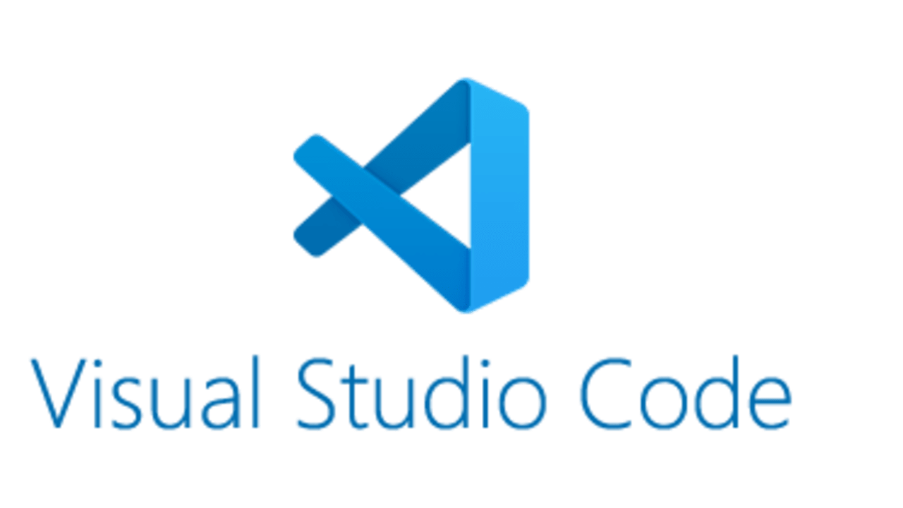
Foundry Toolkit Turns VS Code into an End-to-End AI App Workspace
The product story is that developers can discover models, build agents, test prompts, and manage AI resources from one familiar environment.
Microsoft positions Foundry Toolkit as a single VS Code workflow for building, testing, and deploying AI apps.
The overview highlights local and cloud operation in one toolchain, reducing context switching for developers.
The deck focuses on strategic value for adoption, not low-level implementation detail.

Slide 2

Foundry Toolkit Is Compelling Because It Unifies Workflow, Expands Model Choice, and Accelerates Agent Delivery
Executives can read the whole answer here: the extension matters because it centralizes AI development, broadens model access across 8 source families, and packages agent tooling into one operating surface.
Workflow consolidation
one extension covers resource management, model testing, prompt iteration, and agent development inside VS Code.
Model flexibility
the Model Catalog spans 8 source families, including Microsoft Foundry, Foundry Local, GitHub, ONNX, Ollama, OpenAI, Anthropic, and Google.
Execution speed
4 highlighted capabilities—Create Agents, Model Catalog, Playground, and Agent Builder—cover the main build-test-iterate loop.

Slide 3



A Three-Zone Interface Makes the Workflow Easier to Govern and Scale
The product is easier to adopt because its operating model is organized into 3 visible zones that map cleanly to daily developer tasks.
My Resources
the primary work area for local resources plus the connected Foundry project and its deployed assets.
Developer Tools
the build-and-test surface where model experimentation and agent creation happen.
Help and Feedback
a dedicated support area that reduces friction during rollout and onboarding.

Slide 4
Broad Model Access Reduces Vendor Lock-In and Improves Experimentation Speed
The strongest platform hedge is breadth: teams can compare and use models across 8 sources without leaving the core workspace.
The Model Catalog explicitly includes Microsoft Foundry, Foundry Local, GitHub, ONNX, Ollama, OpenAI, Anthropic, and Google.
Side-by-side model comparison is positioned as a way to find the best fit for each use case rather than defaulting to one provider.
Local options such as ONNX and Ollama support privacy-sensitive or cost-conscious experimentation before full deployment.

Slide 5


Integrated Agent Tooling Shortens the Path from Prompt Idea to Production-Ready Workflow
Foundry Toolkit matters operationally because it packages the core agent lifecycle—creation, testing, prompt refinement, and debugging—into one environment.
Create Agents
teams can start with Prompt Agents using tools and vectors or Hosted Agents with custom code.
Playground
an interactive test surface supports real-time prompt and parameter iteration with multimodal inputs.
Agent Builder
prompt engineering, MCP tool integration, and structured outputs are presented as part of one streamlined workflow.
Agent Inspector and related debugging tools help teams validate behavior before production rollout.

Slide 6



The Platform Has Clear Demand Across Three Audience Segments and Four Immediate Use Cases
The source material signals broad applicability: 3 named user groups map to 4 concrete use cases, making the adoption case easier to justify.
Before
• Primary user groups: app developers, full-stack developers, and mobile developers building intelligent features.
• Secondary learning audiences: researchers, educators, and students are also called out, expanding training and ecosystem relevance.
After
• Top use cases: model evaluation, local inference for privacy/cost control, agent building with MCP tools, and model conversion/optimization for deployment.
• Implication: the platform can support both production delivery teams and experimentation-oriented users in the same environment.

Slide 7

Adoption Looks Lightweight, but Teams Should Plan Around the June 1, 2026 Sidebar Retirement
Implementation appears straightforward, yet the one notable transition signal is the retirement of the legacy Foundry sidebar on June 1, 2026.
Step 1
install the extension from the Visual Studio Marketplace and surface it in the VS Code Activity Bar.
Step 2
connect the Foundry project and confirm access to models, agents, tools, and related resources.
Step 3
use Playground and Agent Builder to validate one pilot use case before wider rollout.
Step 4
align onboarding and documentation to the Foundry Toolkit sidebar because the older Foundry sidebar retires on June 1, 2026.

Slide 8

Appendix Holds Product Detail for Readers Who Want Deeper Technical Context
The main decision story is complete, and any additional screenshots, architecture notes, or rollout details can sit in backup slides.

