Slide 1
WebAssembly With Rust
Robert Hanson
https://github.com/kimtuck/webassembly

Slide 2
Please share!
Share what you learn. And the best time to share is while you’re learning it.
—Jeremy Keith, author of Going Offline and HTML5 For Web Designers
All of us here are doing something cool; consider sharing it!

Slide 3
What we will talk about
What is WebAssembly
What is Rust
Installation / getting started
Some examples

Slide 4
Motivation
Shiny Objects!!!
With Rust!!!
One language, multiple targets
Interesting language features
AND it can compile to web assembly
Notes:
Web assembly and Rust are both pretty new.
Saw Rust at last year’s MidwestJS and thought it was very exciting
Why – binary compatibility with multiple OS/languages/runtimes
Why – ownership model, no garbage collection, no nulls
Then I found out you can target web assembly

Slide 5
Shiny Objects
Web assembly is new.
Chrome – Mar 8 2017 Edge – Oct 16 2017
FireFox – Apr 18 2017 Safari – Sept 18 2017
Webassembly has been viable for about 12 months.
Rust is new. Not really, but new to me.
Rust won first place for "most loved programming language" in the Stack Overflow Developer Survey in 2016, 2017 and 2018

Slide 6
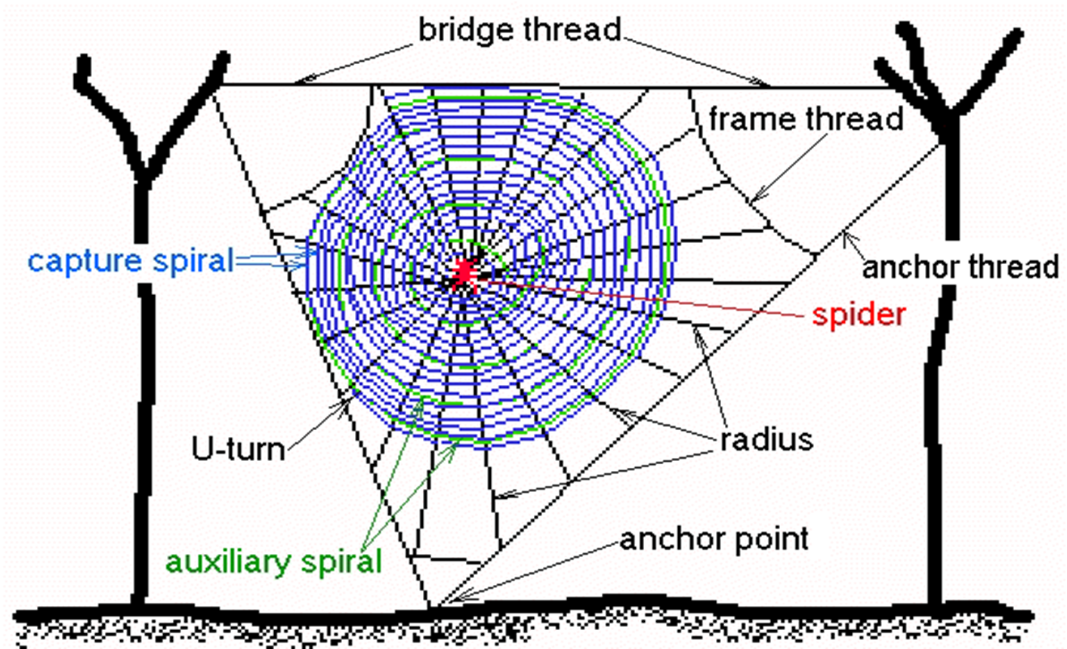
WebAssembly

Slide 7
What is WebAssembly
http://webassembly.org/
WebAssembly (abbreviated Wasm) is a binary instruction format for a stack-based virtual machine. Wasm is designed as a portable target for compilation of high-level languages like C/C++/Rust, enabling deployment on the web for client and server applications.
The Wasm stack machine is designed to be encoded in a size- and load-time-efficient binary format. WebAssembly aims to execute at native speed by taking advantage of common hardware capabilities available on a wide range of platforms

Slide 8
What is WebAssembly
Compilation target
Binary format (with a textual representation in dev tools)
The compiled file (.wasm) is an asset; it’s part of your site like a .js file or .png
Loads fast (and can be cached in indexDB)
Runs at native speed
Single-threaded (same as UI thread)
Can be loaded into webworker, service worker
Interop with javascript
Notes:
Compilation Target – you don’t write web assembly directly, just like you don’t write assembly code directly.
Difference here is that it’s the same assembly language for all systems, so it’s more like java byte code
Loads fast – stream from source and loaded into VM Compare with javascript
(Rust) To other javascript developers, your webassembly looks like an ES6 module, and you call methods on it like other ES6
Future – fast direct dom manipulation

Slide 9
WebAssembly
Use it for things you don’t want to do in JS
Would you:
Write a physics engine in JS
Write image processing in JS
Write a CPU emulator in JS
Write a synthesizer in JS
Render CAD drawings
Because JS sucks at these types of applications
And there is already c/c++/rust code for these
Notes:
AutoCad has ported their app to webassembly; so you can use autocad within the browser.

Slide 10
What can you do with WebAssembly?
Protect your core business logic
Image / video editing.
Image recognition.
Live video augmentation (e.g. putting hats on people’s heads).
CAD applications.
Scientific visualization and simulation.
Platform simulation / emulation (ARC, DOSBox, QEMU, MAME, …).
Encryption.
Notes:
Core business logic
Autocad

Slide 11
Javascript API
You can read the description if you want.
https://developer.mozilla.org/en-US/docs/WebAssembly/Using_the_JavaScript_API
Webassembly spec defines only two integer types and two floating point types.
Webassembly spec talks about “memory”, “tables” etc
But we don’t need to worry about that too much, because we’re using Rust and a tool to generate bindings between Rust and JS.
Notes:
But we can talk about it if you want.

Slide 12
Javascript API
Wasm functions can be called from js; can call js.
Can’t directly interact with the DOM or canvas. But you can call a js function to do that work.
We’ll see how wasm-bindgen gives you that code.
Notes:
We’ll look at that in code later.

Slide 13
Other high level language options
Rust
C, C++ -- emscripten
Lots of other languages https://github.com/appcypher/awesome-wasm-langs

Slide 14

Rust

Slide 15
Rust
Rust provides an easy path to webassembly
Directly compiles to webassembly,
Other languages can compile to webassembly too (c++, etc) but at the moment rust appears to have a lot of traction
It’s early yet; it is possible that some other language will emerge.

Slide 16
Rust language features
No garbage collection
Higher-level language constructs, generics, traits.
No exceptions
Guaranteed memory safety; no null/dangling pointers
Ownership, borrowing
Fearless threading
Npm-like open source packages
Comprehensive build system
Native code for many environments

Slide 17
Rust is ideal for WebAssembly
Large collection of rust packages (crates)
No garbage collection
Higher-level language constructs (structs, strings, lists)
Generics
Threading (when webassembly supports threading)
Easy unit testing
Editor support
With wasm-bindgen, javascript interop is straightforward

Slide 18

Installation

Slide 19
Installation
Install node/npm
And, a C++ compiler is required
Windows users: can use free compiler tools from MS
Install webpack (just for this demo)
npm install --save-dev webpack webpack-cli

Slide 20
Installation
Install rust:
https://www.rust-lang.org/en-US/install.html
Use default installer values (1)
Open command prompt in your project directory
$rustup default nightly
$rustup target add wasm32-unknown-unknown --toolchain nightly
In each project:
$ cargo +nightly install wasm-bindgen-cli --force

Slide 21
Installation
rustup update
cargo update
npm run build
npm run serve

Slide 22
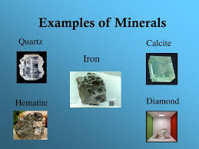
Examples

Slide 23
References
WebAssembly:
Wasm-bind
https://hacks.mozilla.org/2018/04/javascript-to-rust-and-back-again-a-wasm-bindgen-tale/

Slide 24
About Alex Crichton – author of wasm-bindgen
Alex is a member of the Rust core team and has been working on Rust since late 2012. Nowadays he's helping the helping the WebAssembly Rust Working Group make Rust+Wasm the best possible experience. Alex also helps to maintain Cargo (Rust's package manager), the Rust standard library, and Rust's infrastructure for releases and CI.

Slide 25
I’m Robert Hanson, and thanks for listening!

