Slide 1
Your Code Is Lying
sdg I 2017
month

Slide 2
Robert Hanson I sdg

Slide 3
Credits
Applying Functional Principles in C#
by Vladimir Khorikov
A Pluralsight course

Slide 4
Code Repo
https://Github.com/kimtuck/YourCodeIsLying

Slide 5
What is truth?
Every one knows that comments lie
But what about code? Code is the source of truth. Look at the code.

Slide 6

Code can lie too…
Notes:
When you look at it with your eyes, you don’t see everything. You have to look deeper.

Slide 7
Jedi mind exercise
Think about a small method you recently wrote
Think about the method parameters
Think about the return value
How confident are you that it works?

Slide 8
Standin for your code
function div() {
return x / y;
}
Notes:
It’s javascript. What does div do? What is the return value?

Slide 9
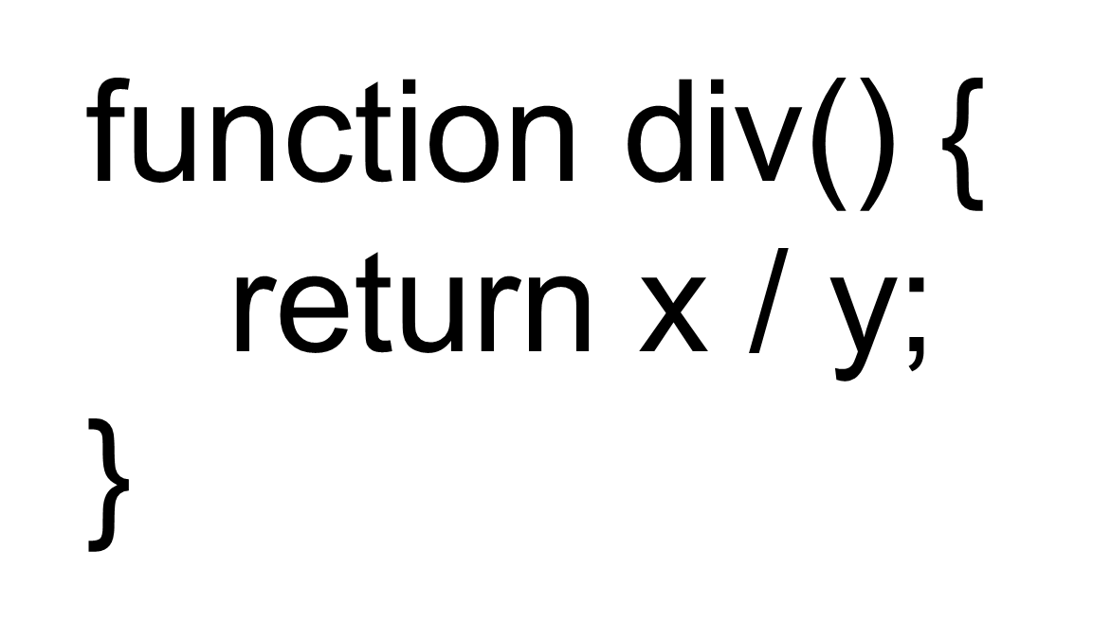
Lets look at the lies that div() has.

Slide 10
Time to look at code

Slide 11
Things to watch out for
Impure functions
Dates
  Everyone is in the same timezone
  Everyone in the same state is in the same timezone
  Timezones do not change
  Future events occur in X seconds
Async
  Async calls will succeed
  async calls will finish synchronously
  Async calls complete in the order they were issued

Slide 12
Honest code:
Pure function
Enforces argument types and ranges
Returns a useful value
Errors in return value
Does not throw exceptions
Has unit tests!

Slide 13
Code Repo
https://Github.com/kimtuck/YourCodeIsLying

Slide 14
Robert Hanson I presenter
https://github.com/kimtuck/YourCodeIsLying
Consultant
Robert.hanson@solutiondesign.com
612-220-7899

