Slide 1
Are you an expert at something? Is your job to write code? Do you work for yourself or someone else?
Notes:
We'll come back to these questions.

Slide 2
Shared Component Library Lessons Learned
Robert Hanson
Front End Developer
Consultant
Sdg
https://github.com/kimtuck/midwestjs
Notes:
Lessons from the trenches is kind of cliché; but I feel like I was involved in a battle.

Slide 3
Are you an expert at something?
Share what you learn. And the best time to share is while you’re learning it.
—Jeremy Keith, author of Going Offline and HTML5 For Web Designers
All of us here are doing something cool; consider sharing it!
You don't have to be an expert; just enthusiastic.

Slide 4
Is your job to write code?
Or is your job to provide a solution to a problem? This is what I learned when I solved a problem.
What is a shared component library; and an example
Lessons learned
Summary
Notes:
Your job, my job, Our job is to provide a solution to a problem.
Eventually we might write code; but before that there is a lot of thinking and planning, collaboration, communication. I'm not going to talk about code today, at least not much.

Slide 5
Shared Component Library
A UI component library (angularjs in this case) -- widgets -- css (scss) -- assets (icons, images)
Input (text, numeric, textarea) Read-only value display Label, Error, Help text Buttons Radio Buttons Tab control Select Grid
Notes:
Problem is: the UI/UX of NBD is a poor user experience. What I was told: M5 and NBD – take elements from M5 and put them into NBD; through shared component library. Started out with a button
Why: because M5 has the right stuff.
-- Look and feel
-- functionality
-- branding
What we find is this:
-- What we thought was there was not there. Have to build it from scratch. -- What is there does not match the expected behavior or look/feel. Have to build it from scratch.
-- What is there is coupled to implementation details. Can take a little bit; but mostly build it from scratch. What we ended up with is something that is mostly freshly implemented.
This is a challenge when you're doing this work as part of a story. Oh – the story needs an input widget. We don't have an input widget in the csl. Quick, go make one.
Mostly atoms and molecules. No really complicated implementation details (Select and Grid are actually complicated though)
Started out with a button

Slide 6
"Shared"
Lots of what you do might be useful to other people
Code? Components? Assets? Design?
Public? Private? Company wide? Project wide?
Maybe you'll find inspiration.

Slide 7
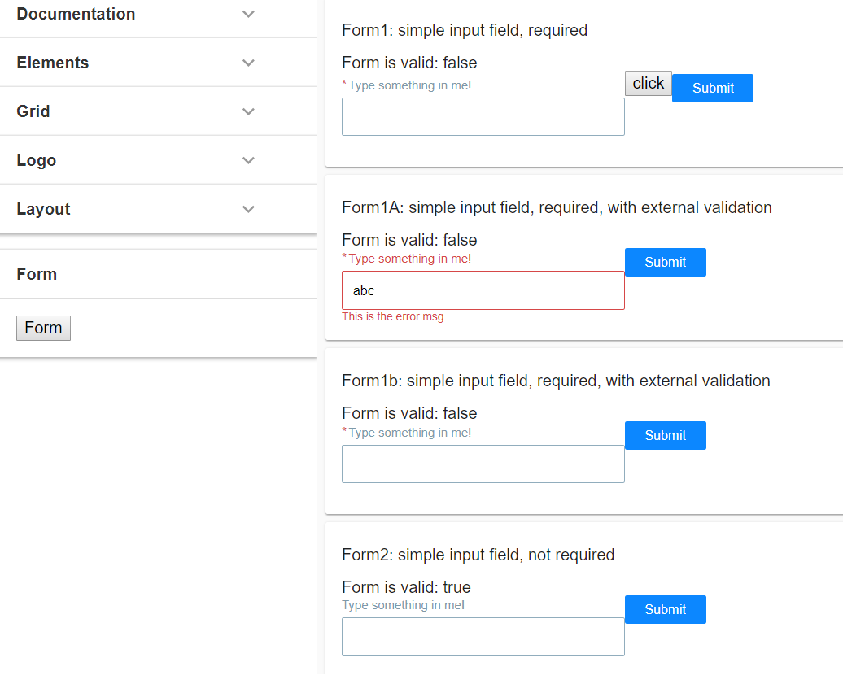
Shared Component Library
Notes:
This takes me to the first lesson I learned:

Slide 8
1. Show me some pictures!
First thing I did was create a styleguide.
Shows how a component operates
Examples – in code – of how to incorporate widget into app
NUMBER ONE WIN
Storybook (https://storybook.js.org/)
Notes:
First thing I did was create a styleguide.
Our UX person created a specification in InVision. Static, with colors, measurements, etc. The Styleguide is like this – showing the components on a webpage, as just components – no context.

Slide 9
Demo of styleguide
Notes:
The styleguide has examples of all the ways that you can use the individual widgets.

Slide 10
Styleguide
Explore and validate keyboard navigation, A11y, responsive, async
Examine styleguide source to see how the sample widget is implemented
Testbed for functionality – form validation, required/not required, async.
Review the visual appearance of the widget
Notes:
Being able to test and fix keyboard navigation, issues with data that is async in a sandbox environment with fast code/test cycles is important.
In my application, data for select dropdown, and possibly the initial value, can be async. Have to get that right. It's easy to simulate async operations with timeout/promises. I can set up a situation where I click a button on the styleguide and load the data for the component
Async using timeout/promise, and see that it works correctly. You can document; but it's cool to see the thing in action then view the source to see how that was done.
Testbed for functionality. Test things like validation, keyboard navigation, async
Review the visual appearance of the widgets. This brings me to the next thing I learned.

Slide 11
2. More Eyes!
There are people who want to give you input. For my project, this was our UX designer. Involve your UX designer(s) early This is an iterative process. Better to get it started early.
We now have once a week meetings with the UX and BAs on the team.
Styleguide is the right tool for this.
Notes:
We've had back-and-forth concerning colors, layout, functionality, keyboard navigation, focus indicators, font size/font family, other ease-of-use (tooltips?)
Having a styleguide and samples pages make this much easier Styleguide was a BIG WIN for me.
Couple of stories:
InVision is a static document. Styleguide is a living document. When you can see it in action, that's better. “Oh, I don’t like how that looks”. Can we make that label not wrap. Grid layout. Spacing between buttons.
UX designer in my case was very specific about px measurements
2.
Button discussion. What the old app considered button styles, vs UX style --- only one primary action, all others secondary, and decide primary vs warn on case by case basis
Review changes with UX designers
UX designers have specific goals. Look and feel; ease of use; branding.
Some UI widgets they're designing may be drop-in; or may be very difficult to produce.
3. Date picker back/and/forth Next thing I learned:

Slide 12
3. You work for someone else
Your component library is meant to be used in some application
How does someone include your library in their application?
How do you manage new features?
How do you diagnose and resolve bugs? Is it your bug or their bug?

Slide 13
4. Make it easy to install
Design the build process to make it easy to use in a project
Npm package? Private repo?
Versioning
Notes:
Bringing in the shared component library:
Design the build process of the library to make it easy to consume. Must be easy to consume (install) in consuming app. Install using npm install (just like other 3rd-party libraries) In our distribution, there is -- a single js file; -- two css files -- a folder for assets like fonts and images Important point: the application does not need to reference the assets directly. Consuming app just needs to deploy the folder. Just a few code changes needed in the app to wire up things (mostly due to angularjs)
And next:

Slide 14
5. Make it easy to use
Make it easy to use it correctly
Make it hard to use incorrectly
Anticipate use cases
Notes:
Example is coming up. What do I mean by this: Surface area – limit the surface area – the number of "knobs" that can be twisted.
Documentation – went to confluence over in-project examples

Slide 15
Example: Class vs Attribute
<csl-button class="button-primary button-large"
<csl-button button-primary button-large
Notes:
Angular uses attributes rather than style for many things.
Currently implemented in the csl-button code; but I could easily change this to a directive that sets css classes. No code change needed
Semantically meaningful, rather than css classes. "a button that looks like a primary button, that looks like a large button." vs "a button that is a primary button; that is a large button"

Slide 16
Best Practices
Goal: you get best practices just by using components.
Build in Accessibility (A11y)
Build in Localization (Internationalization, or I18n)
Validation, required/not required, validation messages
Responsive
Notes:
Absolute goal.
Localization is built in; you can't use this otherwise.
Accessibility is built in – there actually was a lot of work to get this right.
Styleguide pages are really useful for this

Slide 17
6. It's expensive
Do not underestimate the cost of adding a library into a project
Number of usages (especially buttons!)
Need for developer testing
Unit tests, QA testing (regression testing)
Automated tests
Notes:
Automated testing – change of identifiers or other ways of finding and manipulating elements. Replacing a "button" with a component
"Why doesn't it work" -- you will spend time consulting and educating -- async select example
Leads to the next one.

Slide 18
7. Unit test everything
"If there is a problem, it's not in my code"
Notes:
The third question
Even if you don’t work for "someone else" you work for "future you".
Test the ui interactions
Button click → callback fn executes with the right values
Radio button change value → correct value set
Verify presense/absence of css classes (esp important for buttons, tabs)
Easy to write tests, including async, when you're focused on just testing the one component in a non-app environment.

Slide 19
8. Version
Version your releases.
Publish your changes so your consumers know what has changed
Automatic documentation sharepoint/confluence, etc.

Slide 20
9. This is a real project
That means allocating time for the project
Build environment, deploy environment
Code reviews, documentation
Meetings, all the other overhead.
We've been "stealing time" from stories. Bad.
Notes:
We did this as "oh, this story needs a xxxxx component"
– good example is the select, input field implementations.
You start saying "what's the minumum work that needs to be done". Leading to...

Slide 21
10. Your work's never done
Lots can go wrong when the first project uses your library.
Css – project css overriding your css.erriding your styles
Async data. Unanticipated data.
Assets – fonts, icons, images, colors
Part of a form – form validation
Work alongside existing widgets/layout
Responsive?
Notes:
Lots of issues are found when the widget it put into the page.
Css specificity rules (css cascade; esp font size, line height)
Themes Accessability

Slide 22
Do we still have time?

Slide 23
11. You are responsible to many people
Developers: Projects that are immediately consuming your work
Developers: Future projects; rework on existing projects
UX: End user concerns, page layout, keyboard navigation, ease of use
BA's: Interface design, look and feel
Branding/Marketing
Security, auditing, performance monitoring, customer support
Notes:
The front end is "the thing" in many people's eyes. MnSure "website is slow" so MnSure is broken. So there are many people who are giving you input.

Slide 24
12. Components Page
"Samples" page/pages. Similar purpose as styleguide.
Catalog of pages, page sections, page components
Easy to view; independent of application state Pass in all the props/data you need to render a portion of a page.
Purpose: Review with UX and BA.
Notes:
BA's, UX Page mockups are nice.
Help them out by showing them the UI widgets and their capabilities. Lets them build a page with cut/paste
They don't need to spend time indicating widget functionality, colors, spacing, etc.
Help them choose the right UI control (radio button vs select, for example)
Example: numeric input (no error msg necessary)

Slide 25
13. Themes
Accessibility
Color pallets; images

Slide 26
14. Decide what goes where
Does a feature go into the application, or into the library?
Example: Error message for data entry field.
Notes:
-- is the field is required or not: Application -- is the field in an error state: Application -- what is the error message: Application -- display the required indicator: widget -- display the error message – application or widget? -- determine if the required field is empty? -- application or widget?
-- what the error message says – application or widget?

Slide 27
Show me some pictures!
More Eyes!
You work for someone else
Make it easy to install
Make it easy to use
It's expensive
Unit test everything
Version
This is a real project
Your work's never done
You are responsible to many people
Components Page
Themes
Decide what goes where

Slide 28
I’m Robert Hanson, and thanks for listening!

