Slide 1
Education in new Zealand
Kim Van Nguyen
Swapna
Ancy John
Landy Liu

Slide 2
Content
Reason for choice of topic
Analysis - what we analyzed – sources and data
Wrangling - how we wrangled the data, process & obstacles
Conclusion - what we can conclude after this analysis

Slide 3
1. Reason for choice of topic
Education is essential for everybody
Enhance understanding of the world’s progress in education development (countries invest the most or are improving)
Encourage support in education field for countries that need (from NGOs, angels funds, developed countries, UN)
Contribute to better government’s policy (Ministry of Education)
Notes:
Education is necessary for everyone. Everyone should have access to this. We would like to see if governments are making efforts in providing education to people.
We would like to see which countries invest the highest amount of money on education and which countries spend the least. We can also see if countries spending more or spending less overtime.

Slide 4
2. Analysis
Compare countries in 4 aspects:
Government expenditure
Source: World Bank data.worldbank.org/indicator/SE.XPD.TOTL.GB.ZS
Enrolment
Source: United Nations data.un.org/
Labor rate
Source: Databank of World Bank databank.worldbank.org/source/education-statistics-%5e-all-indicators#
Unemployment rate
Source: Databank of World Bank databank.worldbank.org/source/education-statistics-%5e-all-indicators#
Analyse causes and effects of education in New Zealand
Compare the distribution of schools in each region of New Zealand and also analyze the proportion of students in these regions based on their origin i.e. Maori, Asian, European and International students.
source: https://catalogue.data.govt.nz/
Notes:
Insert a map of your country.

Slide 5
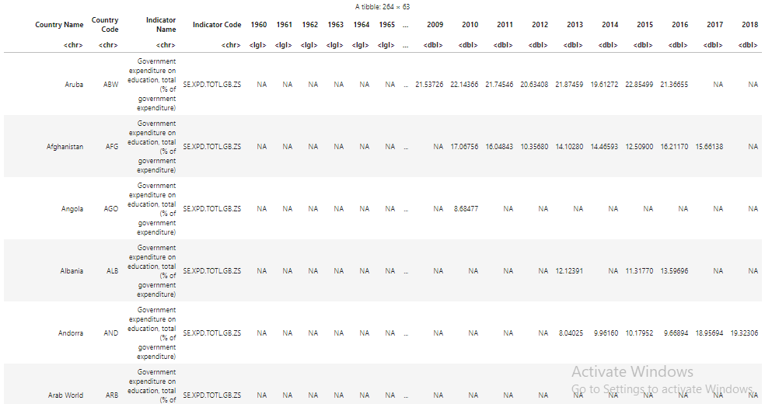
3. Wrangling Government expenditure

Slide 6
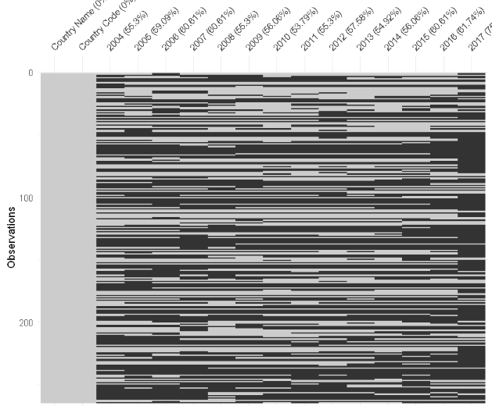
3. Wrangling Government expenditure
Original data
After wrangling

Slide 7
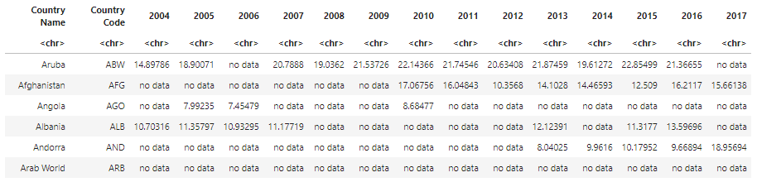
3. Wrangling Government expenditure
AFTER WRANGLING

Slide 8
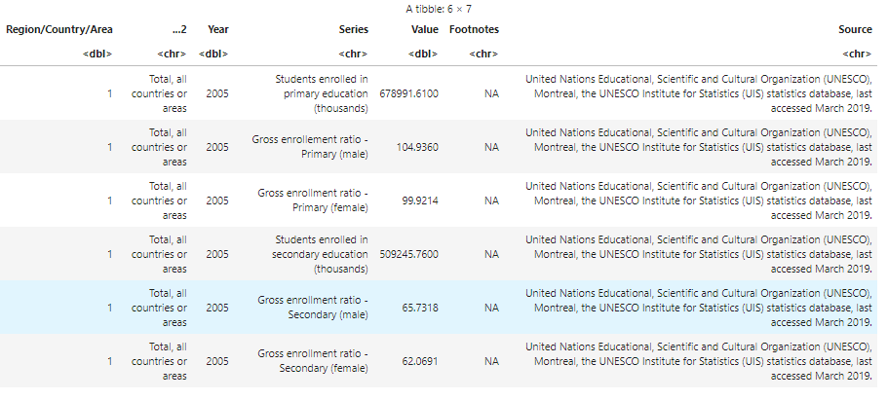
3. Wrangling Enrollment
Original data
Notes:
What, why and how you wrangled

Slide 9
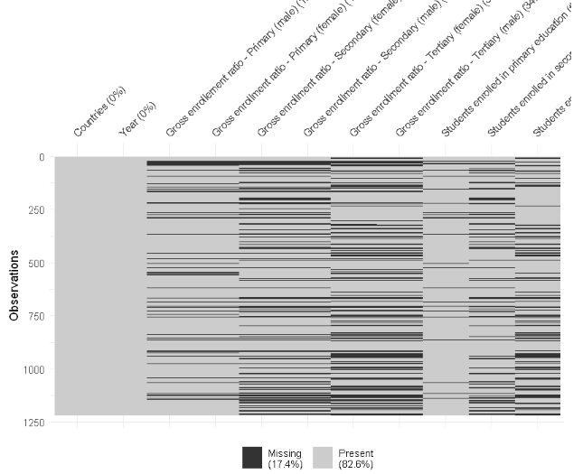

Slide 10
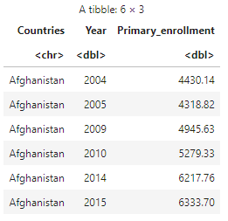
3. Wrangling enrollment
After wrangling
Notes:
What, why and how you wrangled

Slide 11
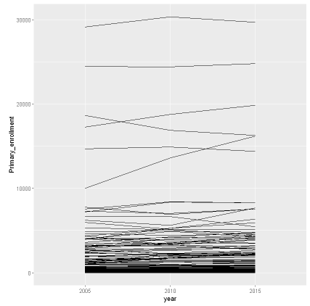
Primary enrollment
5 countries with highest number of enrolment:
India
China
Indonesia
USA
Pakistan
5 countries with lowest number of enrolment:
Niue
Tuvalu
Cook islands
Monaco
Liechtenstein

Slide 12
3. Wrangling Labor rate
Original data
After wrangling

Slide 13
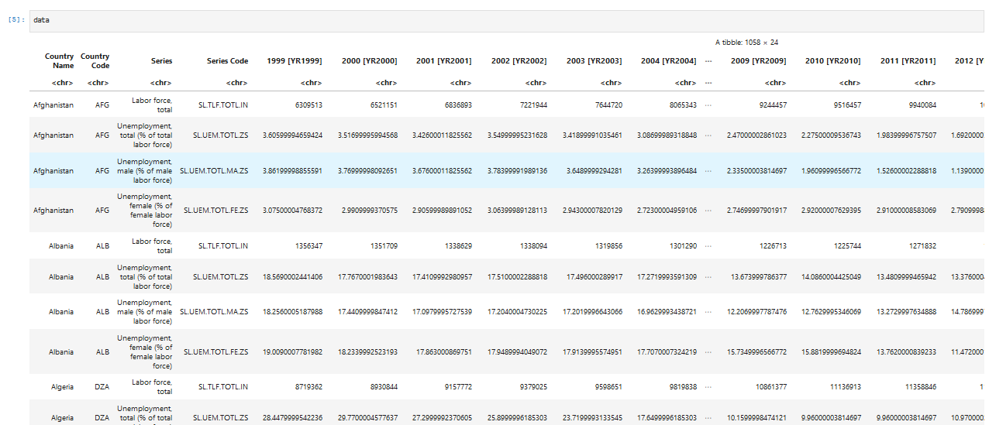
3. Wrangling Labor and unemployment rate

Slide 14
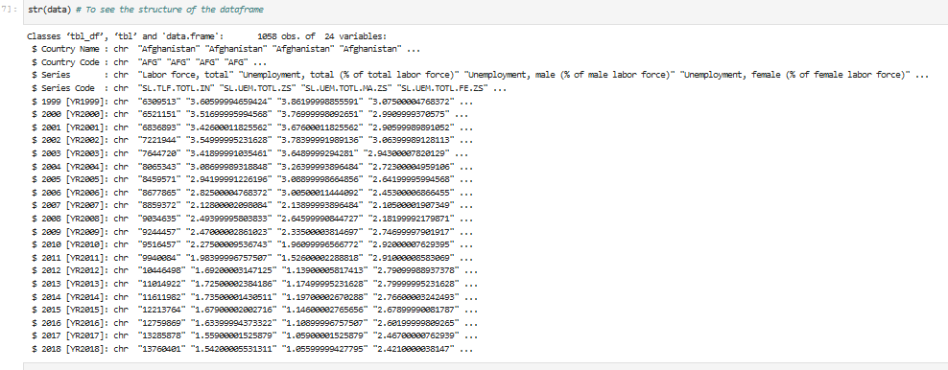
3. Wrangling Original data
Original data

Slide 15
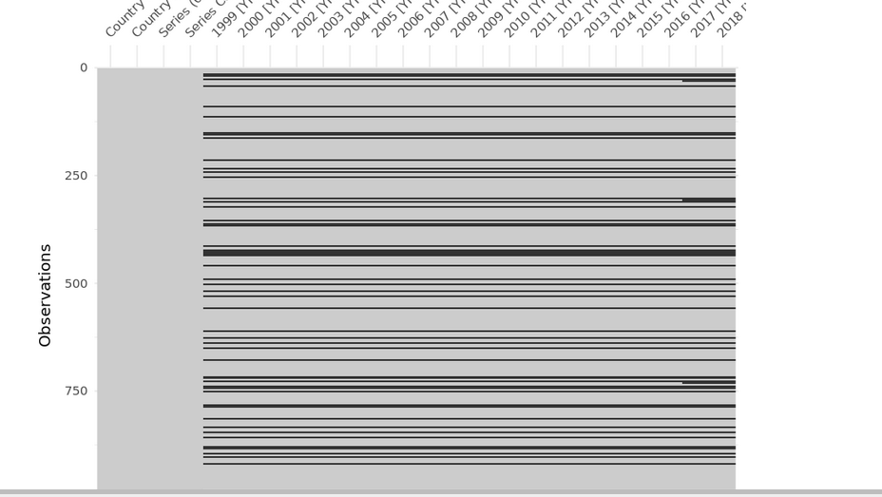
3. Wrangling Missing Values

Slide 16
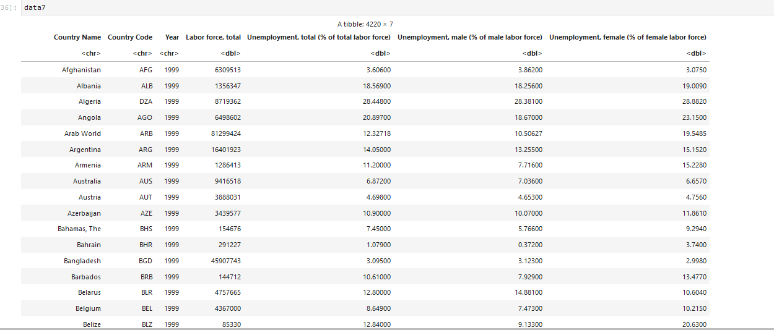
4. Wrangling Wrangled dataframe

Slide 17
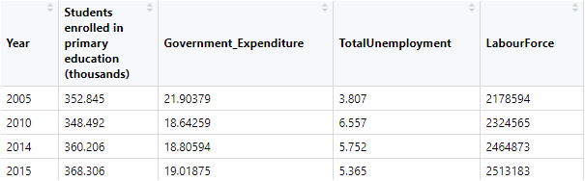
3. Wrangling New Zealand’s education investment and outcome

Slide 18
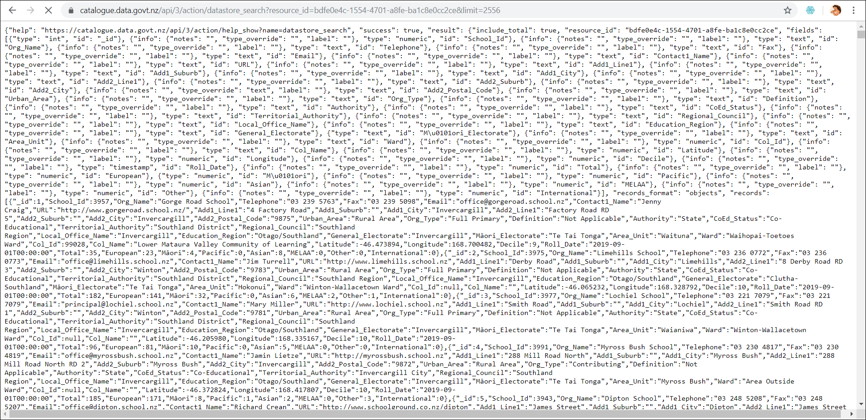
3. Wrangling
1.Original data
Notes:
We accessed resource data via a web API.
Make a "GET" request to the API to pull raw data containing the list of NZ scools , their information, address, students enrolled.

Slide 19
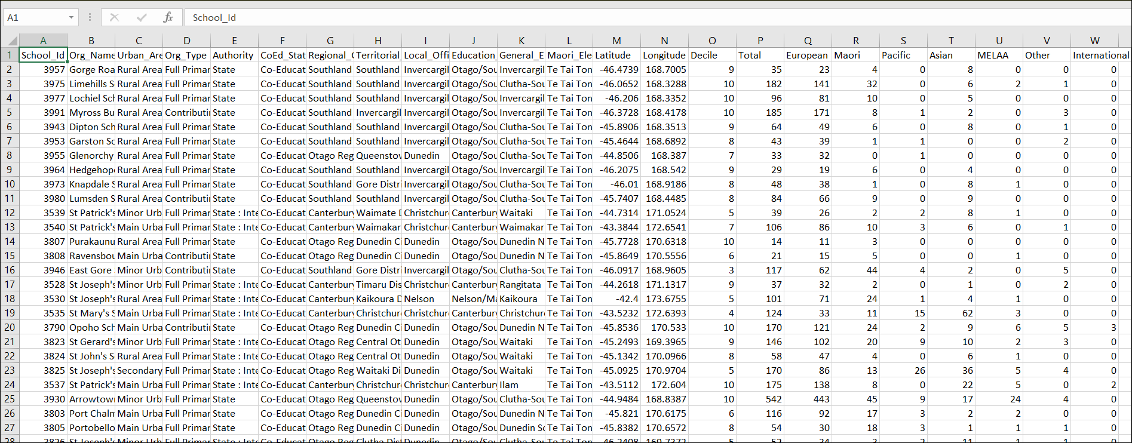
3. Wrangling
2. After Wrangling.

Slide 20
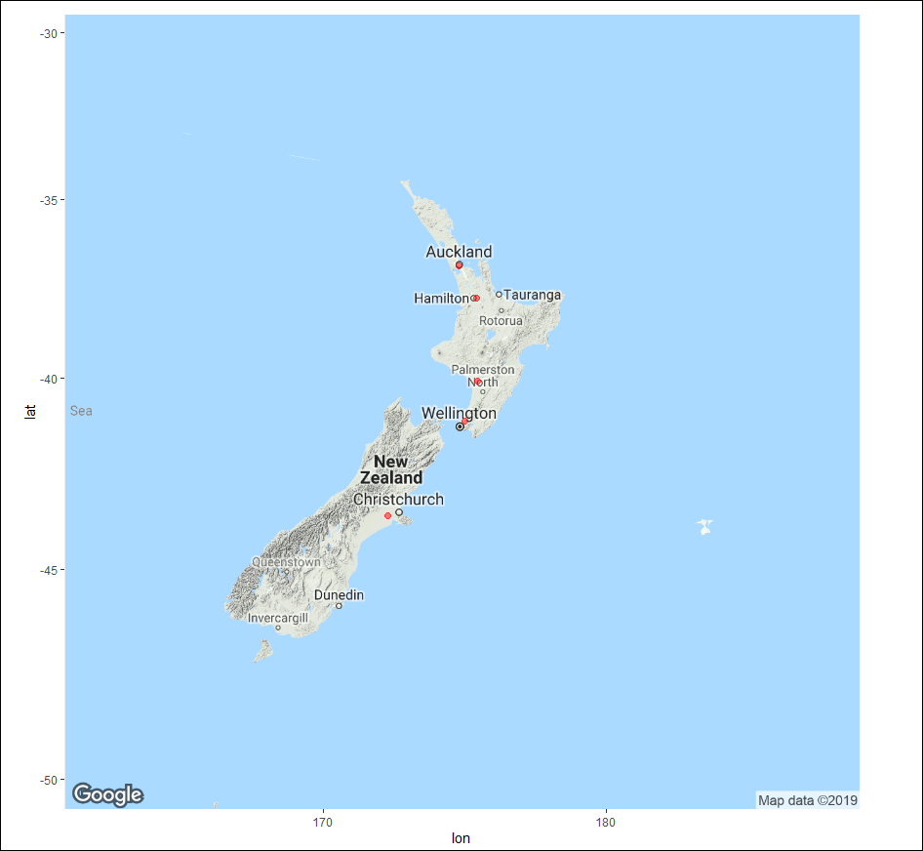
Top Five regions with highest number of schools (Primary: Secondary)
Notes:
1Auckland Region 550
2Waikato Region 309-
3Canterbury Region 291
4Wellington Region 247
5Manawatu-Wanganui Region197
Ggmap is used for the spatial visualisation along with ggplot from data taken from Google maps to plot the graph of NZ along with these points.

Slide 21
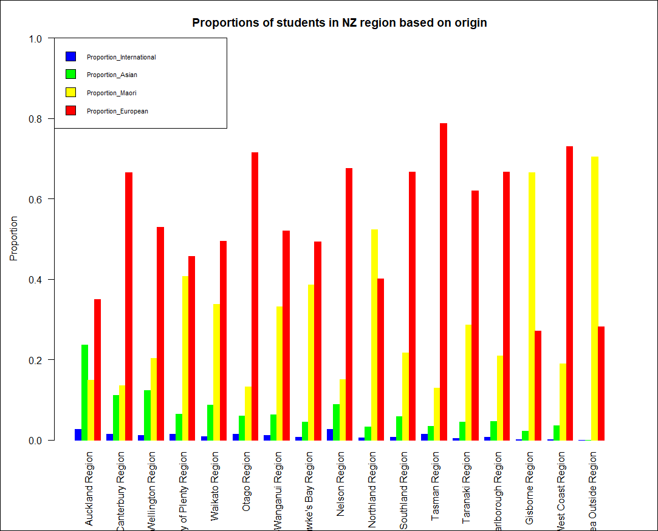
Proportion of students of regions based on their origin
Notes:
Auckland Region
Canterbury Region
Wellington Region
Bay of Plenty Region
Waikato Region
Otago Region Manawatu-Wanganui Region Hawke's Bay Region Nelson Region Northland Region Southland Region Tasman Region Taranaki Region Marlborough Region Gisborne Region West Coast Region Area Outside Region

Slide 22
3. Wrangling Challenges
Missing data
Countries were named differently in different dataset (quotation marks)
Many variables in a dataset that were recorded as observations instead of variables

Slide 23
4. conclusion
Overall image of how the world is progressing in improving education accessibility and quality
The results of investment in education in New Zealand
However!
Only focuses on the basic aspects of education
Limited data. For deep analysis of a specific country, better to use source provided by those countries

Slide 24
Thank you!
QUESTIONS?

