Slide 1
Version control: Git and Github
Kimberly Villalobos Carballo
MIT
August 24th, 2022

Slide 2
What are version control systems (VCSs)?
VCSs are systems used to track changes made to collections of files and folders.
Maintains history of all changes.
Changes to a folder and its contents are tracked in a series of snapshots.
Each snapshot encapsulates the entire state of files/folders within a top-level directory.
Also maintain metadata ( who created each snapshot, messages associated with each snapshot, and so on.)
Can be used for projects big or small, long-term or short-term.
Changes can be done offline.

Slide 3
What are version control systems (VCSs)?
Modern VCSs also let you easily answer questions like:
Who wrote this module?
When was this particular line of this particular file edited? By whom? Why was it edited?
When/why did a particular unit test stop working?
Examples of VCSs:
Git
Mercurial
SVN
CVS
Non Negotiable component of any project!

Slide 4
Why are version control systems useful?
They allow us to:
Look at old snapshots of a project.
Revert the entire project back to a previous state
Keep a log of why certain changes were made.
Work on parallel branches of development.
See what other people have changed.
Resolve conflicts in concurrent development.

Slide 5
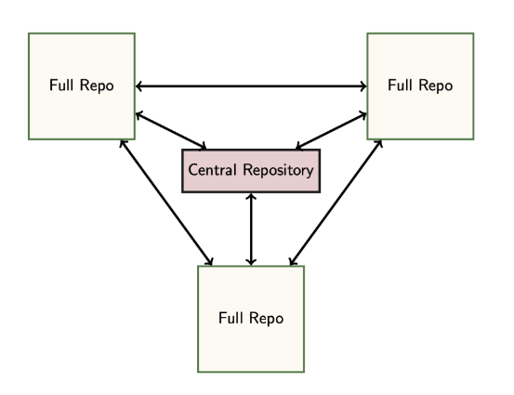
What is Git?
Git is the de facto standard for version control: the most modern VCS (2005), and the most popular!
Git is a distributed version control system : Every developer has the full history of the codebase mirrored on their computer.

Slide 6
Git vs GitHub
Git
A distributed version control system.
Github
A web-based service that allows you to host projects that use Git for version control.
Includes project management features.
Assists with group tasks like setting permissions and assigning collaborators.
It is cloud-based, allowing any authorized person to access or edit your projects from anywhere in the world.

Slide 7
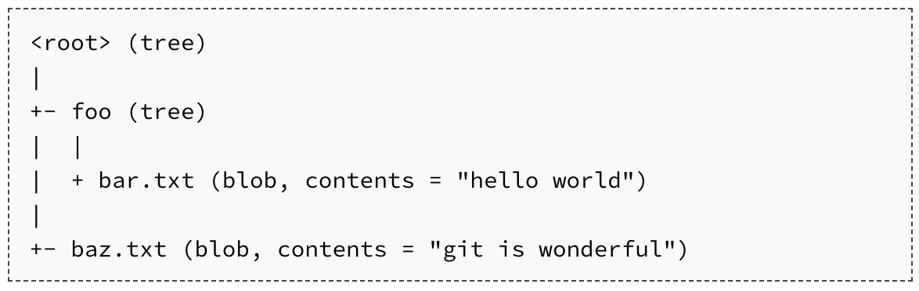
Git: Data Model
Commit (noun): A snapshot of all the files associated with a project.
Commit (verb): The action of storing a new snapshot of all the files associated with a project.
Blob: a file
Tree: a directory (folder)
One commit

Slide 8
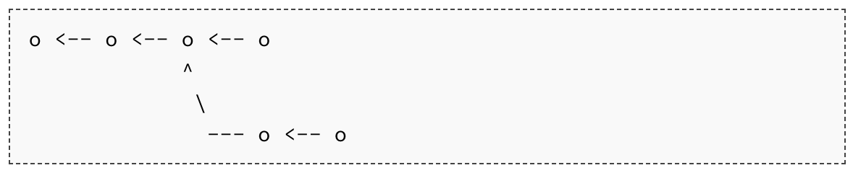
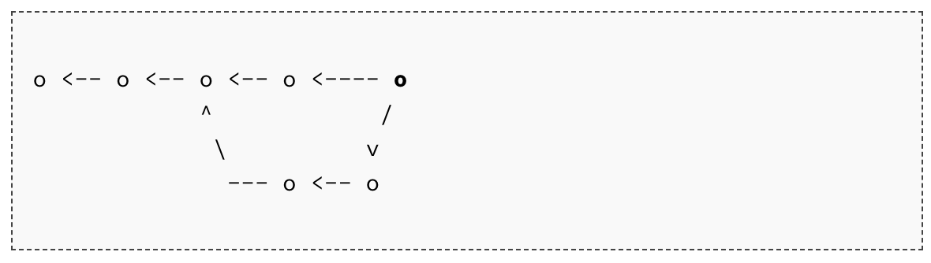
Git: Data Model
Branch: An active line of development.
One branch
Commit History
Another branch
Merge commit

Slide 9
Git: Terminology
Repository: A folder containing all the files associated with the project, as well as the entire history of commits to those files.
Local : Repository sitting on your local machine.
Remote: Repository sitting on a remote machine (e.g. GitHub).
Clone: To pull down a full copy of the remote repository, including all versions of every file and folder for the project.
Add or Stage: Before changes to a file can be committed to a repository, the files in question must be added or staged (before each commit).

Slide 10
Git: Terminology
Push: The act of sending your local commits to a remote repository. Again, until you add, commit, and push your changes, no one else can see them.
Pull: The act of retrieving commits made to a remote repository and writing them into your local repository. This is how you are able to see commits made by others after the time at which you made an initial clone.
Fetch: download and store the changes. At this point, the repository doesn’t look any different, but it knows what the state of the remote repository is and what the state of your local repository is.
Merge: incorporate the changes from the remote repository into the local repository by merging the two lines of development into a single branch.

Slide 11


Git Workflow - Commands
My computer
Repository
Remote computer
Staging Area
Working Directory
Clone

Slide 12
Git Workflow - Commands
My computer
Repository
Staging Area
Working Directory
This is where you edit/create/remove files.

Slide 13
Git Workflow - Commands
My computer
Repository
Staging Area
You next add the changes you want to commit
Working Directory

Slide 14
Git Workflow - Commands
My computer
Repository
Then, you commit your added changes.
Staging Area
Working Directory

Slide 15
Git Workflow - Commands
My computer
Repository
Remote computer
Staging Area
Working Directory
Pull =
Fetch + Merge

Slide 16
Git Workflow - Commands
My computer
Repository
Remote computer
Push
Staging Area
Working Directory

Slide 17
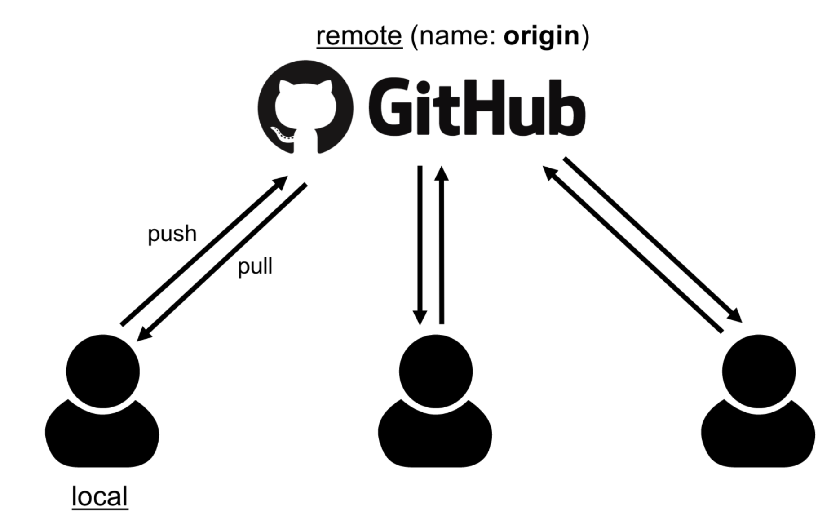
Git Workflow - Local/Remote

Slide 18
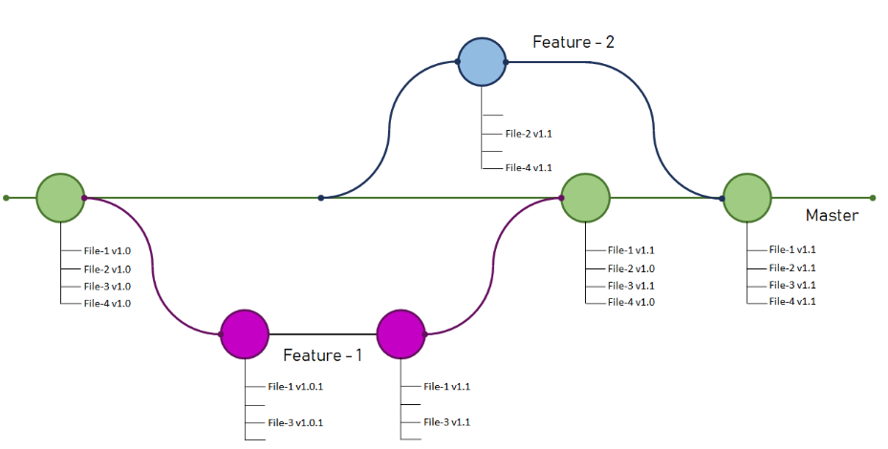
Git Workflow - Branches

Slide 19
The Command Line
We will be using the command-line interface to Git, which can be a bit harder to use if you have never used the command line.
What is the command line?
It is an interface to your computer, similar to the Mac Finder or Windows Explorer, except that it’s text-based.
As the name implies, you interact with it through “commands”.
Each line of input begins with a command and has zero or more arguments, separated by spaces.
The command-line keeps track of what directory (folder) you’re in, which is important to many of the commands you might be running.

Slide 20
The Command Line
Opening the Command Line: On macOS and Linux, open the Terminal application. On Windows, Git for windows includes Git Bash. Run Git Bash to open a terminal where you can run all the commands below, in addition to Git commands.
Common Commands
cd (“change directory”): Changes the current directory. If you’re in a directory that has a subdirectory called hello, then cd hello moves into that subdirectory. Use cd .. to move to the parent directory of your current directory. Use cd ~ to navigate to your home directory.
pwd (“print working directory”) Prints out the current directory, if you’re not sure where you are.
ls (“list”) Lists the files in the current directory. Use ls -l for extra information (a “long” listing) about the files.
mkdir (“make directory”) Creates a new directory in the current directory. To create a directory called goodbye, use mkdir goodbye.
up arrow and down arrow Use the up and down arrow keys to navigate through your history of commands, so you never have to retype a long command line.

Slide 21
The Command Line: exercises
Go to your home directory: $ cd ~
Check all the existing files in your home directory: $ ls
Create a new folder called “Example”: $ mkdir Example
Navigate to the Orientation folder: $ cd Example
Print your current path: $ pwd
Use the up and down arrows to check your previous commands.

Slide 22
The Command Line: creating and editing files
To create or edit files using the command line, we need an editor. There are multiple editors: nano, notepad, vim, … We will be using vim!
In your Example folder, create a text file called “demo.txt”: $ vim demo.txt
You start in a mode called “normal mode”. You can’t immediately type anything into the file!
In order to start typing, press i (stands for “insert”). This will bring you to “insert mode”, so named because in this mode you can type text into the file. When you are done typing, press esc. This will bring you back to “normal mode”.
Once you’re back in normal mode, you can type commands that start with :
To save your work, type :w (stands for “write”) and press return.
To exit (quit) Vim, type :q and press return.
To save and quit in one command, combine them: type :wq and press return.

Slide 23
The Command Line: Git
We’ll first do some setup to use Git from the command terminal.
Tell Git who you are: Every Git commit includes the author’s name and e-mail. Make sure Git knows your name and email by running these two commands:
$ git config --global user.name "your-name"
$ git config --global user.email "username@mit.edu"
2. Set up Vim as your default editor for Git : Every Git commit has a descriptive message, called the commit message. Set Vim as your default editor to write these messages:
$ git config --global core.editor vim

Slide 24
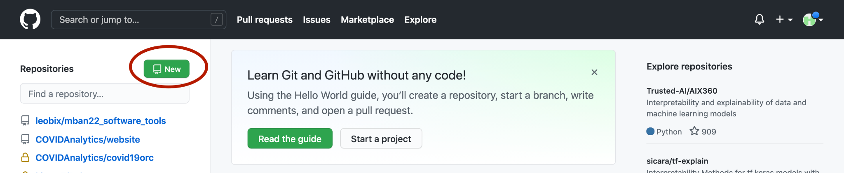
Git: Creating a new Repository

Slide 25
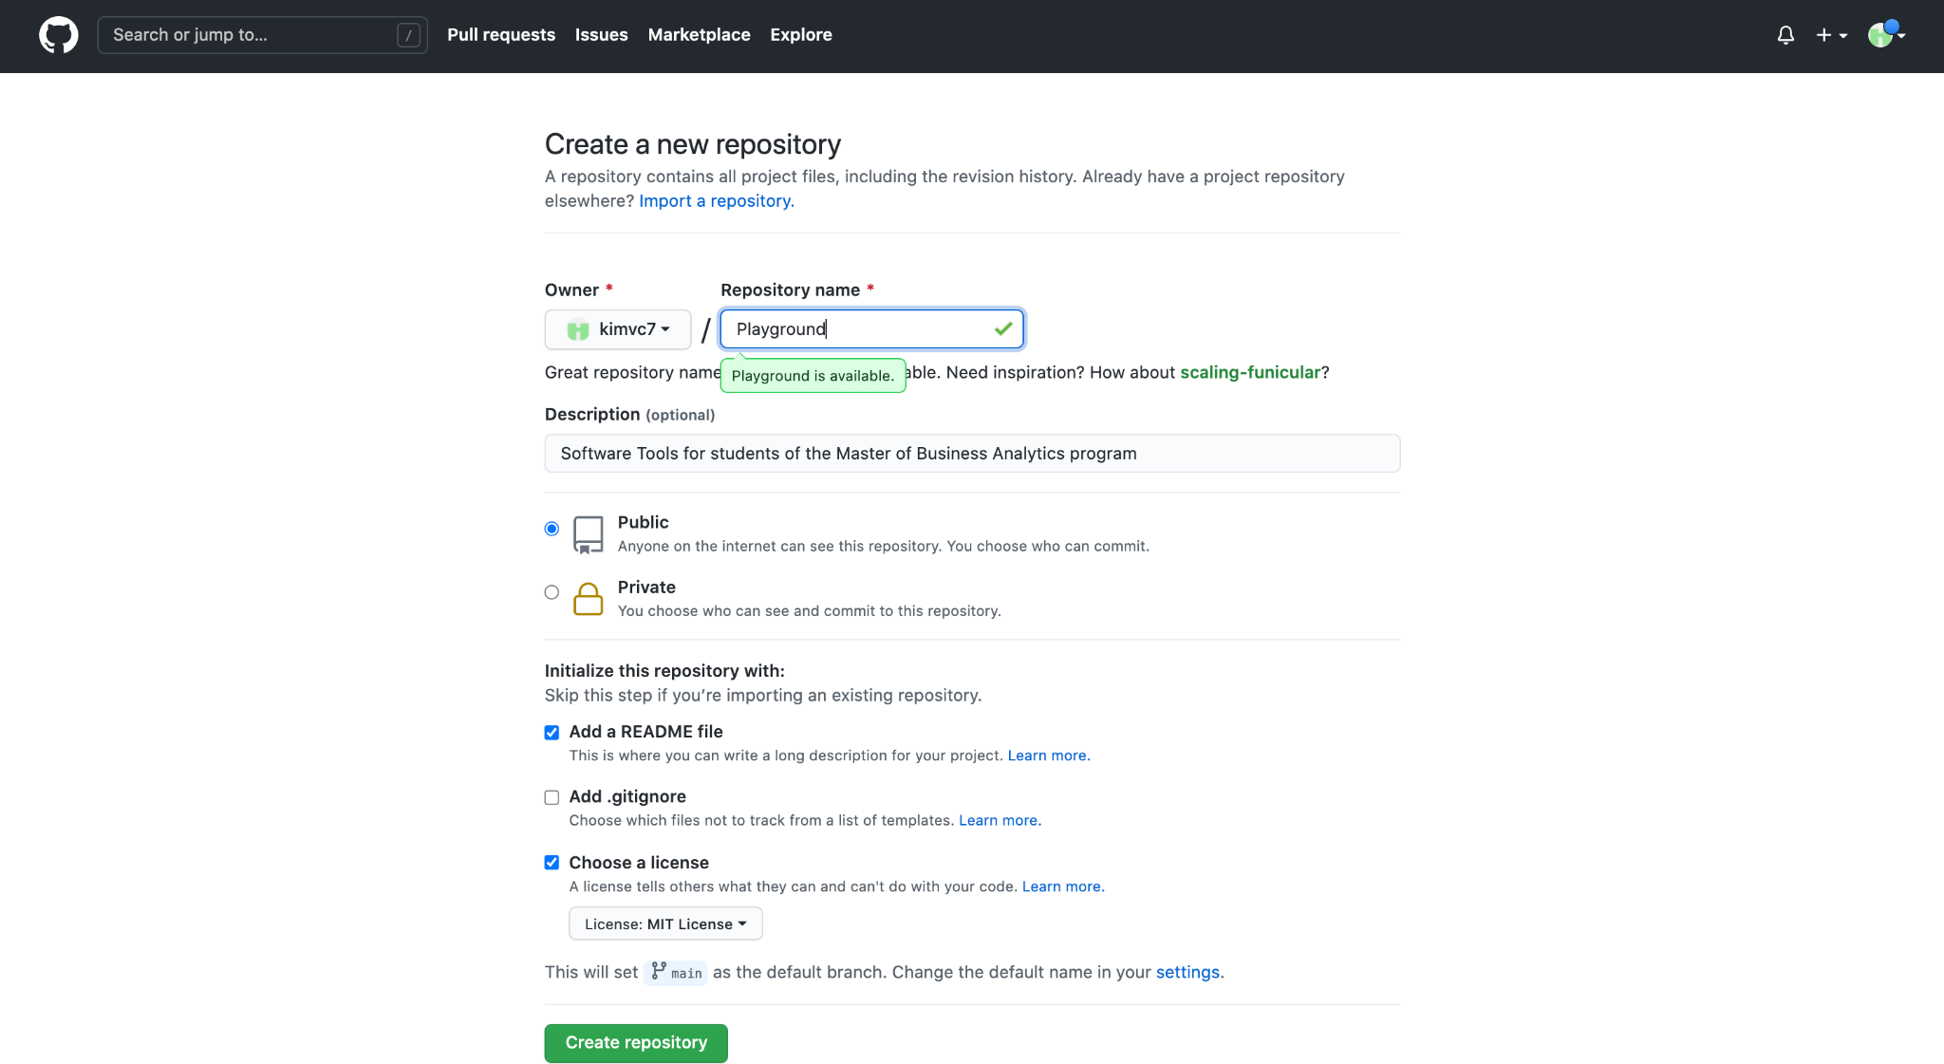
Git: Creating a new Repository

Slide 26
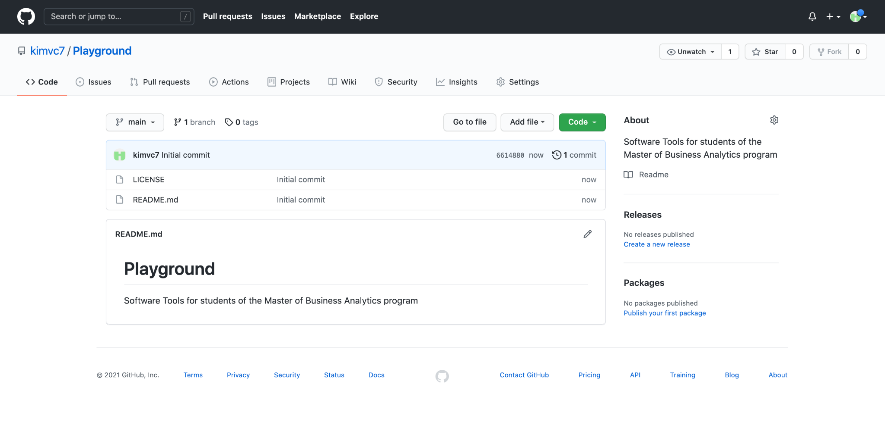
Git: Creating a new Repository

Slide 27
Git: Cloning a new Repository
Go to the repository and copy the URL.
Open the terminal (use Git Bash on Windows) and use the cd command to navigate to the “Example” folder we made earlier (or any other folder where you would like to store your repository). Then run git clone <URI-of-remote-repo>
$ git clone git@github.com:kimvc7/Playground.git
Navigate to the new git repo: $ cd Playground

Slide 28
Now let’s make some changes!
Use the vim editor to create a new file called “new_file.txt” inside of the Playground folder and write “This is a new file”.
$ vim new_file.txt
Run $ git diff to see what has changed since the last commit. (doesn’t show anything since the file didn’t exist).
Run $ git status to see which changes have been staged, which haven’t, and which files aren’t yet tracked by git.
Run $ git log to see a list of the commits made in the repository in reverse order.
HEAD: name of the commit (snapshot) where we currently are.
Origin: default name of the remote.
Master or Main: default name for the latest commit in the main branch of the repository.

Slide 29
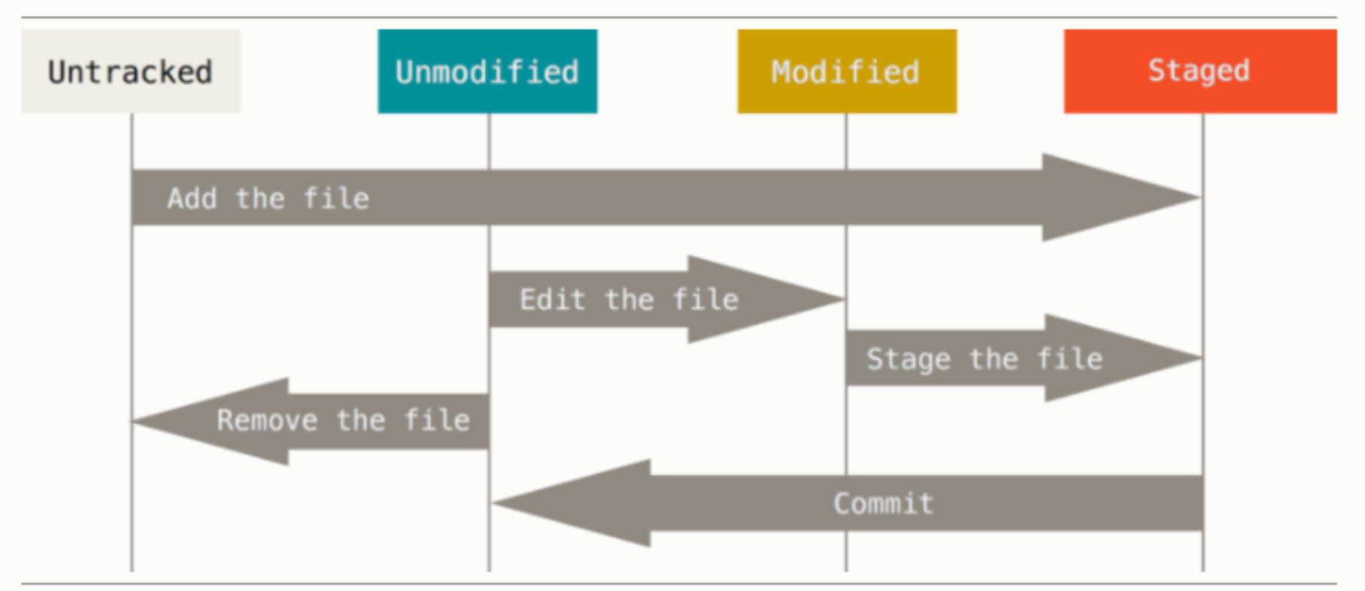
File States
Git will notice any file in the directory of the repository
A file is either tracked or untracked.
A tracked file may be:
Unmodified: No changes since the last commit
Modified: Changes have been made to it since the last commit.
Staged: Changes will be committed in the next commit.

Slide 30
Staging Files
The command git add <filepath> moves untracked or modified files to the staging area to be committed in the next commit. Let’s add our new file!
$ git add new_file.txt
If you run $ git status again you should now see that the file is now in green ready to be committed!
Use git add to either:
Add a new file to the repository (untracked -> staged)
Record a change that you made to an existing file (tracked -> staged)

Slide 31
Committing Files
The command git commit -m <commit message> creates a new snapshot of our repository including all the changes that have been staged . Let’s commit our changes!
$ git commit -m “Add a new file”
The new snapshot (commit) is now saved in our local repository, but they don’t yet exist in the remote repository because we haven’t pushed them.
If you run $ git log again you should now see two commits: the initial commit and the new commit you just created. Notice also:
HEAD now points to the new commit (because this is where you currently are) in the main branch.
The HEAD of the remote is still in the first commit because we have not pushed our changes.

Slide 32
Pulling and Pushing
When we run the command git pull, Git fetches the remote repository from GitHub and merges the new remote updates with our local repository. Always pull before pushing!
Even if both remote and local modified the same file, Git is usually able to correctly merge the two copies.
We get a merge conflict if both parties modified the same part of the file, since Git doesn’t know which version to keep.
In our case, since the file we created does not exist in remote, we won’t get any conflicts. So go ahead, run $ git pull Since nothing has changed in the remote, no files got pulled.
Finally, run the $ git push command to update the remote repository with your local commits.

Slide 33
Creating a merge conflict
Choose a partner to work with.
One of you will add their partner as a collaborator on your playground repo (click Settings and then Collaborators).
The other partner will make a new folder inside the “Example” directory called “Merging” and will clone their partner’s Playground repo in it.
For example: suppose Kim and Yu decide to work together. Together, they decide that Yu will clone Kim’s playground repo. Kim adds Yu as a collaborator. Then Yu clones Kim’s repo inside the “Merging” directory.

Slide 34
Creating a merge conflict
Each partner should make some changes to the playground repo. For this exercise, each partner should make a change to new_file.txt.
Example: Kim works on her original repo. Yu works on her newly cloned repo. Once both partners have made (different) changes to the file, each one should try to stage-commit-push. This should work for the partner who does this first. The other partner should get an error similar to:
To https://github.com/kimvc7/Playground.git ! [rejected] master -> master (fetch first) error: failed to push some refs to ’https://github.com/... hint: Updates were rejected because the remote contains work hint: that you do not have locally. This is usually caused by hint: another repository pushing to the same ref. You may want hint: to first integrate the remote changes (e.g., ’git pull ...’) hint: before pushing again....

Slide 35
The Mistake
The second partner realizes that they’ve made a mistake.
Before pushing, we should always fetch and merge (or pull) from the remote repo.
The partner who attempted to push second did not pull beforehand.
If you receive this message, you should realize that someone pushed while you were working.
This can be fixed by pulling. What do you expect will happen when this partner pushes?

Slide 36
Resolving Merge Conflicts
There is a merge conflict because Git doesn’t know which version is correct. You can see the conflict by checking the new_file.txt file with the cat command: $ cat new_file.txt
The output will be something like:
$ cat existing_file.txt
<<<<<<< HEAD
Edit made by Kim.
=======
Edit made by Yu.
>>>>>>> b3207b5d9cddd22934ccd2fed0a6cc16eefdab73
The markers <<<<<<<, =======, >>>>>>> indicate the conflict.
The section in between the first two markers is your local change (HEAD), while the bottom section indicates the update from remote.
Must resolve conflict manually by editing the file, making sure to get rid of the conflict markers.
$ vim new_file.txt

Slide 37

Resolving Merge Conflicts
Together with your partner, decide on what the file should look like and edit the file accordingly.
After resolving conflicts, we must add the file for staging and commit again.
Git will automatically create a commit message: ”Merge branch ’master’ of https://github.com/kimvc7/ Playground”.
At this point, you would be able to push your changes.
$ git add new_file.txt
$ git commit
$ git push
You could run
git log
to see your commit history after the merge!

Slide 38
Branching Basics
A branch represents an independent line of development.
One can use branches to work on multiple things in parallel.
When working on Feature1 and Feature2 that involve the same files, open a branch for each.
When each feature is completed, merge its branch back into master.
Default branch is master/main.

Slide 39
Creating and Merging Branches
In your repo, create a new branch called “feature_one”: $ git branch feature_one
Switch to the new branch: $ git checkout feature_one
Create a new file called “yet_another_file.txt” and write “Hello” in it: $ vim yet_another_file.txt
Add, commit and push your changes.
$ git add yet_another_file.txt
$ git commit -m “Add one more file”
$ git push origin feature_one
Switch to the main/master branch
$ git checkout main
Remote name
Branch name
Merge the two branches: $ git merge feature_one
Push: $ git push

Slide 40
Useful Tips:
Google is your friend. (e.g. ”How to undo merge in Git”.)
Almost anything can be undone, as long as it is committed.
Commit often, pull often.
Might take a while to get used to, but it is useful knowledge that will improve productivity and collaboration.

Slide 41
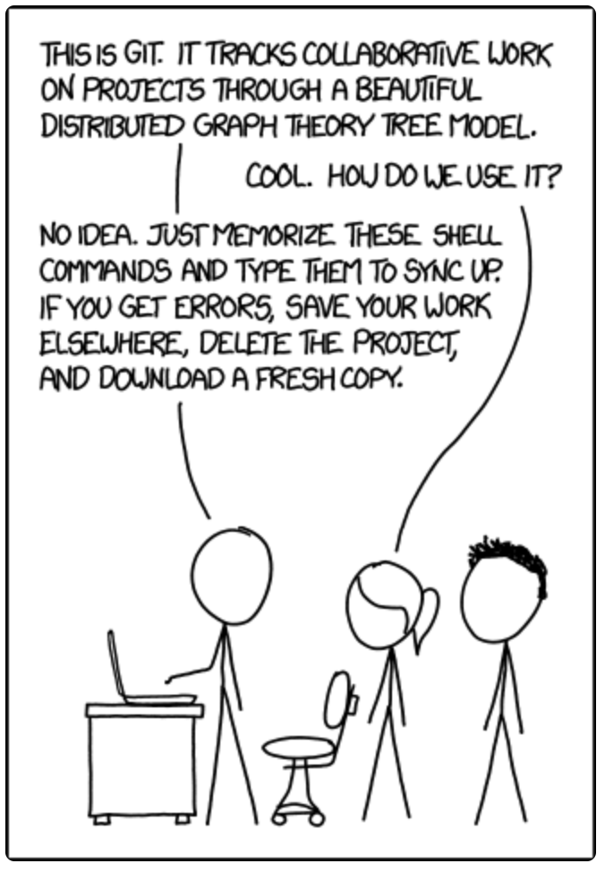
FUNNY, BUT WRONG

Slide 42
THANK YOU!

Slide 43
Acknowledgements
6.031: Software Construction - MIT : Getting Started
Galit Lukin’s slides: Introduction to Git and Github
Jackie Baek’s slides: Introduction to Git and Github
The Missing Semester of Your CS Education - MIT: Version Control (Git)

