Slide 1
Vitamin C Serum Product Launch Strategy
Andy Vong

Slide 2
Outline
Market Landscape
$1.28M/month in sales
75 products on market
Top 25% of sellers make up $0.85M of sales, ~66%
Competitor Analysis
Suggest setting price at $20-$40
Expect monthly revenue of $10K - $31K
Title Strategy
30 words
Include bottle size
Popular words include
Ferulic acid, Hyaluronic acid, Brightening, Anti-Aging
[Product Line] Vitamin C Serum for Face with Ferulic Acid, Hyaluronic Acid, and Vitamin E | Skin-Brightening and Anti-Aging Serum 1.2 oz

Slide 3
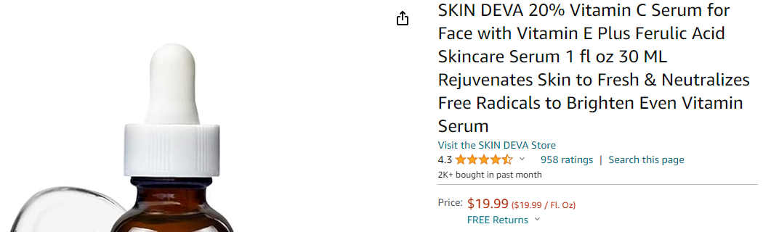
Data Scraped from Amazon US
For September 2023
Includes price, sales in last month, rating, title, url

Slide 4
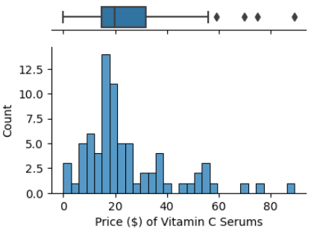
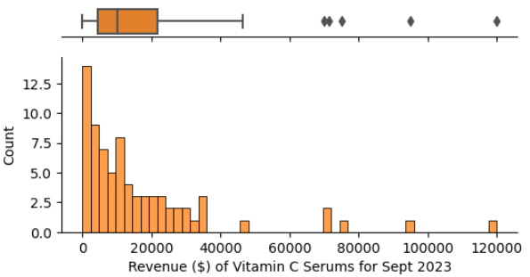
Vitamin C Serums Total Sales $1.28M/month
75 Products on market
Top 25% of sellers take home $0.85M, or 66% of monthly revenue
Mean price is $32.32
Median revenue is $31,500

Slide 5
Expect Between $10,000 and $31,500 in Revenue

Slide 6
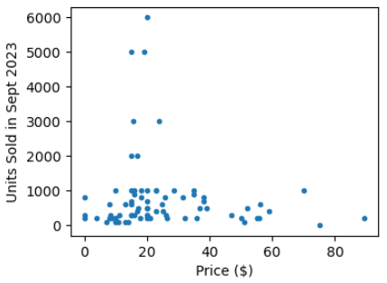
Sales are not correlated with Price; Suggest Pricing between $20-$40
Majority of products priced between $0-$40
No trend in sales within this range
As a premium product, want to price above the median ($20)
Pricing beyond $40 may impact sales

Slide 7
Attract Customers by Emulating Titles of Successful Products
Top 25% of sellers with price between $20-$40
Analyzed titles using TF-IDF (Term Frequency – Inverse Document Frequency)
Identifies words/phrases in the titles of successful products by comparing them to the words/phrases found in other products
Positive Example:
SKIN DEVA 20% Vitamin C Serum for Face with Vitamin E Plus Ferulic Acid Skincare Serum 1 fl oz 30 ML Rejuvenates Skin to Fresh & Neutralizes Free Radicals to Brighten Even Vitamin Serum
Negative Example:
Vanicream Vitamin C Serum - Free of Dyes, Fragrance, Masking Fragrance, Lanolin, Parabens & Formaldehyde Releasers - For Sensitive Skin - 1.2 Fl Oz

Slide 8
[Product Line] Vitamin C Serum for Face with Ferulic Acid, Hyaluronic Acid, and Vitamin E | Skin-Brightening and Anti-Aging Serum 1.2 oz
Stick to about 30 words in title
Include bottle size (1 oz, 30 mL, etc.)
Important words/phrases to include are
serum, face, ferulic acid, hyaluronic acid, brightening, anti aging, vitamin
customers are smart and want to know the active ingredients, so include them!
popular active ingredients are vitamin c, vitamin e, ferulic acid, and hyaluronic acid
customers also like descriptors "brightening" and "anti-aging"
be sure to call it a serum, and specify that it is for the face
Less important words are
women, hydrating, firming, retinol

Slide 9
Summary
Price product for $20-$40
Expect monthly revenue between $10,000 and $31,500
Stick to descriptive titles
Highlight ingredients
Especially Vitamin C, Vitamin E, Ferulic Acid, and Hyaluronic Acid
Strong descriptors include brightening and anti-aging

