Slide 1
IntelliCare -
An Intelligent Hospital Triaging System
Christopher Agia, Luke Volpatti,
Samuel Looper, and Steve Kim
From the University of Toronto

Slide 2
Problem statement
Wait times in Ontario ERs are long - average 1.5h!
Triaging is done manually and is inaccurate
Dangerous for patients with urgent needs
Hospital resources like bed space are scarce and inefficiently used

Slide 3
Solution: The IntelliCare System
Patient data inputted in computer interface
Deep learning model generates accurate triage score
Nurse verifies or overrules computer generated score
Patient profile is added to emergency room priority queue
Hospital resources (like beds) are allocated to patients

Slide 4
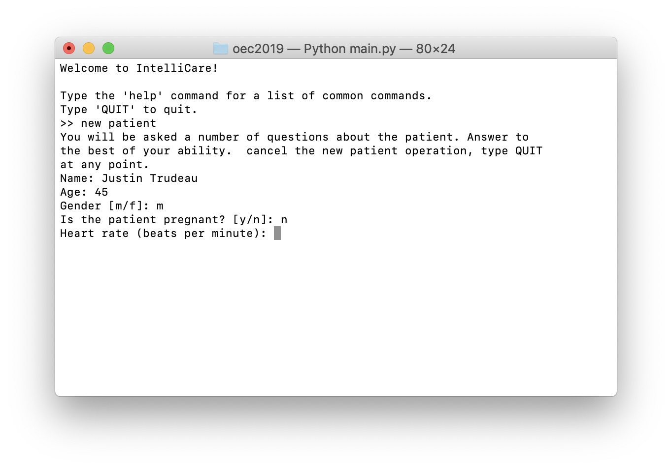
Interface
Simple text-based interface, easy for nurses to navigate
Data fed directly to machine learning model
Triage score output from machine learning model never used without first getting nurse’s input

Slide 5
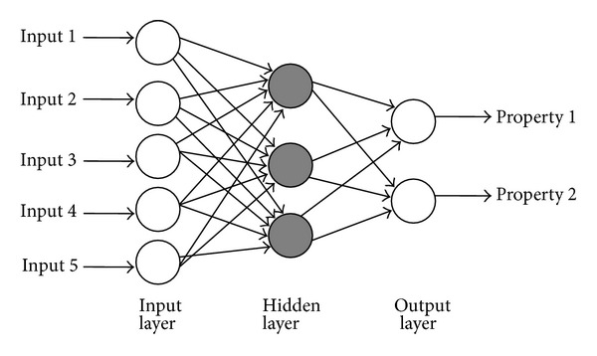
Machine Learning Model
We used a neural network to suggest nurses/secretaries a triage score for every patient that comes into the hospital
Created a Multi-layer Perceptron Neural Network
Input layer: 11 neurons
Output layer: 5 neurons
Hidden layers: 11 neurons, 1 layer
Research shows ~94% accuracy in predicting correct triage scores [1]
Insufficient data resulted in skewed predictions

Slide 6
Machine Learning Model (cont.)
Linear input layers: Tanh activation function
One-hot encode labels to the feature data
Features were not normalized;
Output layer: LeakyReLU to output values between 0 and 1
Final Output: Softmax to map the non-normalized output to a probability distribution

Slide 7
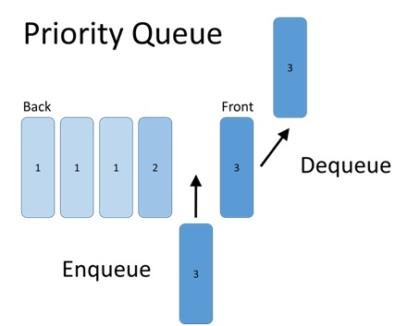
The Patient Priority Queue
The machine learning model outputs the patient database with a priority score
This set of incoming patients is stored in a priority queue, ensuring higher priority patients are prioritized
This abstract data structure can be queried for to allocate patients to bed in the allocation algorithm

Slide 8
The Bed Allocation Algorithm
Given the standard layout of the hospital, reduce the overhead cost identifying vacant beds for waiting patients
Algorithm prioritizes patients based on the priority queue
Dynamically allocates beds at varying levels of care in the hospital to new patients
Keeps track of maintenance time requirements
Optimizes the distribution of beds to reduce bed turnover time and reduce wait time

Slide 9
Performance Metrics
Throughout the operation of a hospital using our system, our algorithm keeps track of key performance metrics and outputs an analytics report at the end of the working day to evaluate the occupancy of our hospital with respect to:
Wait Time (average wait time, wait time per priority class)
Bed Turnover Time (average turnover time, turnover time per floor)
Bed Occupancy Ratios (average occupancy ratio, occupancy ratio per floor)
This gives our client hospital key insights into the bottlenecks in their triaging processes: can check for hospital gridlock, over/ under usage and demand for beds

Slide 10
Future Considerations
More training data!
Gov’t of Manitoba has triage data - need permission to access it
Real time patient notification
Increase efficiency by notifying patients in real time on their cell phones when the doctor is ready to see them
Integration with doctor’s office, giving them the ability to notify others when they have finished seeing a patient

Slide 11
Citations
[1]https://www.ripublication.com/ijaer17/ijaerv12n15_%20(37).pdf?fbclid=IwAR1PZVxpIRfjg_PRZclYEAzjJzUD5YB0njHFXWAlh2Mia9TsohQRUrVGkLg

