Slide 1
UTEK Presentation
By: Team 6 (Steve Kim, Daniel Leal, Robert Li, Zhiye Song)

Slide 2
Best First Algorithm

Slide 3
Uses heuristics to guide the search

Slide 4
What is the heuristic?

Slide 5
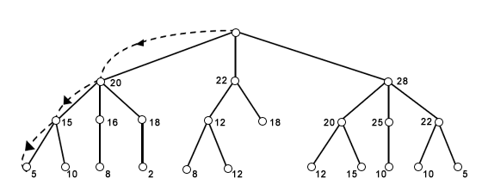
Figure 1. Best-First search of a Tree [1]

Slide 6
Current Key Set:
{1, 3, 5}
Next Key Tries:
{2, 3, 5}
{1, 4, 5}
{1, 3, 6}

Slide 7
Index of Coincidence

Slide 8
What is coincidence counting?

Slide 9
Coincidence Counting
Determines the likelihood of finding two matching letters from random selection in a text
Used in our program to determine the key set length

Slide 10
How is it used for determining the key set length in decrypting a cipher?

Slide 11
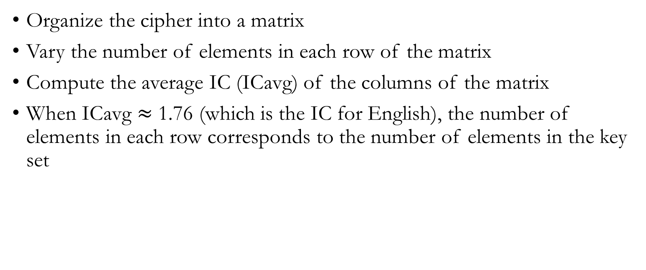
Determining the key set length
Organize the cipher into a matrix
Vary the number of elements in each row of the matrix
Compute the average IC (ICavg) of the columns of the matrix
When ICavg $≈$ 1.76 (which is the IC for English), the number of elements in each row corresponds to the number of elements in the key set

Slide 12
Citations
[1] http://www.universalteacherpublications.com/univ/ebooks/ai/Ch7/page7.htm

