Slide 1
eBotics™ Warehouse Logistics Planning Algorithm
By Christopher Agia, Luke Volpatti, Samuel Looper & Steve Kim

Slide 2
Problem Definition
Given the Cartesian coordinates of a set number of robots, packages, and obstacles, determine an efficient (and potentially optimal) path planning algorithm to collect packages and return them to the origin.
Some considerations:
Weight capacity of the warehouse robots (100kg)
Collision avoidance; stationary (obstacles) and moving (robots)
Path efficiency; minimize number of timesteps
How can we deal with these constraints in an efficient manner?

Slide 3
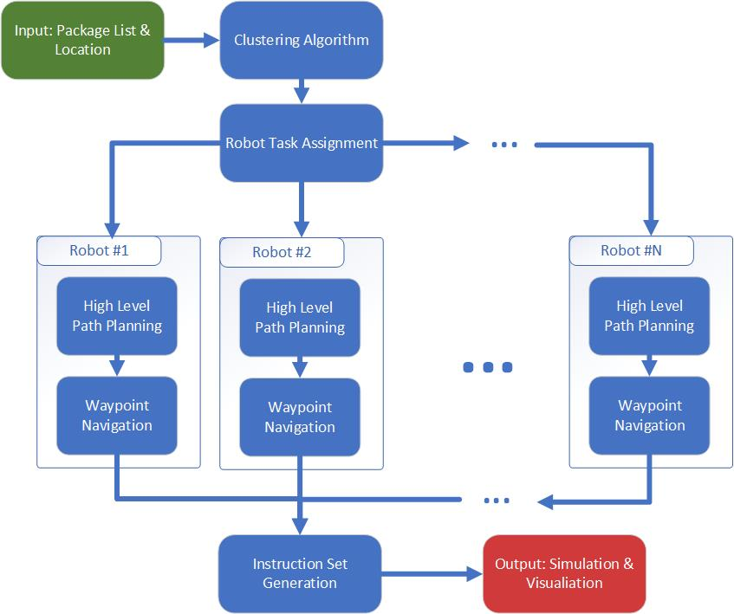
High Level Solution

Slide 4
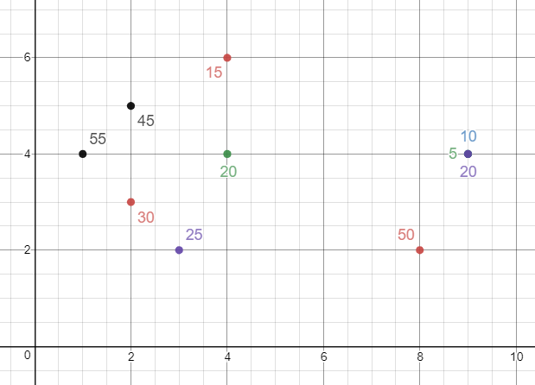
Clustering Algorithm
Occupancy Grid Map
Group packages into clusters (which a single robot can pick up in one run)
Discrete combinatorial optimization problem (NP complete!)
Greedy algorithm with heuristic to optimize clustering:
Minimizing distance between objects
Maximizing total weight carried, constrained to less than 100 lbs.
Cluster #1
Cluster #3
Cluster #2

Slide 5
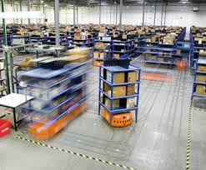
Robot Task Assignment
Need to parallelize - 2 robots working at the same time is better than 1!
Developed cost function to assess robot workload:
Increases with respect to distance of objects
Increases with respect to number of objects in cluster
Algorithm balances the robot workload - we want all robots to do about the same amount of work
Created new clusters and redistributed packages until there are at least as many clusters as there are robots

Slide 6
High Level Path Planning
Occupancy Grid Map
Order the elements within each cluster into a path that a robot will follow
NP complete! Use a greedy approach: always go to nearest neighbor
Future work: use a heuristic approach like simulated annealing for better optimality
Cluster #1
Cluster #3
Cluster #2
Optimal path for cluster #2

Slide 7
Way-Point Navigation - A* Search
Key to solving problems 2. and 3. - “Collision Avoidance & Path Efficiency”
Algorithm
Optimal pathfinding between any two nodes in a graph (i.e. discretized OGM)
Uses heuristics to decrease run-time and space complexity
Built-in obstacle avoidance
Primary Use?
Clusters of Packages → Sequences
Path traceback for robotic collision avoidance

Slide 8
Simulation & Visualization
Used Matplotlib.animations to be easily integrated with the rest of our applications
Can vary parameters with ease
Provides a good visual understanding of how our algorithm works

Slide 9
Next Steps & Real World Application
Algorithm assumes perfect localization & mapping
Efficient and scalable solution - use of heuristics to balance speed and optimality, can be tuned based on conditions
Improvements:
Account for number of robots in clustering algorithm
Better simulation tools to improve parameter tuning
Future considerations:
How can we connect robots to the internet to give them instructions on-the-fly?
How can we apply machine learning to learn optimal path patterns?

