Slide 1
Basic Mechanisms Underlying Seizures and Epilepsy
American Epilepsy Society

Slide 2
Basic Mechanisms Underlying
Seizures and Epilepsy
⬧ Seizure: the clinical manifestation of an abnormal and excessive excitation and synchronization of a population of cortical neurons
⬧ Epilepsy: a tendency toward recurrent seizures unprovoked by any systemic or acute neurologic insults
⬧ Epileptogenesis: sequence of events that converts a normal neuronal network into a hyperexcitable network

Slide 3
Basic Mechanisms Underlying
Seizures and Epilepsy
⬧ Feedback and
feed-forward inhibition, illustrated via cartoon and schematic of simplified hippocampal circuit
Babb TL, Brown WJ. Pathological Findings in Epilepsy. In: Engel J. Jr. Ed.
Surgical Treatment of the Epilepsies. New York: Raven Press 1987: 511-540.

Slide 4
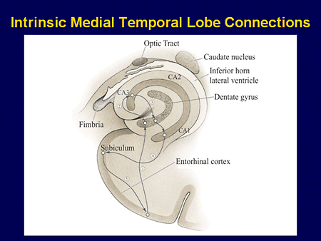
Basic Mechanisms Underlying
Seizures and Epilepsy

Slide 5
Epilepsy—Glutamate
⬧ The brain’s major excitatory neurotransmitter
⬧ Two groups of glutamate receptors
  Ionotropic—fast synaptic transmission
    NMDA, AMPA, kainate
    Gated Ca⁺⁺ and Gated Na+ channels
  Metabotropic—slow synaptic transmission
    Quisqualate
    Regulation of second messengers (cAMP and Inositol)
    Modulation of synaptic activity
⬧ Modulation of glutamate receptors
  Glycine, polyamine sites, Zinc, redox site

Slide 6
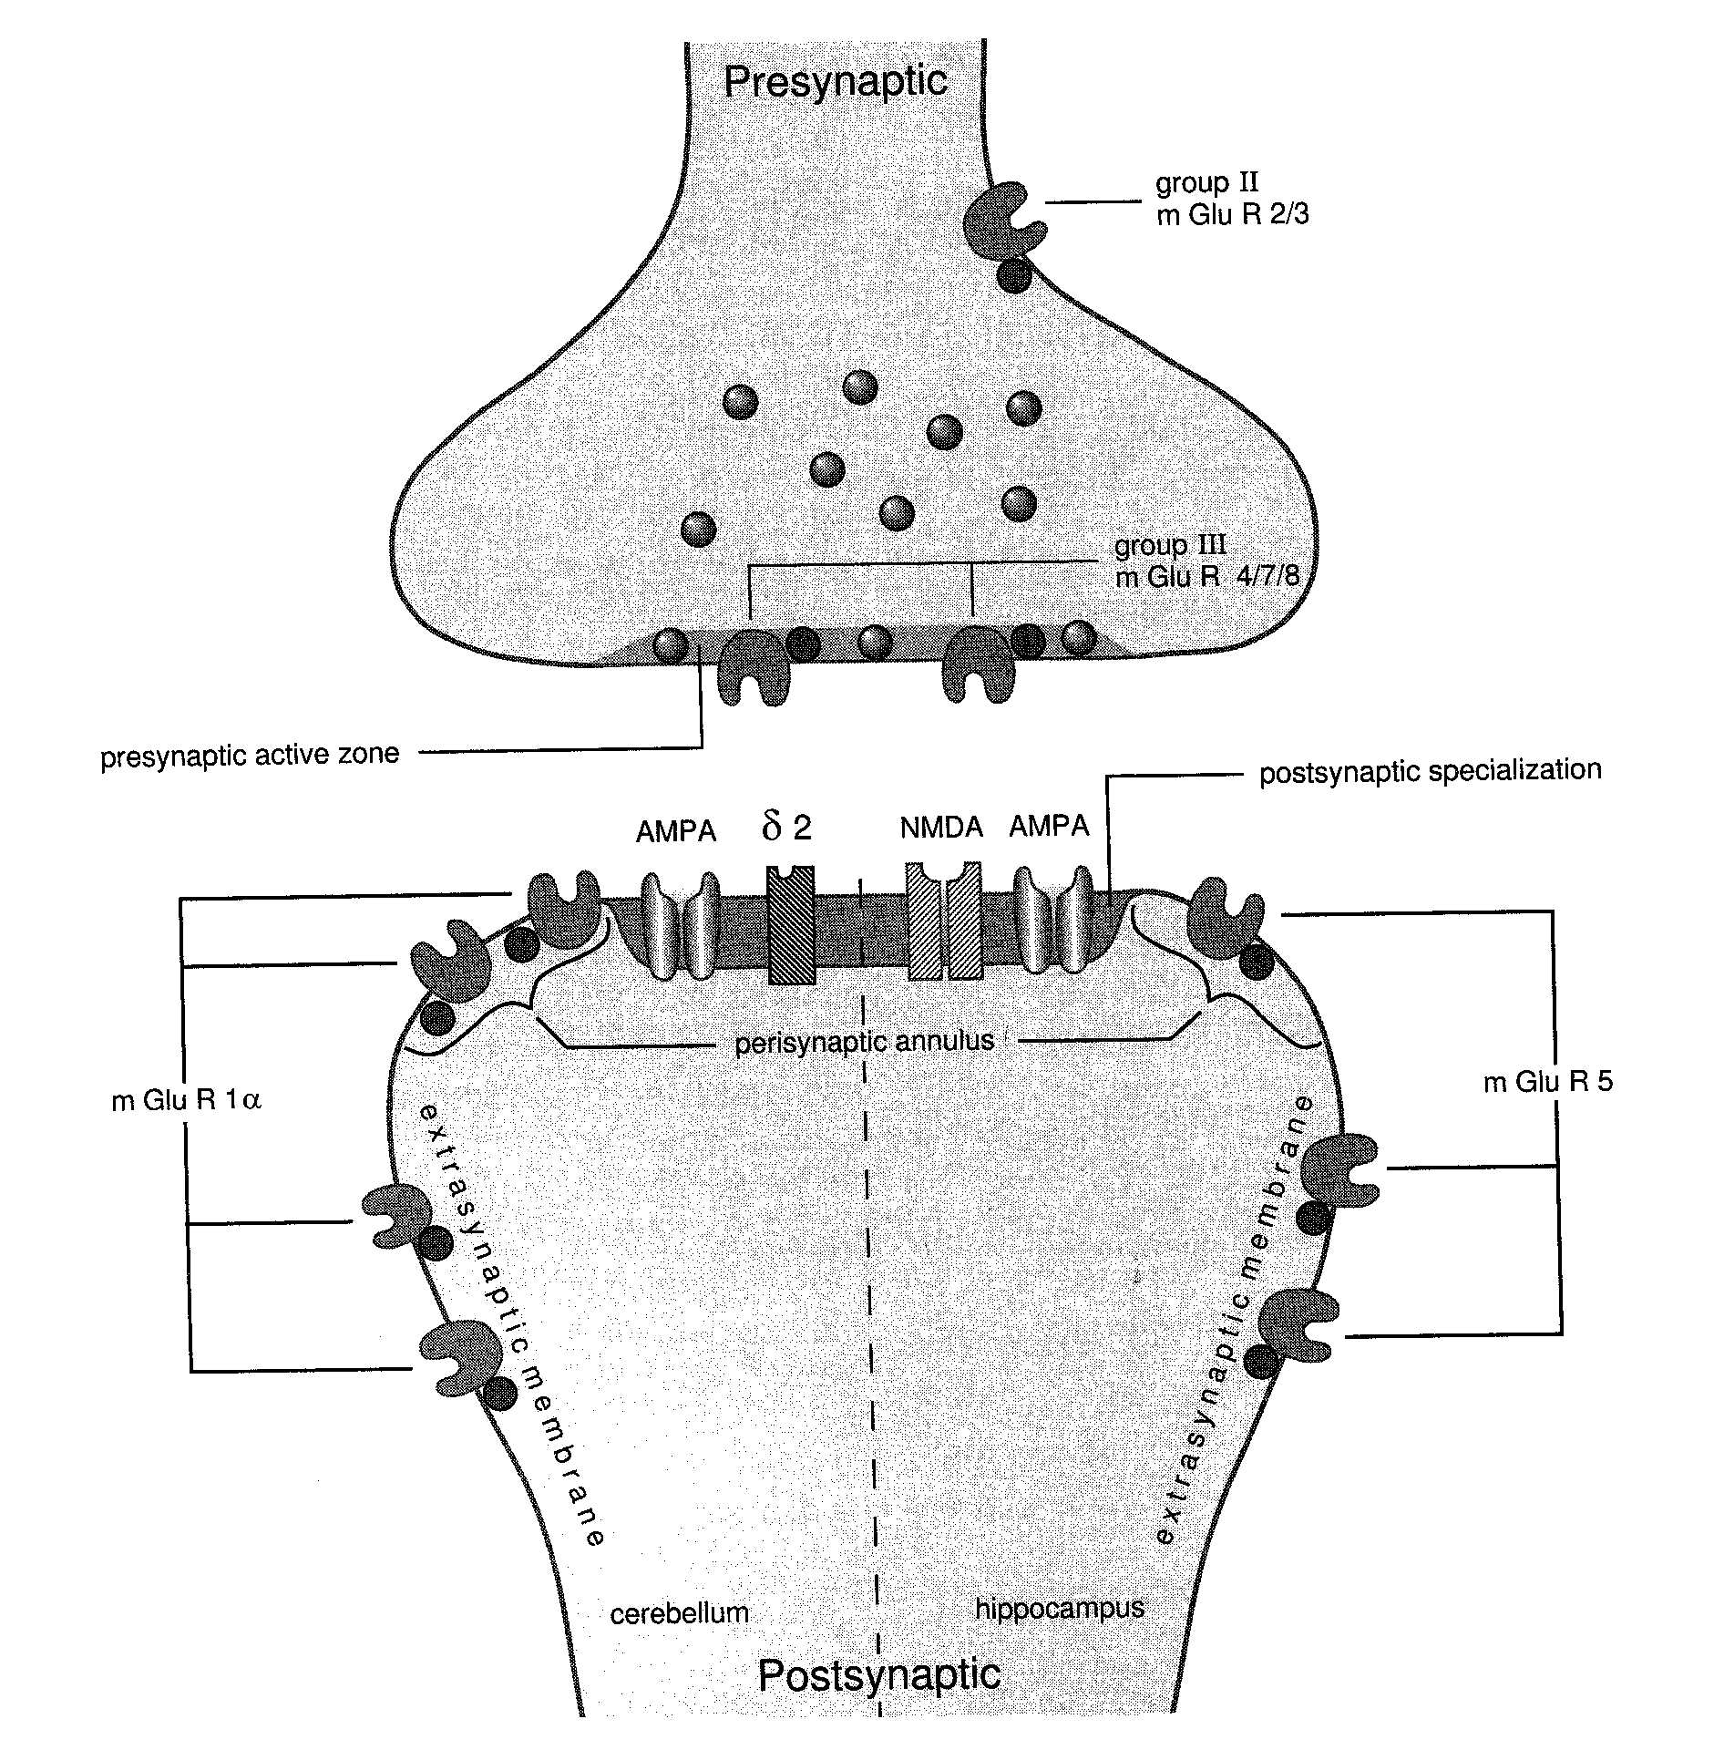
Epilepsy—Glutamate
⬧ Diagram of the various glutamate receptor subtypes and locations
From Takumi et al, 1998

Slide 7
Epilepsy—GABA
⬧ Major inhibitory neurotransmitter in the CNS
⬧ Two types of receptors
  GABA_{A}—post-synaptic, specific recognition sites, linked to CI⁻ channel
  GABA_{B} —presynaptic autoreceptors, mediated by K⁺ currents

Slide 8
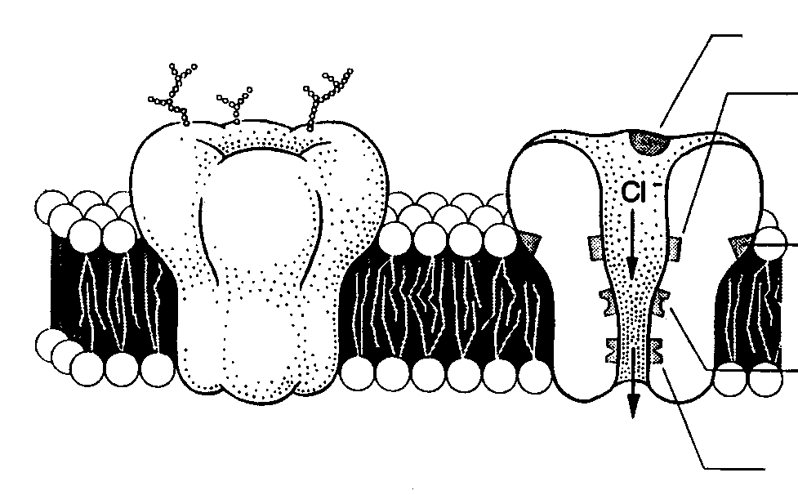
Epilepsy—GABA
GABA site
Barbiturate site
Benzodiazepine
site
Steroid site
Picrotoxin site
Diagram of the GABA_{A} receptor
From Olsen and Sapp, 1995

Slide 9
Cellular Mechanisms of
Seizure Generation
⬧ Excitation (too much)
  Ionic—inward Na⁺, Ca⁺⁺ currents
  Neurotransmitter—glutamate, aspartate
⬧ Inhibition (too little)
  Ionic—inward CI⁻, outward K⁺ currents
  Neurotransmitter—GABA

Slide 10
Neuronal (Intrinsic) Factors Modifying Neuronal Excitability
⬧ Ion channel type, number, and distribution
⬧ Biochemical modification of receptors
⬧ Activation of second-messenger systems
⬧ Modulation of gene expression
(e.g., for receptor proteins)

Slide 11
Extra-Neuronal (Extrinsic) Factors Modifying Neuronal Excitability
⬧ Changes in extracellular ion concentration
⬧ Remodeling of synapse location or configuration by afferent input
⬧ Modulation of transmitter metabolism or uptake by glial cells

Slide 12
Mechanisms of Generating Hyperexcitable Networks
⬧ Excitatory axonal “sprouting”
⬧ Loss of inhibitory neurons
⬧ Loss of excitatory neurons “driving” inhibitory neurons

Slide 13
Electroencephalogram (EEG)
⬧ Graphical depiction of cortical electrical activity, usually recorded from the scalp.
⬧ Advantage of high temporal resolution but poor spatial resolution of cortical disorders.
⬧ EEG is the most important neurophysiological study for the diagnosis, prognosis, and treatment of epilepsy.

Slide 14
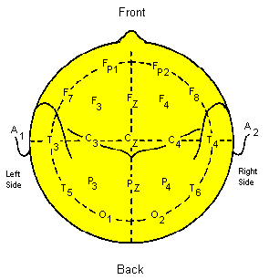
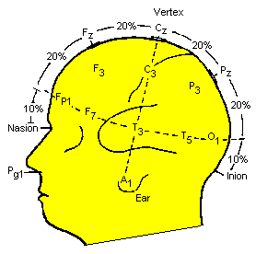
10/20 System of EEG Electrode Placement

Slide 15
Physiological Basis of the EEG
⬧ Extracellular dipole generated by excitatory post-synaptic potential at apical dendrite of pyramidal cell

Slide 16
Physiological Basis of the EEG (cont.)
⬧ Electrical field generated by similarly oriented pyramidal cells in cortex (layer 5) and detected by scalp electrode

Slide 17
Electroencephalogram (EEG)
⬧ Clinical applications
  Seizures/epilepsy
  Sleep
  Altered consciousness
  Focal and diffuse disturbances in
  cerebral functioning

Slide 18
EEG Frequencies
⬧ Alpha: 8 to ≤ 13 Hz
⬧ Beta: >13 Hz
⬧ Theta: 4 to under 8 Hz
⬧ Delta: <4 Hz

Slide 19
EEG Frequencies
EEG Frequencies
A) Fast activity
B) Mixed activity
C) Mixed activity
D) Alpha activity (8 to ≤ 13 Hz)
E) Theta activity (4 to under 8 Hz)
F) Mixed delta and theta activity
G) Predominant delta activity
(<4 Hz)
Not shown: Beta activity (>13 Hz)
Niedermeyer E, Ed. The Epilepsies: Diagnosis and Management. Urban and Schwarzenberg, Baltimore, 1990

Slide 20
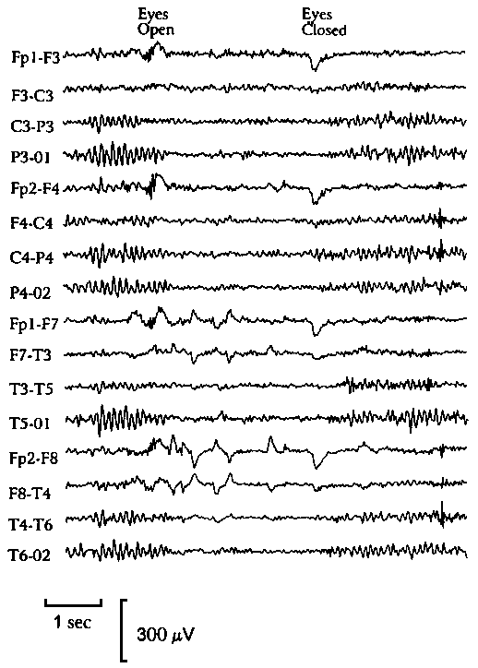
Normal Adult EEG
⬧ Normal alpha rhythm

Slide 21
EEG Abnormalities
⬧ Background activity abnormalities
  Slowing not consistent with behavioral state
    May be focal, lateralized, or generalized
  Significant asymmetry
⬧ Transient abnormalities / Discharges
  Spikes
  Sharp waves
  Spike and slow wave complexes
  May be focal, lateralized, or generalized

Slide 22
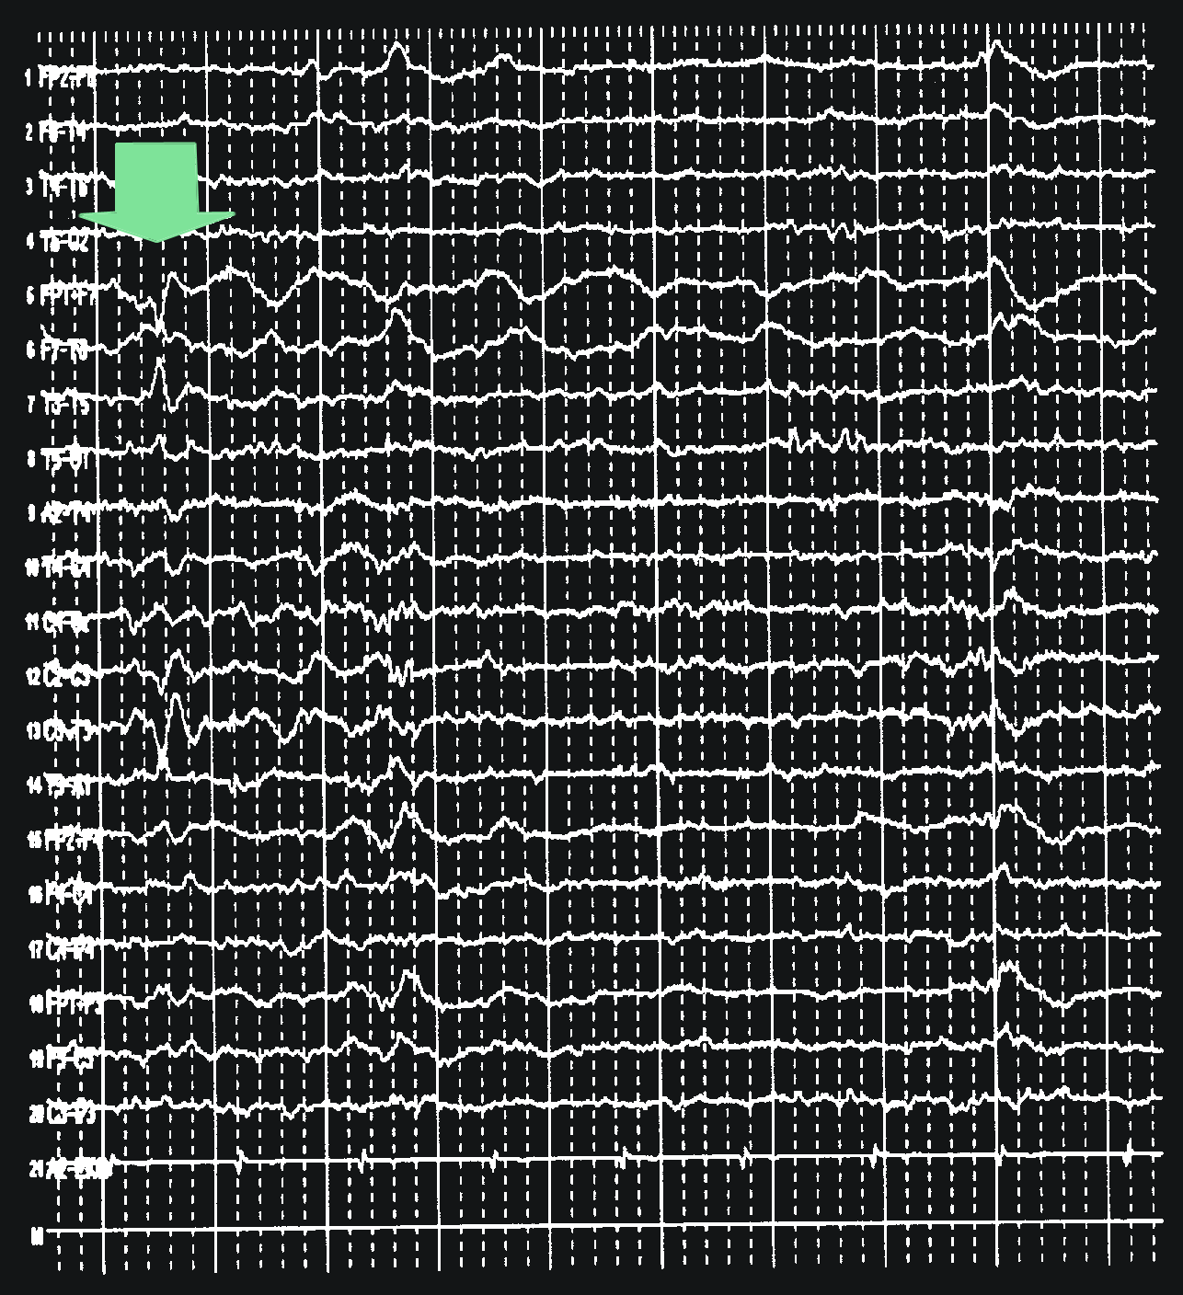
Sharp Waves
⬧ An example of a left temporal lobe sharp wave (arrow)

Slide 23
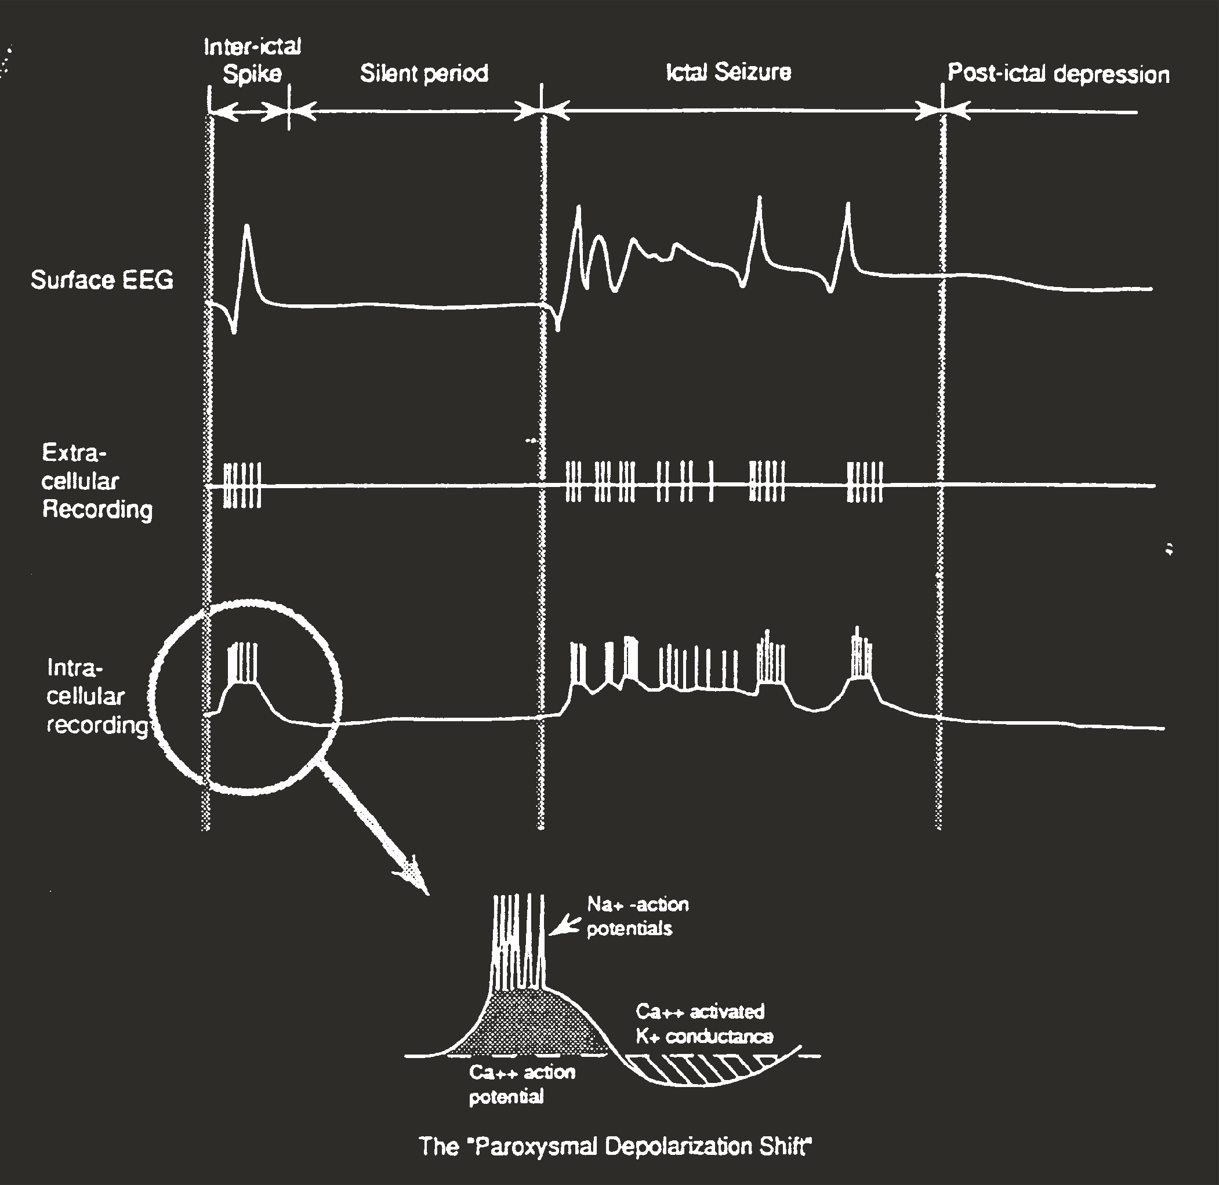
The “Interictal Spike and Paroxysmal Depolarization Shift”
Intracellular and extracellular events of the paroxysmal depolarizing shift underlying the interictal epileptiform spike detected by surface EEG
Ayala et al., 1973

Slide 24
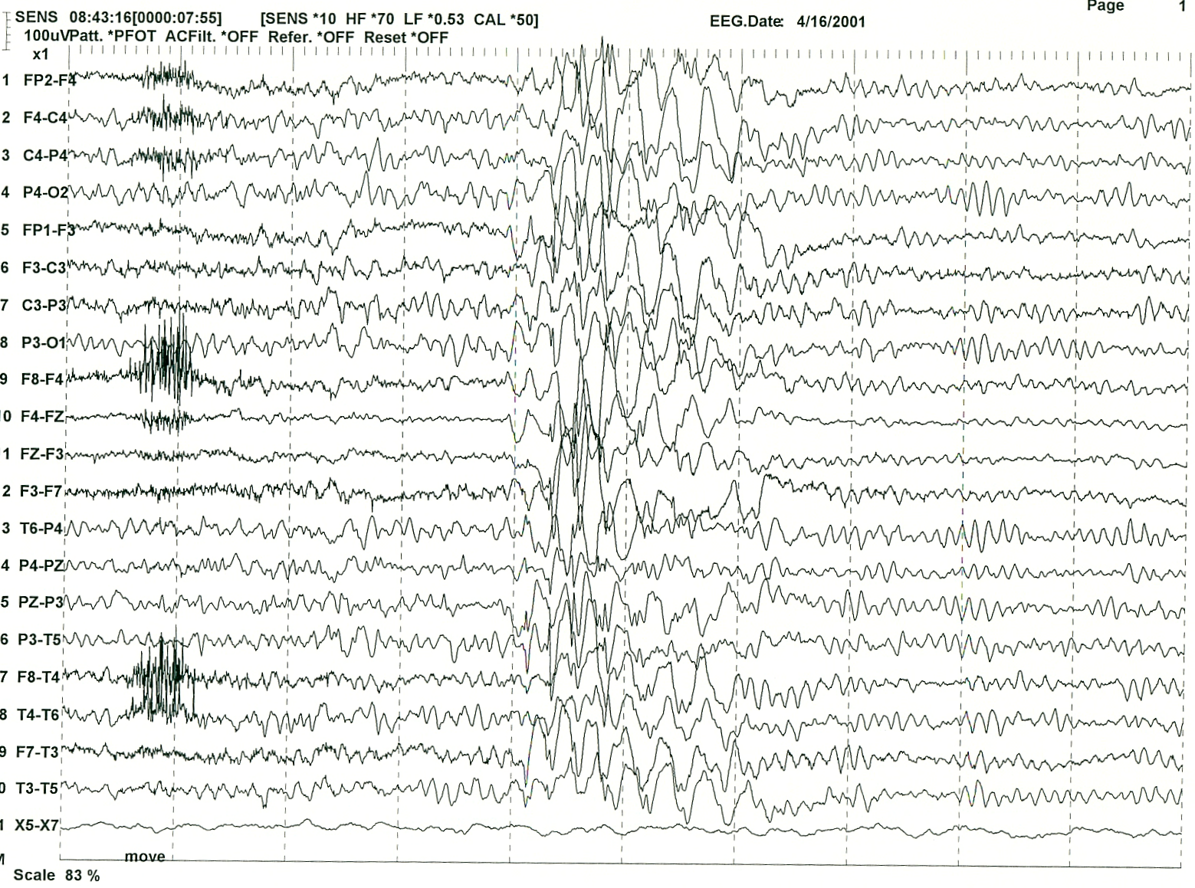
Generalize Spike Wave Discharge

Slide 25
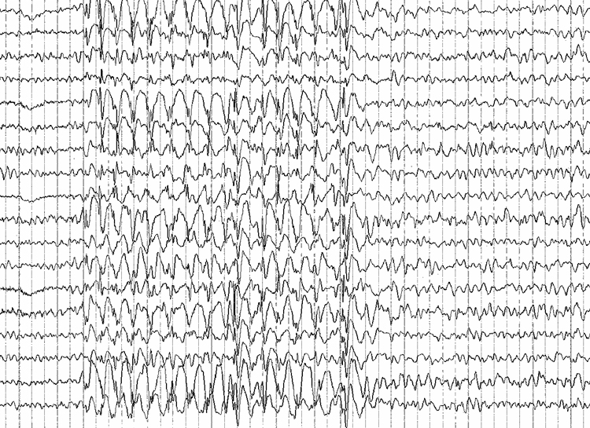
EEG: Absence Seizure

Slide 26
Possible Mechanism of
Delayed Epileptogenesis
⬧ Kindling model: repeated subconvulsive stimuli resulting in electrical afterdischarges
  Eventually lead to stimulation-induced clinical seizures
  In some cases, lead to spontaneous seizures (epilepsy)
  Applicability to human epilepsy uncertain

Slide 27
Cortical Development
⬧ Neural tube
⬧ Cerebral vesicles
⬧ Germinal matrix
⬧ Neuronal migration and differentiation
⬧ “Pruning” of neurons and neuronal connections
⬧ Myelination

Slide 28
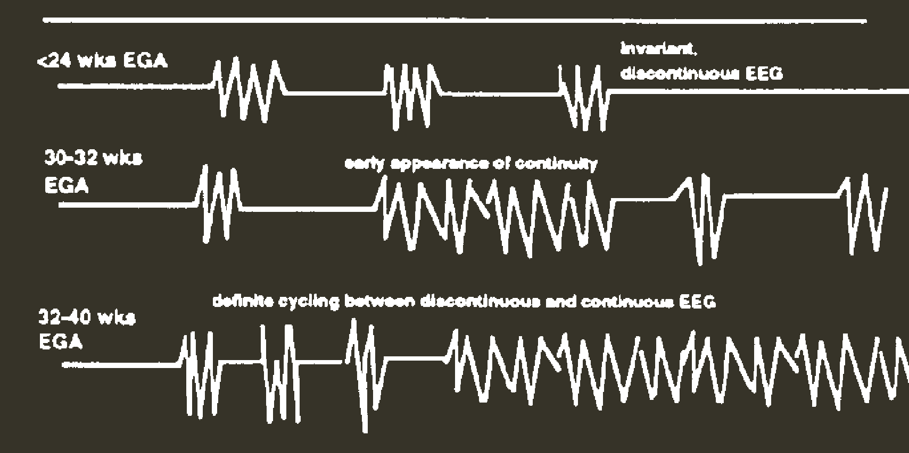
Behavioral Cycling and EEG Changes During Development
EGA = embrionic gestational age
Kellway P and Crawley JW. A primer of Electroencephalography of Infants,
Section I and II: Methodology and Criteria of Normality. Baylor University College
of Medicine, Houston, Texas 1964.

Slide 29
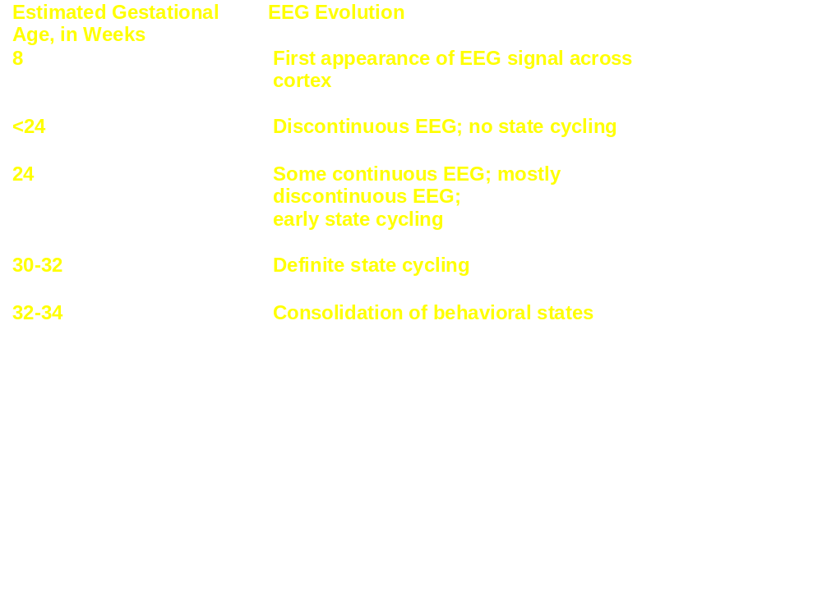
EEG Change During Development
EEG Evolution and Early Cortical Development
Kellway P and Crawley JW. A primer of Electroencephalography of Infants,
Section I and II: Methodology and Criteria of Normality. Baylor University College
of Medicine, Houston, Texas 1964.

Slide 30
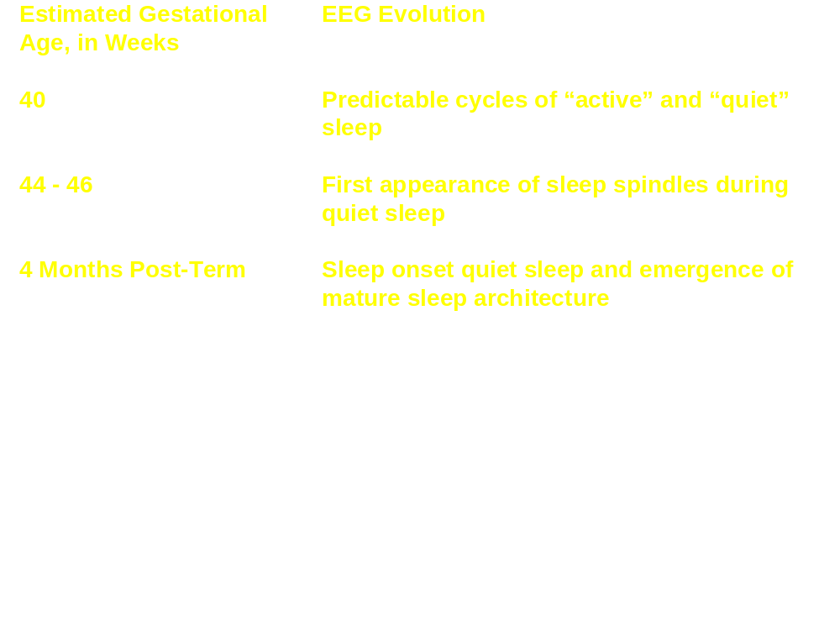
EEG Change During Development (cont.)
EEG Evolution and Early Cortical Development
Kellway P and Crawley JW. A primer of Electroencephalography of Infants,
Section I and II: Methodology and Criteria of Normality. Baylor University College
of Medicine, Houston, Texas 1964.

