Slide 1
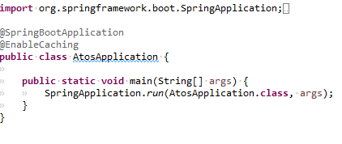
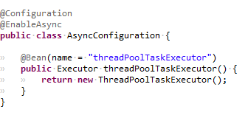
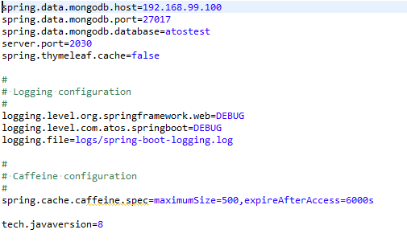
Spring Boot Basics
Automatically configure Spring whenever possible
Absolutely no code generation and no requirement for XML configuration
Create stand-alone Spring applications
Embed Tomcat, Jetty or Undertow directly (no need to deploy WAR files)

Slide 2


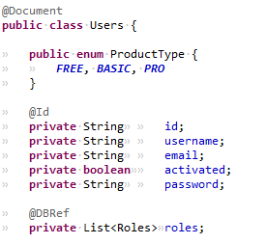
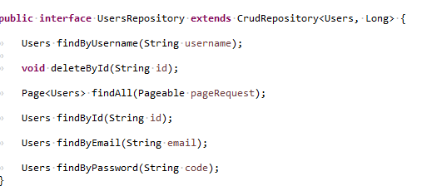
Spring Data Configuration(MongoDB)

Slide 3





Spring Boot Cache

Slide 4
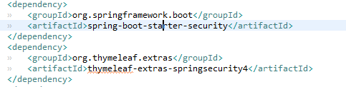
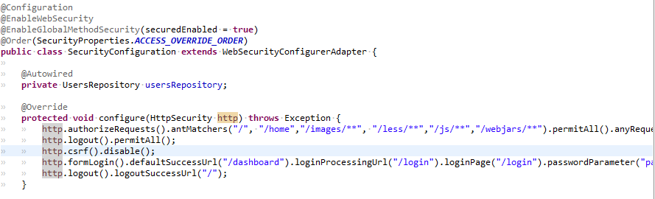
Spring Security Configuration

Slide 5

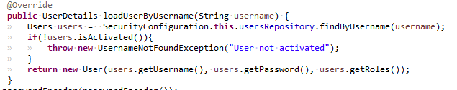
Enable method security.
Order ACCESS_OVERRIDE_ORDER

Slide 6

Spring security Thymeleaf Configuration

Slide 7
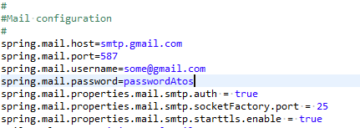


Spring Boot Email Configuration
http://docs.spring.io/spring-boot/docs/current/reference/html/boot-features-email.html

Slide 8

Spring Boot Thymeleaf
http://www.thymeleaf.org/doc/articles/layouts.html

Slide 9

Webjars

Slide 10

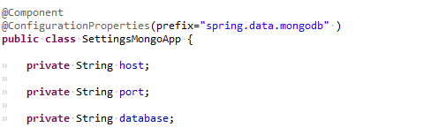
Spring boot Properties File
https://docs.spring.io/spring-boot/docs/current/reference/html/boot-features-external-config.html

Slide 11
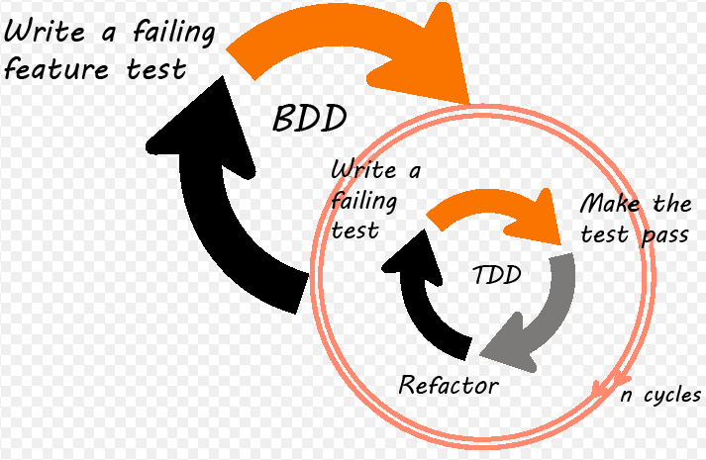
TDD/BDD/CI Pipeline

Slide 12
TDD Test Driven Development
Life-cycle
Write a test
Run the test. (No implementation, test failing)
Write enought code to make test pass.
Run tests
Refactor
Repeat

Slide 13

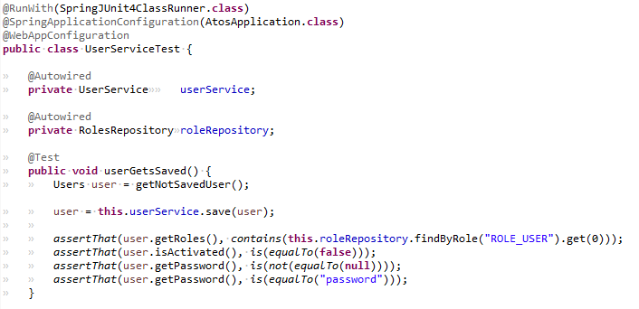
Example TDD test

Slide 14
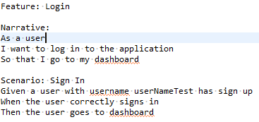
BDD Jbehave with Spring Boot

Slide 15

Spring MockMvc

Slide 16


Spring Boot Integration tests

