Slide 1
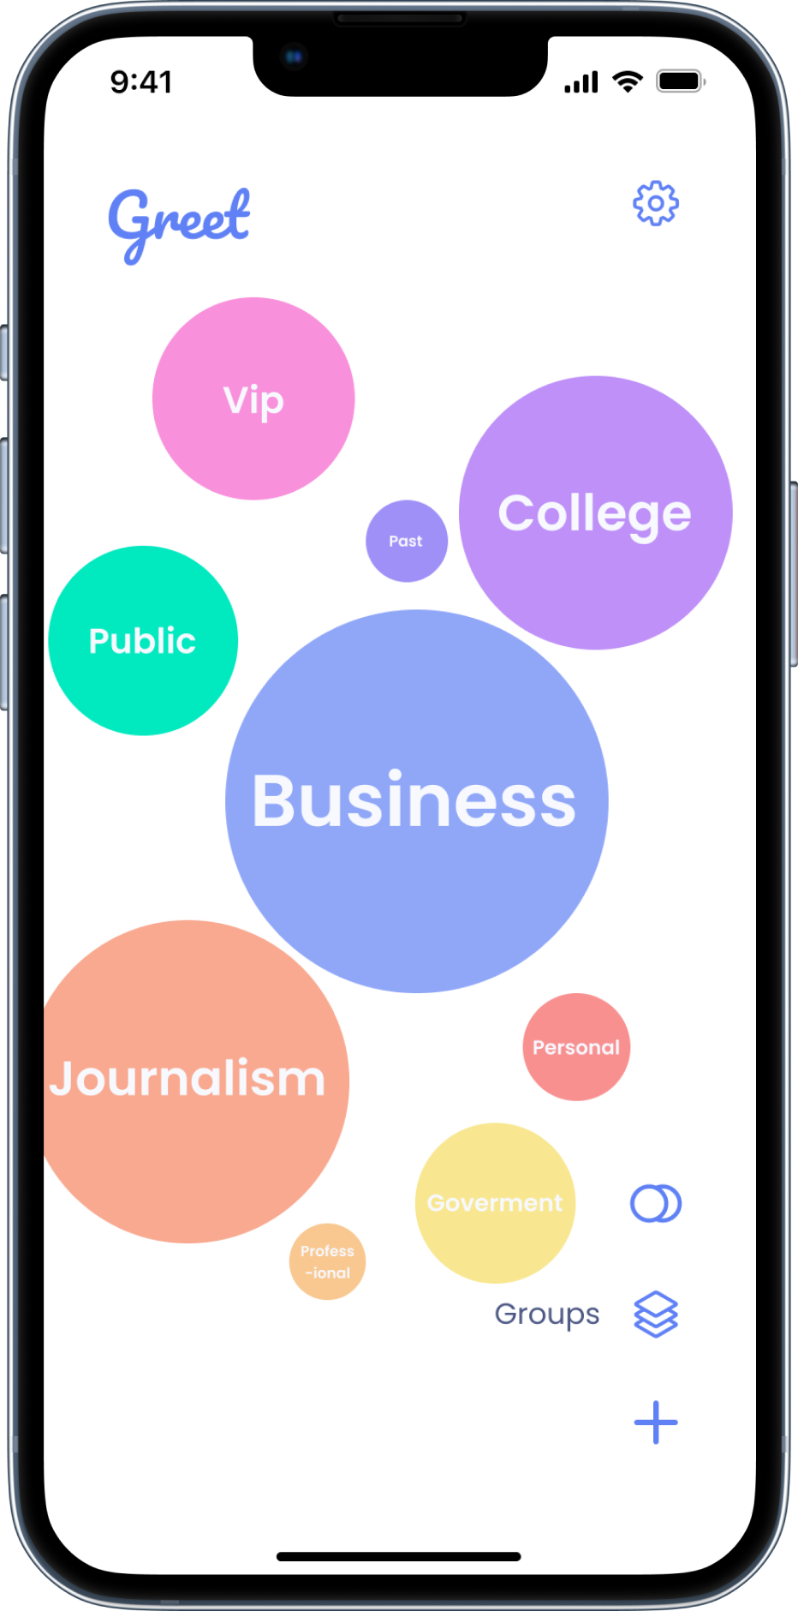
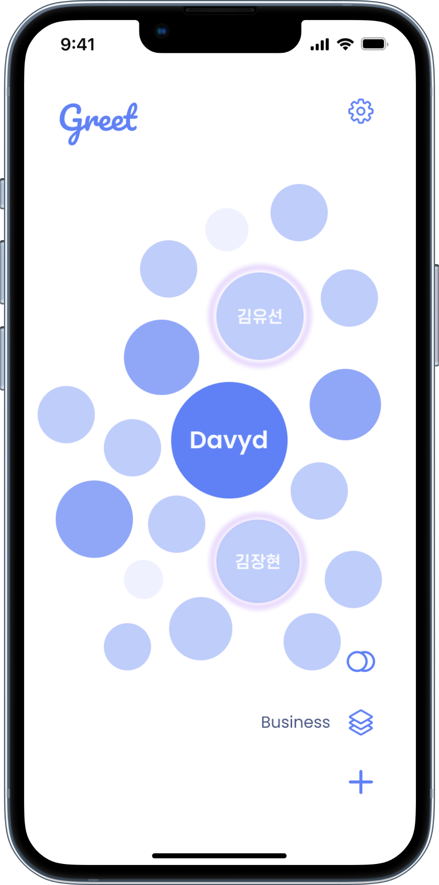
Product
“Smart categorization with intuitive people-first search”
Yoosun

