Slide 1
Chapter 12: COINTEGRATION
Main article: Engle-Granger(1987-Econometrica) – “Co-Integration and Error Correction: Representation, Estimation, and Testing “
VAR: it is good to describe short-run relationship (Stationary Variables or VAR on first difference), but many economic variables are not stationary.
By taking the first difference we lose important information (we are modeling the growth rate, not the level of the time series. If the variables are cointegrated and we run a regression in differences, then the model is misspecified and the results will be biased.
COINTEGRATION: a way of modeling long-run relationship between integrated variables in their level. The series “move together” over time. A linear long-term relationship combination of them will be stationary.
HOW? By modeling the difference between those integrated variables: Error Correction Mechanism (ECM).

Slide 2
A simple way to understand cointegration
A drunk and her dog behavior:
Here we are assuming that a drunk follows a random walk path (integrated of order 1);
Her dog (unleashed) may follow her (same path, also integrated of order 1).
The distance between them will be relatively stable (due their relationship): the barking and calling are what we call “error correction mechanism”: whenever they tend to diverge, they will come close again (converge). The drunk and her dog have a “common stochastic trend”.
In the short-run some “forces” move the variables out of equilibrium, but there will be forces that push ten back to their long-run equilibrium.
Testing for cointegration is a way of checking if what the Theory predicts is consistent with the data.
We have discussed “spurious regression”, when 2 integrated variables that are not related, if we regress one against the other, we will find significant correlation between them, so, this is spurious.
However, when two variables are cointegrated of order 1, the difference between them will be stationary and we can use this difference to apply time series techniques that we have learn so far.

Slide 3
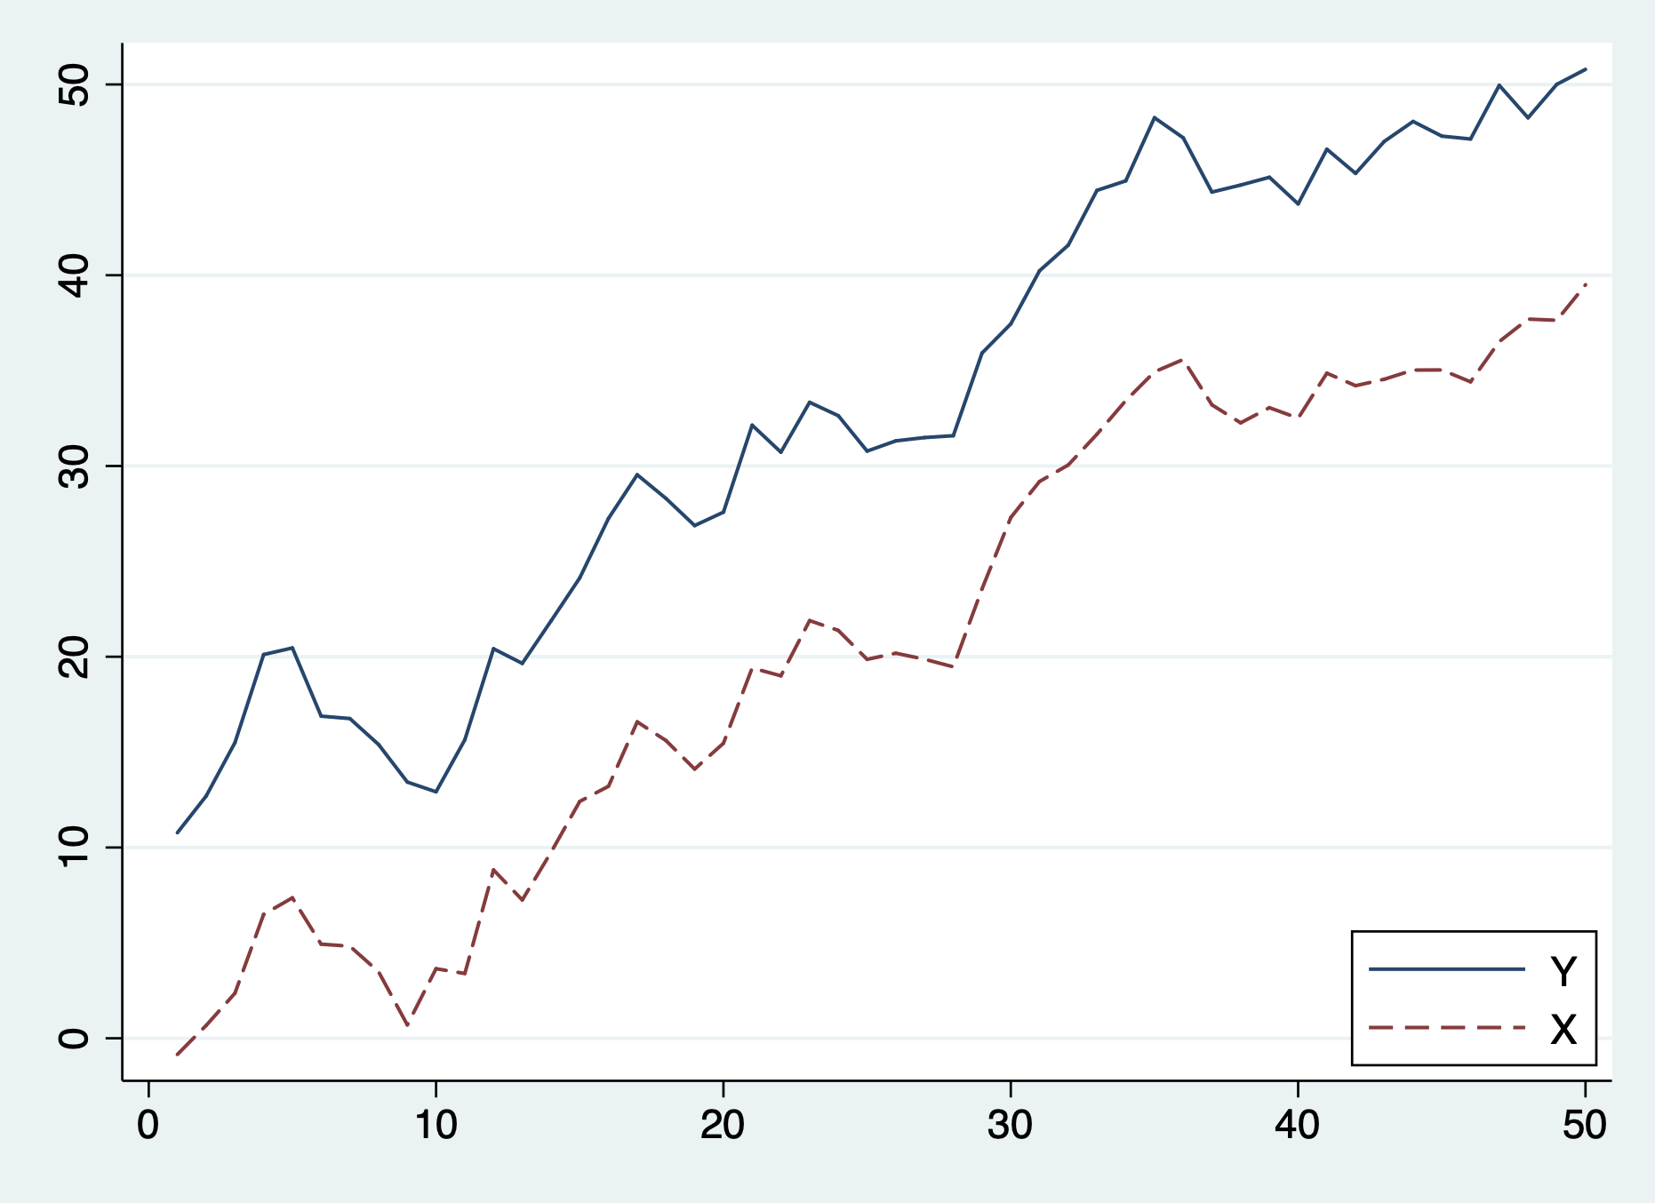
Their path: Y is the drunk; X is her dog: we may not know where they will go as a pair (due the fact that their trend is stochastic), but they will be close to each other: cointegrated.

Slide 4
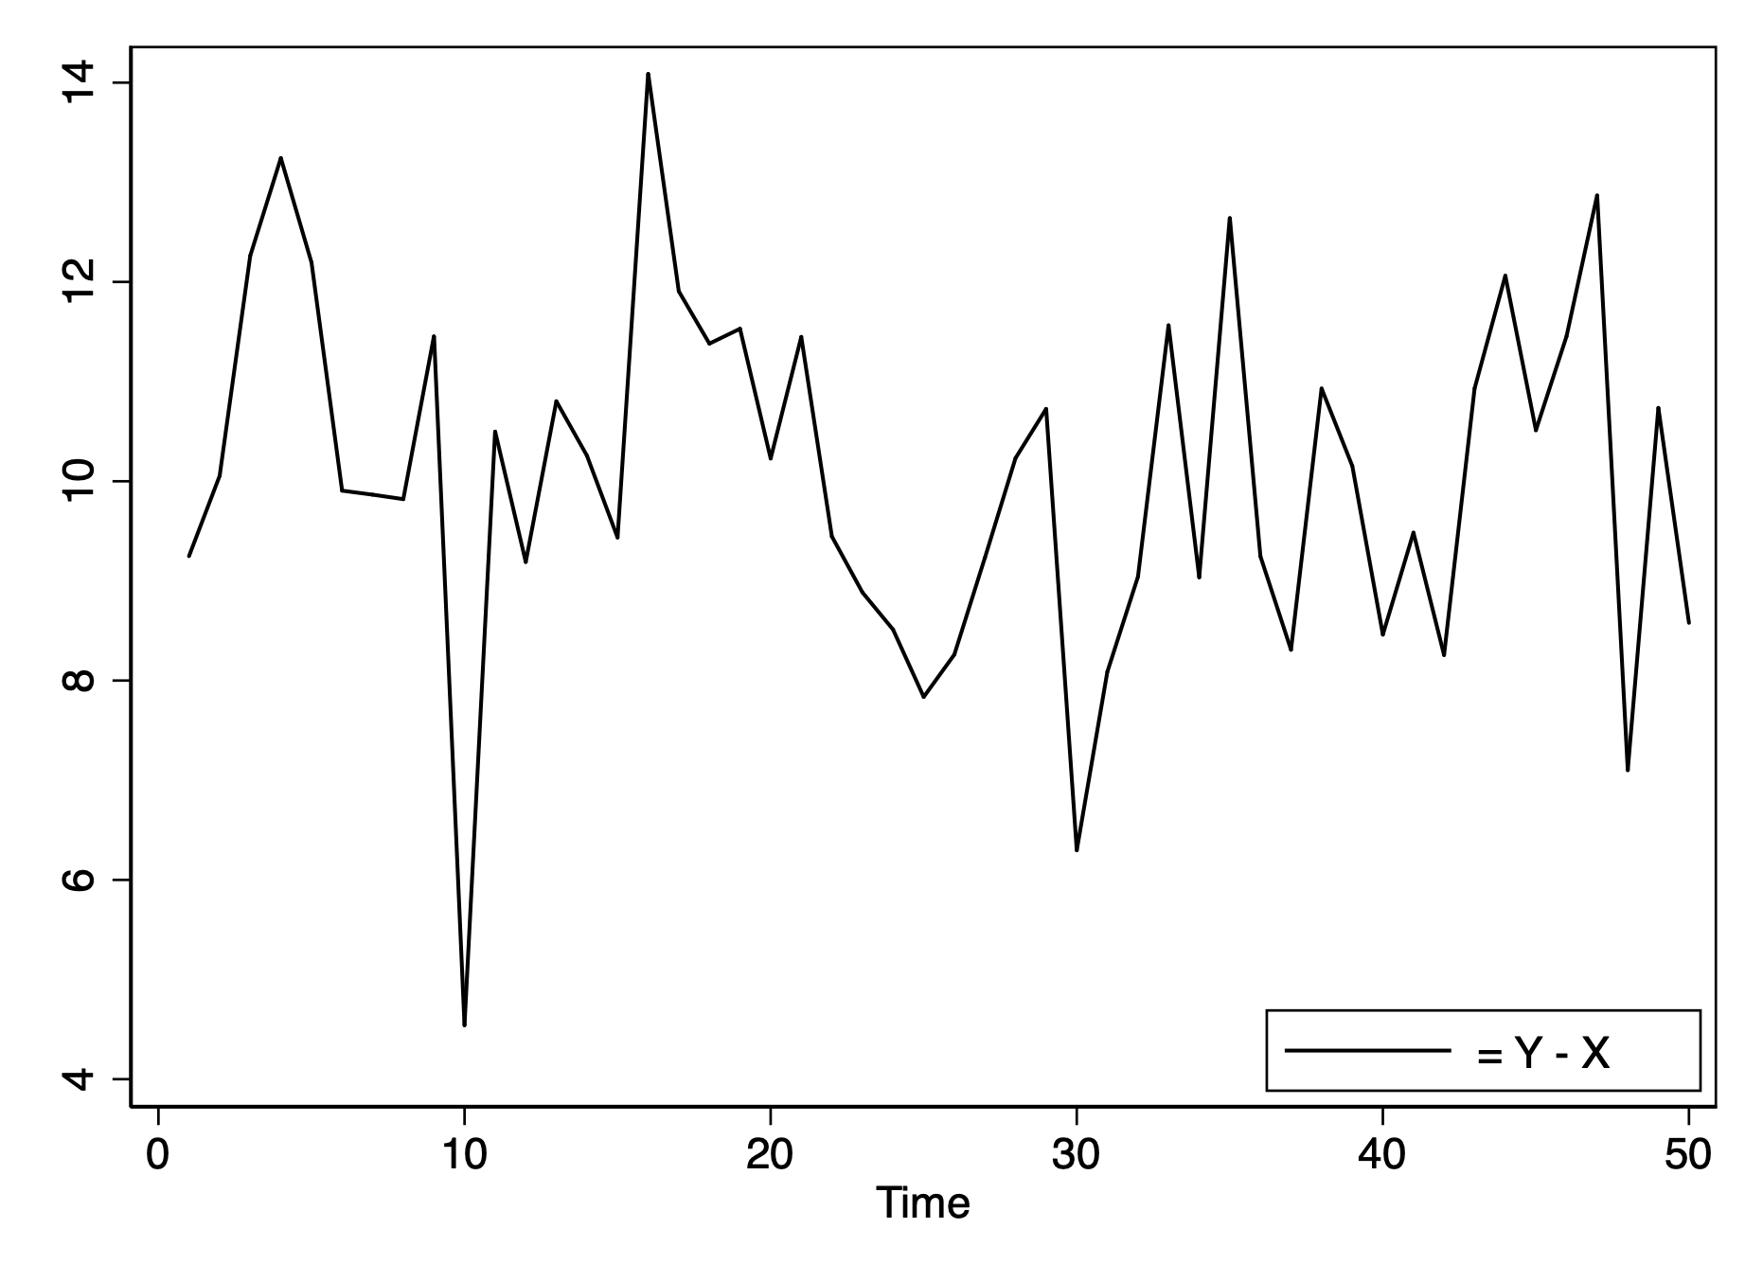
The distance between them is stationary

Slide 5
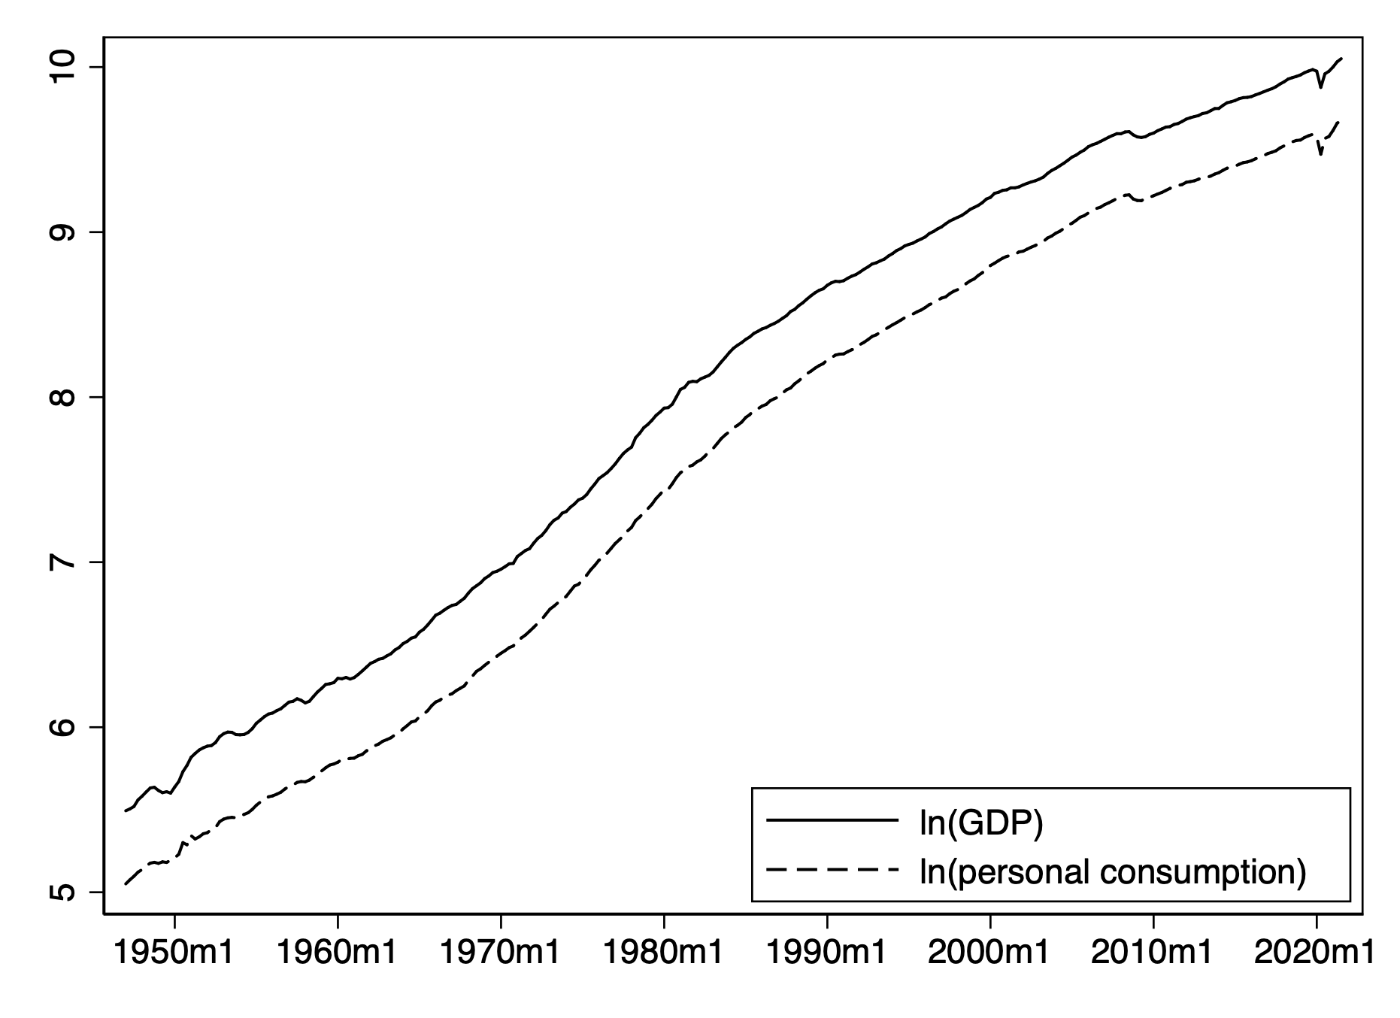
Example of Cointegrated series: GDP and Personal Consumption

Slide 6
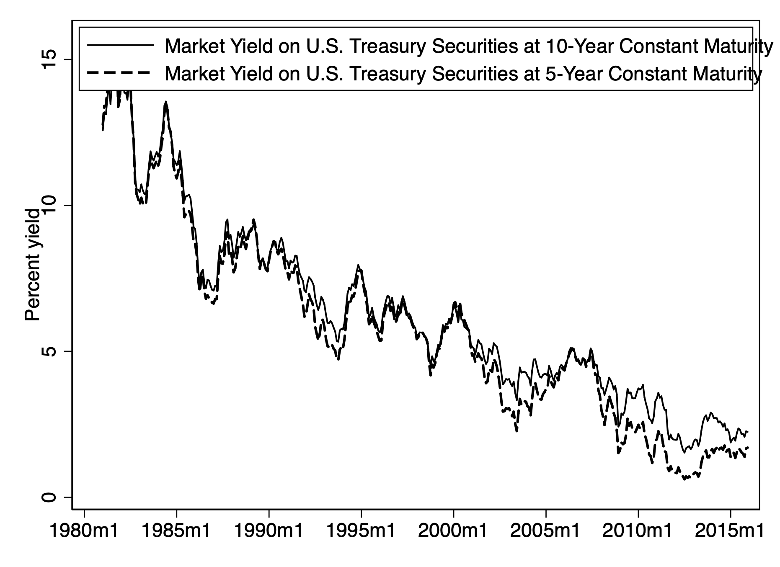
Example of Cointegrated series: Short-term and long-term interest rates

Slide 7
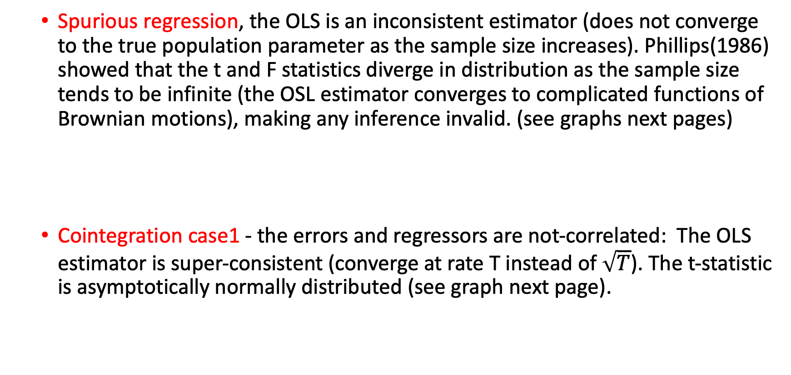
Spurious Regression and Cointegration
Spurious regression, the OLS is an inconsistent estimator (does not converge to the true population parameter as the sample size increases). Phillips(1986) showed that the t and F statistics diverge in distribution as the sample size tends to be infinite (the OSL estimator converges to complicated functions of Brownian motions), making any inference invalid. (see graphs next pages)
Cointegration case1 - the errors and regressors are not-correlated: The OLS estimator is super-consistent (converge at rate T instead of $\sqrt{T}$). The t-statistic is asymptotically normally distributed (see graph next page).

Slide 8
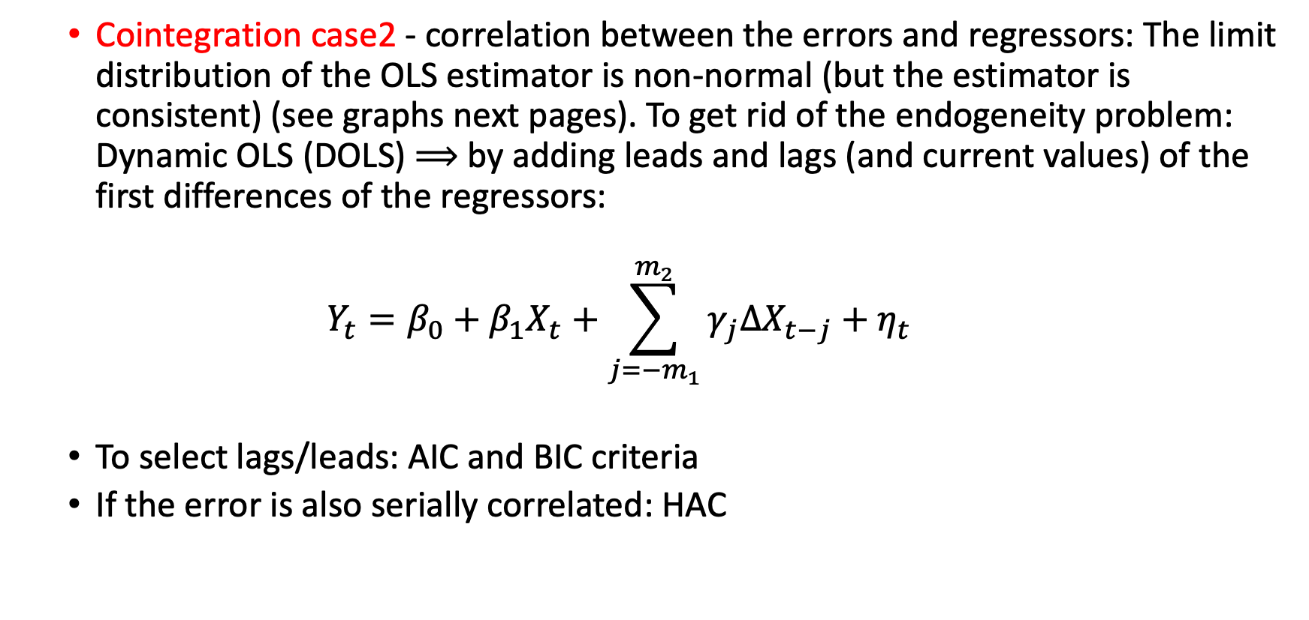
Spurious Regression and Cointegration
Cointegration case2 - correlation between the errors and regressors: The limit distribution of the OLS estimator is non-normal (but the estimator is consistent) (see graphs next pages). To get rid of the endogeneity problem: Dynamic OLS (DOLS) $⟹$ by adding leads and lags (and current values) of the first differences of the regressors:
$$Y_{t}=β_{0}+β_{1}X_{t}+\sum_{j=−m_{1}}^{m_{2}}{γ_{j}ΔX_{t−j}}+η_{t}$$
To select lags/leads: AIC and BIC criteria
If the error is also serially correlated: HAC

Slide 9
Spurious Regression and Cointegration case 1

Slide 10
Cointegration: case 2

Slide 11
ERROR CORRECTION MECHANISM
IF X and Y are COINTEGRATED: we can regress Y against X (or X against Y), and this relation is not spurious. The linear combination annihilates the stochastic trends. The I(1) series are attracted to each other in the long run (we will see how it works: Error correction mechanism)
However, we may have temporary divergencies (short-term disequilibrium): the error measures the extent to which the system is out of equilibrium.

Slide 12
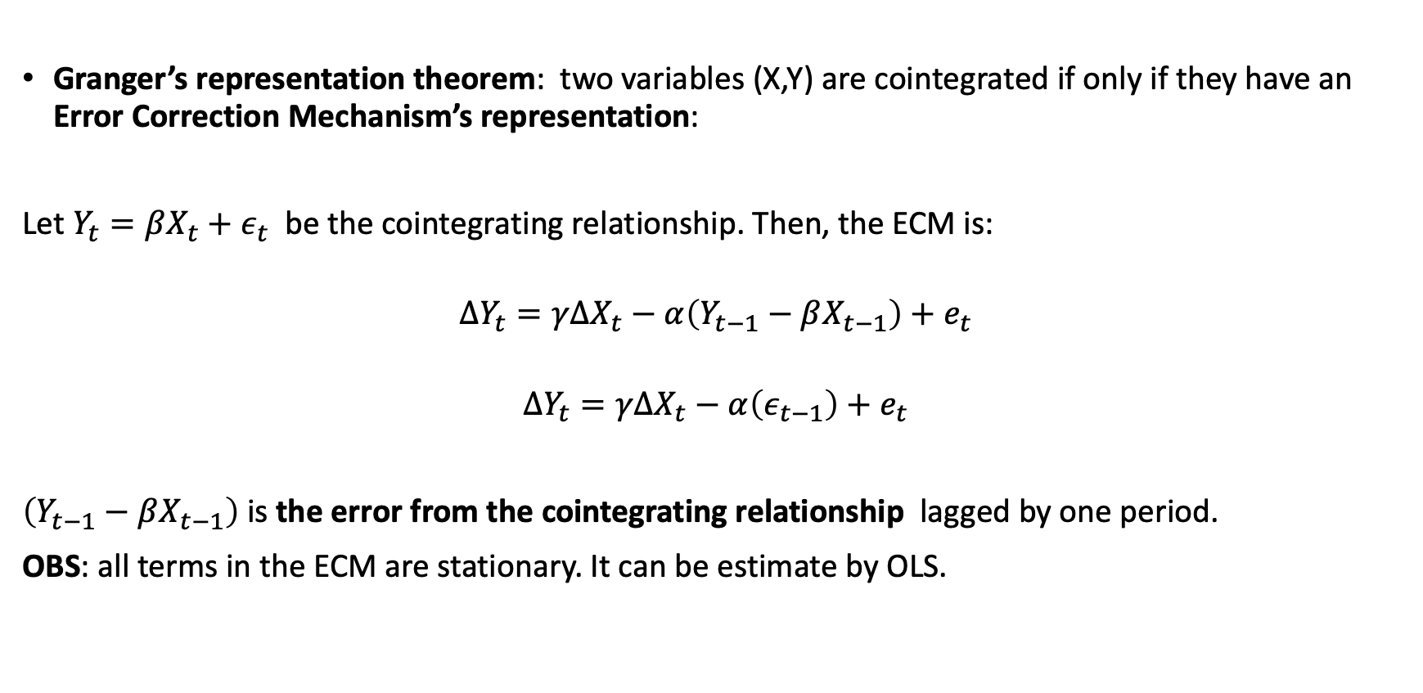
ERROR CORRECTION MECHANISM
Granger’s representation theorem: two variables (X,Y) are cointegrated if only if they have an Error Correction Mechanism’s representation:
Let $Y_{t}=βX_{t}+ε_{t}$ be the cointegrating relationship. Then, the ECM is:
$${ΔY}_{t}=γΔX_{t}−α\left(Y_{t−1}−βX_{t−1}\right)+e_{t}$$
$${ΔY}_{t}=γΔX_{t}−α\left(ε_{t−1}\right)+e_{t}$$
$\left(Y_{t−1}−βX_{t−1}\right)$ is the error from the cointegrating relationship lagged by one period.
OBS: all terms in the ECM are stationary. It can be estimate by OLS.

Slide 13
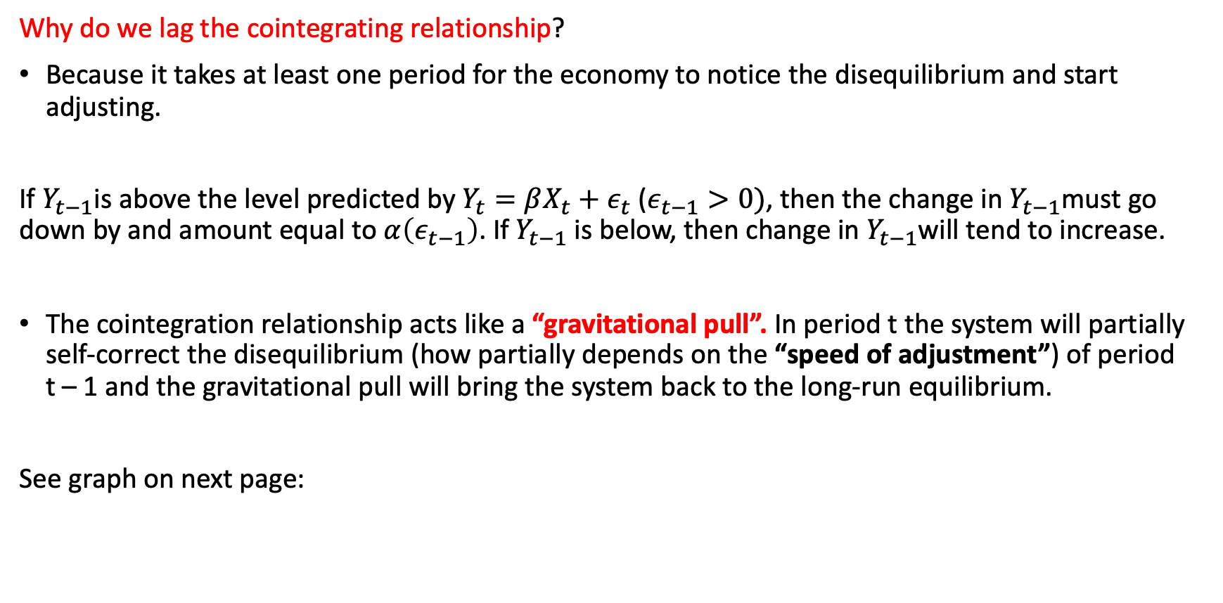
ERROR CORRECTION MECHANISM
Why do we lag the cointegrating relationship?
Because it takes at least one period for the economy to notice the disequilibrium and start adjusting.
If $Y_{t−1}$is above the level predicted by $Y_{t}=βX_{t}+ε_{t}$ ($ε_{t−1}>0)$, then the change in $Y_{t−1}$must go down by and amount equal to $α\left(ε_{t−1}\right)$. If $Y_{t−1}$ is below, then change in $Y_{t−1}$will tend to increase.
The cointegration relationship acts like a “gravitational pull”. In period t the system will partially self-correct the disequilibrium (how partially depends on the “speed of adjustment”) of period t – 1 and the gravitational pull will bring the system back to the long-run equilibrium.
See graph on next page:

Slide 14
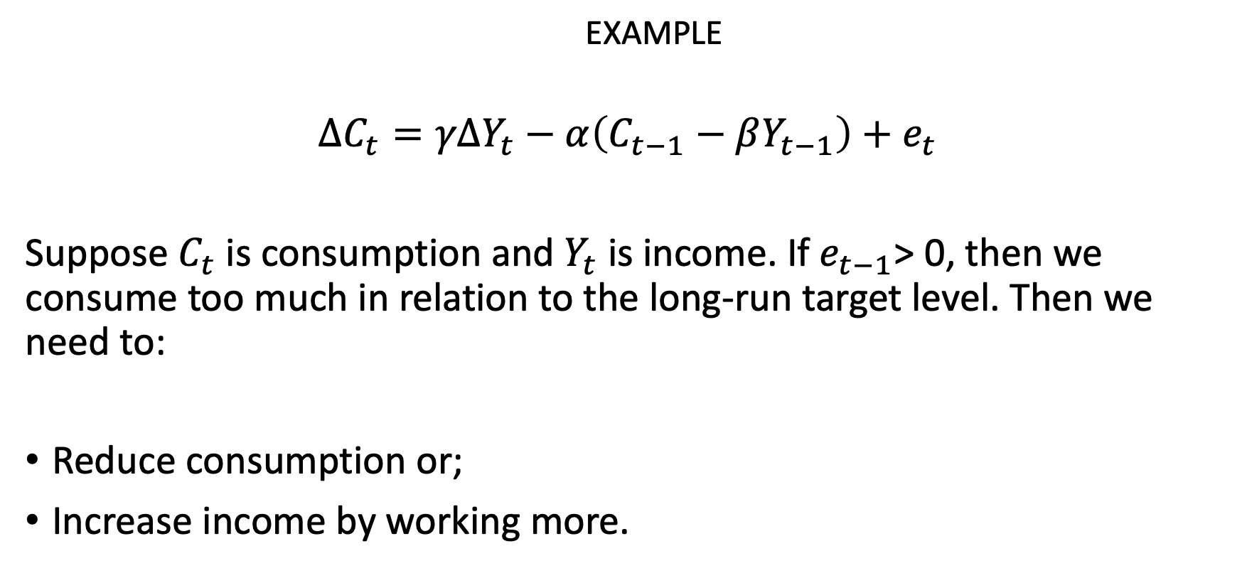
EXAMPLE
$${ΔC}_{t}=γΔY_{t}−α\left(C_{t−1}−βY_{t−1}\right)+e_{t}$$
Suppose $C_{t}$ is consumption and $Y_{t}$ is income. If $e_{t−1}$> 0, then we consume too much in relation to the long-run target level. Then we need to:
Reduce consumption or;
Increase income by working more.

Slide 15
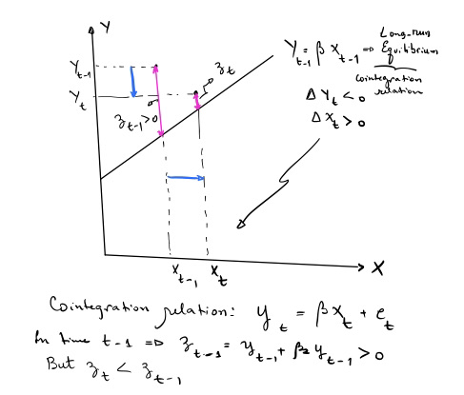

Slide 16
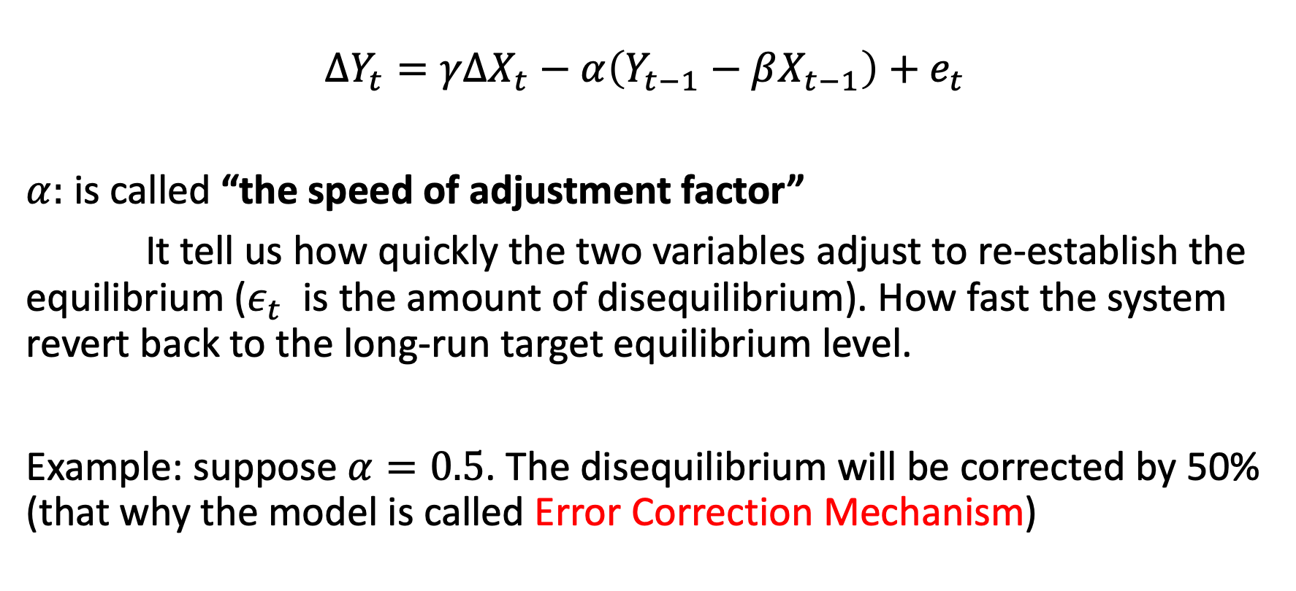
The Speed of Adjustment Factor
$${ΔY}_{t}=γΔX_{t}−α\left(Y_{t−1}−βX_{t−1}\right)+e_{t}$$
$α:$ is called “the speed of adjustment factor”
It tell us how quickly the two variables adjust to re-establish the equilibrium ($ε_{t}$ is the amount of disequilibrium). How fast the system revert back to the long-run target equilibrium level.
Example: suppose $α=0.5$. The disequilibrium will be corrected by 50% (that why the model is called Error Correction Mechanism)

Slide 17
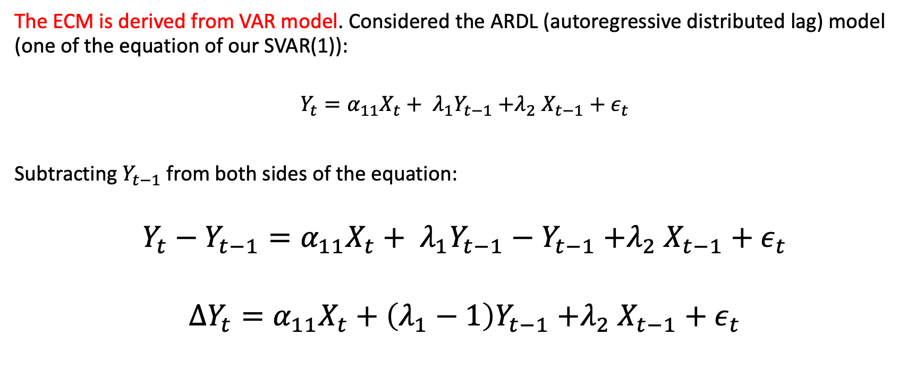
Deriving the ECM
The ECM is derived from VAR model. Considered the ARDL (autoregressive distributed lag) model (one of the equation of our SVAR(1)):
$$Y_{t}={α_{11}X_{t}+ λ}_{1}Y_{t−1}{+λ}_{2}X_{t−1}+ε_{t}$$
Subtracting $Y_{t−1}$ from both sides of the equation:
$$Y_{t}−Y_{t−1}={α_{11}X_{t}+ λ}_{1}Y_{t−1}−Y_{t−1}{+λ}_{2}X_{t−1}+ε_{t}$$
$${ΔY}_{t}=α_{11}X_{t}+{\left(λ_{1}−1\right)Y}_{t−1}{+λ}_{2}X_{t−1}+ε_{t}$$

Slide 18
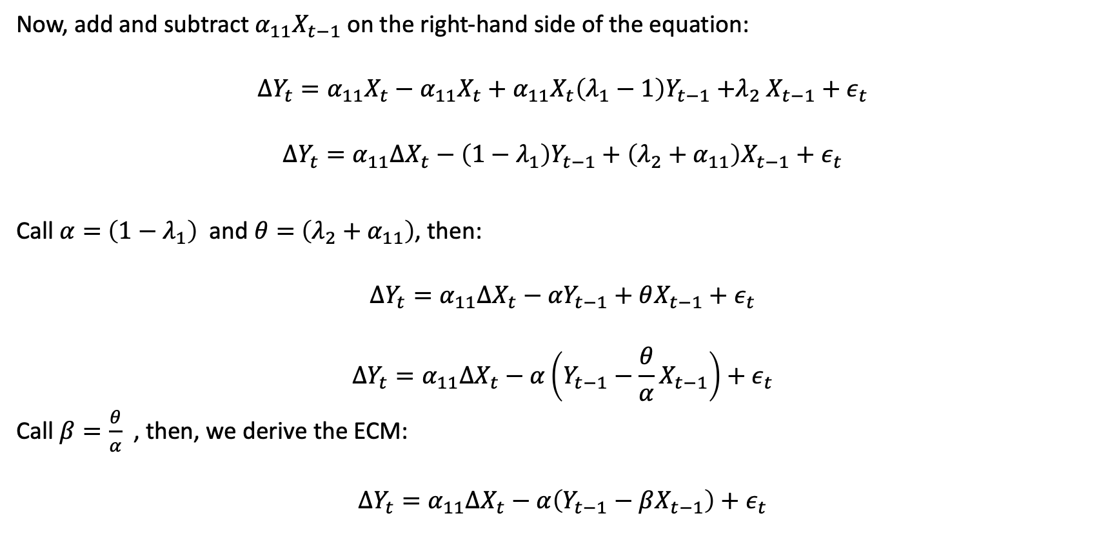
Deriving the ECM
Now, add and subtract $α_{11}X_{t−1}$on the right-hand side of the equation:
$${ΔY}_{t}=α_{11}X_{t}−α_{11}X_{t}+α_{11}X_{t}{\left(λ_{1}−1\right)Y}_{t−1}{+λ}_{2}X_{t−1}+ε_{t}$$
$${ΔY}_{t}=α_{11}ΔX_{t}−{\left({1−λ}_{1}\right)Y}_{t−1}+\left(λ_{2}+α_{11}\right)X_{t−1}+ε_{t}$$
Call $α=$ $\left({1−λ}_{1}\right)$ and $θ=$ $\left(λ_{2}+α_{11}\right)$, then:
$${ΔY}_{t}=α_{11}ΔX_{t}−{αY}_{t−1}+θX_{t−1}+ε_{t}$$
$${ΔY}_{t}=α_{11}ΔX_{t}−α\left(Y_{t−1}−\frac{θ}{α}X_{t−1}\right)+ε_{t}$$
Call $β=\frac{θ}{α}$ , then, we derive the ECM:
$${ΔY}_{t}=α_{11}ΔX_{t}−α\left(Y_{t−1}−βX_{t−1}\right)+ε_{t}$$

Slide 19
Engle and Granger’s (E-G) Residual Tests of Cointegration
Our question: How do we test if two variable are cointegrated?
Definition: to be cointegrated, the variables have to be integrated of the same order (d) and a linear combination of them have to be integrated of a lower order (d-1). If X and Y are I(1), then their linear combination have to be stationary (or I(0)).

Slide 20
Engle and Granger’s Residual Tests of Cointegration
Two step procedure:
Test for unit root on each series (check if it is I(1)) (ADF, PP tests, UN with breaks, for example); if you cannot reject the null hypothesis, then got to step 2.
Regress Y on X and estimate the residuals;
Test whether the estimated residuals are I(0); do no include the constant on the unit root test.
Critical values for the unit test on the residuals differ from the ADF critical values. The STATA command egranger will run the unit root test on the residual and compute the correct critical values.
You will need to install this command:
Type on STATA command windows:
ssc install egranger

Slide 21
Engle-Granger approach example
clear all
set obs 50
set seed 4321
gen time = _n
tsset time
gen ex = rnormal(0,2)
gen ey = rnormal(0,2)
gen X = ex in 1
replace X = 1.0 + L.X + ex in 2/L
gen Y = 10 + X + ey
* Are X and Y I(1)?
dfuller X, drift
dfuller Y, drift
dfuller D.X
dfuller D.Y
* Estimate the long-run relationship, and extract the residuals
reg Y X
predict ehat, residuals
dfuller ehat, nocons

Slide 22
The Unit Root commands on STATA would give us the right test statistics, but the wrong critical values.
* We need to use MacKinnon critical values.
MacKinnon (2010) critical values
* Using the tables, two variables, n=49, p=0.05, and a constant:
di -3.33613 + (-6.1101)/49 + (-6.823)/(49^2)
*or
egranger Y X, regress
* Estimate the ECM
reg D.Y D.X L.ehat

Slide 23
Critics to the two-step E-G approach
Who cause who: Which variable should we include on the left-hand side of the regression equation? Y or X? It can lead to contradictory results.
E-G approach works well when we have only one cointegrating vector. It is not appropriated to test for cointegration between more than two variables.
Johansen’s procedure allows to test for cointegration among more than 2 variables. It is base on VAR(p) model in level. It put together the short-term predictive power of VARs with the long-term predictive power of ECMs:
The multi-equation VECM (Vector Error Correction Mechanism) approach.

Slide 24
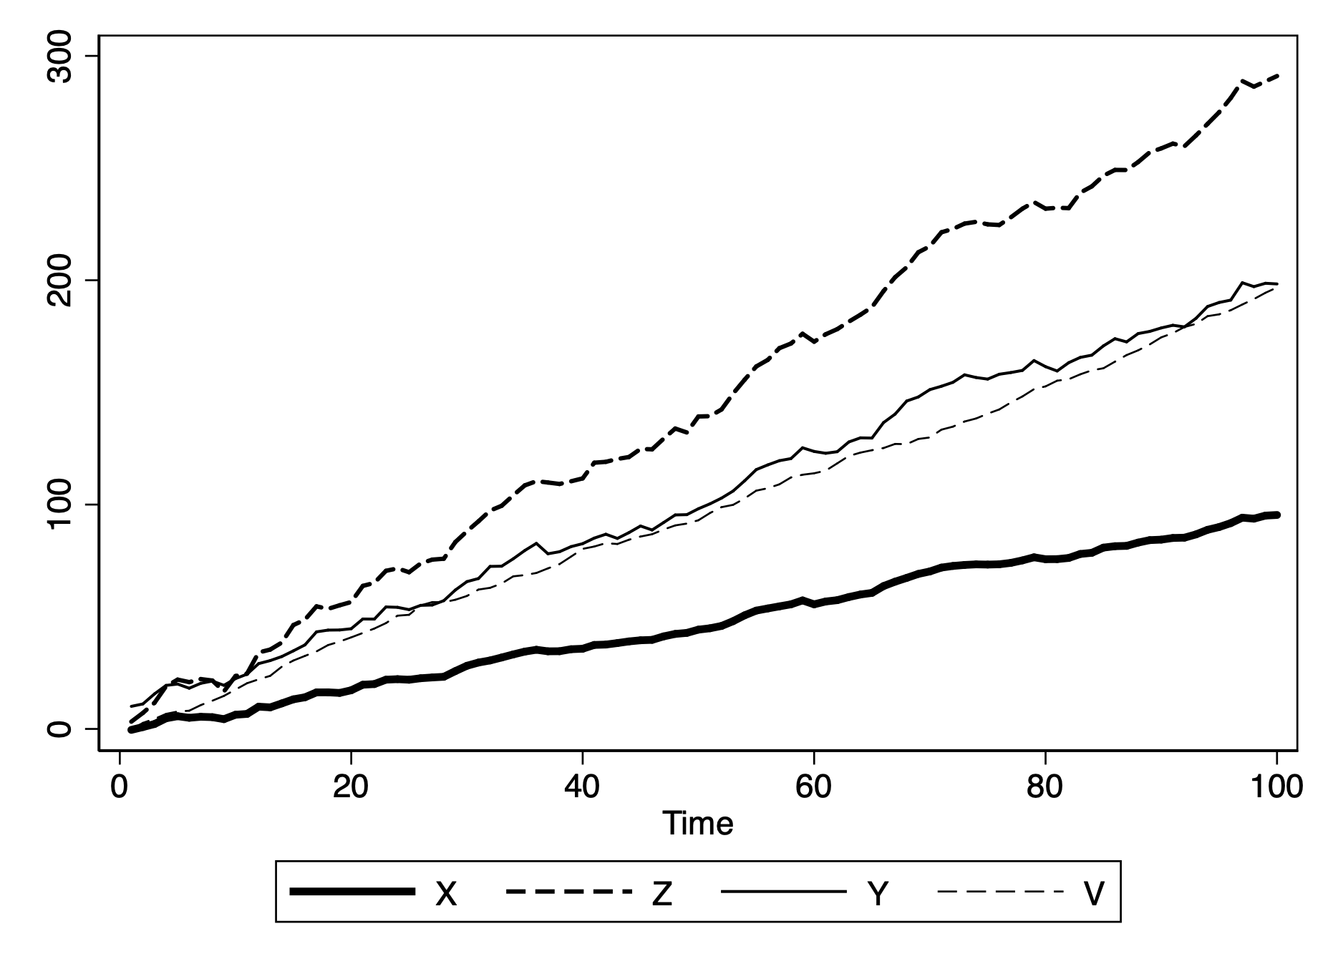
3-cointegrated series (X, Y, and Z); V is not

Slide 25
Johansen Tests (1988)
It extend the E-G to a multivariate VAR model.
The VAR is transformed to a VECM when there are cointegrating relations
Two main tests:
Trace test;
Maximum Eigenvalues test.

Slide 26
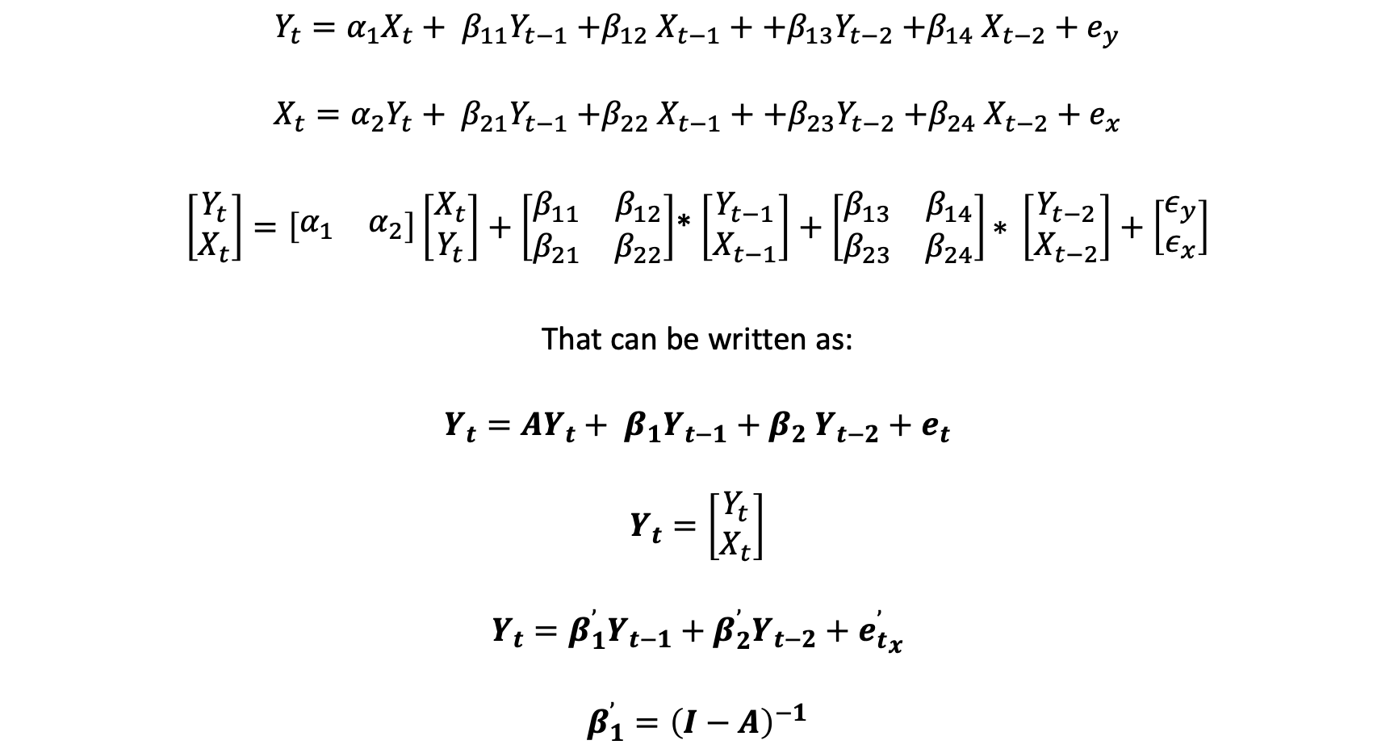
Deriving the VECM from a Simple SVAR(2) model
$$Y_{t}={α_{1}X_{t}+ β}_{11}Y_{t−1}{+β}_{12}X_{t−1}+{{+β}_{13}Y}_{t−2}{+β}_{14}X_{t−2}+e_{y}$$
$$X_{t}={α_{2}Y_{t}+ β}_{21}Y_{t−1}{+β}_{22}X_{t−1}+{{+β}_{23}Y}_{t−2}{+β}_{24}X_{t−2}+e_{x}$$
$\left[\begin{matrix}Y_{t} \\ X_{t}\end{matrix}\right]=\left[\begin{matrix}α_{1} & α_{2}\end{matrix}\right]\left[\begin{matrix}X_{t} \\ Y_{t}\end{matrix}\right]+\left[\begin{matrix}β_{11} & β_{12} \\ β_{21} & β_{22}\end{matrix}\right]$* $\left[\begin{matrix}Y_{t−1} \\ X_{t−1}\end{matrix}\right]+\left[\begin{matrix}β_{13} & β_{14} \\ β_{23} & β_{24}\end{matrix}\right]\text{∗} \left[\begin{matrix}Y_{t−2} \\ X_{t−2}\end{matrix}\right]+\left[\begin{matrix}ε_{y} \\ ε_{x}\end{matrix}\right]$
That can be written as:
$$Y_{t}={AY_{t}+ β}_{1}Y_{t−1}{+ β}_{2}Y_{t−2}+e_{t}$$
$$Y_{t}=\left[\begin{matrix}Y_{t} \\ X_{t}\end{matrix}\right]$$
$$Y_{t}={β_{1}^{’}Y}_{t−1}+{β_{2}^{’}Y}_{t−2}+{e_{t}^{’}}_{x}$$
$$β_{1}^{’}={\left(I−A\right)}^{−1}$$

Slide 27
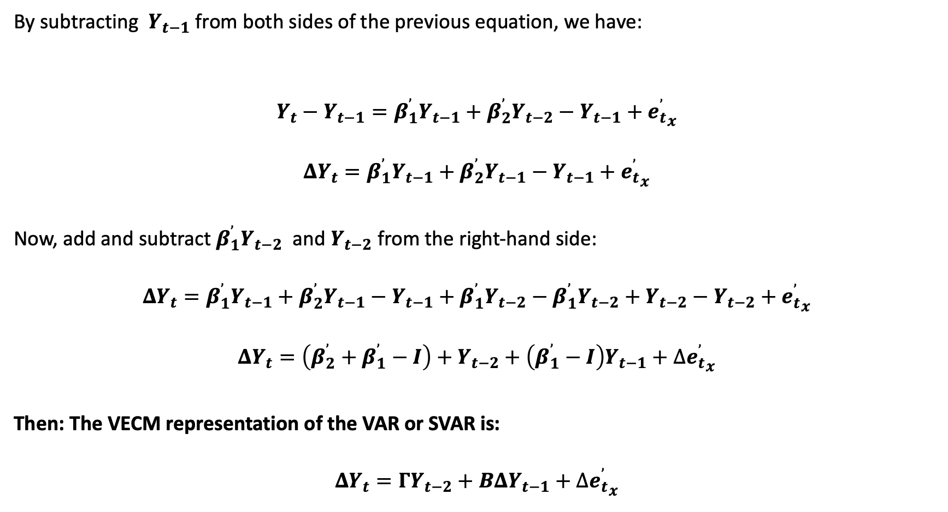
Deriving the VECM from a Simple VAR(2) model
By subtracting $Y_{t−1}$ from both sides of the previous equation, we have:
$$Y_{t}−Y_{t−1}={β_{1}^{’}Y}_{t−1}+{β_{2}^{’}Y}_{t−2}−Y_{t−1}+{e_{t}^{’}}_{x}$$
$$ΔY_{t}={β_{1}^{’}Y}_{t−1}+{β_{2}^{’}Y}_{t−1}−Y_{t−1}+{e_{t}^{’}}_{x}$$
Now, add and subtract${ β}_{1}^{’}Y_{t−2}$ and $Y_{t−2}$ from the right-hand side:
$$ΔY_{t}={β_{1}^{’}Y}_{t−1}+{β_{2}^{’}Y}_{t−1}−Y_{t−1}+β_{1}^{’}Y_{t−2}−β_{1}^{’}Y_{t−2}+Y_{t−2}−Y_{t−2}+{e_{t}^{’}}_{x}$$
$$ΔY_{t}=\left(β_{2}^{’}+β_{1}^{’}−I\right)+Y_{t−2}+\left(β_{1}^{’}−I\right)Y_{t−1}+∆{e_{t}^{’}}_{x}$$
Then: The VECM representation of the VAR or SVAR is:
$$ΔY_{t}=ΓY_{t−2}+B{ΔY}_{t−1}+∆{e_{t}^{’}}_{x}$$

Slide 28
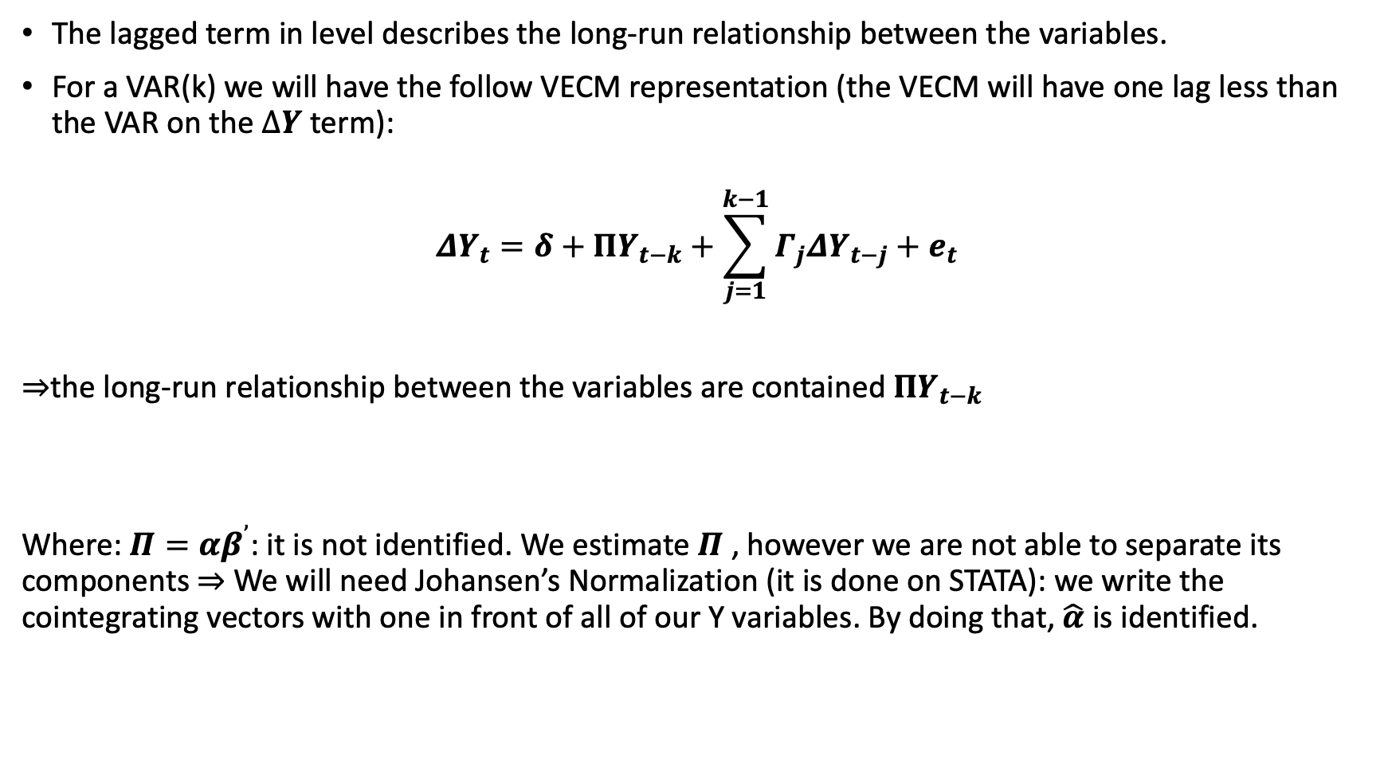
The lagged term in level describes the long-run relationship between the variables.
For a VAR(k) we will have the follow VECM representation (the VECM will have one lag less than the VAR on the $ΔY$ term):
$${ΔY}_{t}=δ+ΠY_{t−k}+\sum_{j=1}^{k−1}{Γ_{j}ΔY_{t−j}}+e_{t}$$
$⇒$the long-run relationship between the variables are contained $ΠY_{t−k}$
Where: $Π=αβ^{’}$: it is not identified. We estimate $Π$ , however we are not able to separate its components $⇒$ We will need Johansen’s Normalization (it is done on STATA): we write the cointegrating vectors with one in front of all of our Y variables. By doing that, $\hat{α}$ is identified.

Slide 29
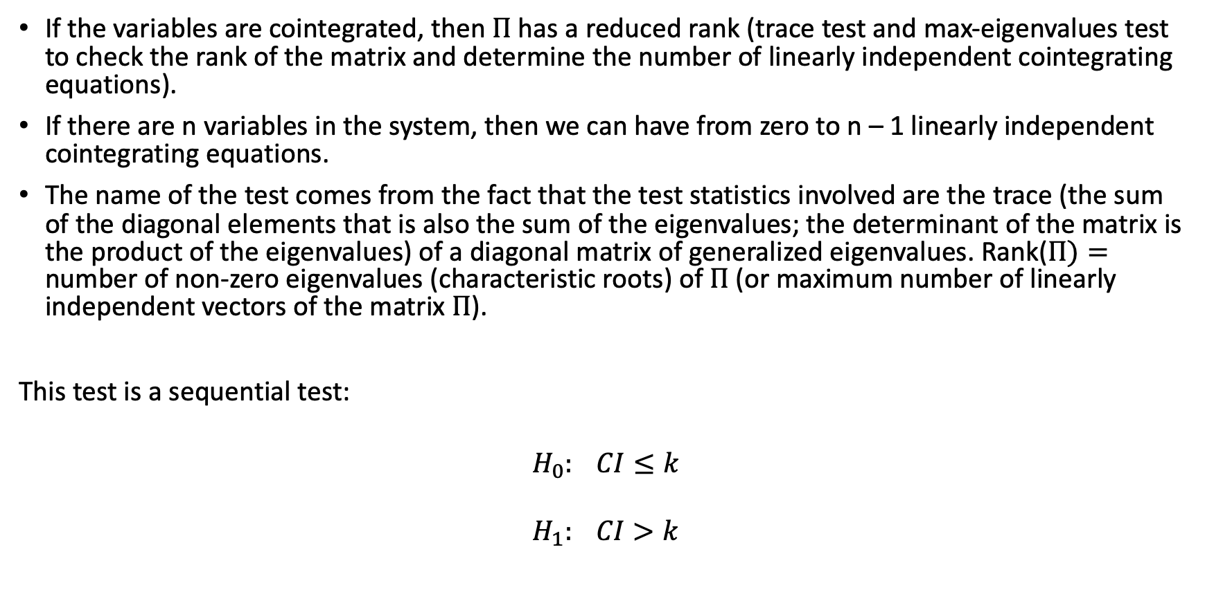
Johansen’s Trace Test and the Rank of $Π$
If the variables are cointegrated, then $Π$ has a reduced rank (trace test and max-eigenvalues test to check the rank of the matrix and determine the number of linearly independent cointegrating equations).
If there are n variables in the system, then we can have from zero to n – 1 linearly independent cointegrating equations.
The name of the test comes from the fact that the test statistics involved are the trace (the sum of the diagonal elements that is also the sum of the eigenvalues; the determinant of the matrix is the product of the eigenvalues) of a diagonal matrix of generalized eigenvalues. Rank($Π)=$ number of non-zero eigenvalues (characteristic roots) of $Π$ (or maximum number of linearly independent vectors of the matrix $Π$).
This test is a sequential test:
$$H_{0}: CI≤k$$
$$H_{1}: CI>k$$

Slide 30
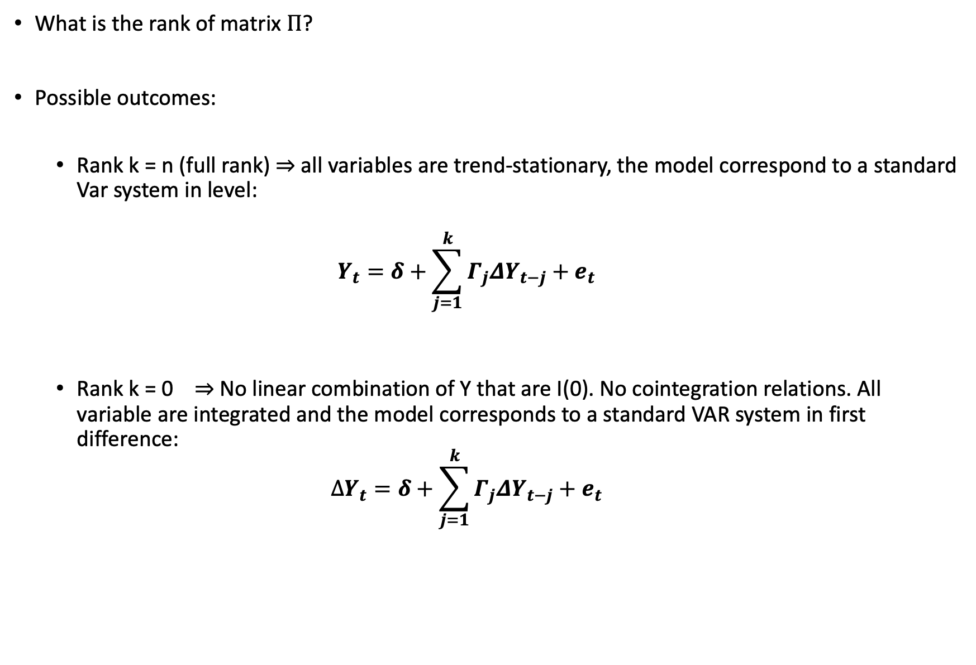
What is the rank of matrix $Π$?
Possible outcomes:
Rank k = n (full rank) $⇒$ all variables are trend-stationary, the model correspond to a standard Var system in level:
$$Y_{t}=δ+\sum_{j=1}^{k}{Γ_{j}ΔY_{t−j}}+e_{t}$$
Rank k = 0 $⇒$ No linear combination of Y that are I(0). No cointegration relations. All variable are integrated and the model corresponds to a standard VAR system in first difference:
$$ΔY_{t}=δ+\sum_{j=1}^{k}{Γ_{j}ΔY_{t−j}}+e_{t}$$

Slide 31
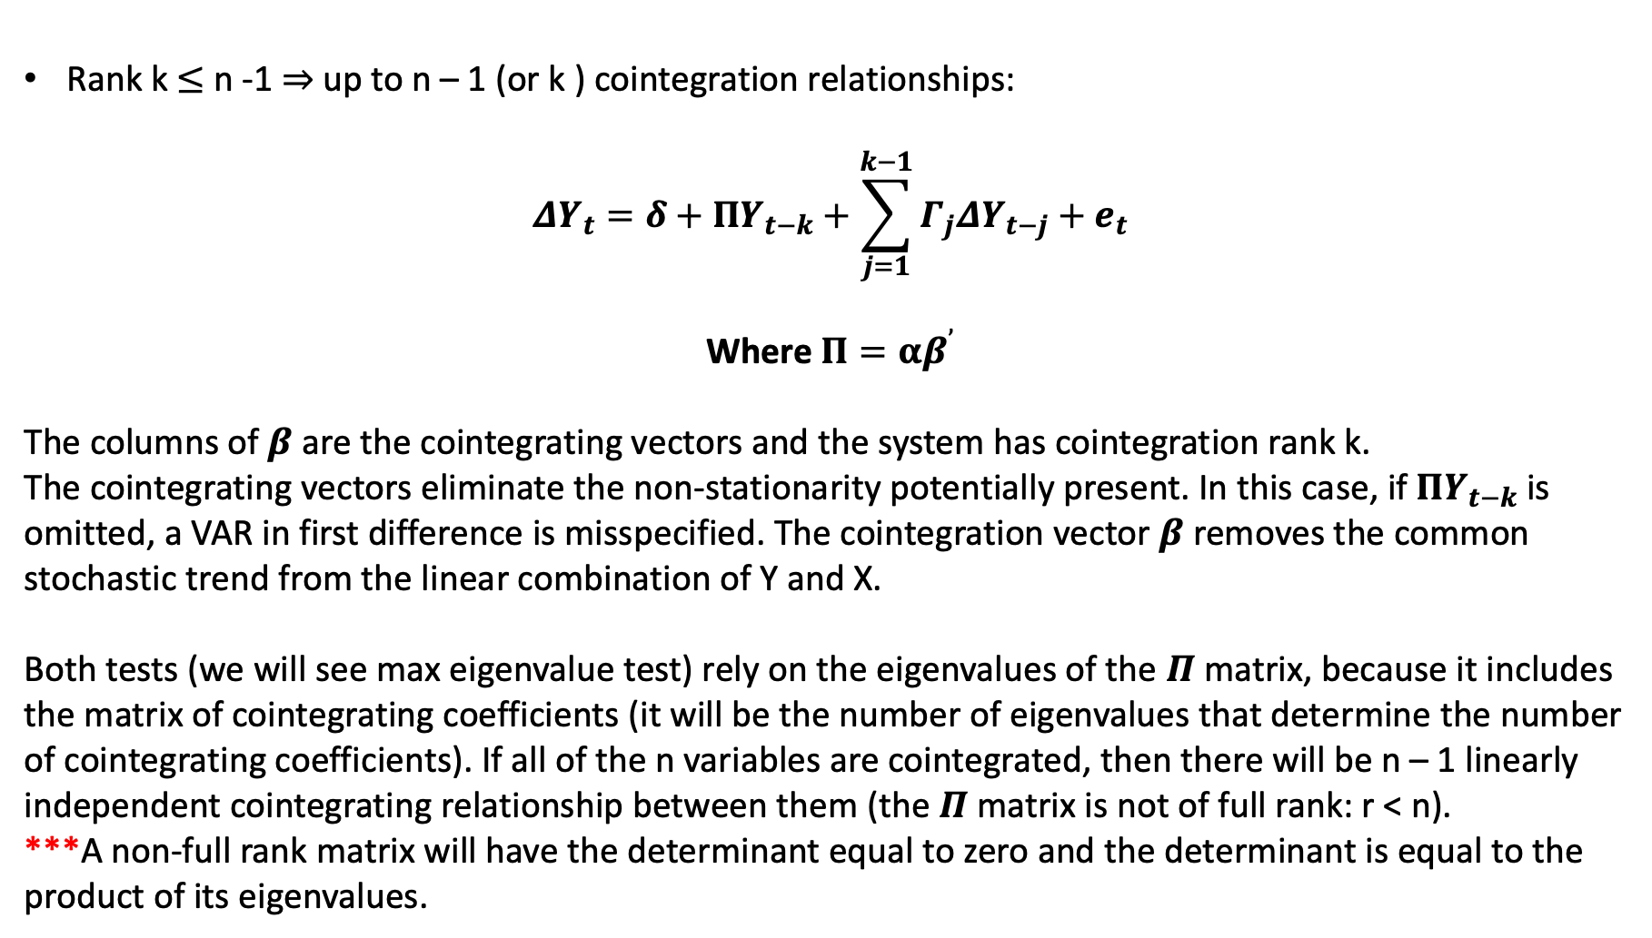
Rank k $≤$ n -1 $⇒$ up to n – 1 (or k ) cointegration relationships:
$${ΔY}_{t}=δ+ΠY_{t−k}+\sum_{j=1}^{k−1}{Γ_{j}ΔY_{t−j}}+e_{t}$$
Where $Π=αβ^{’}$
The columns of $β$ are the cointegrating vectors and the system has cointegration rank k.
The cointegrating vectors eliminate the non-stationarity potentially present. In this case, if $ΠY_{t−k}$ is omitted, a VAR in first difference is misspecified. The cointegration vector $β$ removes the common stochastic trend from the linear combination of Y and X.
Both tests (we will see max eigenvalue test) rely on the eigenvalues of the $Π$ matrix, because it includes the matrix of cointegrating coefficients (it will be the number of eigenvalues that determine the number of cointegrating coefficients). If all of the n variables are cointegrated, then there will be n – 1 linearly independent cointegrating relationship between them (the $Π$matrix is not of full rank: r < n).
***A non-full rank matrix will have the determinant equal to zero and the determinant is equal to the product of its eigenvalues.

Slide 32
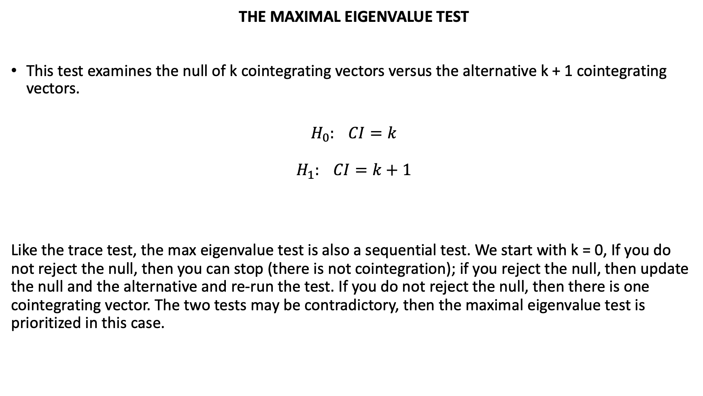
THE MAXIMAL EIGENVALUE TEST
This test examines the null of k cointegrating vectors versus the alternative k + 1 cointegrating vectors.
$$H_{0}: CI=k$$
$$H_{1}: CI=k+1$$
Like the trace test, the max eigenvalue test is also a sequential test. We start with k = 0, If you do not reject the null, then you can stop (there is not cointegration); if you reject the null, then update the null and the alternative and re-run the test. If you do not reject the null, then there is one cointegrating vector. The two tests may be contradictory, then the maximal eigenvalue test is prioritized in this case.

Slide 33
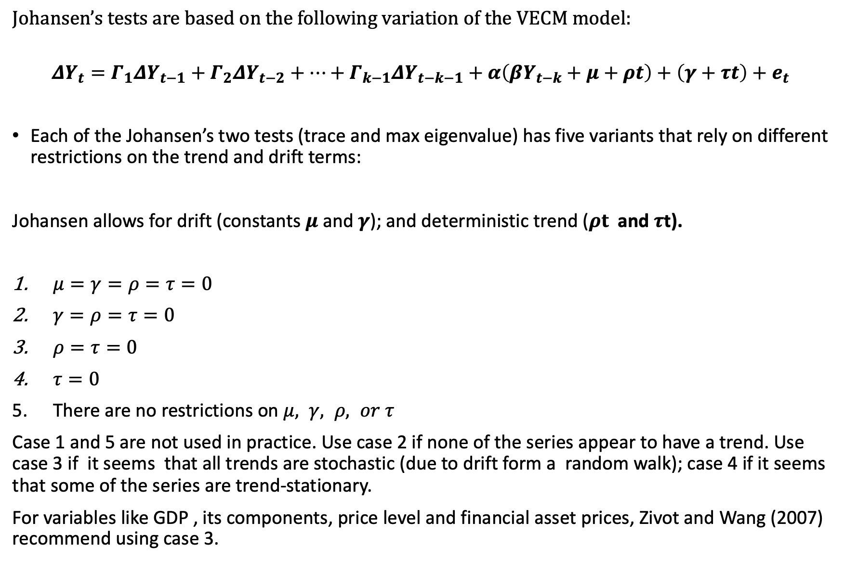
Johansen’s tests are based on the following variation of the VECM model:
$${ΔY}_{t}=Γ_{1}ΔY_{t−1}+Γ_{2}ΔY_{t−2}+…+Γ_{k−1}ΔY_{t−k−1}+α\left(βY_{t−k}+μ+ρt\right)+\left(γ+τt\right)+e_{t}$$
Each of the Johansen’s two tests (trace and max eigenvalue) has five variants that rely on different restrictions on the trend and drift terms:
Johansen allows for drift (constants $μ$ and $γ$); and deterministic trend ($ρt$ and $τ$t).
$μ=γ=ρ=τ=0$
$γ=ρ=τ=0$
$ρ=τ=0$
$τ=0$
There are no restrictions on $μ, γ, ρ, or τ$
Case 1 and 5 are not used in practice. Use case 2 if none of the series appear to have a trend. Use case 3 if it seems that all trends are stochastic (due to drift form a random walk); case 4 if it seems that some of the series are trend-stationary.
For variables like GDP , its components, price level and financial asset prices, Zivot and Wang (2007) recommend using case 3.

Slide 34
Johansen’s test on STATA
vecrank is the command on STATA to test for the cointegration rank:
vecrank X1 X2 X3 X4 X5, max
The command above you compute both statistic, the trace statistic and max eigenvalue statistic.
Once you find out how many cointegrating equation you have, the next step is to estimate those long-run cointegrating relationship, as well as the short-run adjustment terms (speed of adjustment):
vec Z Y X, rank(2) trend(constant)

Slide 35
IRFs, OIRFs and Forecasting from VECMs
VECMs are derived from VAR or SVAR, so we can estimate impulse response functions, OIRFs, and FEVDs, after estimating a VECM.
STATA will compute IRFs, OIRFs, and FEVDs after estimating a VECM.
As we have seen when estimating a VAR model, for better results, the lag-length selection is very important. Correctly estimating the number of lags affects the ability to estimate the correct rank r. VECM have one fewer lag than the level-VAR.
WE can use AIC, SBIC, HQIC, and FPE criteria to select the appropriate number of lags. Some studies found that BIC and HQIC are better to identify correctly the number of cointegrating vectors.

